Slide 1
Local video model benchmark results
MacBook Pro M4 Pro, 24GB unified memory · same red-ball prompt, judged on every measured video
Model | Settings · power | Weights | Mean performance | TTFT (ms) | Memory GiB¹ | Correct videos
LTX-2.3 distilled MLX (keyframes) | 768×512 · new prompt · keyframes · AC | MLX 4-bit | 132.22 s/clip | — | 9.19 | 9 of 9
LTX-2.3 distilled MLX | 768×512 · new prompt · AC | MLX 4-bit | 108.97 s/clip | — | 9.19 | 3 of 3
LTX-2.3 distilled MLX | 512×320 · original prompt · AC | MLX 4-bit | 52.67 s/clip | — | 7.68 | 1 of 3
Wan 2.2 TI2V 5B | 512×320 · original prompt · AC | FP16 | 274.06 s/clip | — | 14.94 | 1 of 3
LTX-Video 2B v0.9.5 | 512×320 · original prompt · battery | BF16 | 78.84 s/clip | — | 8.15 | 1 of 3
LTX-Video 2B v0.9.5 | 768×512 · new prompt · AC | BF16 | 142.91 s/clip | — | 15.12 | 0 of 3
LTX-Video 2B distilled v0.9.6 | 512×320 · original prompt · battery | BF16 | 16.55 s/clip | — | 8.15 | 0 of 3
Wan 2.1 T2V 1.3B | 512×320 · original prompt · battery | FP16 | 825.73 s/clip | — | 11.16 | 0 of 3
Answer for the 24 GB Mac mini: LTX-2.3 distilled (MLX, 4-bit) with start and end keyframes: 9 of 9 videos correct, 132 s per video on this Mac, peak process memory 14.6 GiB. Text only (no keyframes): 3 of 3, and 8 of 9 over nine seeds.
¹ Memory: ComfyUI rows = mean of each run’s 1 Hz sampled maximum MPS driver allocation; MLX rows = mean of each run’s sampled MLX peak. Neither is total RAM.
Power: battery rows ran with Low Power Mode on, AC rows without it, so speeds are only comparable within one power condition. TTFT (time to first token) is a language-model metric and does not apply here (—).
“New prompt” drops “slowly” and states the motion explicitly. Keyframes: a still of the ball on the left pins frame 1 and one of the ball on the right guides frame 49. Correct = exactly one red ball rolls left→right and stays round.
1
Notes:
LTX-2.3 distilled MLX (keyframes) (768×512 · new prompt · keyframes · AC): mean = (129.520 + 131.420 + 135.716) / 3 = 132.2187 s; memory 9.190 GiB; correct videos 9/3.
LTX-2.3 distilled MLX (round 2) (768×512 · new prompt · AC): mean = (107.684 + 108.645 + 110.587) / 3 = 108.9720 s; memory 9.188 GiB; correct videos 3/3.
LTX-2.3 distilled MLX (512×320 · original prompt · AC): mean = (52.358 + 52.618 + 53.046) / 3 = 52.6740 s; memory 7.676 GiB; correct videos 1/3.
Wan 2.2 TI2V 5B (512×320 · original prompt · AC): mean = (273.162 + 273.085 + 275.929) / 3 = 274.0587 s; memory 14.935 GiB; correct videos 1/3.
LTX-Video 2B v0.9.5 (512×320 · original prompt · battery): mean = (73.578 + 79.840 + 83.088) / 3 = 78.8353 s; memory 8.153 GiB; correct videos 1/3.
LTX-Video 2B v0.9.5 (round 2) (768×512 · new prompt · AC): mean = (144.823 + 142.549 + 141.347) / 3 = 142.9063 s; memory 15.115 GiB; correct videos 0/3.
LTX-Video 2B distilled v0.9.6 (512×320 · original prompt · battery): mean = (18.080 + 16.375 + 15.193) / 3 = 16.5493 s; memory 8.153 GiB; correct videos 0/3.
Wan 2.1 T2V 1.3B (512×320 · original prompt · battery): mean = (852.447 + 770.932 + 853.808) / 3 = 825.7290 s; memory 11.163 GiB; correct videos 0/3.
Extra seeds 45–50 (round-2 settings): 5/6 correct, mean 112.57 s, peak MLX 14.22 GiB, peak process phys_footprint 14.59 GiB.
Sources: comparison-results.json, RESULTS.md and each folder’s results.jsonl and visual-task-results.json under /Users/dyn/AI/video-model-comparison-2026-10-29.

Slide 2
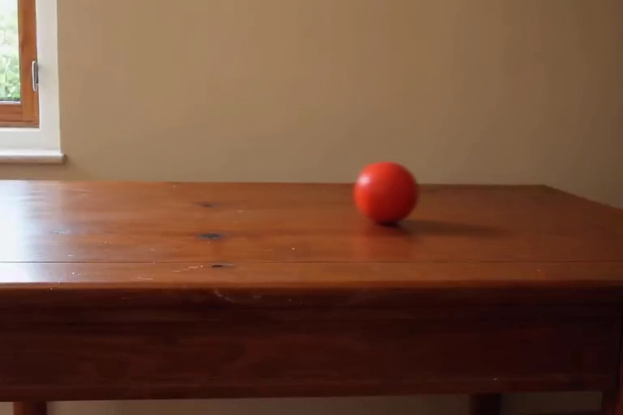
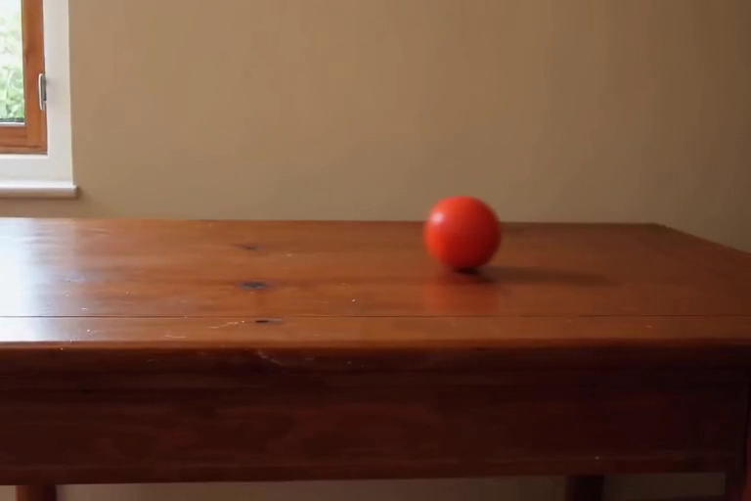

Recommended: LTX-2.3 + keyframes, 9 of 9 correct
768×512 · new prompt · start + end keyframes · 132.22 s per video · AC power · Correct videos: 9 of 9 (seeds 42–50)
Video 1 seed 42
Video 2 seed 43
Video 3 seed 44
Correct
129.5 s to make
Correct
131.4 s to make
Correct
135.7 s to make
Why: One ball rolls steadily from the left to the right of the table.
Why: One ball rolls steadily from the left to the right of the table.
Why: One ball rolls steadily from the left to the right of the table.
Click a video to play it (1.96 s). Seeds 45–50 (not shown) were also all correct.
Keyframes: frames 16 and 49 of the passing text-only clip (seed 47) anchor the first and last frames; the model generates the roll in between.
Peak process memory 14.6 GiB (Activity Monitor’s figure, GPU buffers included).
2
Notes:
Seed 42: 129.520 s, pass. Reviewed observation: One round red ball rolls steadily from the left (x 0.19) to the right (x 0.91) across the anchored scene; ball present in all 49 frames, never moves backwards.
Seed 43: 131.420 s, pass. Reviewed observation: One round red ball rolls steadily from the left (x 0.19) to the right (x 0.91) across the anchored scene; ball present in all 49 frames, never moves backwards.
Seed 44: 135.716 s, pass. Reviewed observation: One round red ball rolls steadily from the left (x 0.19) to the right (x 0.91) across the anchored scene; ball present in all 49 frames, never moves backwards.
Videos: assets/videos/*.mp4 (H.264 copies of the original outputs, made by make_videos.py). Source folder: /Users/dyn/AI/video-model-comparison-2026-10-29/round3/ltx23-mlx-keyframes

Slide 3
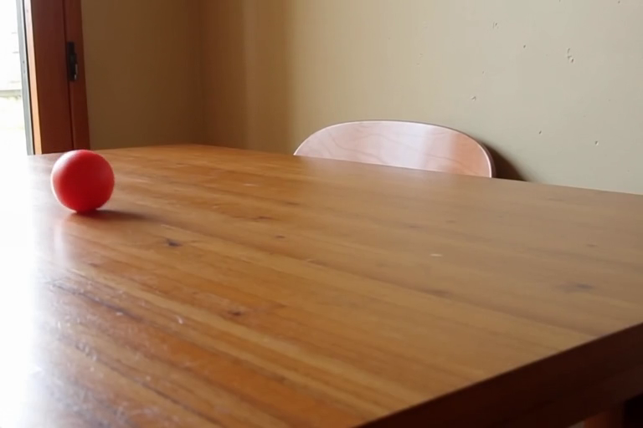
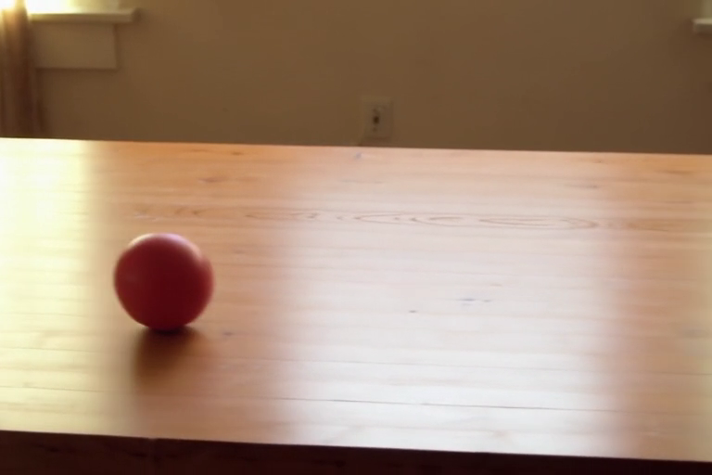
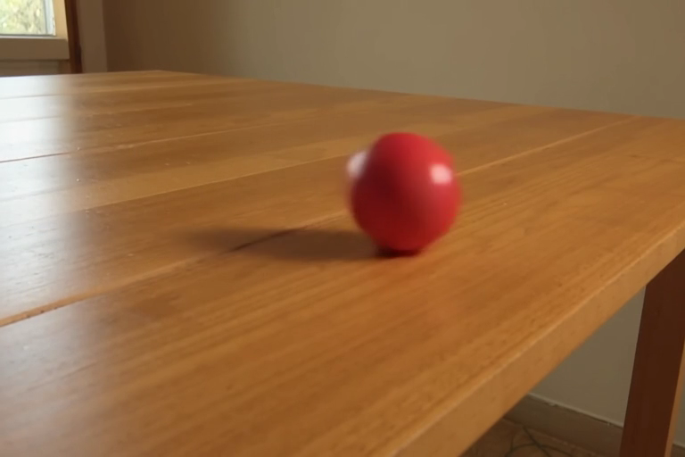
Text only: LTX-2.3 distilled (MLX 4-bit), 3 of 3 correct
768×512 · new prompt · 108.97 s per video · 9.19 GiB¹ · AC power · Correct videos: 3 of 3
Video 1 seed 42
Video 2 seed 43
Video 3 seed 44
Correct
107.7 s to make
Correct
108.6 s to make
Correct
110.6 s to make
Why: One ball rolls from the far left to the right, towards the camera.
Why: One ball enters from the left and rolls steadily to the right.
Why: One ball rolls right across the whole table and out of the frame.
Click a video to play it (1.96 s). The still image is frame 25 of 49.
Six extra seeds (45–50) with the same settings: 5 of 6 correct. Peak process memory 14.6 GiB (Activity Monitor’s figure, GPU buffers included); first load 14.2 GiB of MLX memory while the Gemma text encoder runs.
¹ Memory: ComfyUI rows = mean of each run’s 1 Hz sampled maximum MPS driver allocation; MLX rows = mean of each run’s sampled MLX peak. Neither is total RAM.
3
Notes:
Seed 42: 107.684 s, pass. Reviewed observation: One round red ball rolls from the far left of the table to the right and towards the camera (red-blob x 0.08→0.42); the only other red-ish region is the static door frame.
Seed 43: 108.645 s, pass. Reviewed observation: One round red ball enters from the left edge and rolls steadily to the right (x 0.00→0.47); slight camera drift.
Seed 44: 110.587 s, pass. Reviewed observation: One round red ball enters from the left and rolls right across the table until it leaves the frame at the right edge (x 0.02→0.97).
Videos: assets/videos/*.mp4 (H.264 copies of the original outputs, made by make_videos.py). Source folder: /Users/dyn/AI/video-model-comparison-2026-10-29/round2/ltx23-mlx

Slide 4
What made it work
Same prompt idea, same seeds, same 49 frames: four steps from 1 of 3 to 9 of 9
Start: LTX-Video 2B
512×320, original prompt
1 of 3
1. Newer model: LTX-2.3 (MLX 4-bit)
same prompt and size; realistic scene, but one ball rolled the wrong way
1 of 3
2–3. Clearer prompt + 768×512
“slowly” removed, motion stated explicitly; seed 46 still rolled towards the camera
8 of 9
4. Start + end keyframes
the ball’s first and last positions are fixed; the model makes the roll
9 of 9
Why this is hard
Open video models follow a motion direction only about 27–30% of the time (CAPE-T2V, Aug 2026): 3 of 3 by chance is about 3%.
Fits the 24 GB Mac mini
Peak process memory 14.6 GiB with low-RAM streaming; 28.1 GB of weights on disk; about 132 s per video here.
On the M5 Pro
Same weights and memory; MLX uses the M5 GPU neural accelerators (macOS 26.2+), so it should be faster. Check the first videos there.
Prompt and size were changed together, so their separate effects are not measured. The 2B model with the new prompt and size got 0 of 3.
4
Notes:
Direction-following rates: CAPE-T2V (https://arxiv.org/pdf/2608.03046) and T2V-CompBench (https://arxiv.org/html/2407.14505v2). Recipe and script: /Users/dyn/AI/video-model-comparison-2026-10-29/mac-mini-recipe.

Slide 5
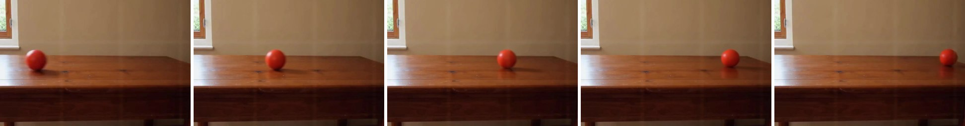
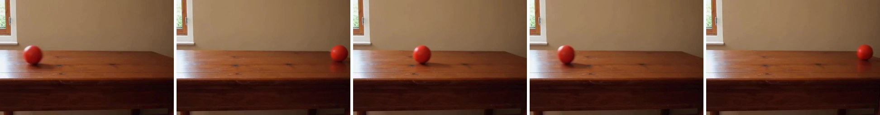
How big can it go on 24 GB?
Recommended setup (LTX-2.3 + keyframes) at larger sizes and longer clips · seeds 42 and 43 per size · AC power
Size × frames | Length | Peak GiB² | 2nd video GiB² | Time / video | Correct
768×512 × 49 | 2.0 s | 14.6 | 5.8 | 131 s | 2 of 2
960×640 × 49 | 2.0 s | 14.6 | 5.6 | 210 s | 2 of 2
1152×768 × 49 | 2.0 s | 14.6 | 5.6 | 302 s | 2 of 2
1344×896 × 49 | 2.0 s | 14.6 | 7.0 | 427 s | 1 of 2
1536×1024 × 49 | 2.0 s | 14.6 | 8.7 | 597 s | 2 of 2
768×512 × 97 | 3.9 s | 14.6 | 9.9 | 238 s | 0 of 2
768×512 × 121 | 4.8 s | 14.6 | 8.0 | 288 s | 1 of 2
768×512 × 145 | 5.8 s | 14.6 | 9.3 | 377 s | 1 of 2
1536×1024 × 97 | 3.9 s | 14.6 | 13.7 | 1199 s | 0 of 2
Correct 1536×1024, 2 s: one steady roll
five frames, start → end
Wrong 768×512, 6 s: rolls right, back left, then right again
five frames, start → end
Why longer clips fail: the keyframes fix only the first and last frame. The ball still crosses in about 2 s, then rolls back, leaves the frame or disappears before the last frame pulls it back.
Mac mini answer: keep 49 frames (2 s); any size up to 1536×1024 fits and works. Memory is never the limit; bigger sizes only cost time. Longer clips mostly fail.
² Peak GiB = highest process memory (Activity Monitor’s figure, GPU buffers included), set by the text-encoder load at start-up; 2nd video GiB = highest memory while making the next video. macOS recommends at most 17.8 GiB (19.07 GB) of GPU memory on a 24 GB Mac; every size stayed below it (highest: 14.6 GiB) and swap never grew.
Two seeds per size, so these are spot checks, not pass rates. 1344×896 seed 42 overshot the right edge and rolled back in.
5
Notes:
768x512x49: peak 14.576 GiB, 2nd video 5.846 GiB, MLX peak 14.215 GiB, warm swap Δ -0.80 GiB, cold 142.5 s, warm 130.5 s, correct 2/2.
960x640x49: peak 14.582 GiB, 2nd video 5.572 GiB, MLX peak 14.215 GiB, warm swap Δ -0.57 GiB, cold 214.9 s, warm 209.6 s, correct 2/2.
1152x768x49: peak 14.573 GiB, 2nd video 5.643 GiB, MLX peak 14.215 GiB, warm swap Δ -0.55 GiB, cold 314.0 s, warm 302.5 s, correct 2/2.
1344x896x49: peak 14.611 GiB, 2nd video 6.957 GiB, MLX peak 14.215 GiB, warm swap Δ -0.75 GiB, cold 436.3 s, warm 427.4 s, correct 1/2.
1536x1024x49: peak 14.575 GiB, 2nd video 8.656 GiB, MLX peak 14.215 GiB, warm swap Δ -0.45 GiB, cold 598.6 s, warm 596.5 s, correct 2/2.
768x512x97: peak 14.592 GiB, 2nd video 9.894 GiB, MLX peak 14.254 GiB, warm swap Δ -0.27 GiB, cold 244.8 s, warm 237.9 s, correct 0/2.
768x512x121: peak 14.607 GiB, 2nd video 7.984 GiB, MLX peak 14.215 GiB, warm swap Δ -0.10 GiB, cold 300.1 s, warm 288.1 s, correct 1/2.
768x512x145: peak 14.564 GiB, 2nd video 9.262 GiB, MLX peak 14.215 GiB, warm swap Δ -0.73 GiB, cold 366.0 s, warm 376.8 s, correct 1/2.
1536x1024x97: peak 14.596 GiB, 2nd video 13.739 GiB, MLX peak 14.215 GiB, warm swap Δ 1.15 GiB, cold 1228.7 s, warm 1199.5 s, correct 0/2.
Sources: /Users/dyn/AI/video-model-comparison-2026-10-29/round4/ltx23-mlx-ladder (ladder-results.json, visual-task-results.json, visual-assessment.md, ball-check.json).

Slide 6
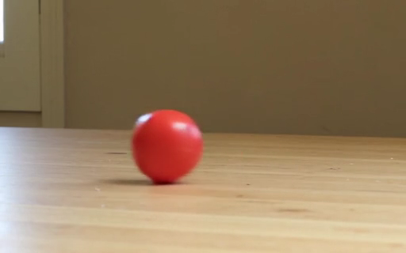
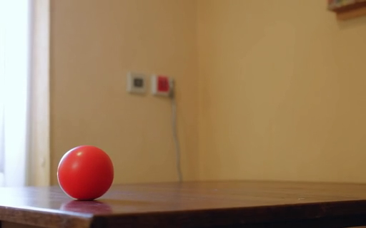
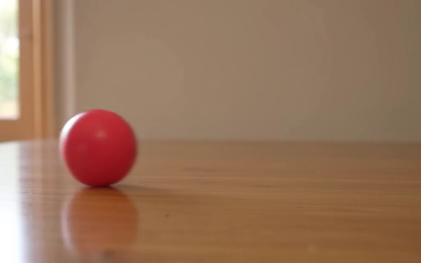
LTX-2.3 distilled MLX
512×320 · original prompt · AC · 52.67 s per video · 7.68 GiB¹ · Correct videos: 1 of 3
Video 1 seed 42
Video 2 seed 43
Video 3 seed 44
Wrong
52.4 s to make
Wrong
52.6 s to make
Correct
53.0 s to make
Why: The ball rolls from right to left, the wrong direction.
Why: The ball barely moves.
Why: One ball enters from the left and rolls steadily to the right.
Click a video to play it (1.96 s). The still image is frame 25 of 49.
¹ Memory: ComfyUI rows = mean of each run’s 1 Hz sampled maximum MPS driver allocation; MLX rows = mean of each run’s sampled MLX peak. Neither is total RAM.
6
Notes:
Seed 42: 52.358 s, fail. Reviewed observation: One ball enters from the right and rolls to the left until it leaves the frame (red-blob x 0.99→0.01).
Seed 43: 52.618 s, fail. Reviewed observation: One ball at the left of the table stays nearly still.
Seed 44: 53.046 s, pass. Reviewed observation: One round red ball enters from the left edge and rolls steadily to the right (red-blob x 0.01→0.67).
Videos: assets/videos/*.mp4 (H.264 copies of the original outputs, made by make_videos.py). Source folder: /Users/dyn/AI/video-model-comparison-2026-10-29/ltx23-mlx

Slide 7
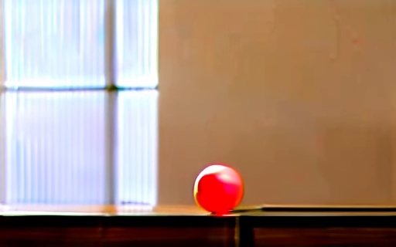
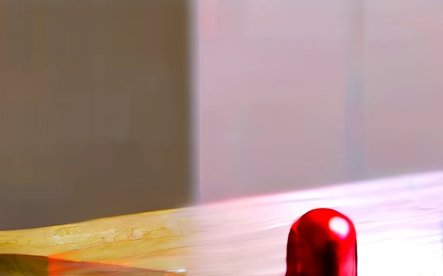
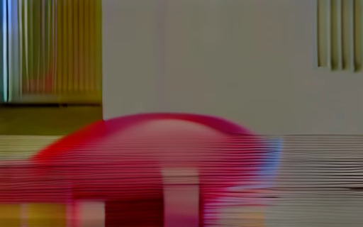
Wan 2.2 TI2V 5B
512×320 · original prompt · AC · 274.06 s per video · 14.94 GiB¹ · Correct videos: 1 of 3
Video 1 seed 42
Video 2 seed 43
Video 3 seed 44
Correct
273.2 s to make
Wrong
273.1 s to make
Wrong
275.9 s to make
Why: One ball drops onto the table edge on the left, then moves clearly to the right.
Why: Blurred, overexposed scene; a red blob appears and vanishes.
Why: A large pink dome melts into a red smear.
Click a video to play it (1.96 s). The still image is frame 25 of 49.
¹ Memory: ComfyUI rows = mean of each run’s 1 Hz sampled maximum MPS driver allocation; MLX rows = mean of each run’s sampled MLX peak. Neither is total RAM.
7
Notes:
Seed 42: 273.162 s, pass. Reviewed observation: One red ball drops onto the table edge at the left, then moves clearly to the right along it and stays broadly round (slight wobble late in the clip).
Seed 43: 273.085 s, fail. Reviewed observation: Blurred, overexposed scene that drifts; a red blob appears and vanishes.
Seed 44: 275.929 s, fail. Reviewed observation: A large translucent pink dome melts into a red smear; heavy artifacts.
Videos: assets/videos/*.mp4 (H.264 copies of the original outputs, made by make_videos.py). Source folder: /Users/dyn/AI/video-model-comparison-2026-10-29/wan22

Slide 8
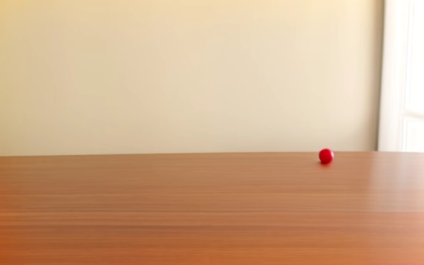


LTX-Video 2B v0.9.5
512×320 · original prompt · battery · 78.84 s per video · 8.15 GiB¹ · Correct videos: 1 of 3
Video 1 seed 42
Video 2 seed 43
Video 3 seed 44
Wrong
73.6 s to make
Correct
79.8 s to make
Wrong
83.1 s to make
Why: The ball barely moves.
Why: One red ball rolls from left to right and stays round.
Why: The ball barely moves.
Click a video to play it (1.96 s). The still image is frame 25 of 49.
¹ Memory: ComfyUI rows = mean of each run’s 1 Hz sampled maximum MPS driver allocation; MLX rows = mean of each run’s sampled MLX peak. Neither is total RAM.
8
Notes:
Seed 42: 73.578 s, fail. Reviewed observation: Nearly static.
Seed 43: 79.840 s, pass. Reviewed observation: Clear left-to-right displacement of one round red ball.
Seed 44: 83.088 s, fail. Reviewed observation: Nearly static.
Videos: assets/videos/*.mp4 (H.264 copies of the original outputs, made by make_videos.py). Source folder: /Users/dyn/AI/ltx-benchmark-2026-10-29

Slide 9

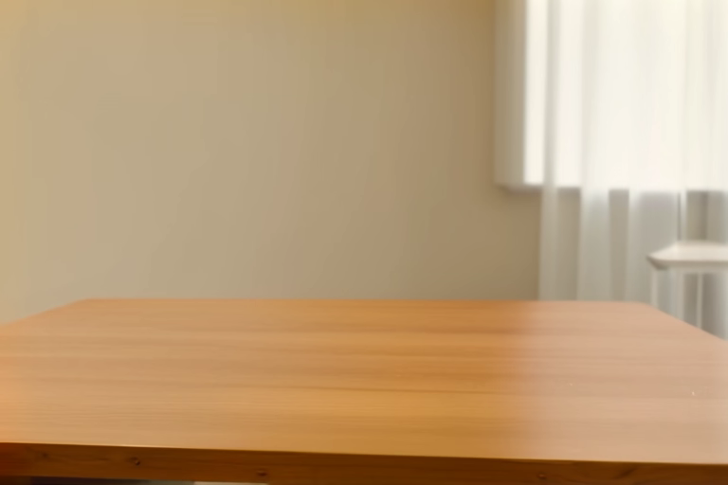
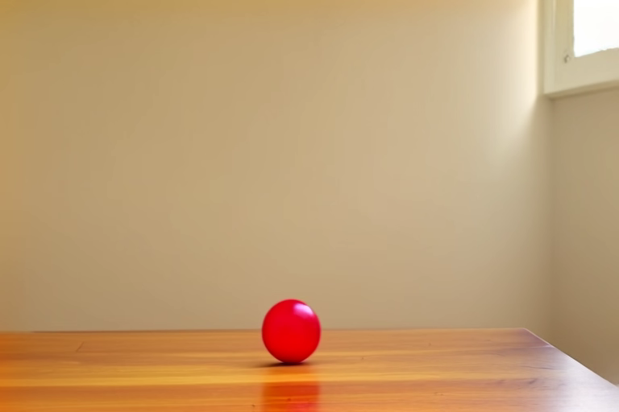
LTX-Video 2B v0.9.5 — new prompt
768×512 · new prompt · AC · 142.91 s per video · 15.12 GiB¹ · Correct videos: 0 of 3
Video 1 seed 42
Video 2 seed 43
Video 3 seed 44
Wrong
144.8 s to make
Wrong
142.5 s to make
Wrong
141.3 s to make
Why: The ball shifts slightly at the right edge, then disappears.
Why: No ball appears; the table stays empty.
Why: The ball stays still in the centre.
Click a video to play it (1.96 s). The still image is frame 25 of 49.
¹ Memory: ComfyUI rows = mean of each run’s 1 Hz sampled maximum MPS driver allocation; MLX rows = mean of each run’s sampled MLX peak. Neither is total RAM.
9
Notes:
Seed 42: 144.823 s, fail. Reviewed observation: One ball near the right edge shifts slightly, then disappears before the end.
Seed 43: 142.549 s, fail. Reviewed observation: No ball appears; empty table.
Seed 44: 141.347 s, fail. Reviewed observation: One ball in the centre stays still.
Videos: assets/videos/*.mp4 (H.264 copies of the original outputs, made by make_videos.py). Source folder: /Users/dyn/AI/video-model-comparison-2026-10-29/round2/ltx095

Slide 10
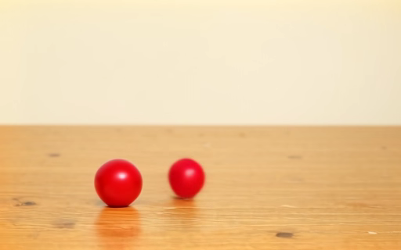
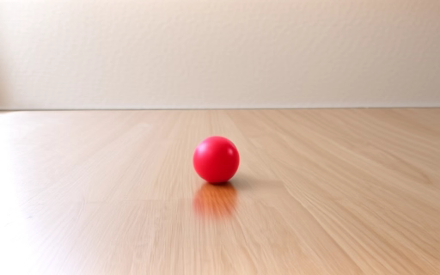
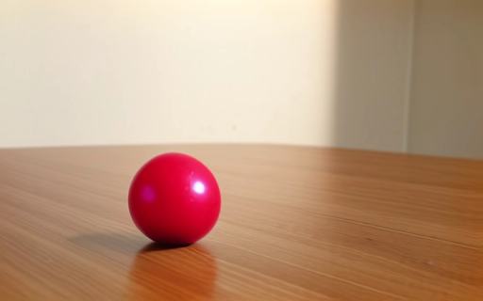
LTX-Video 2B distilled v0.9.6
512×320 · original prompt · battery · 16.55 s per video · 8.15 GiB¹ · Correct videos: 0 of 3
Video 1 seed 42
Video 2 seed 43
Video 3 seed 44
Wrong
18.1 s to make
Wrong
16.4 s to make
Wrong
15.2 s to make
Why: A second red ball appears; the first one hardly moves.
Why: The ball barely moves.
Why: The ball barely moves.
Click a video to play it (1.96 s). The still image is frame 25 of 49.
¹ Memory: ComfyUI rows = mean of each run’s 1 Hz sampled maximum MPS driver allocation; MLX rows = mean of each run’s sampled MLX peak. Neither is total RAM.
10
Notes:
Seed 42: 18.080 s, fail. Reviewed observation: A second red ball appears and moves right; original remains almost static.
Seed 43: 16.375 s, fail. Reviewed observation: Nearly static.
Seed 44: 15.193 s, fail. Reviewed observation: Nearly static.
Videos: assets/videos/*.mp4 (H.264 copies of the original outputs, made by make_videos.py). Source folder: /Users/dyn/AI/video-model-comparison-2026-10-29/ltx-distilled

Slide 11
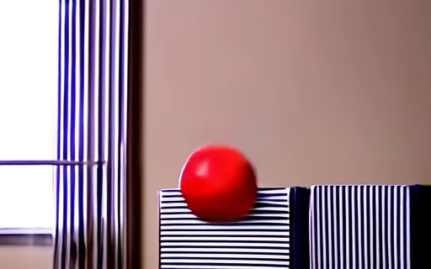
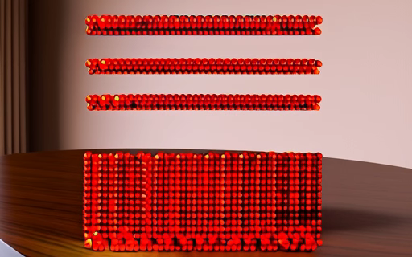
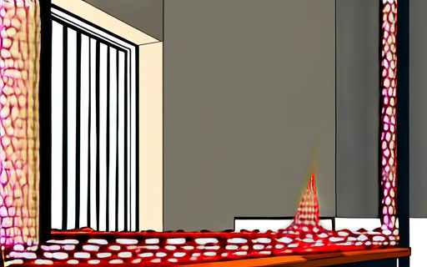
Wan 2.1 T2V 1.3B
512×320 · original prompt · battery · 825.73 s per video · 11.16 GiB¹ · Correct videos: 0 of 3
Video 1 seed 42
Video 2 seed 43
Video 3 seed 44
Wrong
852.4 s to make
Wrong
770.9 s to make
Wrong
853.8 s to make
Why: The ball falls down to the left off a striped box instead of rolling across a table.
Why: Dozens of small red beads appear instead of one ball.
Why: Cartoon-style room; a red net shape keeps changing and the ball appears only at the end.
Click a video to play it (1.96 s). The still image is frame 25 of 49.
¹ Memory: ComfyUI rows = mean of each run’s 1 Hz sampled maximum MPS driver allocation; MLX rows = mean of each run’s sampled MLX peak. Neither is total RAM.
11
Notes:
Seed 42: 852.447 s, fail. Reviewed observation: One red ball drops down and to the left off a striped box; no left-to-right roll, table barely visible.
Seed 43: 770.932 s, fail. Reviewed observation: Dozens of small red beads form a block and floating rows; not a single ball.
Seed 44: 853.808 s, fail. Reviewed observation: Cartoon-style room; a red mesh shape morphs and a ball appears floating only at the end.
Videos: assets/videos/*.mp4 (H.264 copies of the original outputs, made by make_videos.py). Source folder: /Users/dyn/AI/video-model-comparison-2026-10-29/wan21

