Slide 1
One setup made every video correct
Red-ball prompt · tested on a MacBook Pro M4 Pro, 24 GB · target: Mac mini M5 Pro, 24 GB
Model | Weights | Output | Mean performance | TTFT (ms) | Memory GiB¹ | Correct videos
LTX-2.3 distilled + keyframes | MLX 4-bit | 768×512, 2 s | 132.22 s/clip | — | 14.6 | 9 of 9
9 of 9
14.6 GiB
132 s
videos correct: every seed tested (42–50)
peak memory; fits a 24 GB Mac (macOS GPU limit 17.8 GiB)
to make one 2-second video on this M4 Pro
Out of 8 red-ball setups tested across 5 models, this is the only one correct on all 9 seeds tested. LTX-2.5 results are on slide 4.
¹ Memory = peak process memory (Activity Monitor’s figure, GPU buffers included). TTFT (time to first token) applies to language models, not video, so it is “—”.
Seed = the random start number: the same prompt with a different seed gives a different video.
1
Notes:
Mean = (129.520 + 131.420 + 135.716) / 3 = 132.2187 s (seeds 42–44, AC power). Peak process phys_footprint 14.632 GiB (first load, with the Gemma text encoder). Correct 9/9 on seeds 42–50. The text-only version of the same model was 3/3 on seeds 42–44 but 8/9 over seeds 42–50. Sources: /Users/dyn/AI/video-model-comparison-2026-10-29/round3/ltx23-mlx-keyframes and /Users/dyn/AI/video-model-comparison-2026-10-29/comparison-results.json.

Slide 2
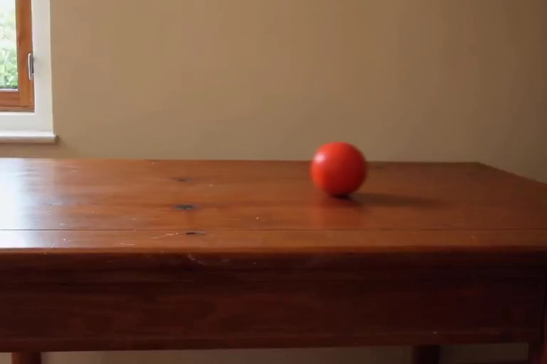
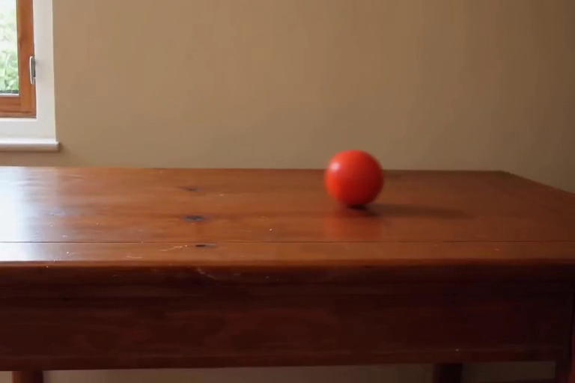

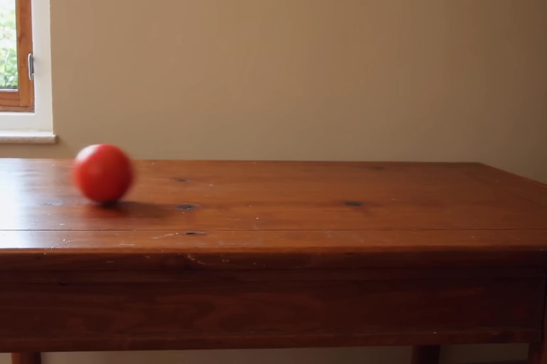
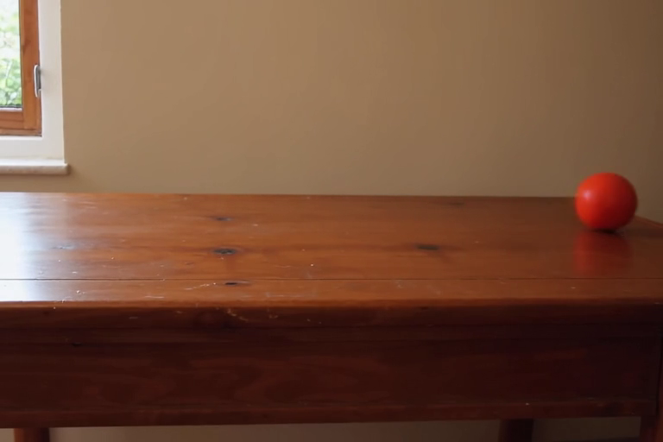
LTX-2.3 distilled (MLX 4-bit) + keyframes
Click a video to play it · 768×512, 49 frames (2 s), 25 FPS · seeds 42–44 shown; seeds 45–50 were also correct
Seed 42 Correct · 130 s to make
Seed 43 Correct · 131 s to make
Seed 44 Correct · 136 s to make
What the name means
LTX-2.3 distilled
Lightricks’ open video model. “Distilled” means it was trained to need few steps: 8 at half size, then a 2× upscale and 3 more.
MLX 4-bit
Runs on Apple’s MLX framework. The weights are stored in 4 bits, so the model and its text encoder fit a 24 GB Mac (peak 14.6 GiB).
+ keyframes
→
the model makes the roll
frame 1: fixed
frame 49: guided
Keyframe stills = frames 16 and 49 of one of the model’s own correct videos (seed 47, made without keyframes), so every video shows the same table and start and end positions.
2
Notes:
Seed 42: 129.520 s, correct. Reviewed observation: One round red ball rolls steadily from the left (x 0.19) to the right (x 0.91) across the anchored scene; ball present in all 49 frames, never moves backwards.
Seed 43: 131.420 s, correct. Reviewed observation: One round red ball rolls steadily from the left (x 0.19) to the right (x 0.91) across the anchored scene; ball present in all 49 frames, never moves backwards.
Seed 44: 135.716 s, correct. Reviewed observation: One round red ball rolls steadily from the left (x 0.19) to the right (x 0.91) across the anchored scene; ball present in all 49 frames, never moves backwards.
Pipeline: DistilledPipeline, 8 steps at 384×256, 2× spatial latent upscale, 3 steps at 768×512, low-RAM streaming, audio off. Anchors: /Users/dyn/AI/video-model-comparison-2026-10-29/round3/ltx23-mlx-keyframes/anchors.

Slide 3
How big can it go on 24 GB?
LTX-2.3 + keyframes at larger sizes and longer clips · 2 seeds per size (42, 43) · AC power
Size | Frames (length) | Peak memory GiB¹ | Memory while making a video (GiB) | Time per video | Correct
768×512 | 49 (2.0 s) | 14.6 | 5.8 | 131 s | 2 of 2
960×640 | 49 (2.0 s) | 14.6 | 5.6 | 210 s | 2 of 2
1152×768 | 49 (2.0 s) | 14.6 | 5.6 | 302 s | 2 of 2
1344×896 | 49 (2.0 s) | 14.6 | 7.0 | 427 s | 1 of 2
1536×1024 | 49 (2.0 s) | 14.6 | 8.7 | 597 s | 2 of 2
768×512 | 97 (3.9 s) | 14.6 | 9.9 | 238 s | 0 of 2
768×512 | 121 (4.8 s) | 14.6 | 8.0 | 288 s | 1 of 2
768×512 | 145 (5.8 s) | 14.6 | 9.3 | 377 s | 1 of 2
1536×1024 | 97 (3.9 s) | 14.6 | 13.7 | 1,199 s | 0 of 2
Every size fits: peak 14.6 GiB, under the 17.8 GiB macOS GPU limit.
2-second clips work up to 1536×1024 (9 of 10 correct); longer clips fail (2 of 8 correct).
¹ Highest process memory, GPU buffers included. It comes from loading the text encoder at start-up, so it is the same for every size.
3
Notes:
768x512x49: peak 14.576 GiB, while making the 2nd video 5.846 GiB, warm swap Δ -0.80 GiB, cold 142.5 s, warm 130.5 s, correct 2/2.
960x640x49: peak 14.582 GiB, while making the 2nd video 5.572 GiB, warm swap Δ -0.57 GiB, cold 214.9 s, warm 209.6 s, correct 2/2.
1152x768x49: peak 14.573 GiB, while making the 2nd video 5.643 GiB, warm swap Δ -0.55 GiB, cold 314.0 s, warm 302.5 s, correct 2/2.
1344x896x49: peak 14.611 GiB, while making the 2nd video 6.957 GiB, warm swap Δ -0.75 GiB, cold 436.3 s, warm 427.4 s, correct 1/2.
1536x1024x49: peak 14.575 GiB, while making the 2nd video 8.656 GiB, warm swap Δ -0.45 GiB, cold 598.6 s, warm 596.5 s, correct 2/2.
768x512x97: peak 14.592 GiB, while making the 2nd video 9.894 GiB, warm swap Δ -0.27 GiB, cold 244.8 s, warm 237.9 s, correct 0/2.
768x512x121: peak 14.607 GiB, while making the 2nd video 7.984 GiB, warm swap Δ -0.10 GiB, cold 300.1 s, warm 288.1 s, correct 1/2.
768x512x145: peak 14.564 GiB, while making the 2nd video 9.262 GiB, warm swap Δ -0.73 GiB, cold 366.0 s, warm 376.8 s, correct 1/2.
1536x1024x97: peak 14.596 GiB, while making the 2nd video 13.739 GiB, warm swap Δ 1.15 GiB, cold 1228.7 s, warm 1199.5 s, correct 0/2.
Sources: /Users/dyn/AI/video-model-comparison-2026-10-29/round4/ltx23-mlx-ladder (ladder-results.json, visual-task-results.json, visual-assessment.md).

Slide 4
Upgrade test: LTX-2.5 distilled vs LTX-2.3
Text only (no keyframes) · 768×512, 2 s · 2 prompts × 3 seeds (42, 43, 44) · MacBook Pro M4 Pro, 24 GB
Model | Prompt | Correct | Time / video | Peak memory GiB¹ | Memory making a video GiB | Power
LTX-2.3 distilled | Red ball | 3 of 3 | 109 s | 14.6 | 6.3 | AC
LTX-2.3 distilled | Blue car | 3 of 3 | 110 s | 14.6 | 7.4 | battery
LTX-2.5 distilled | Red ball | 3 of 3 | 175 s | 15.5 | 6.7 | battery
LTX-2.5 distilled | Blue car | 3 of 3 | 168 s | 15.5 | 7.7 | battery
6 of 6
15.5 GiB
1.6×
LTX-2.5 videos correct (LTX-2.3: 6 of 6)
LTX-2.5 peak memory, under the 17.8 GiB limit (LTX-2.3: 14.6)
slower: about 172 s per video vs 109 s
¹ Highest process memory incl. GPU buffers, set by loading the text encoder at start-up (LTX-2.5: Gemma-4, 9.8 GiB file). LTX-2.3 red-ball memory is from its same-settings run on seeds 45–50.
Both models were correct on every seed here, so 3 seeds per prompt cannot show which follows prompts better; LTX-2.5 ranks higher in public tests (Artificial Analysis Elo 947 vs 838).
4
Notes:
LTX-2.3 Red ball: 3/3, mean 108.97 s (seeds 107.7, 108.6, 110.6), peak 14.585 GiB, while making 6.295 GiB, AC.
LTX-2.3 Blue car: 3/3, mean 109.64 s (seeds 109.7, 112.0, 107.2), peak 14.571 GiB, while making 7.449 GiB, battery.
LTX-2.5 Red ball: 3/3, mean 175.14 s (seeds 185.9, 171.9, 167.6), peak 15.451 GiB, while making 6.717 GiB, battery.
LTX-2.5 Blue car: 3/3, mean 168.30 s (seeds 166.9, 166.5, 171.4), peak 15.455 GiB, while making 7.651 GiB, battery.
Sources: /Users/dyn/AI/video-model-comparison-2026-10-29/round2/ltx23-mlx, /Users/dyn/AI/video-model-comparison-2026-10-29/round5/ltx23-mlx-bluecar, /Users/dyn/AI/video-model-comparison-2026-10-29/round5/ltx25-mlx-redball, /Users/dyn/AI/video-model-comparison-2026-10-29/round5/ltx25-mlx-bluecar. LTX-2.5 weights: dgrauet/ltx-2.5-mlx-q4 (int4), ltx-pipelines-mlx 0.18.0.

Slide 5
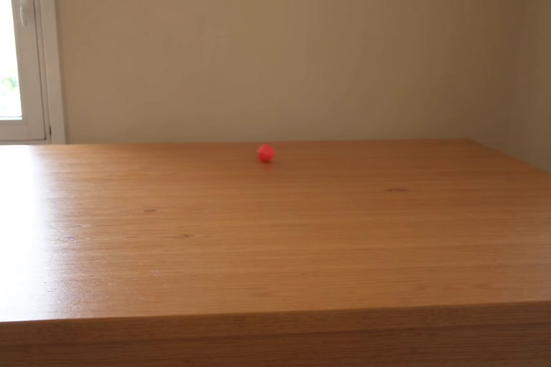
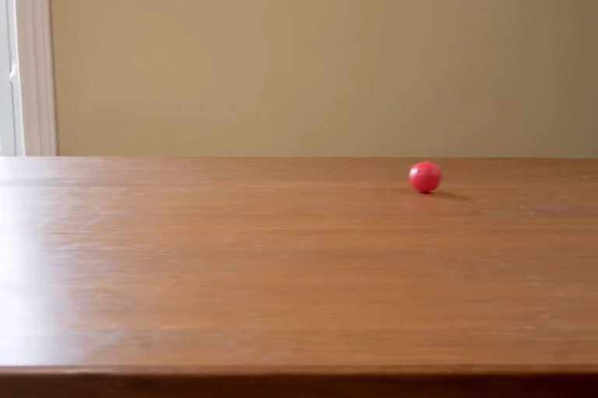
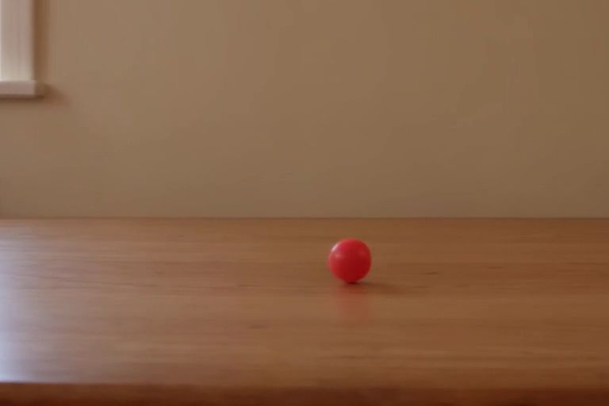
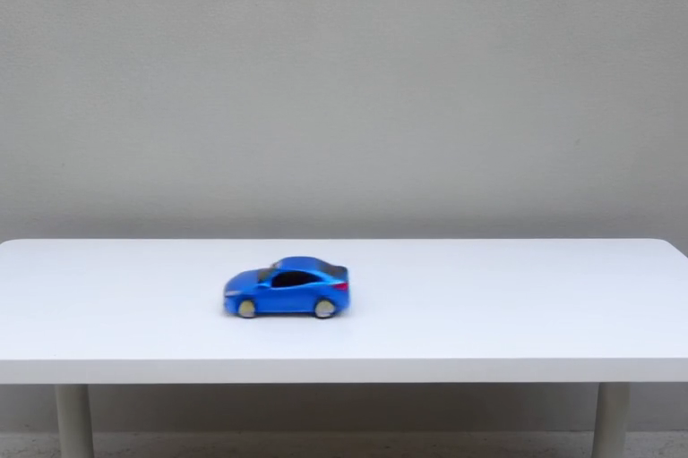
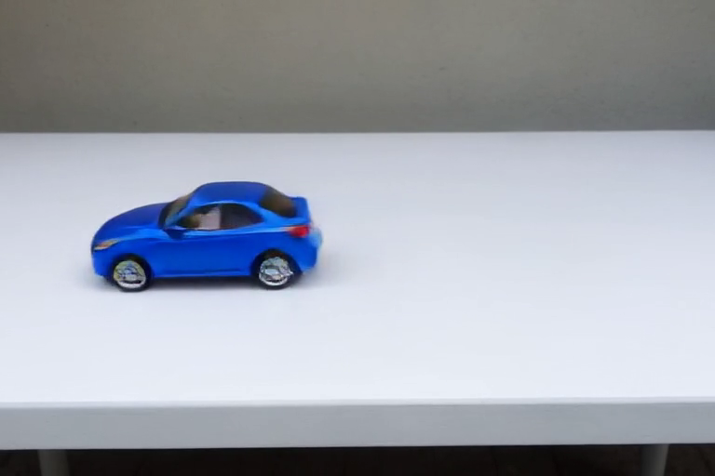
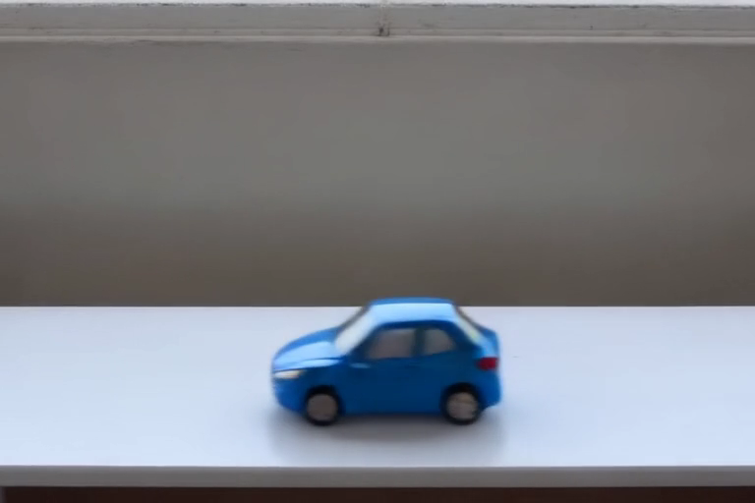
LTX-2.5 distilled: the 6 test videos
Click a video to play it · text only, 768×512, 49 frames (2 s), 25 FPS · all 6 correct
Red ball
left → right
Seed 42 Correct · small ball rolls left → right
Seed 43 Correct · rolls left → right, exits
Seed 44 Correct · rolls right; camera follows it
Blue car
right → left
Seed 42 Correct · drives right → left across
Seed 43 Correct · drives right → left across
Seed 44 Correct · drives right → left across
5
Notes:
Red ball seed 42: 185.9 s, correct
Red ball seed 43: 171.9 s, correct
Red ball seed 44: 167.6 s, correct
Blue car seed 42: 166.9 s, correct
Blue car seed 43: 166.5 s, correct
Blue car seed 44: 171.4 s, correct

