Slide 1
Deep learning
And Deep Networks for Natural Language Processing

Slide 2
Overview of the Talk
Overview of Deep Learning
Justification \ Properties of Deep Learning
Neural Networks 101
Brief History of Deep Learning
Implementation Details
RBM’s and DBN’s
Auto-Encoders
Deep Learning for NLP
i) Learning Neural Embeddings
Ii) Recursive Auto-Encoders

Slide 3
Aims of Talk
Provide a comprehensible introduction to Deep Learning for the uninitiated
Give an overview of how deep learning can be applied to NLP
Provide an understanding of the justification for deep learning and the approaches used
Illustrate the type of problems it can be used to solve

Slide 4
What this Talk is Not
What I am Not
An expert in Deep Learning
Deep exploration of the mathematics behind some of the deep learning models (although some basic-intermediate math is covered)
An extensive explanation of neural networks - some knowledge is assumed

Slide 5
However
Some of this stuff can be confusing \ complex
So……
Please feel free to ask sensible questions during the talk for clarification if needed
And
I have an accent, so let me know if you have trouble understanding the Queen’s English

Slide 6
Overview of the Talk
Overview of Deep Learning

Slide 7
Deep Learning – WTF?
Learning deep (many layered) neural networks
The more layers in a Neural Network, the more abstract features can be represented
E.g. Classify a cat:
Bottom Layers: Edge detectors, curves, corners straight lines
Middle Layers: Fur patterns, eyes, ears
Higher Layers: Body, head, legs
Top Layer: Cat or Dog

Slide 8
Deep Learning – WTF?
Real world information has a hierarchical structure, cannot easily be modeled by a neural network with 3 layers
The human brain is a deep neural network, has many layers of neurons which acts as feature detectors, detecting more and more abstract features as you go up

Slide 9
Deep Learning – WTF?
Traditional approach is to use back propagation to train multiple layers
However back propagation does not work well over multiple layers and does not scale well
Back propagation cannot leverage unlabelled data
Recent advances in deep learning attempt to address this short-comings

Slide 10
Deep-Learning is Typically –
1. Layer-wise, bottom-up pre-training of unsupervised neural networks (auto-encoders, RBM’s)
2. Supervised training on labeled data using either:
i) Features learned from 1. fed into a classifier
e.g. SVM
ii) An additional output layer is placed on top to form a feed forward network, which is then trained using back prop on labeled data

Slide 11
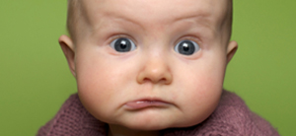
Huh?....

Slide 12
Huh?....
Don’t worry, we’ll come back to that shortly….

Slide 13
Overview of the Talk
Overview of Deep Learning
Justification \ Properties of Deep Learning

Slide 14
Why? – Achieved State of the Art in a Number of Different Areas
Language Modeling (2012, Mikolov et al)
Image Recognition (Krizhevsky won 2012 ImageNet competition)
Sentiment Classification (2011, Socher et al)
Speech Recognition (2010, Dahl et al)
MNIST hand-written digit recognition (Ciresan et al, 2010)
Andrew Ng – Machine Learning Professor, Stanford:
“I’ve worked all my life in Machine Learning, and I’ve never seen one algorithm knock over benchmarks like Deep Learning”

Slide 15
Qu: What do these Problems have in Common?

Slide 16
Application Areas
Typically applied to image and speech recognition, and NLP
Each are non-linear classification problems where the inputs are highly hierarchal in nature (language, images, etc)
The world has a hierarchical structure – Jeff Hawkins – On Intelligence
Problems that humans excel in and machine do very poorly

Slide 17
Deep vs Shallow Networks
Given the same number of non-linear (neural network) units, a deep architecture is more expressive than a shallow one (Bishop 1995)
Two layer (plus input layer) neural networks have been shown to be able to approximate any function
However, functions compactly represented in k layers may require exponential size when expressed in 2 layers

Slide 18
Deep Network
Shallow Network
Shallow (2 layer) networks need a lot more hidden layer nodes to compensate for lack of expressivity
In a deep network, high levels can express combinations between features learned at lower levels
Notes:
Analogy – nodes as features

Slide 19
Traditional Supervised Machine Learning Approach
For each new problem:
Gather as much LABELED data as you can get \ handle
Throw a bunch of algorithms at it (after trying RF \ SVM .. insert favorite algo here)
Pick the best
Spend hours hand engineering some features \ doing feature selection \ dimensionality reduction (PCA, SVD, etc)
RINSE AND REPEAT…..

Slide 20
Biological Justification
This is NOT how humans learn
Humans learn facts and skills and apply them to different problem areas
-> Transfer Learning
Humans first learn simple concepts, and then learner more complex ideas by combining simpler concepts
There is evidence that the cortex has a single learning algorithm:
Inputs from optic nerves of ferrets was rerouted to into their audio cortex
They were able to learn to see with their audio cortex instead
If we want a general learning algorithm, it needs to be able to:
Work with any type of data
Extract it’s own features
Transfer what it’s learned to new domains
Perform multi-modal learning – simultaneously learn from multiple different inputs (vision, language, etc)

Slide 21
Unsupervised Training
Far more un-labeled data in the world (i.e. online) than labeled data:
Websites
Books
Videos
Pictures
Deep networks take advantage of unlabelled data by learning good representations of the data through unsupervised learning
Humans learn initially from unlabelled examples
Babies learn to talk without labeled data

Slide 22
Unsupervised Feature Learning
Learning features that represent the data allows them to be used to train a supervised classifier
As the features are learned in an unsupervised way from a different and larger dataset, less risk of over-fitting
No need for manual feature engineering
(e.g. Kaggle Salary Prediction contest)
Latent features are learned that attempt to explain the data

Slide 23
Unsupervised Learning - Distributed Representations
Approaches to unsupervised learning of features fall into two categories:
Local Representations (hard clustering)
Distributed Representations (soft \ fuzzy clustering)
Hard clustering approaches (e.g. k-means, DBSCAN) - learn to map a set of data points to individual clusters

Slide 24
Distributed Representations
Fuzzy clustering, dimensionality reduction approaches (SVD, PCA), topic modeling (LDA) and unsupervised feature learning with neural networks learn distributed representations
Assumes that the data can be explained by the interaction of many different unobserved factors
Unseen configurations of these factors can more effectively explain unseen data
Much fewer features needed to describe the space as they can be combined in many different ways

Slide 25
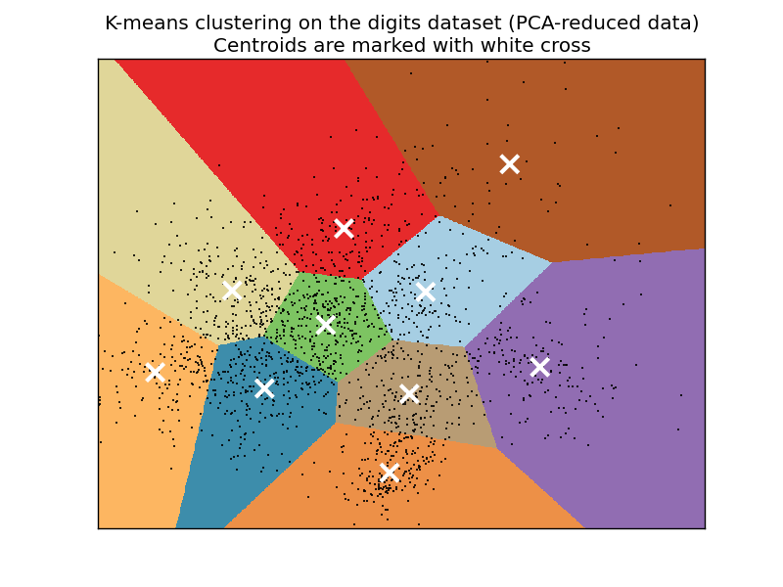
Local Representation

Slide 26
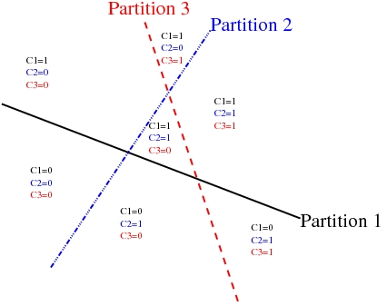
Distributed Representation

Slide 27
Hierarchical Representations
These factors are organized into multiple levels
Each level creates new features from combinations of features from the level below
Each level is more abstract than the ones below
Hierarchies of distributed representations attempt to solve the “Curse of Dimensionality” by learning the underlying latent variables that cause the variability in the data

Slide 28
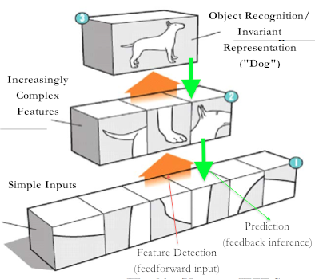
Hierarchical Representations

Slide 29
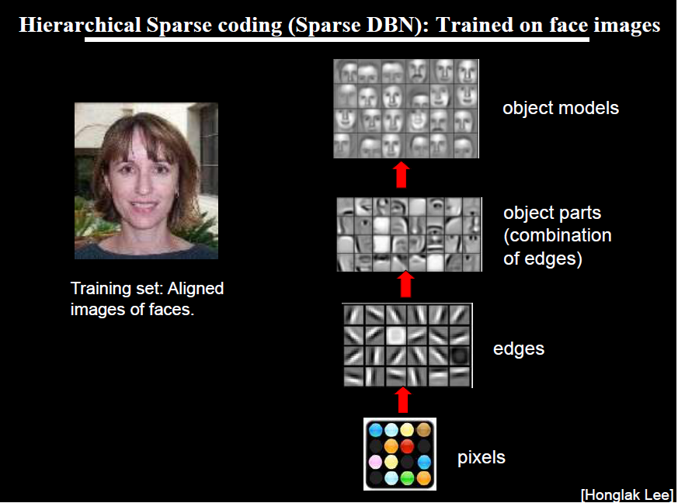
Notes:
From “Machine Learning and AI for Brain Simulations” – Andrew Ng Talk, UCLA, 2012
Visualization of weights at different layers of three layer deep neural networks trained on pictures of faces, cars, elephants and chairs
This is proof, for me at least, that we are doing something really special here

Slide 30
Discriminative Vs Generative Models
2 types of classification algorithms
1. Generative – Model Joint Distribution
p(Class /\ Data)
E.g. NB, HMM, RBM (see later), LDA
2. Discriminative – Conditional Distribution
p(Class\Data)
E.g. Decision Trees, SVMs, Nnets, Linear Regression, Logistic Regression

Slide 31
Discriminative Vs Generative Models
Discriminative models tend to give better classification accuracy
BUT are more prone to over-fitting (that again…)
Generative models can be used to generate conditional models:
p(A/B) = p(A /\ B)/p(B)
Generative models can also generate samples of data according to the distribution of the training data (hence the name) i.e. they learn to model the data distribution not Class\Data

Slide 32
Discriminative + Generative Model –> Semi-Supervised Learning
In deep learning, a generative model (RBM, Auto-Encoder) is learned from the data
Generative model maximizes prior - p(Data)
Then a discriminative classifier is trained using the features learned from the generative model
This maximizes posterior - p(Class\ Data)
Popular discriminative classifiers used:
NNet soft max layer
SVM
Logistic Regression

Slide 33
Overview of the Talk
Overview of Deep Learning
Justification \ Properties of Deep Learning
Neural Networks 101

Slide 34
Neural Networks – Very Brief Primer
Activation Function
Back Propagation
Gradient Descent
Notes:
Ask if I need to cover this

Slide 35
Activation Function
For each neuron, sum the inputs multiplied by their weights, and add the bias
The result is passed through an activation function, whose output feeds the next layer
Non-linearity needed to learn non-linear functions
Typically the sigmoid function used (as in logistic regression)
Hyperbolic tangent also popular, has a shallower gradient around the limits

Slide 36
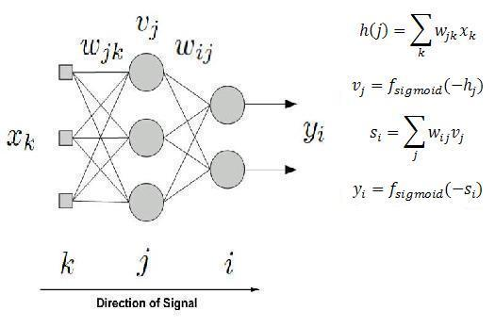
Sigmoid Function

Slide 37
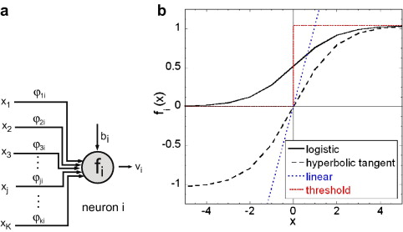
Activation Functions

Slide 38
Back Propagation 101
Target = y
Learn y = f(x)
For each Neuron:
Activation <- Sum the inputs, add the bias, apply a sigmoid function (tanh, logistic, etc) as the activation function
Activations Propagate through the layers
Output Layer: compute error for each neuron:
Error = y– f(x)
Update the weights using the derivative of the error
Backwards – propagate the error derivatives through the hidden layers

Slide 39
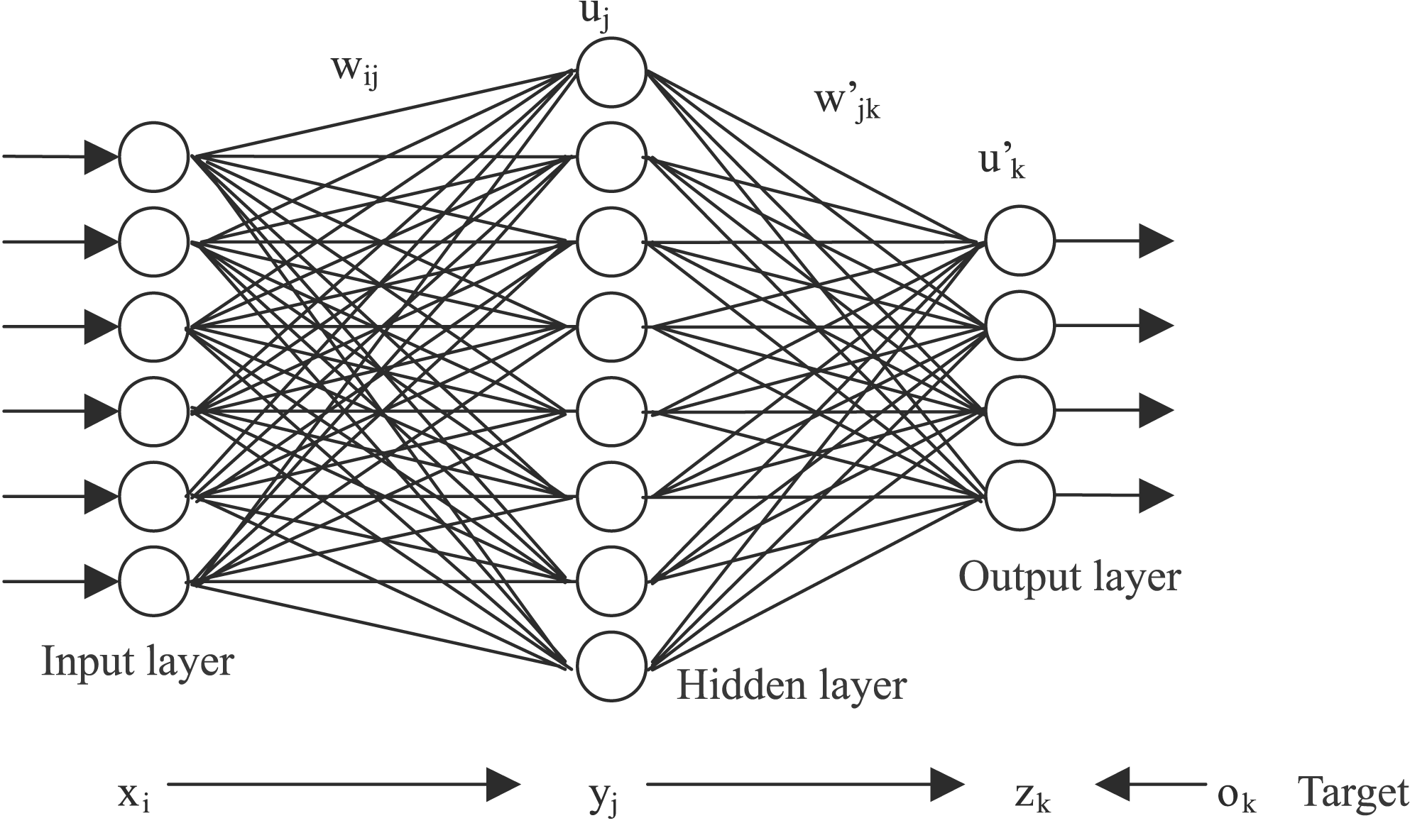
Backpropagation
Errors
Notes:
Typical FF Nnet – back propagation sends weight updates from the output layer back through to the hidden layer(s)

Slide 40
Gradient Descent
Weights are updated using the partial derivative of the activation function w.r.t. the error
Derivative pushes learning down the gradient of steepest descent on the error curve

Slide 41
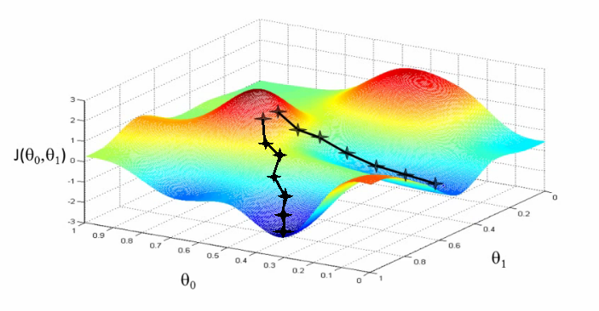
Gradient Descent

Slide 42
Drawbacks - Backpropagation
Needs labeled data (most data is not labeled)
Scalability – does not scale well over multiple layers
Very slow to converge
“Vanishing gradients problem” : errors shrink exponentially with the number of layers
Thus makes poor use of many layers
This is the reason most feed forward neural networks have only 3 layers
For more: “Understanding the Difficulty of Training Deep Feed Forward Neural Networks”: http://machinelearning.wustl.edu/mlpapers/paper_files/AISTATS2010_GlorotB10.pdf

Slide 43
Overview of the Talk
Overview of Deep Learning
Justification \ Properties of Deep Learning
Neural Networks 101
Brief History of Deep Learning

Slide 44
Brief History of Deep Learning
See: http://www.ipam.ucla.edu/publications/gss2012/gss2012_10596.pdf
1960’s – Perceptron invented (single neuron)
1960’s – Papert and Minsky prove that perceptrons can only learn to model linearly separable functions. Interest in perceptrons rapidly declines.
1970’s-1980’s – Back propagation (BP) invented for training multiple layers of non-linear features. Leads to a resurgence in interest in neural networks
BP takes errors from the output layer and propagates them back through the hidden layer(s)
1990’s - Many researchers gave up on BP as it could not make effective use of multiple hidden layers
1990’s – present: Simple, faster models, such as SVM’s came to dominate the field

Slide 45
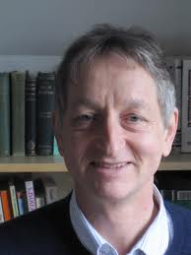
Brief History of Deep Learning (cont…)
Mid 2000’s – Geoffrey Hinton makes a breakthrough, trains deep belief networks by
Stacking RBM’s on top of one another – deep belief network
Training layer by layer on un-labeled data
Using back prop to fine tune weights on labeled data
Bengio et al, 2006 – examined deep auto-encoders as an alternative to Deep Boltzmann Machines
Easier to train

Slide 46
Enabling Factors
Training of deep networks was made computationally feasible by:
Faster CPU’s
The move to parallel CPU architectures
Advent of GPU computing
Neural networks are often represented as a matrix of weight vectors
GPU’s are optimized for very fast matrix multiplication
2008 - Nvidia’s CUDA library for GPU computing is released

Slide 47
Overview of the Talk
Overview of Deep Learning
Justification \ Properties of Deep Learning
Neural Networks 101
Brief History of Deep Learning
Implementation Details:
RBM’s and DBN’s
Auto-Encoders

Slide 48
Implementation
Most current architectures consist of learning layers of RBM’s or Auto-Encoders
Both are 2 layer neural networks that learn to model their inputs
Key difference:
RBM’s model their inputs as a probability distribution
Auto-Encoders learn to reproduce inputs as their outputs

Slide 49
Restricted Boltzmann Machines (RBM’s)
Two layer undirected (bi-directional) neural network:
Visible Layer
Hidden Layer
Connections run visible to hidden
No connections within each layer
Trained to maximize the expected log probability of the data
For the physicists\chemists: ‘Boltzmann’ as they minimize the energy of the data (equates to maximizing the probability)
Inputs are binary vectors (as it learns Bernouli distributions over each input)

Slide 50
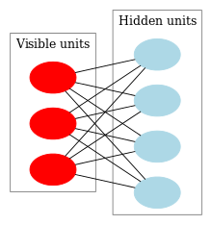
RBM Structure – Bipartite Graph

Slide 51
Activation Function
The activation function is computed the same way as in a regular neural network
Logistic function usually used (0-1)
However, the output is treated as a probability and each neuron is activated if activation > random variable(0-1)
Hidden layer neurons take visible units as inputs
Visible neurons take binary input vectors as initial input, then hidden layer probabilities (during Gibbs sampling – next slide)

Slide 52
Training Procedure – Contrastive Divergence
Remarkably simple
Performs Gibbs Sampling (MCMC technique)
Equates to computing a probability distribution using a Markov Chain Monte Carlo approach

Slide 53
Contrastive Divergence
PASS 1: From inputs v, compute hidden layer probabilities h
PASS 2: Pass those values back down to the visible layer, and back up to the hidden layer to get v’ and h’
Update the weights using the differences in the outer products of the hidden and visible activations between the first and second passes (multiplied by some learning rate)
Note: For some reason, all implementations I have seen take the inner (dot) and not the outer product
To approach the optimal model, an infinite number of passes are needed, so this approach provides proximate inference, but works well in practice

Slide 54
Feature Representation
Once trained, the hidden layer activations of an RBM can be used as learned features

Slide 55
Auto Encoders
An auto-encoder is a 3 layer neural network, which is trained to reconstruct its inputs by using them as the output
Needs to learn features that capture the variance in the data so it can be reproduced
If only linear activation functions are used, it can be shown to be equivalent to PCA and can be used for dimensionality reduction
Once trained, the hidden layer activations are used as the learned features, and the top layer can be discarded
However, the auto-encoder will learn the identity function unless some strategy is used to force it to learn features from the data

Slide 56
Training Strategies
De-noising Auto-Encoders
Some random noise added to the input
The encoder is required to reproduce the original input
Hinton’s group recently showed that randomly deactivating inputs (dropout) during training will improve the generalization performance of regular neural networks
Contractive Auto-Encoders
Setting the number of nodes in the hidden layer to be much lower than the number of input nodes forces the network to perform dimensionality reduction,
This prevents it from learning the identity function as the hidden layer has insufficient nodes to simply store the input
Sparse Auto-Encoders
A sparsity penalty is applied to the weight update function
Penalizes the total size of the connection weights,
Causes most weights to have small values
Allows

Slide 57
Building Deep Networks
RBM’s or Auto-Encoders can be trained layer by layer
The features learned from one layer are fed into the next layer
The top-layer activations can be treated as features and fed into any suitable classifier (RF, SVM, etc)

Slide 58
Building Deep Networks
Alternatively, an additional output layer can be placed on top, and the network fine-tuned with back propagation
Back propagation only works well in deep networks only if the weights are initialized close to a good solution
The layer wise pre-training ensures this
Many other approaches exist for fine tuning deep networks (e.g. dropout, maxout)

Slide 59
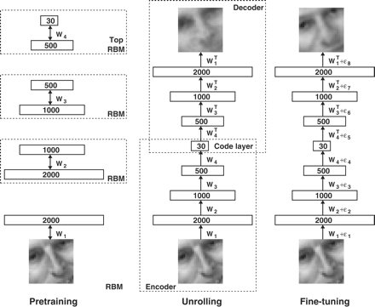
Training a Deep Auto-Encoder from Stacked RBM’s – Hinton `06
Notes:
From “Reducing the Dimensionality of Data with Neural Networks” – Hinton, Salkhutdinov, 2006
Uses a layer of RBM’s to initialize weights
Then a deep auto-encoder is trained from the stacked RBM’s after unrolling to form a decoder
Back prop is used for fine tuning

Slide 60
Overview of the Talk
Overview of Deep Learning
Justification \ Properties of Deep Learning
Neural Networks 101
Brief History of Deep Learning
Implementation Details
RBM’s and DBN’s
Auto-Encoders
Deep Learning for NLP
i) Learning Neural Embeddings
Ii) Recursive Auto-Encoders

Slide 61
Deep Learning for NLP
This section will focus primarily on the ground-breaking work of Richard Socher at Stanford:
“Semi-Supervised Recursive Autoencoders for Predicting Sentiment Distributions” (2011)
His work builds on top of the neural word embeddings work performed by Collobert and Weston (2008)

Slide 62
Word Vectors
To do NLP with neural networks, words need to be represented as vectors
Traditional approach – “one hot vector”
Binary vector
Length = | vocab |
1 in the position of the word id, the rest are 0
However, does not represent word meaning
Similar words such as English and French, cat and dog should have similar vector representations
However, similarity between all “one hot vectors” is the same

Slide 63
Solution: Distributional Word Vectors
Word is represented as a distribution over k latent variables
Distribution chosen so that similar words have similar distributions
Traditional approaches have used various vector space models
Words form the rows
Columns represent the context (other words occurring within x words, whole documents, etc)
Cells represent co-occurrence (binary vectors) frequency, tf-idf or relative distance from the context word
Dimensionality reduction (PCA, SVD, etc) used to reduce the vector size

Slide 64
Neural Word Embeddings
Various researchers (Bengio, Collobert and Weston, Hinton) have used neural language models to develop “word embeddings”
A language model is a statistical model that assigns a probability to words given the preceding words
Have similar properties to distributional word vectors, but claim better representations

Slide 65
Neural Word Embeddings
Collobert and Weston, 2008 -“A Unified Architecture for Natural Language Processing”
They extracted all 11-length n-grams from the entire of Wikipedia
Middle (6th) word is the target word
Negative examples are created by replacing the middle word with a different word chosen randomly
For each word, they randomly initialized a 50 element vector
The n-grams are then translated into input vectors by concatenating the corresponding vector for each word
These are fed into a neural network that is trained to maximize the difference between the probability it assigns to a valid versus an invalid sentence
Errors are propagated back into the word embeddings

Slide 66
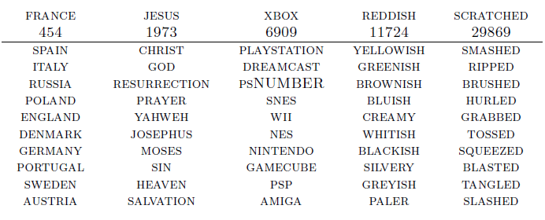
Results
Example words with their 10 nearest neighbors according to the embeddings:
Notes:
From “A Unified Architecture for Natural Language Processing: Deep Neural Networks with Multitask Learning” – Collobert and Weston, 2008, p6

Slide 67
A Unified Architecture for NLP
Using a very complex, deep architecture, Collobert and Weston were able to train a single deep model to do:
NER (Named Entity Recognition)
POS tagging
Chunking (shallow parsing)
Parsing
SRL (Semantic Role Labeling)
Model is too complex to cover here
No hand engineered features were used
Achieved either near SOTA or the SOTA in each of the above domains

Slide 68
Recursive Auto-Encoders
Using the Neural Language Model technique to learn word vectors, Richard Socher developed a deep architecture for NLP
His architecture was applied to sentiment analysis, but can be used for nearly any text classification problem

Slide 69
Recursive Auto-Encoders
Each sentence is reduced to a single 50 element vector as follows:
Each sentence of length n is mapped into n - 50 element word vectors using neural word embeddings
For each bi-gram in the sentence, concatenate the word vectors and feed into a contractive auto-encoder – 100 inputs 50 outputs
Take the bi-gram with the lowest reconstruction error, and replace with the output of the auto-encoder
Repeat until you have one 50 element vector

Slide 70
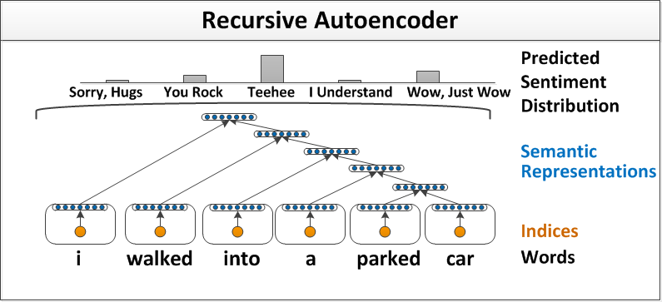
The Recursive Auto-Encoder

Slide 71
Semi-Supervised Training
Greedy algorithm
Can be viewed as constructing a binary parse tree with the lowest reconstruction error
Auto-encoder is trained with two objective functions:
1 Minimize the reconstruction error
2 Minimize the classification error in a softmax layer
The output at each level of the tree is fed into a softmax neural network layer, trained on labeled data

Slide 72
Semi-Supervised Training
Cost function minimizes both the reconstruction error of the input vectors, and the classification error of the softmax classifier on labeled data
The sentence is then classified by feeding the top-level auto-encoder output into the softmax classifier
Can use either:
1 . Static Collobert and Weston neural word embeddings
2. Learn it’s own embeddings using back propagation through structure to propagate errors back into word embeddings matrix

Slide 73
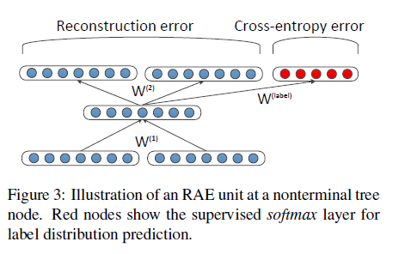
Semi-Supervised Training
Notes:
Reconstruction error is weighted by the number of child nodes
Outputs normalized (to a unit vector) to prevent hidden layer having diminishing activations

Slide 74
Results
SOTA Results on standard sentiment analysis datasets
In our current research in automated essay annotation, this algorithm out-performed other approaches considerably:
Logistic Regression using bags of word (binary vectors):
F1 of 0.62
RAE, using default parameters:
F1 of 0.71
My current best non-deep learning approach
F1 of 0.66
Also uses a (much simpler) word vector composition model

Slide 75
Some Criticisms of RAE
It is considered a deep learning approach because the auto-encoder forms a deep network with itself when parsing a sentence
Only uses one auto-encoder, thus fails to utilize hierarchical composition of features present in other deep networks
50 hidden neurons * (100 inputs + bias)
Thus only 5,050 parameters (weights)
Probably insufficient to model the English language!

Slide 76
Disadvantages of Deep Learning
Very slow to train
Availability of algorithms – lots of Python implementations, pretty rate in other languages (e.g. R)
Models are very complex, with lot of parameters to optimize:
Initialization of weights
Layer-wise training algorithm (RBM, AE, several others)
Neural architecture
Number of layers
Size of layers
Type – regular, pooling, max pooling, soft max
Fine-tuning using back prop or feed outputs into a different classifier

Slide 77
Disadvantages of Deep Learning
Steep learning curve
Some problems more amenable to deep learning than other applications
Simpler models may be sufficient for certain problem domains
Regression models?
Unless you are working with images, the models are very hard to explain (compared with a decision tree)
What does neuron 524 do?

Slide 78
Useful Deep Learning Links
Deeplearning.Net:
Code, tutorials, papers
http://deeplearning.net/
Theano (Cuda + Python also):
Comprehensive tutorials
Symbolic programming (like SymPy) can be a little confusing
http://deeplearning.net/software/theano/
Toronto groups’ code (Cuda + Python):
Easier to understand than Theano
https://github.com/nitishsrivastava/deepnet
www.socher.org
All of Richard Socher’s research papers and code (mainly Matlab, some java)
Links to his tutorials on YouTube on Deep Learning and NLP
The SENNA system developed by Collobert and Weston
http://ronan.collobert.com/senna/
A pretty complete NLP system (for download) that uses Deep Learning to perform NER, POS tagging, parsing, chunking and SRL
Contains the word embeddings file so you can use their word embeddings in your own work

