Slide 1
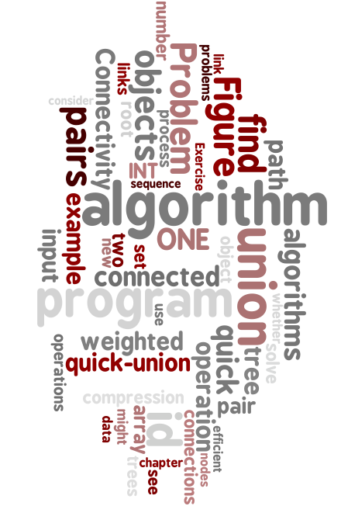
1.5 Union Find
dynamic connectivity
quick find
quick union
improvements
applications
Algorithms, 4th Edition | ∙ | Robert Sedgewick and Kevin Wayne | ∙ | Copyright © 2002–2010 | ∙ | March 16, 2011 9:10:29 PM

Slide 2
Subtext of today’s lecture (and this course)
Steps to developing a usable algorithm.
Model the problem.
Find an algorithm to solve it.
Fast enough? Fits in memory?
If not, figure out why.
Find a way to address the problem.
Iterate until satisfied.
The scientific method.
Mathematical analysis.
Notes:
and computational complexity

Slide 3
dynamic connectivity
quick find
quick union
improvements
applications

Slide 4
Dynamic connectivity
Given a set of objects
Union: connect two objects.
Connected: is there a path connecting the two objects?
more difficult problem: find the path
union(3, 4)
union(8, 0)
union(2, 3)
6
5
1
union(5, 6)
connected(0, 2) no
connected(2, 4) yes
2
3
4
union(5, 1)
union(7, 3)
union(1, 6)
union(4, 8)
0
7
8
connected(0, 2) yes
connected(2, 4) yes

Slide 5
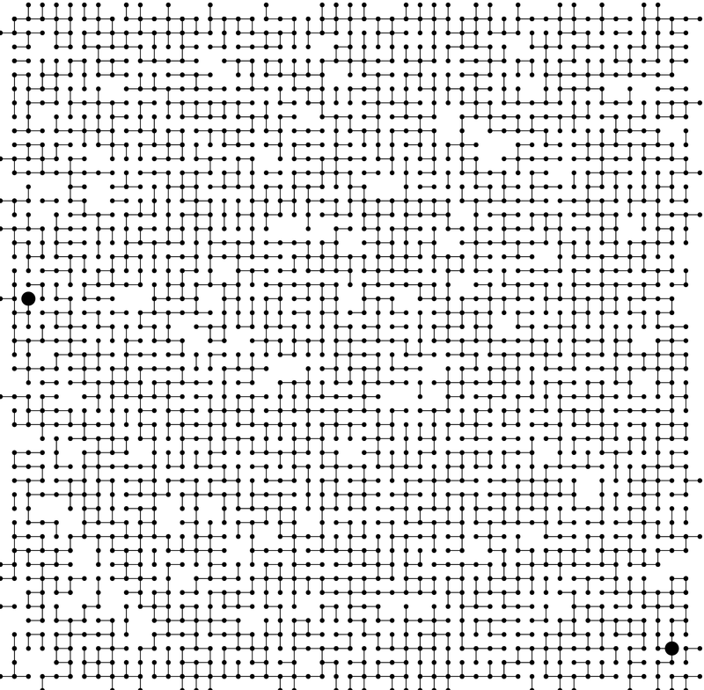
Connectivity example
Q. Is there a path from p to q?
p
q
A. Yes.
Notes:
medium.txt (625 sites, 900 edges, 3 connected components)

Slide 6
Modeling the objects
Dynamic connectivity applications involve manipulating objects of all types.
Pixels in a digital photo.
Computers in a network.
Variable names in Fortran.
Friends in a social network.
Transistors in a computer chip.
Elements in a mathematical set.
Metallic sites in a composite system.
When programming, convenient to name sites 0 to N-1.
Use integers as array index.
Suppress details not relevant to union-find.
can use symbol table to translate from site names to integers: stay tuned (Chapter 3)
Notes:
Manhattan sewers, McCosh rooms

Slide 7
Modeling the connections
We assume "is connected to" is an equivalence relation:
Reflexive: p is connected to p.
Symmetric: if p is connected to q, then q is connected to p.
Transitive: if p is connected to q and q is connected to r, then p is connected to r.
Connected components. Maximal set of objects that are mutually connected.
0
1
2
3
4
5
6
7
{ 0 } { 1 4 5 } { 2 3 6 7 }
3 connected components
Notes:
Simple model captures the essential nature of connectivity.
equivalence relation partitions objects into equivalence classes
sets = connected components = equivalence class

Slide 8
Implementing the operations
Find query. Check if two objects are in the same component.
Union command. Replace components containing two objects with their union.
union(2, 5)
0
1
2
3
0
1
2
3
4
5
6
7
4
5
6
7
{ 0 } { 1 4 5 } { 2 3 6 7 }
{ 0 } { 1 2 3 4 5 6 7 }
3 connected components
2 connected components

Slide 9
Union-find data type (API)
Goal. Design efficient data structure for union-find.
Number of objects N can be huge.
Number of operations M can be huge.
Find queries and union commands may be intermixed.
public class UF
UF(int N)
initialize union-find data structure with N objects (0 to N-1)
void
union(int p, int q)
add connection between p and q
boolean
connected(int p, int q)
are p and q in the same component?
int
find(int p)
component identifier for p (0 to N-1)
int
count()
number of components

Slide 10
Dynamic-connectivity client
Read in number of objects N from standard input.
Repeat:
read in pair of integers from standard input
write out pair if they are not already connected
public static void main(String[] args)
{
int N = StdIn.readInt();
UF uf = new UF(N);
while (!StdIn.isEmpty())
{
int p = StdIn.readInt();
int q = StdIn.readInt();
if (uf.connected(p, q)) continue;
uf.union(p, q);
StdOut.println(p + " " + q);
}
}
% more tiny.txt
10
4 3
3 8
6 5
9 4
2 1
8 9
5 0
7 2
6 1
1 0
6 7

Slide 11
dynamic connectivity
quick find
quick union
improvements
applications

Slide 12
Quick-find [eager approach]
Data structure.
Integer array id[] of size N.
Interpretation: p and q in same component iff they have the same id.
i 0 1 2 3 4 5 6 7 8 9
id[i] 0 1 9 9 9 6 6 7 8 9
5 and 6 are connected 2, 3, 4, and 9 are connected
0
1
2
3
4
5
6
7
8
9

Slide 13
Quick-find [eager approach]
Data structure.
Integer array id[] of size N.
Interpretation: p and q in same component iff they have the same id.
Find. Check if p and q have the same id.
i 0 1 2 3 4 5 6 7 8 9
id[i] 0 1 9 9 9 6 6 7 8 9
5 and 6 are connected 2, 3, 4, and 9 are connected
id[3] = 9; id[6] = 6 3 and 6 in different components
Notes:
find is fast because you just look up two array entries

Slide 14
Quick-find [eager approach]
Data structure.
Integer array id[] of size N.
Interpretation: p and q in same component iff they have the same id.
Find. Check if p and q have the same id.
Union. To merge sets containing p and q, change all entries with id[p] to id[q].
i 0 1 2 3 4 5 6 7 8 9
id[i] 0 1 9 9 9 6 6 7 8 9
5 and 6 are connected 2, 3, 4, and 9 are connected
id[3] = 9; id[6] = 6 3 and 6 in different components
i 0 1 2 3 4 5 6 7 8 9
id[i] 0 1 6 6 6 6 6 7 8 6
union of 3 and 6 2, 3, 4, 5, 6, and 9 are connected
problem: many values can change
Notes:
challenge is updating data structure to maintain this property
Note: could also update all entries with id[q] to id[p]

Slide 15
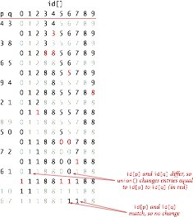
Quick-find example

Slide 16
Quick-find: Java implementation
public class QuickFindUF
{
private int[] id;
public QuickFindUF(int N)
{
id = new int[N];
for (int i = 0; i < N; i++)
id[i] = i;
}
public boolean connected(int p, int q)
{ return id[p] == id[q]; }
public void union(int p, int q)
{
int pid = id[p];
int qid = id[q];
for (int i = 0; i < id.length; i++)
if (id[i] == pid) id[i] = qid;
}
}
set id of each object to itself (N array accesses)
check whether p and q
are in the same component
(2 array accesses)
change all entries with id[p] to id[q]
(linear number of array accesses)
Notes:
Caveat: need to save away pid = id[p] since id[p] might change

Slide 17
Quick-find is too slow
Cost model. Number of array accesses (for read or write).
Quick-find defect.
Union too expensive.
Trees are flat, but too expensive to keep them flat.
Ex. Takes N ² array accesses to process sequence of N union commands on N objects.
algorithm | init | union | find
quick-find | N | N | 1
Notes:
this is order-of-growth of number of array accesses - we discard constants

Slide 18
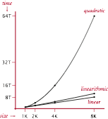
Quadratic algorithms do not scale
Rough standard (for now).
10⁹ operations per second.
10⁹ words of main memory.
Touch all words in approximately 1 second.
Ex. Huge problem for quick-find.
10⁹ union commands on 10⁹ objects.
Quick-find takes more than 10¹⁸ operations.
30+ years of computer time!
Paradoxically, quadratic algorithms get worse with newer equipment.
New computer may be 10x as fast.
But, has 10x as much memory so problem may be 10x bigger.
With quadratic algorithm, takes 10x as long!
a truism (roughly) since 1950!
Notes:
edges may not fit in main memory
Note: number of union operations is at most 10^9; each union operation takes 10^9 steps.
Technology improves things by a constant factor. [Moore's law]
But might be costly.
Good algorithmic design can do much better and might be cheap.
Supercomputers cannot rescue a bad algorithm.

Slide 19
dynamic connectivity
quick find
quick union
improvements
applications

Slide 20
Quick-union [lazy approach]
Data structure.
Integer array id[] of size N.
Interpretation: id[i] is parent of i.
Root of i is id[id[id[...id[i]...]]].
keep going until it doesn’t change
i 0 1 2 3 4 5 6 7 8 9
id[i] 0 1 9 4 9 6 6 7 8 9
0
1
9
6
7
8
2
4
5
q
p
3
3's root is 9; 5's root is 6
Notes:
3s parent is 4, 4s parent is 9
could use parent pointer/reference instead of id[] array, but array easier if objects are 0..N-1

Slide 21
Quick-union [lazy approach]
Data structure.
Integer array id[] of size N.
Interpretation: id[i] is parent of i.
Root of i is id[id[id[...id[i]...]]].
Find. Check if p and q have the same root.
keep going until it doesn’t change
i 0 1 2 3 4 5 6 7 8 9
id[i] 0 1 9 4 9 6 6 7 8 9
0
1
9
6
7
8
2
4
5
q
p
3
3's root is 9; 5's root is 6 3 and 5 are in different components

Slide 22
Quick-union [lazy approach]
Data structure.
Integer array id[] of size N.
Interpretation: id[i] is parent of i.
Root of i is id[id[id[...id[i]...]]].
Find. Check if p and q have the same root.
Union. To merge sets containing p and q, set the id of p's root to the id of q's root.
keep going until it doesn’t change
i 0 1 2 3 4 5 6 7 8 9
id[i] 0 1 9 4 9 6 6 7 8 9
0
1
9
6
7
8
2
4
5
q
p
3
3's root is 9; 5's root is 6 3 and 5 are in different components
0
1
6
7
8
i 0 1 2 3 4 5 6 7 8 9
id[i] 0 1 9 4 9 6 6 7 8 6
9
5
q
2
4
only one value changes
3
p
Notes:
only have to change one array entry to execute union, but price you pay is traveling up tree to find roots.

Slide 23
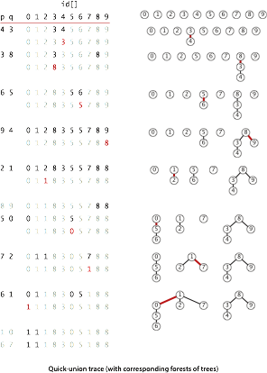
Quick-union example

Slide 24
Quick-union example

Slide 25
Quick-union: Java implementation
public class QuickUnionUF{ private int[] id; public QuickUnionUF(int N) { id = new int[N];
for (int i = 0; i < N; i++) id[i] = i; } private int root(int i) {
while (i != id[i]) i = id[i];
return i; } public boolean connected(int p, int q) { return root(p) == root(q); } public void union(int p, int q) {
int i = root(p), j = root(q);
id[i] = j; }
}
set id of each object to itself (N array accesses)
chase parent pointers until reach root
(depth of i array accesses)
check if p and q have same root
(depth of p and q array accesses)
change root of p to point to root of q
(depth of p and q array accesses)

Slide 26
Quick-union is also too slow
Cost model. Number of array accesses (for read or write).
Quick-find defect.
Union too expensive (N array accesses).
Trees are flat, but too expensive to keep them flat.
Quick-union defect.
Trees can get tall.
Find too expensive (could be N array accesses).
algorithm | init | union | find
quick-find | N | N | 1
quick-union | N | N † | N
worst case
† includes cost of finding root

Slide 27
dynamic connectivity
quick find
quick union
improvements
applications

Slide 28
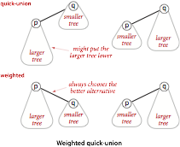
Improvement 1: weighting
Weighted quick-union.
Modify quick-union to avoid tall trees.
Keep track of size of each tree (number of objects).
Balance by linking small tree below large one.

Slide 29
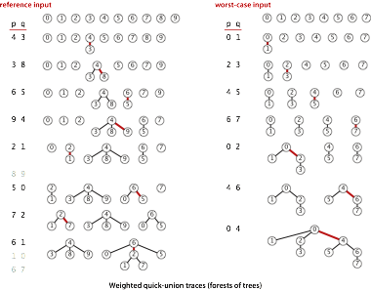
Weighted quick-union examples

Slide 30
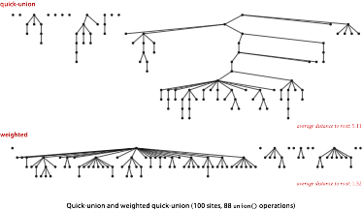
Quick-union and weighted quick-union example

Slide 31
Weighted quick-union: Java implementation
Data structure. Same as quick-union, but maintain extra array sz[i] to count number of objects in the tree rooted at i.
Find. Identical to quick-union.
Union. Modify quick-union to:
Merge smaller tree into larger tree.
Update the sz[] array.
return root(p) == root(q);
int i = root(p);
int j = root(q);
if (sz[i] < sz[j]) { id[i] = j; sz[j] += sz[i]; }
else { id[j] = i; sz[i] += sz[j]; }

Slide 32
Weighted quick-union analysis
Running time.
Find: takes time proportional to depth of p and q.
Union: takes constant time, given roots.
Proposition. Depth of any node x is at most lg N.
1
0
6
8
9
4
7
5
2
3
x
N = 10
depth(x) = 3 ≤ lg N

Slide 33
Weighted quick-union analysis
Running time.
Find: takes time proportional to depth of p and q.
Union: takes constant time, given roots.
Proposition. Depth of any node x is at most lg N.
Pf. When does depth of x increase?
Increases by 1 when tree T1 containing x is merged into another tree T2.
The size of the tree containing x at least doubles since | T 2 | ≥ | T 1 |.
Size of tree containing x can double at most lg N times. Why?
T2
T1
x
Notes:
could also merge by height or rank, as done in some textbooks, but union by size achieves same amortized complexity
since we are merging by size, size(T1) >= size(T2)

Slide 34
Weighted quick-union analysis
Running time.
Find: takes time proportional to depth of p and q.
Union: takes constant time, given roots.
Proposition. Depth of any node x is at most lg N.
Q. Stop at guaranteed acceptable performance?
A. No, easy to improve further.
algorithm | init | union | find
quick-find | N | N | 1
quick-union | N | N † | N
weighted QU | N | lg N † | lg N
† includes cost of finding root

Slide 35
Improvement 2: path compression
Quick union with path compression. Just after computing the root of p,
set the id of each examined node to point to that root.
0
0
1
2
9
6
3
1
2
3
4
5
11
12
8
7
4
5
6
7
10
root(9)
8
9
p
10
11
12

Slide 36
Path compression: Java implementation
Standard implementation: add second loop to find() to set the id[] of each examined node to the root.
Simpler one-pass variant: halve the path length by making every other node in path point to its grandparent.
In practice. No reason not to! Keeps tree almost completely flat.
public int root(int i) { while (i != id[i]) {
id[i] = id[id[i]];
i = id[i];
}
return i; }
only one extra line of code !
Notes:
can avoid second pass by using "halving."

Slide 37
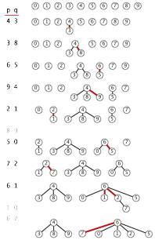
Weighted quick-union with path compression example
1 linked to 6 because of path compression
7 linked to 6 because of path compression

Slide 38
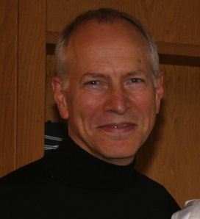
Weighted quick-union with path compression: amortized analysis
Proposition. Starting from an empty data structure,
any sequence of M union−find operations on N objects makes at most proportional to N + M lg* N array accesses.
Proof is very difficult.
Can be improved to N + M α(M, N).
But the algorithm is still simple!
Linear-time algorithm for M union-find ops on N objects?
Cost within constant factor of reading in the data.
In theory, WQUPC is not quite linear.
In practice, WQUPC is linear.
Amazing fact. No linear-time algorithm exists.
see COS 423
Bob Tarjan
(Turing Award '86)
N | lg* N
1 | 0
2 | 1
4 | 2
16 | 3
65536 | 4
2⁶⁵⁵³⁶ | 5
because lg* N is a constant in this universe
lg* function
in "cell-probe" model of computation
Notes:
Seems like performance has to get better. Really difficult problem that was open for a while.
Tarjan proved a tight bound relating it to inverse Ackermann function alpha(M, N) . We won't define here
iterated logarithm function = lg * = number of times needed to take the lg of a number until reaching 1
Note: haven't yet introduced big Oh notation

Slide 39
Summary
Bottom line. WQUPC makes it possible to solve problems that could not otherwise be addressed.
Ex. [10⁹ unions and finds with 10⁹ objects]
WQUPC reduces time from 30 years to 6 seconds.
Supercomputer won't help much; good algorithm enables solution.
algorithm
worst-case time
quick-find
M N
quick-union
M N
weighted QU
N + M log N
QU + path compression
N + M log N
weighted QU + path compression
N + M lg* N
M union−find operations on a set of N objects
Notes:
WQUPC on Java cell phone beats QF on supercomputer!
if we could do this well on every problem, we'd be in great shape! but lots of useful problems where N^2 or N^3 is easy, basic ideas in data structures hammers it to N log N or better.

Slide 40
dynamic connectivity
quick find
quick union
improvements
applications

Slide 41
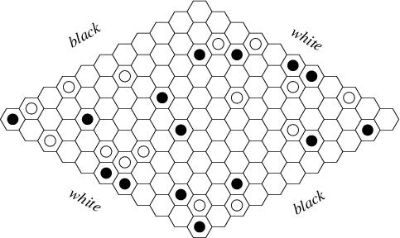
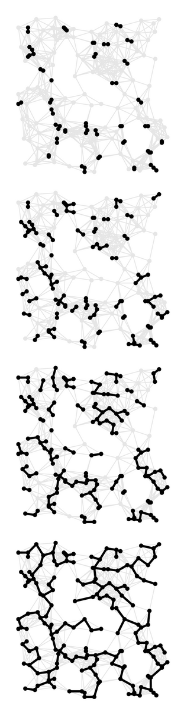
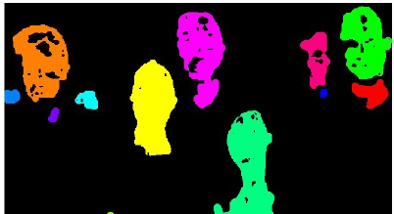
Union-find applications
Percolation.
Games (Go, Hex).
Dynamic connectivity.
Least common ancestor.
Equivalence of finite state automata.
Hoshen-Kopelman algorithm in physics.
Hinley-Milner polymorphic type inference.
Kruskal's minimum spanning tree algorithm.
Compiling equivalence statements in Fortran.
Morphological attribute openings and closings.
Matlab's bwlabel() function in image processing.
Notes:
References:
A Linear Time Algorithm for a Special Case of Disjoint Set Union, Gabow and Tarjan.
The Design and Analysis of Computer Algorithms, Aho, Hopcroft, and Ullman.
do this slide very quickly
More applications
* Micali-Vazarani algorithm for nonbipartite matching.
* Weihe's algorithm for edge-disjoint s-t paths in planar graphs.
* Scheduling unit-time tasks with a partial order to two processors in order to minimize last completion time.
Scheduling unit-time tasks to P processors so that each job finishes between its release time and deadline.

Slide 42
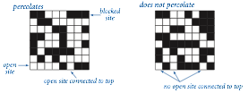
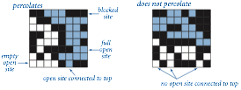
Percolation
A model for many physical systems:
N-by-N grid of sites.
Each site is open with probability p (or blocked with probability 1 − p).
System percolates iff top and bottom are connected by open sites.
N = 8

Slide 43
Percolation
A model for many physical systems:
N-by-N grid of sites.
Each site is open with probability p (or blocked with probability 1 − p).
System percolates iff top and bottom are connected by open sites.
model | system | vacant site | occupied site | percolates
electricity | material | conductor | insulated | conducts
fluid flow | material | empty | blocked | porous
social interaction | population | person | empty | communicates

Slide 44
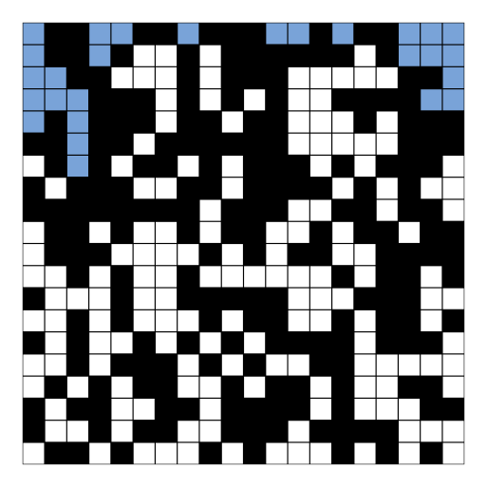
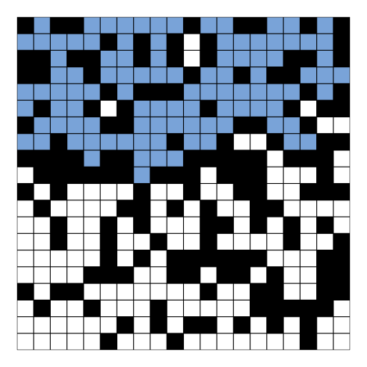
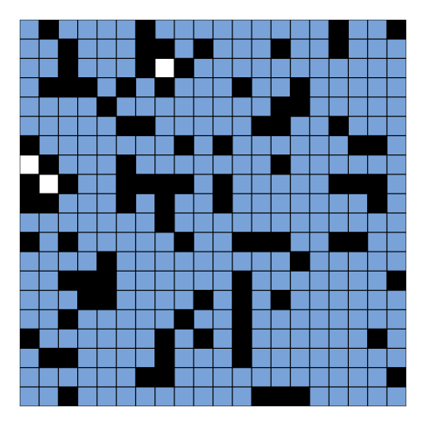
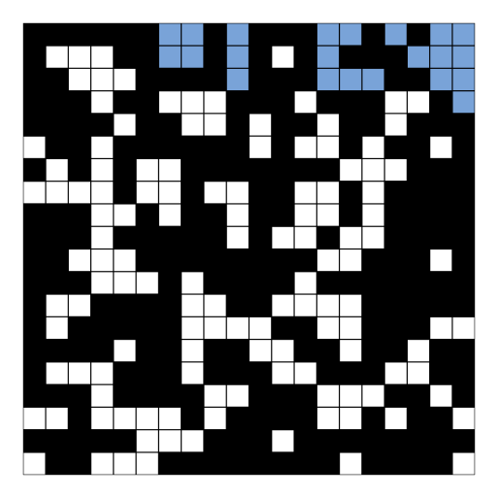
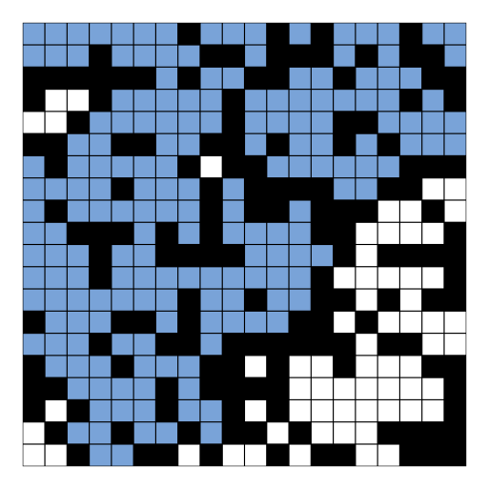
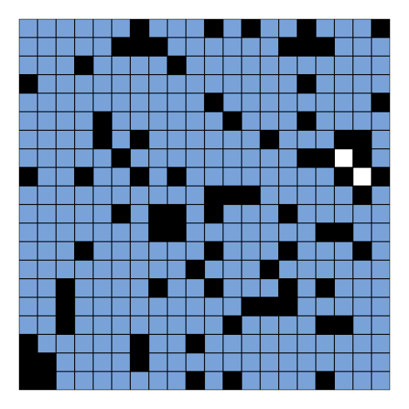
Likelihood of percolation
Depends on site vacancy probability p.
p low (0.4)
does not percolate
p medium (0.6)
percolates?
p high (0.8)
percolates
Notes:
p = 0.4, 0.6, and 0.8, N = 20

Slide 45
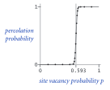
Percolation phase transition
When N is large, theory guarantees a sharp threshold p*.
p > p*: almost certainly percolates.
p < p*: almost certainly does not percolate.
Q. What is the value of p* ?
p*
N = 100
Notes:
mathematical theory proves that a threshold exists (as N gets large), but does not provide a value

Slide 46
Monte Carlo simulation
Initialize N-by-N whole grid to be blocked.
Declare random sites open until top connected to bottom.
Vacancy percentage estimates p*.
full open site (connected to top)
empty open site (not connected to top)
blocked site
N = 20
Notes:
204 sites => vacancy percentage is 204/400 = 51%

Slide 47
Dynamic connectivity solution to estimate percolation threshold
Q. How to check whether an N-by-N system percolates?
N = 5
open site
blocked site

Slide 48
Dynamic connectivity solution to estimate percolation threshold
Q. How to check whether an N-by-N system percolates?
Create an object for each site and name them 0 to N ² – 1.
N = 5
0
1
2
3
4
5
6
7
8
9
10
11
12
13
14
15
16
17
18
19
20
21
22
23
24
open site
blocked site

Slide 49
Dynamic connectivity solution to estimate percolation threshold
Q. How to check whether an N-by-N system percolates?
Create an object for each site and name them 0 to N ² – 1.
Sites are in same set if connected by open sites.
N = 5
open site
blocked site

Slide 50
Dynamic connectivity solution to estimate percolation threshold
Q. How to check whether an N-by-N system percolates?
Create an object for each site and name them 0 to N ² – 1.
Sites are in same set if connected by open sites.
Percolates iff any site on bottom row is connected to site on top row.
brute-force algorithm: N ² calls to connected()
N = 5
open site
blocked site

Slide 51
Dynamic connectivity solution to estimate percolation threshold
Clever trick. Introduce two virtual sites (and connections to top and bottom).
Percolates iff virtual top site is connected to virtual bottom site.
efficient algorithm: only 1 call to connected()
virtual top site
N = 5
open site
virtual bottom site
blocked site

Slide 52
Dynamic connectivity solution to estimate percolation threshold
Clever trick. Introduce two virtual sites (and connections to top and bottom).
Percolates iff virtual top site is connected to virtual bottom site.
Open site is full iff connected to virtual top site.
needed only for visualization
virtual top site
N = 5
empty open site (not connected to top)
full open site (connected to top)
virtual bottom site
blocked site
Notes:
a bit of a cheat if "backwash" (then sites connected to bottom row will be declared full after system percolates)

Slide 53
Dynamic connectivity solution to estimate percolation threshold
Q. How to model as dynamic connectivity problem when opening a new site?
open this site
N = 5
open site
blocked site

Slide 54
Dynamic connectivity solution to estimate percolation threshold
Q. How to model as dynamic connectivity problem when opening a new site?
A. Connect new site to all of its adjacent open sites.
up to 4 calls to union()
open this site
N = 5
open site
blocked site

Slide 55
Percolation threshold
Q. What is percolation threshold p* ?
A. About 0.592746 for large square lattices.
Fast algorithm enables accurate answer to scientific question.
constant know only via simulation
p*
N = 100

Slide 56
Hex
Hex. [Piet Hein 1942, John Nash 1948, Parker Brothers 1962]
Two players alternate in picking a cell in a hexagonal grid.
Black: make a black path from upper left to lower right.
White: make a white path from lower left to upper right.
Union-find application. Algorithm to detect when a player has won.
http://mathworld.wolfram.com/GameofHex.html
Notes:
Hex also called Nash or John (latter because it was played on tiled floor of bathrooms)

Slide 57
Subtext of today’s lecture (and this course)
Steps to developing a usable algorithm.
Model the problem.
Find an algorithm to solve it.
Fast enough? Fits in memory?
If not, figure out why.
Find a way to address the problem.
Iterate until satisfied.
The scientific method.
Mathematical analysis.
Notes:
and computational complexity

