Slide 1
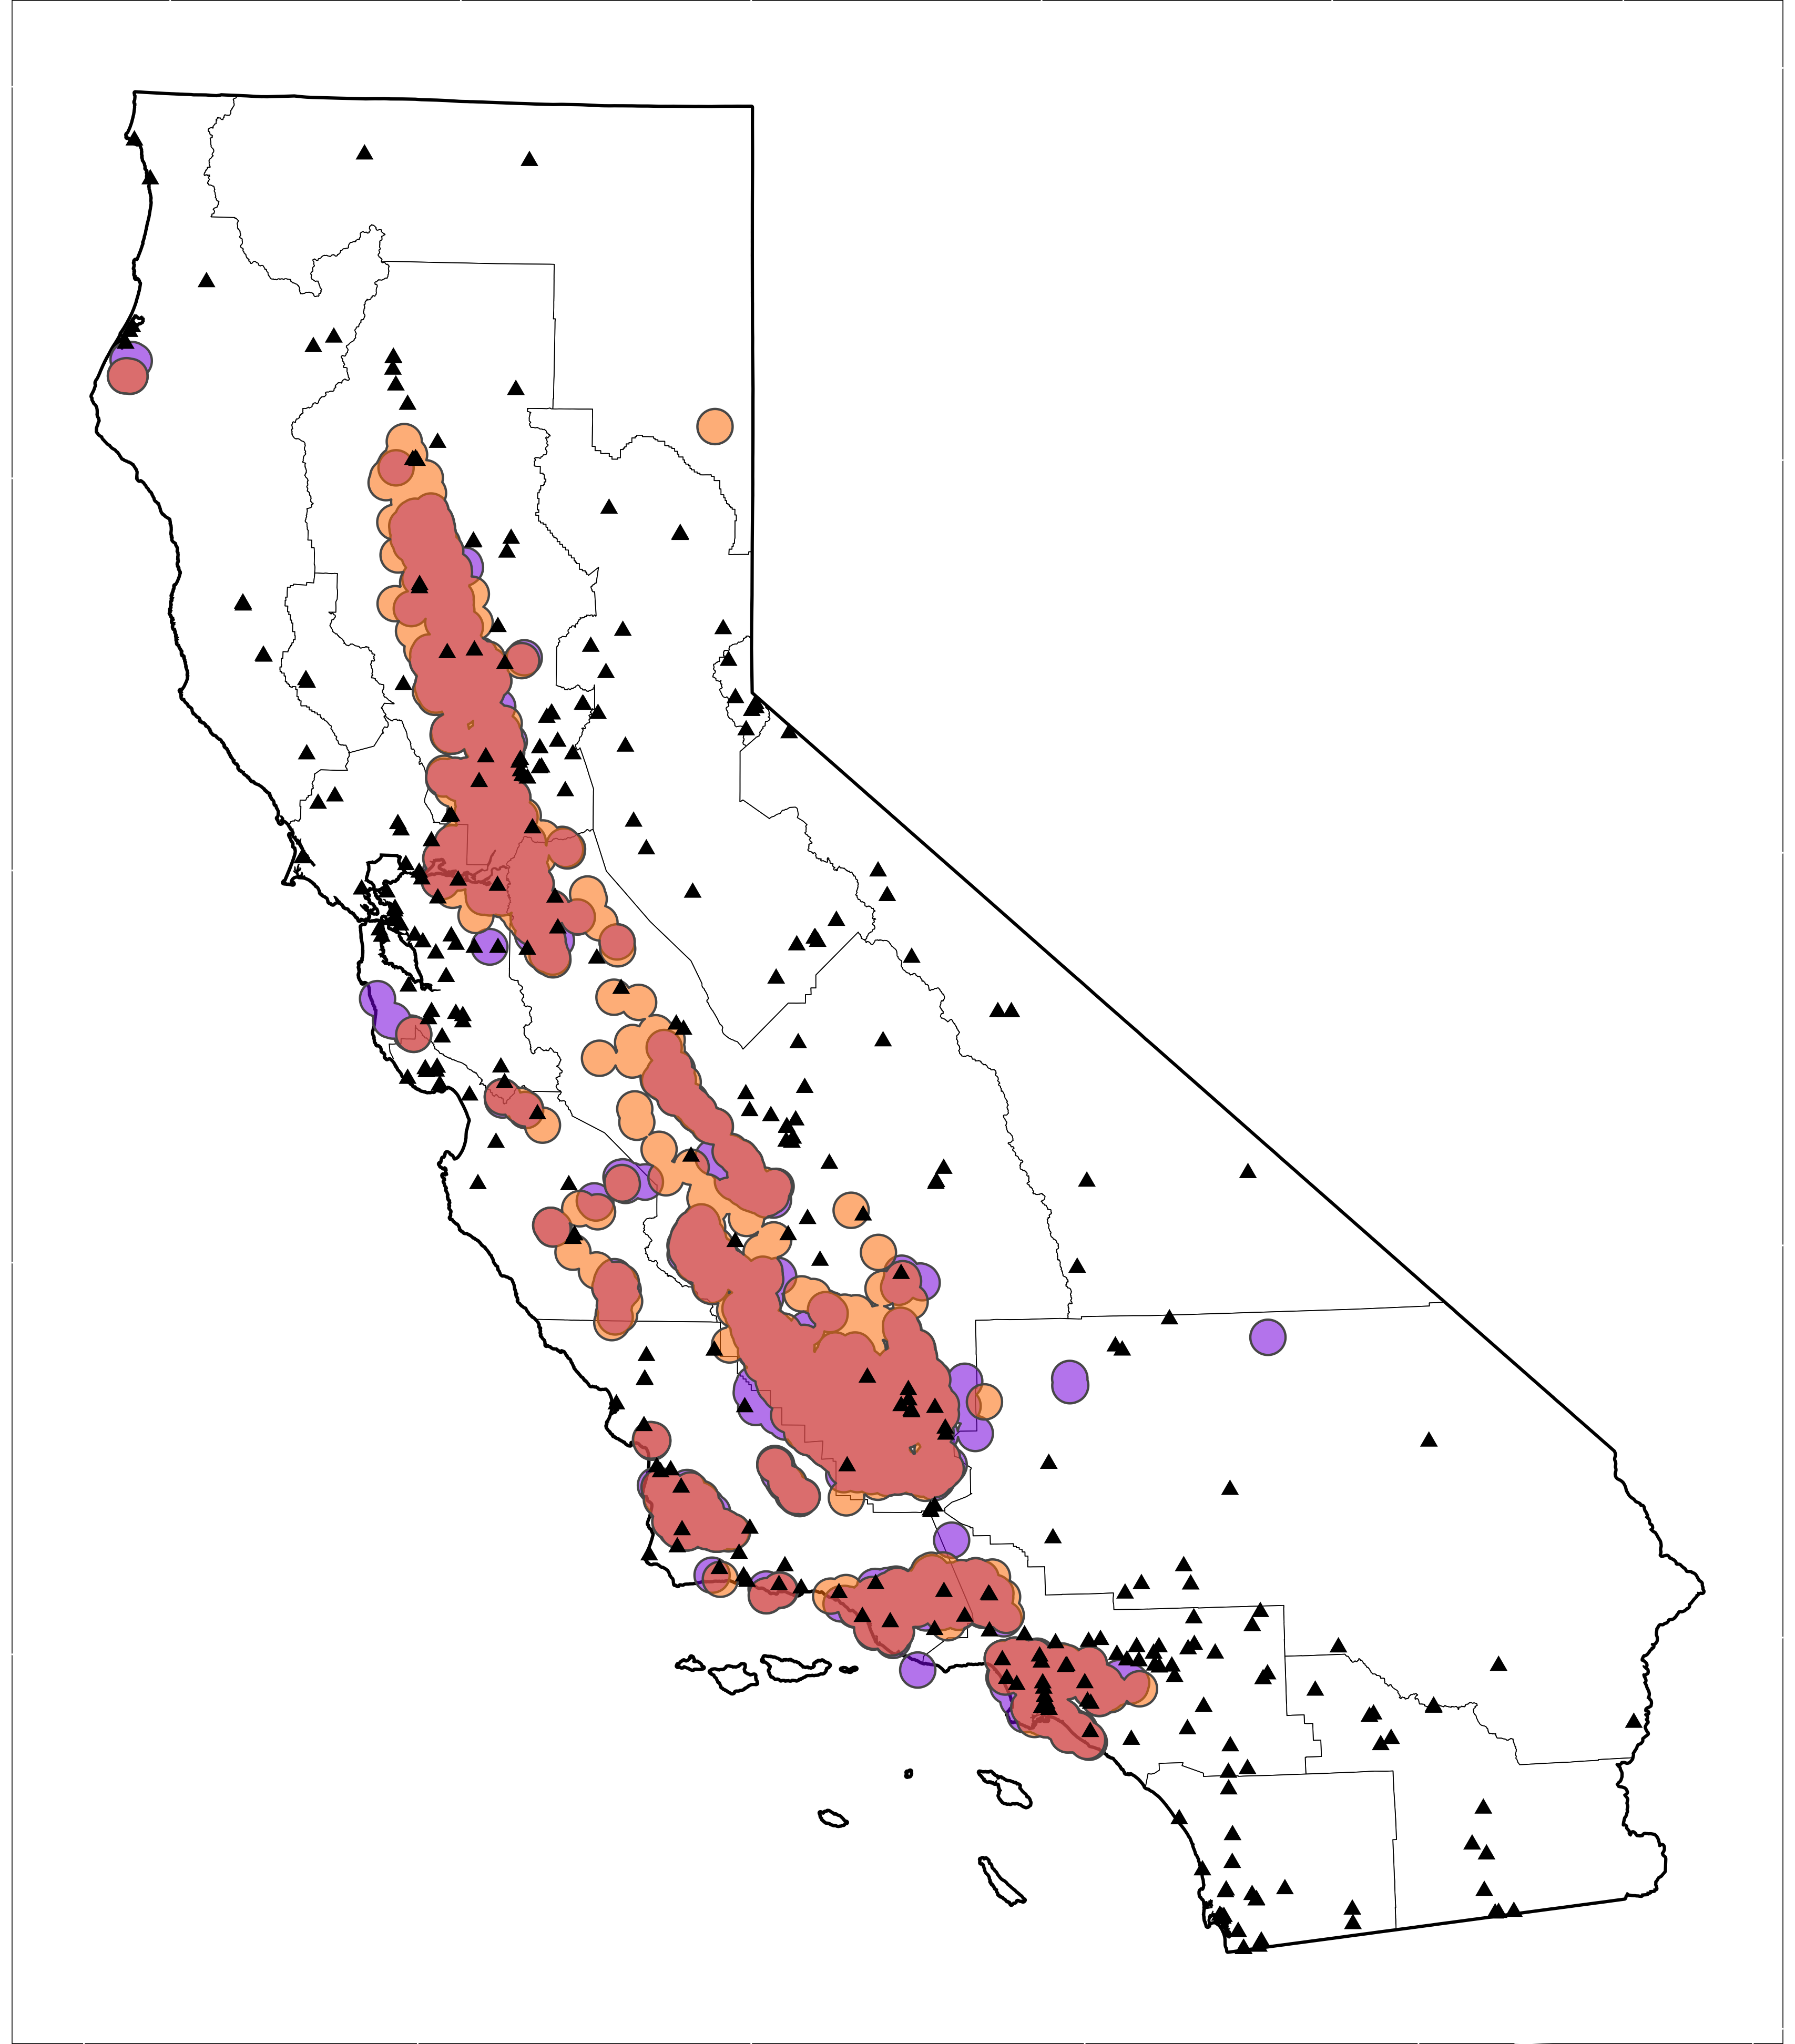
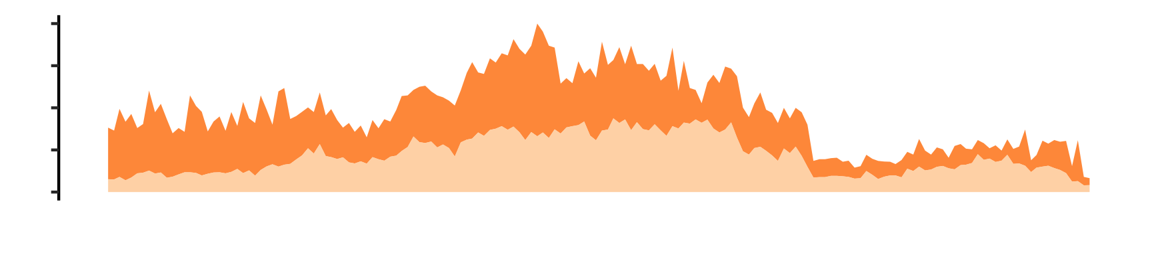

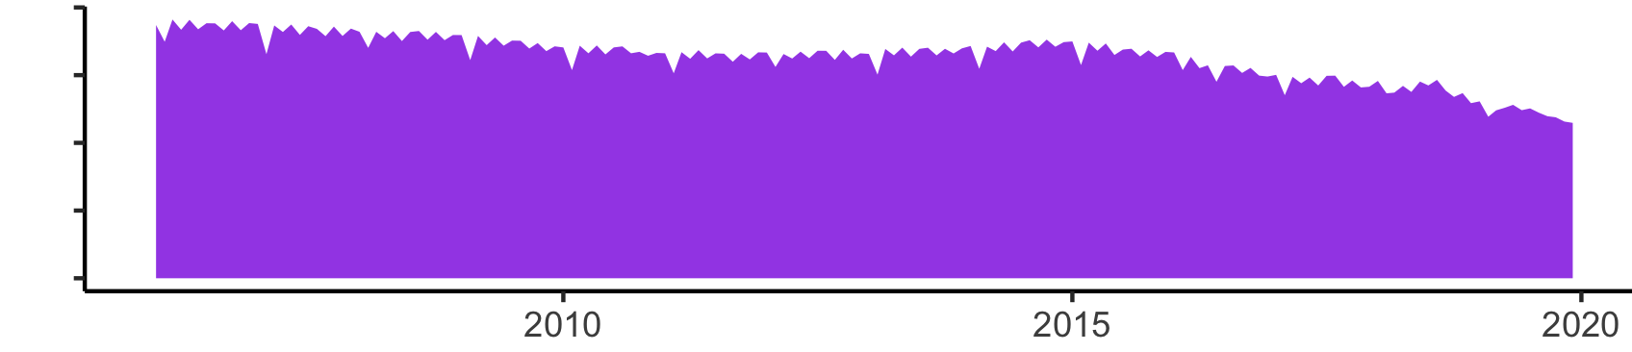
a.
Air quality monitor
Wells in preproduction, 10 km buffer
Wells in production, 10 km buffer
Wells in preproduction and production,10 km buffer
Sacramento Valley
San Joaquin Valley
South Central Coast
South Coast
800
b.
Well preproduction
(n)
0
2
c.
1
Oil and gas production (BOE x 10⁶)
0

