Slide 1
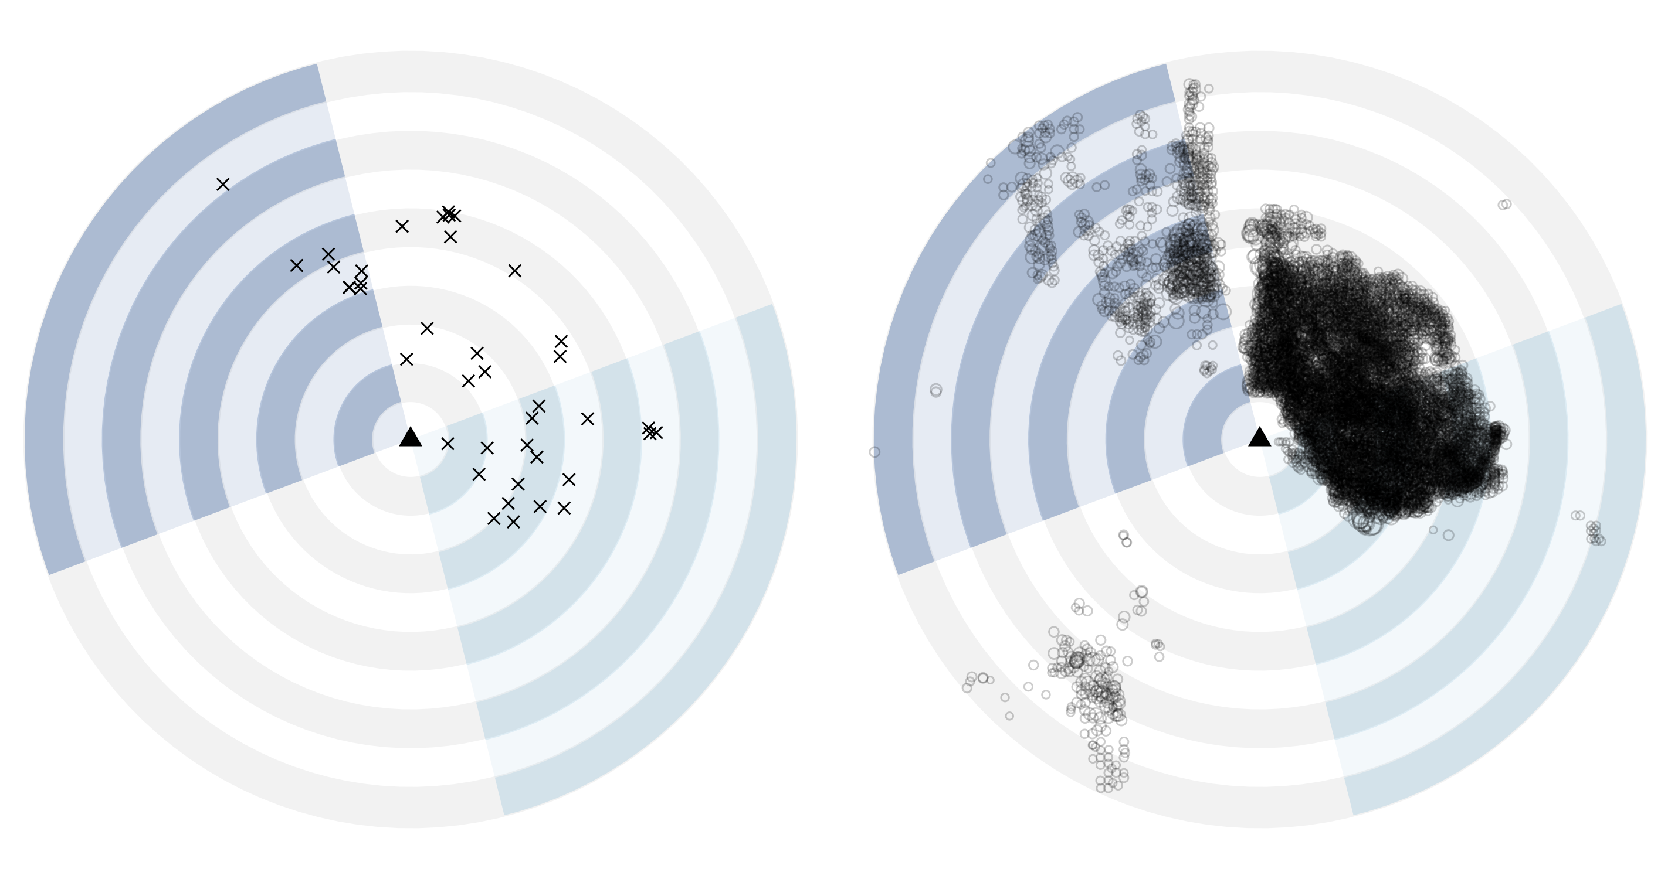
a.
b.
N
 | Air quality monitor
✕ | Preproduction well
 | Producing well
○
10 km

