Slide 1
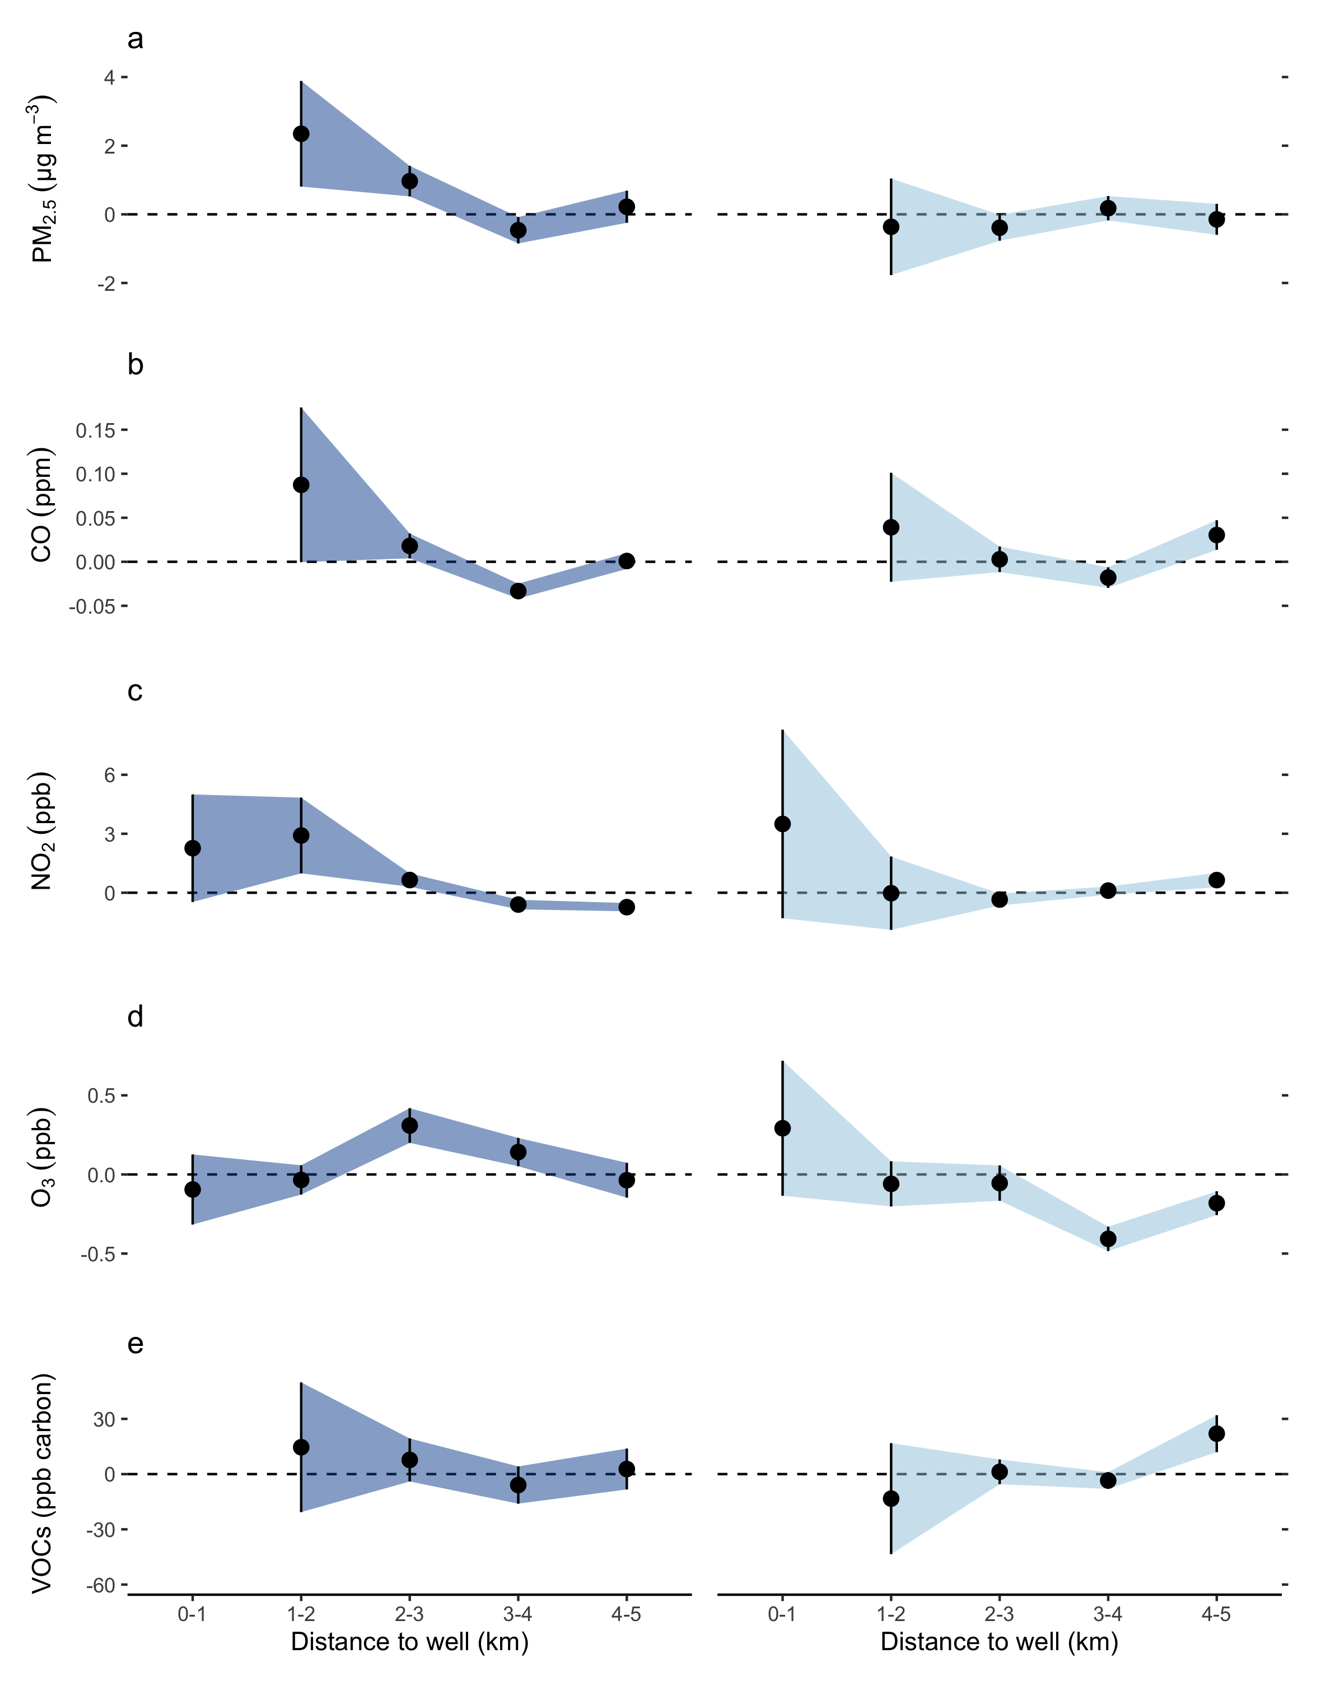
Upwind
Downwind
3,000
1,250
2,400
11,400
750

