Slide 1
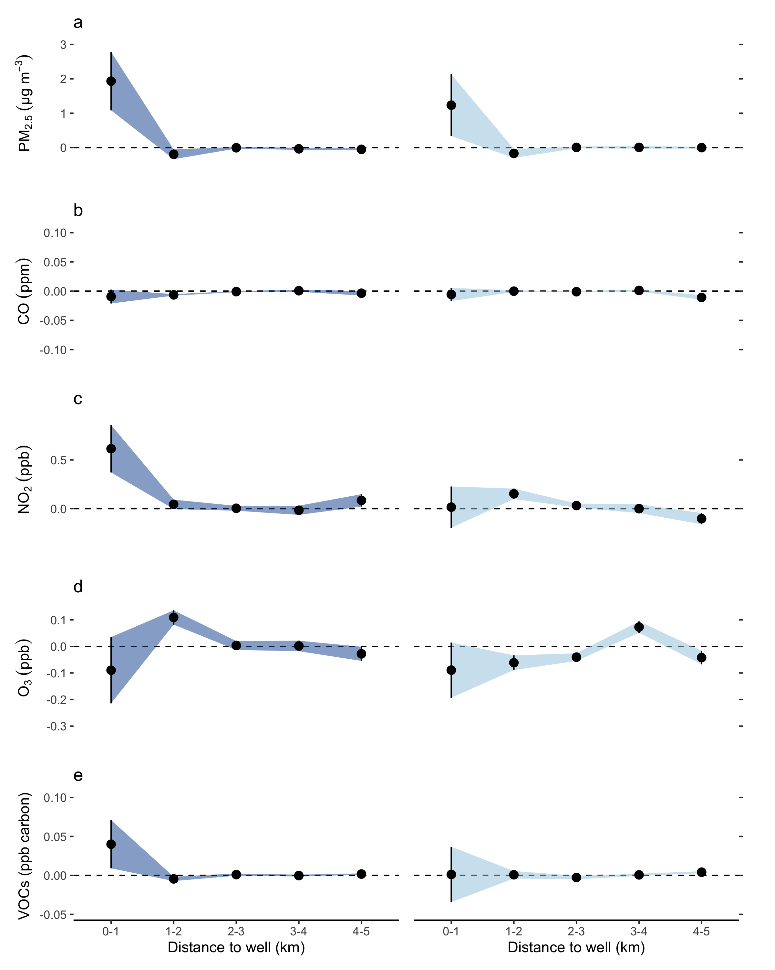
Upwind
Downwind
32,000
30,000
38,000
56,500
14,000

