Slide 1
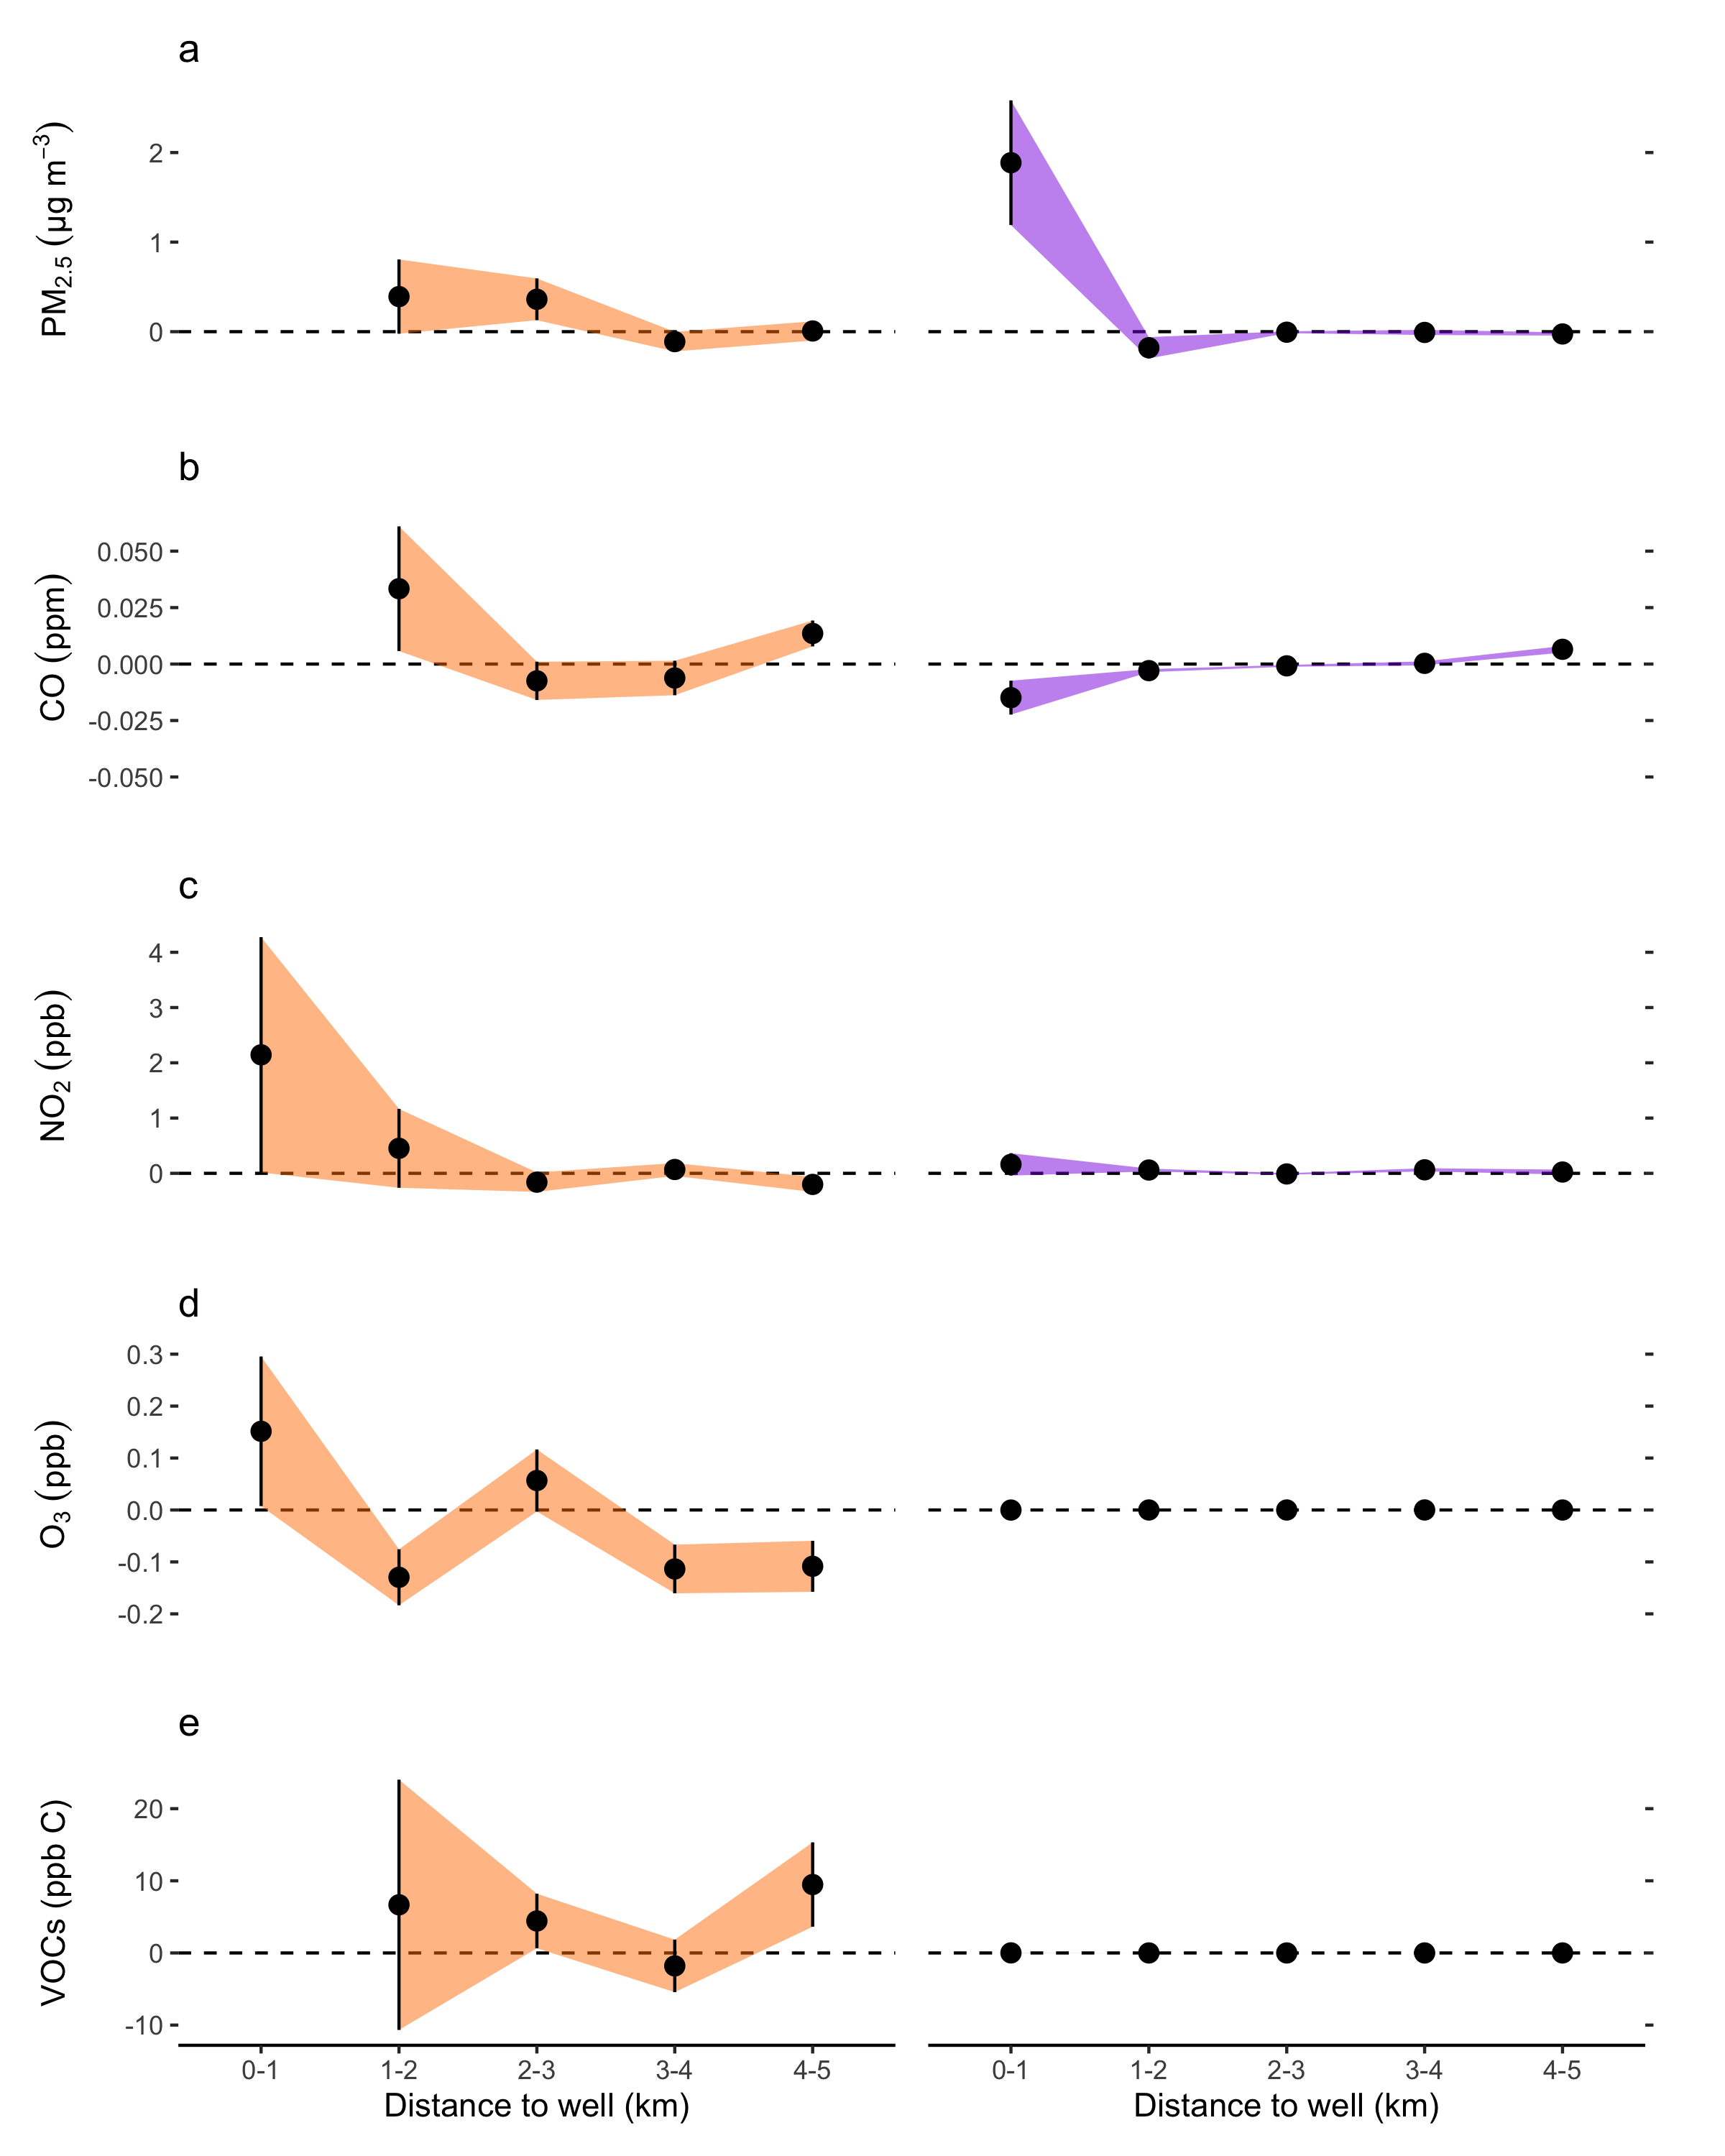
Preproduction Wells
Production Volume

