Slide 1
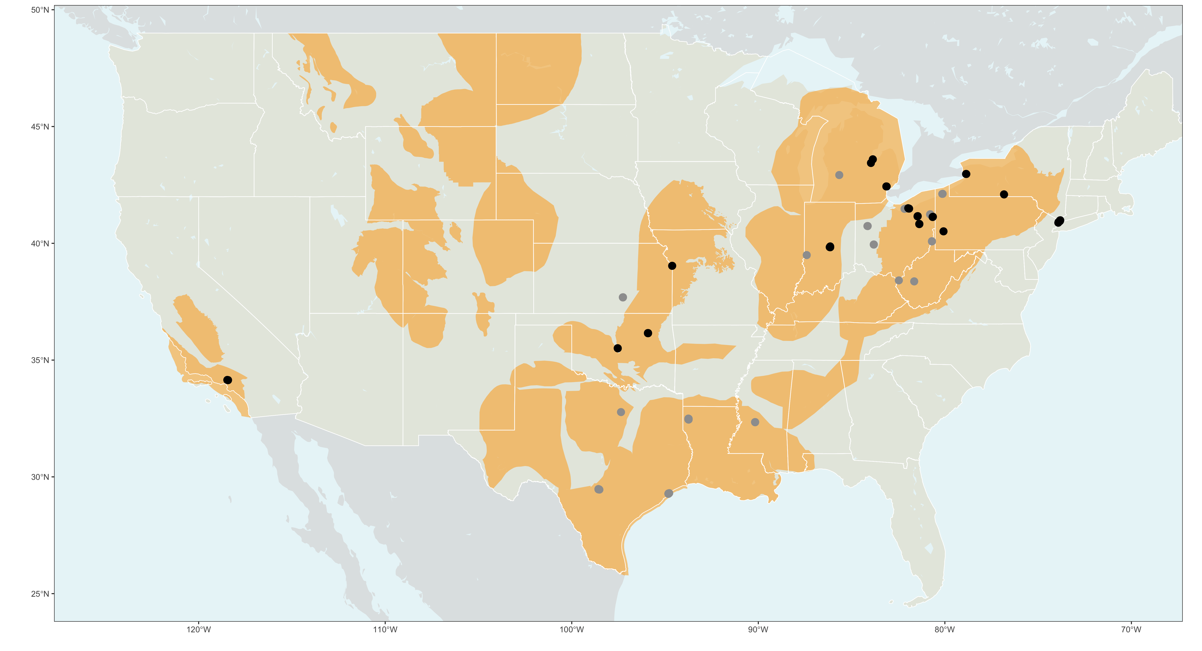
Buffalo
Akron
Elmira
Bay City
Saginaw
Lower Westchester
County
Detroit
Youngstown
Indianapolis
Pittsburgh
New York City
Kansas City
Cleveland
Canton
Tulsa
Oklahoma City
Los Angeles
City with wells and census data
City with wells
Oil basins

