Slide 1
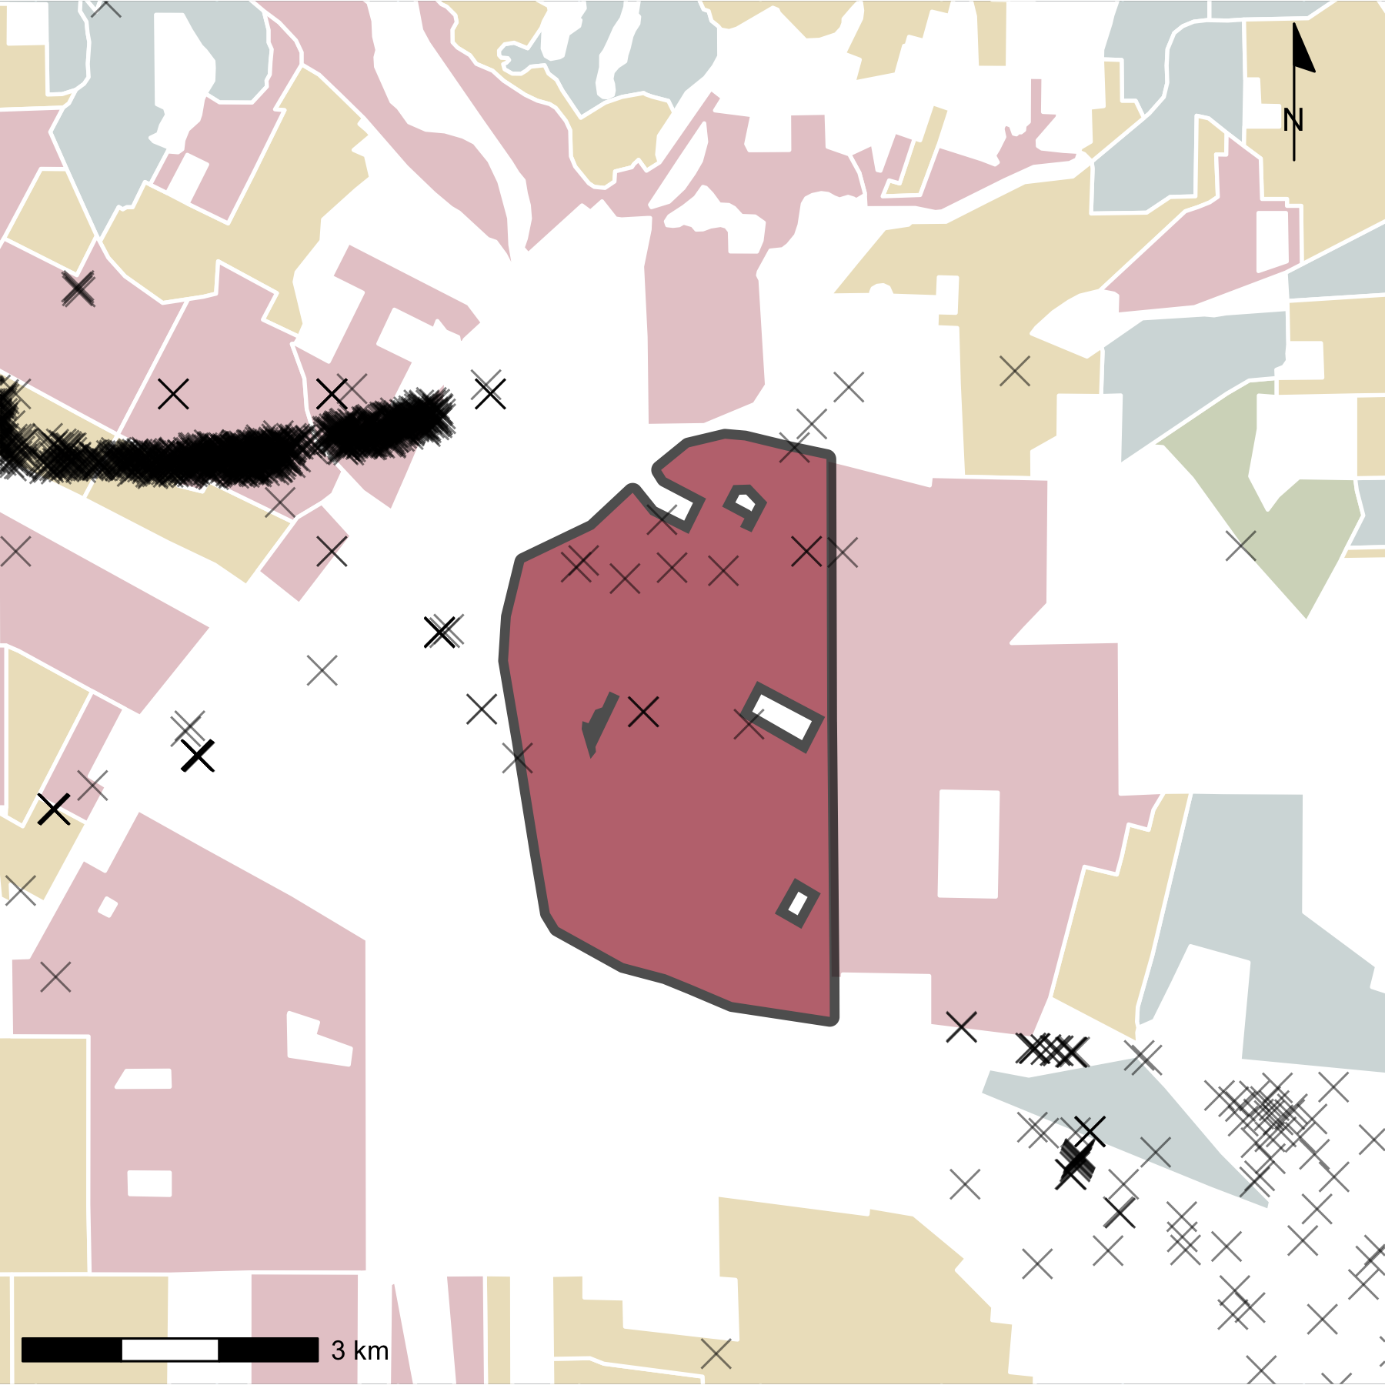
HOLC Grade
A
B
C
D
✕
Well

