Slide 1
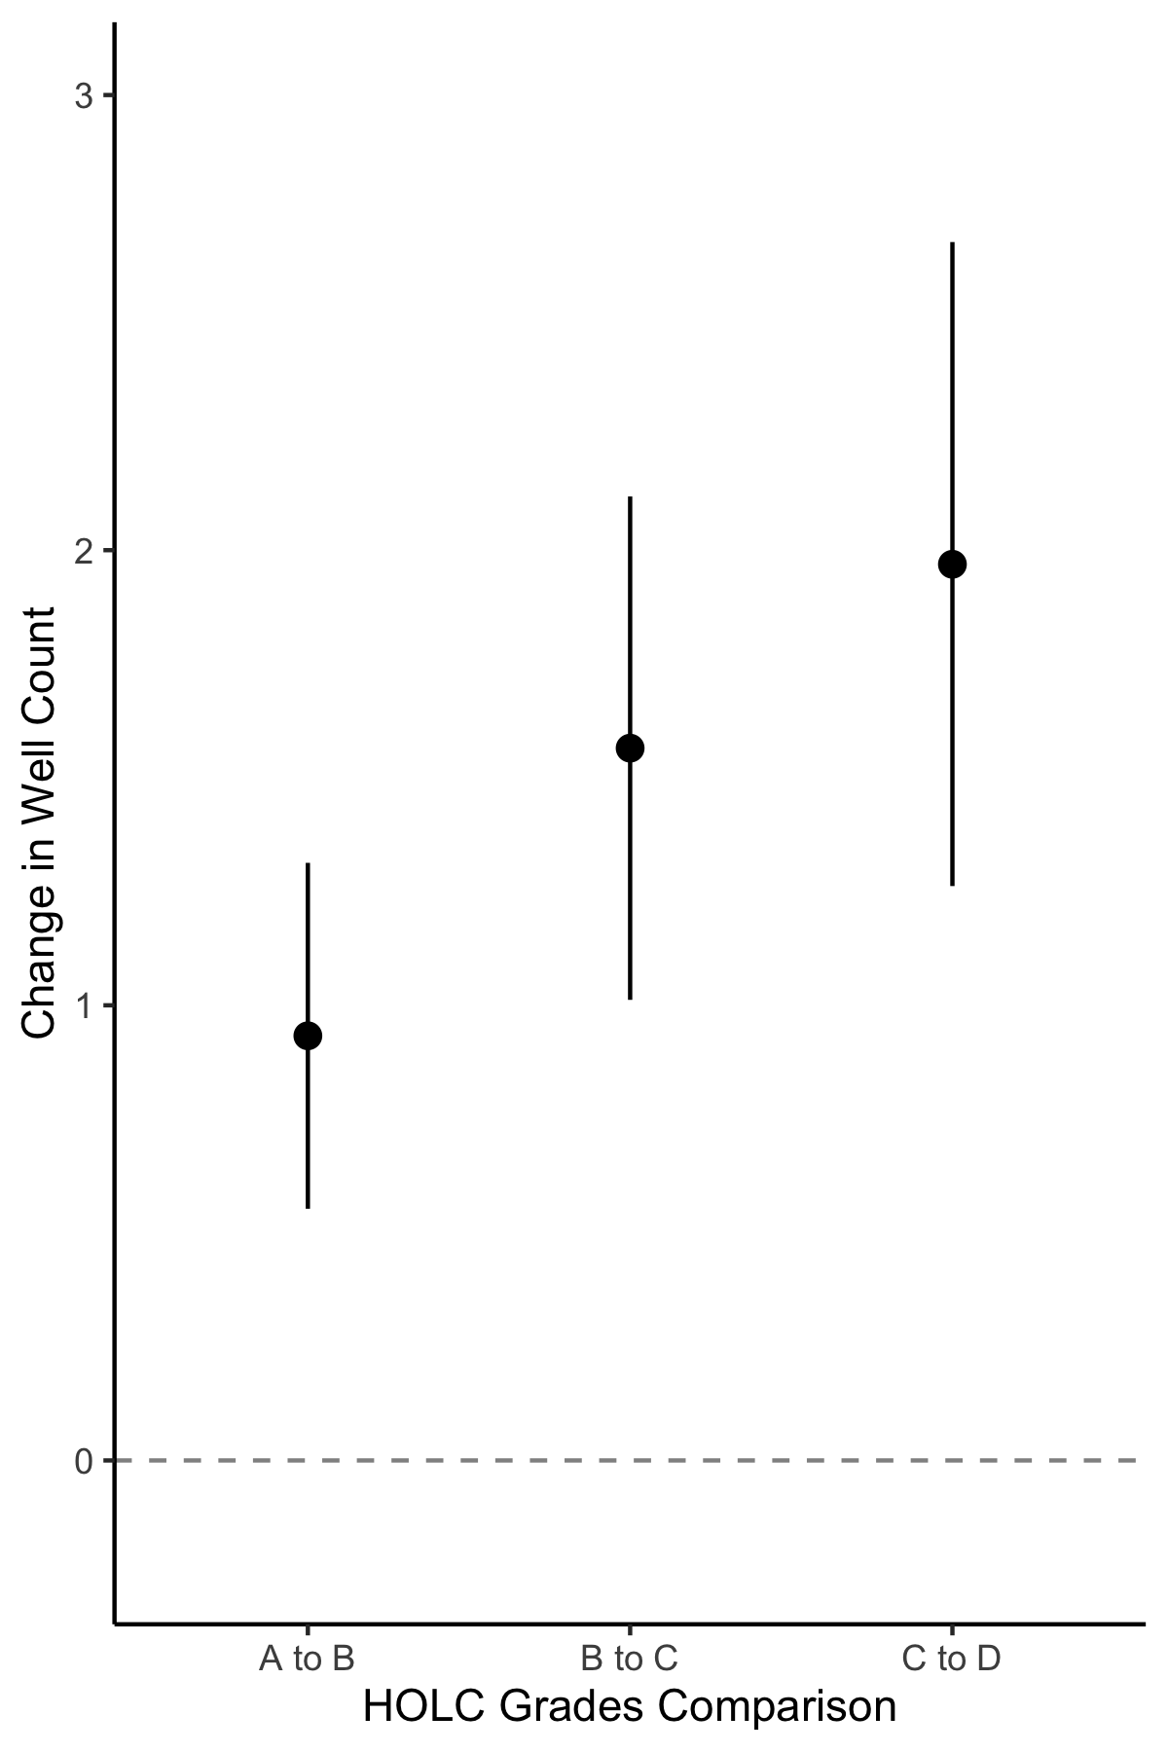
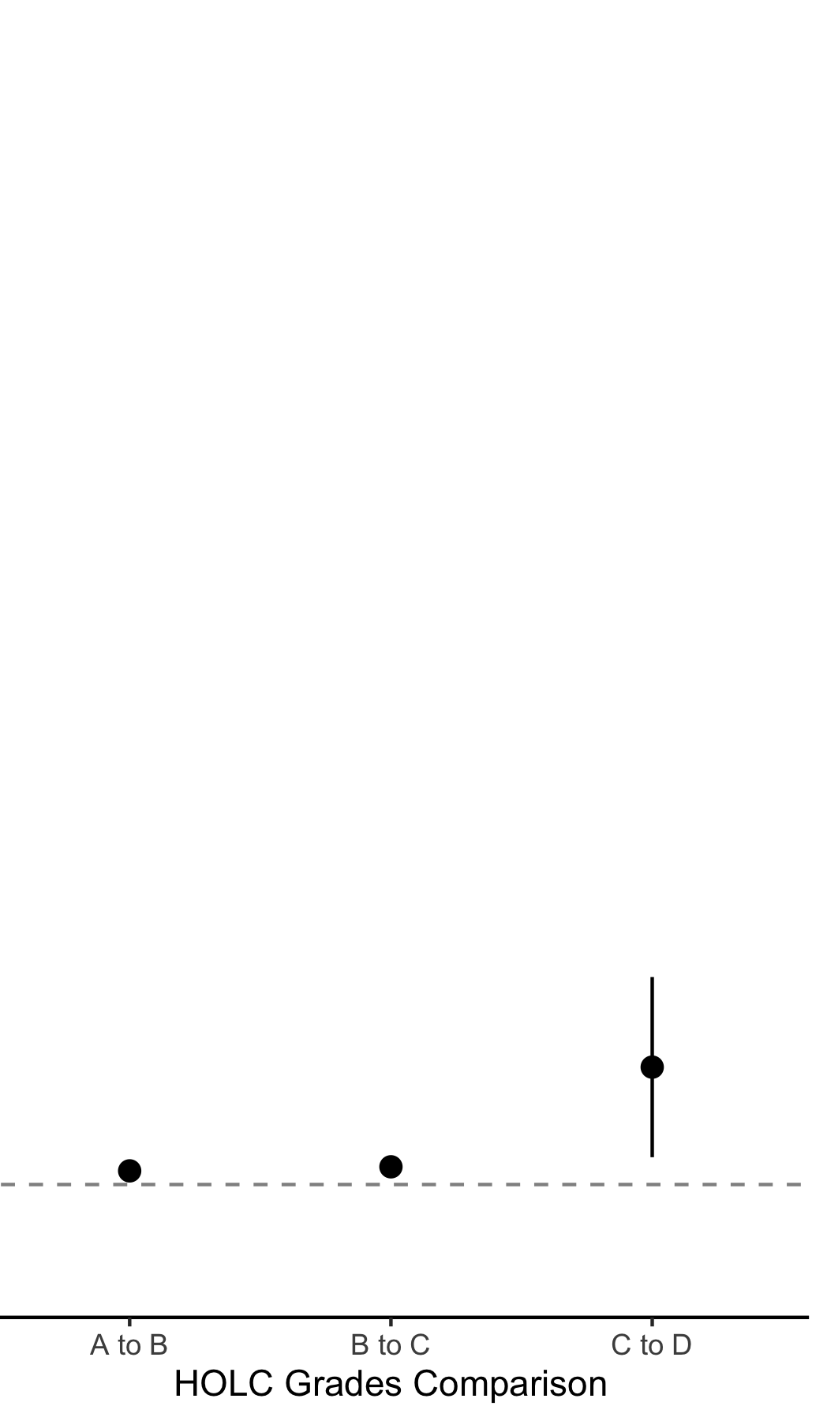
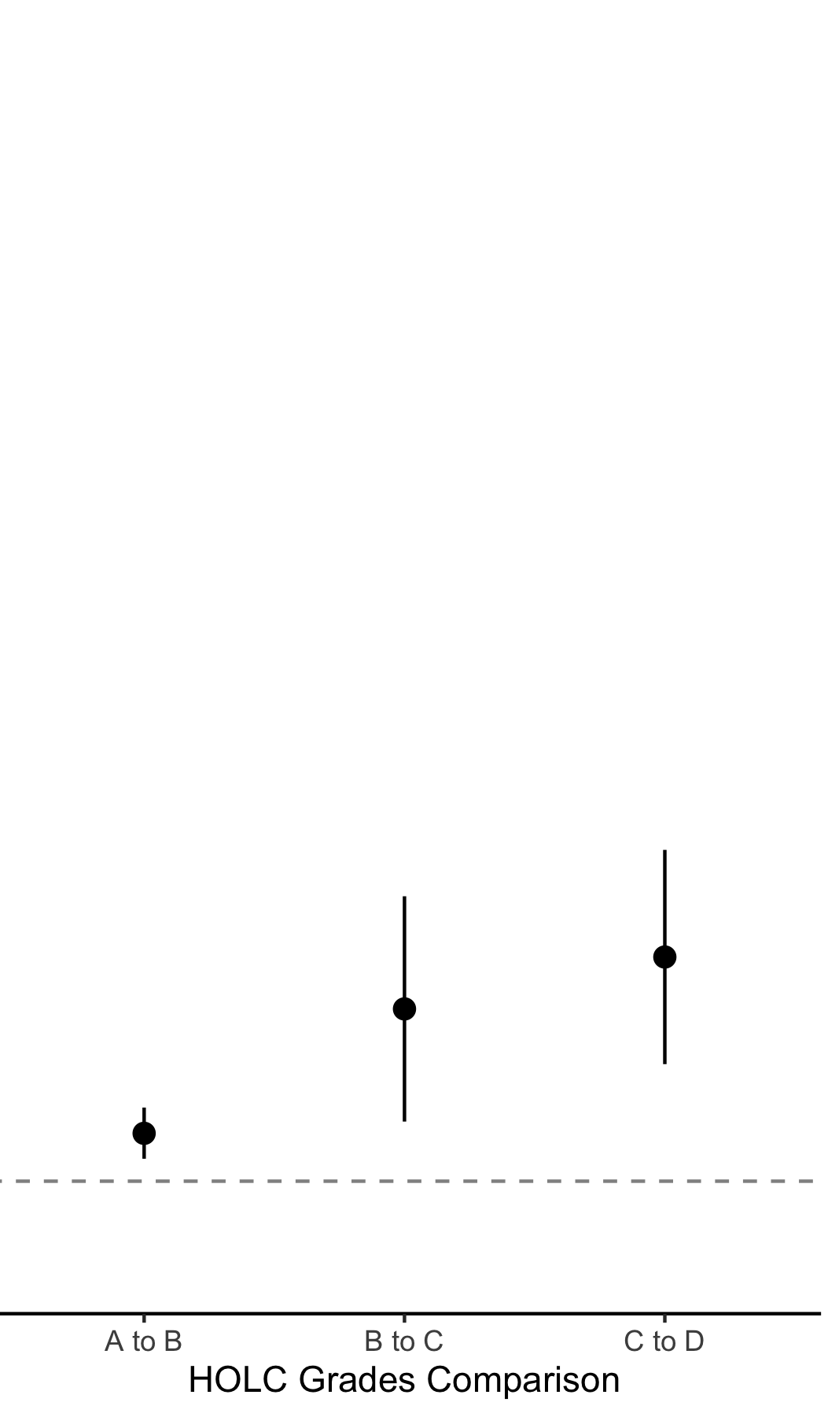
All Wells
Wells Before Appraisal
Wells After Appraisal
3
2
Δ Wells (n)
1
0
618 1,781 4,451
84 231 940
127 582 1,792
n wells
B-A C-B D-C
B-A C-B D-C
B-A C-B D-C

