Slide 1
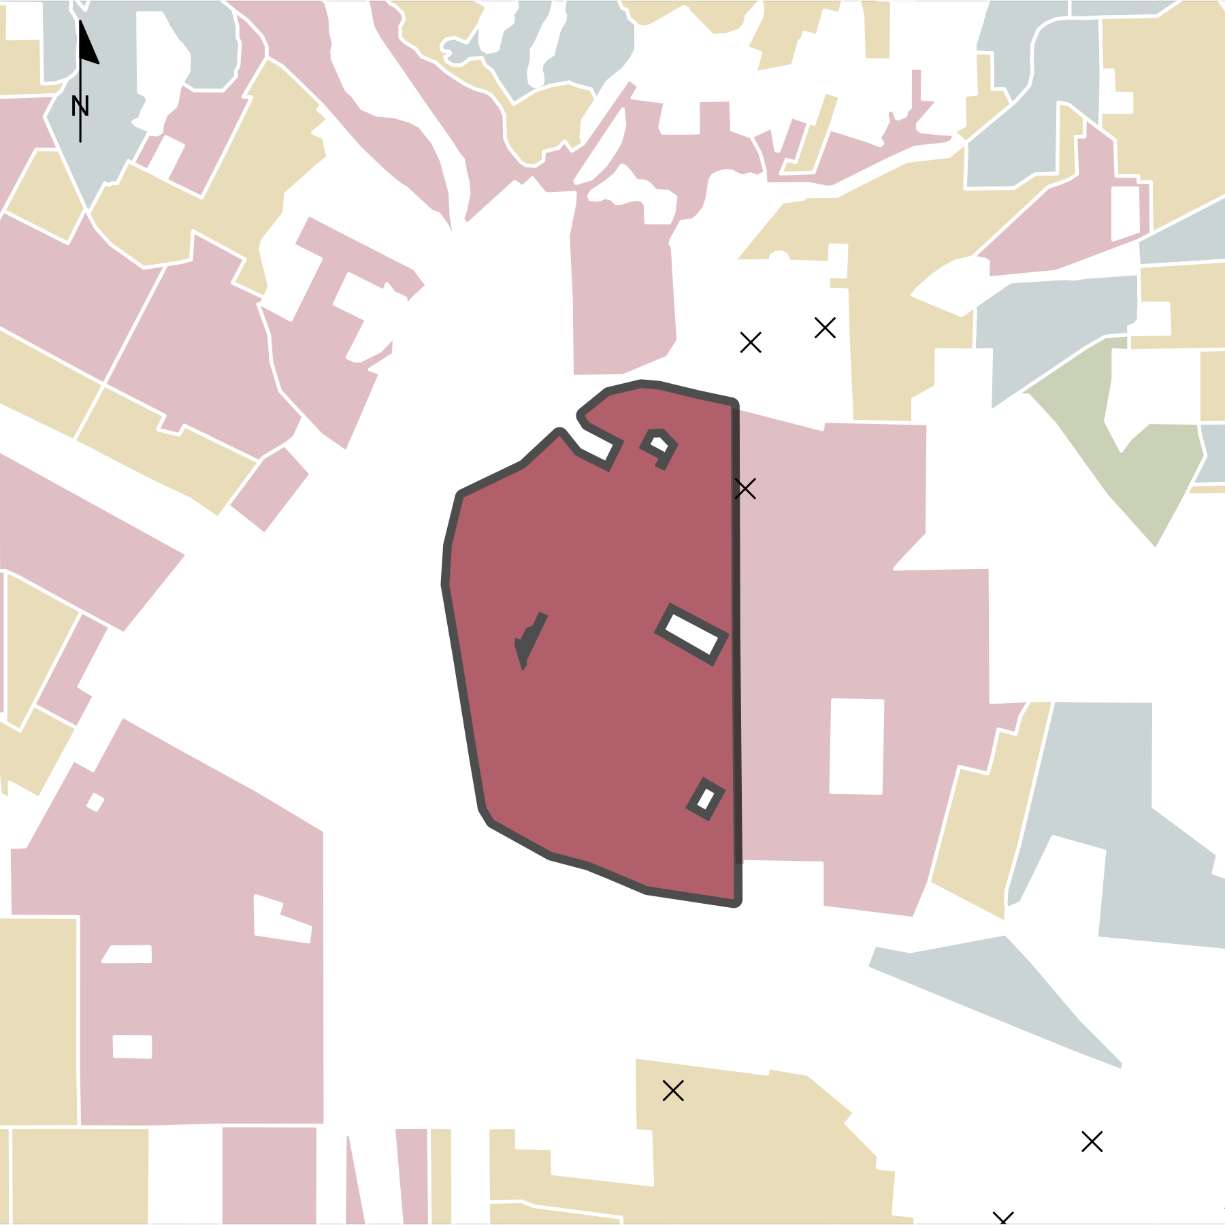
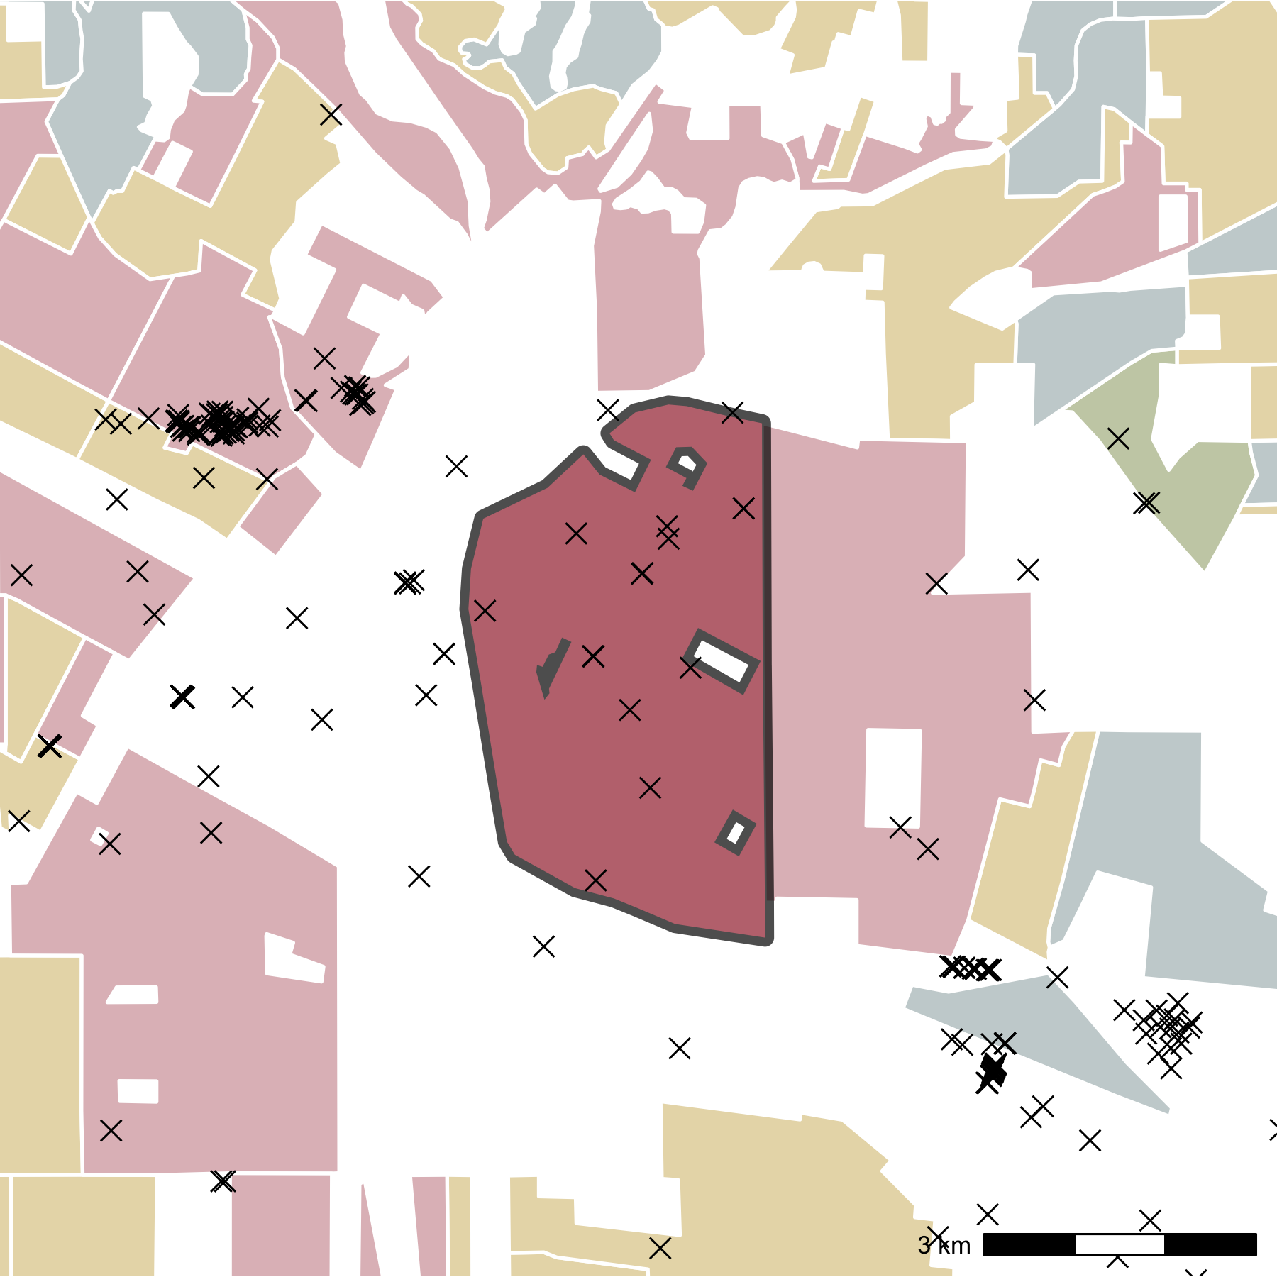
(a)
(b)
HOLC Grade
A
B
C
D
✕
Well

