Slide 1
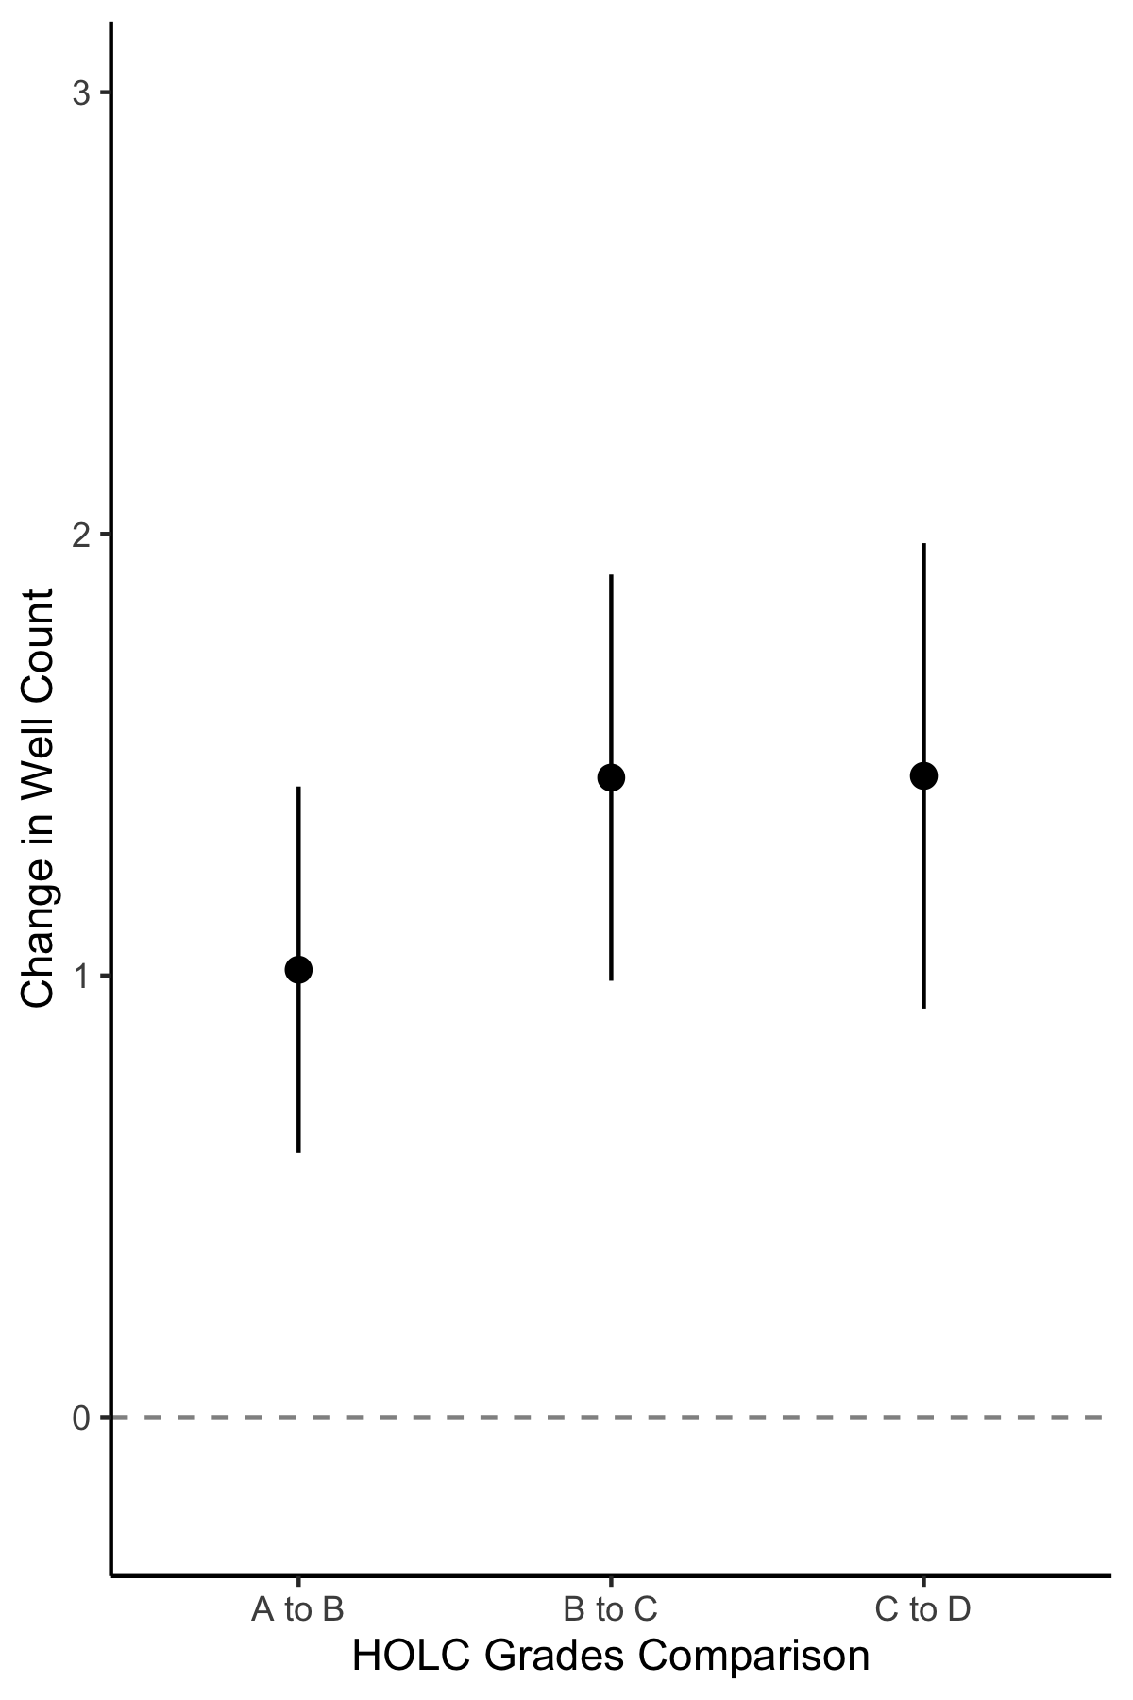
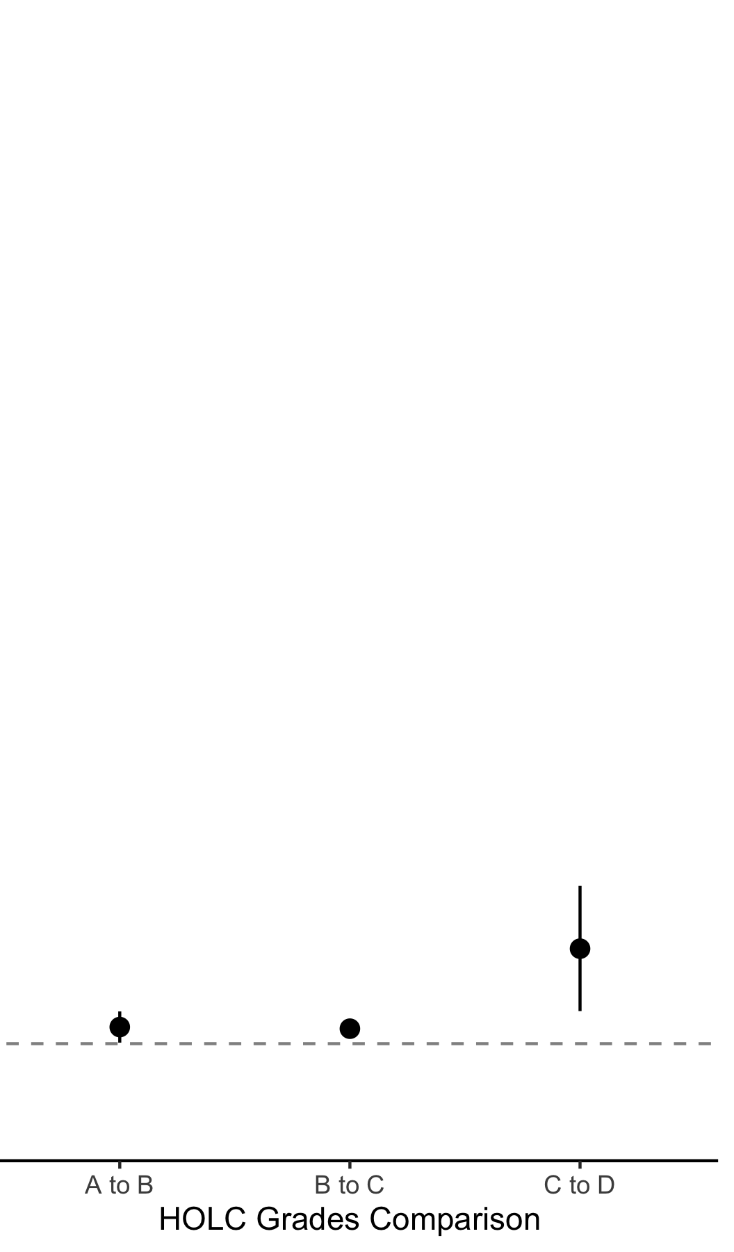
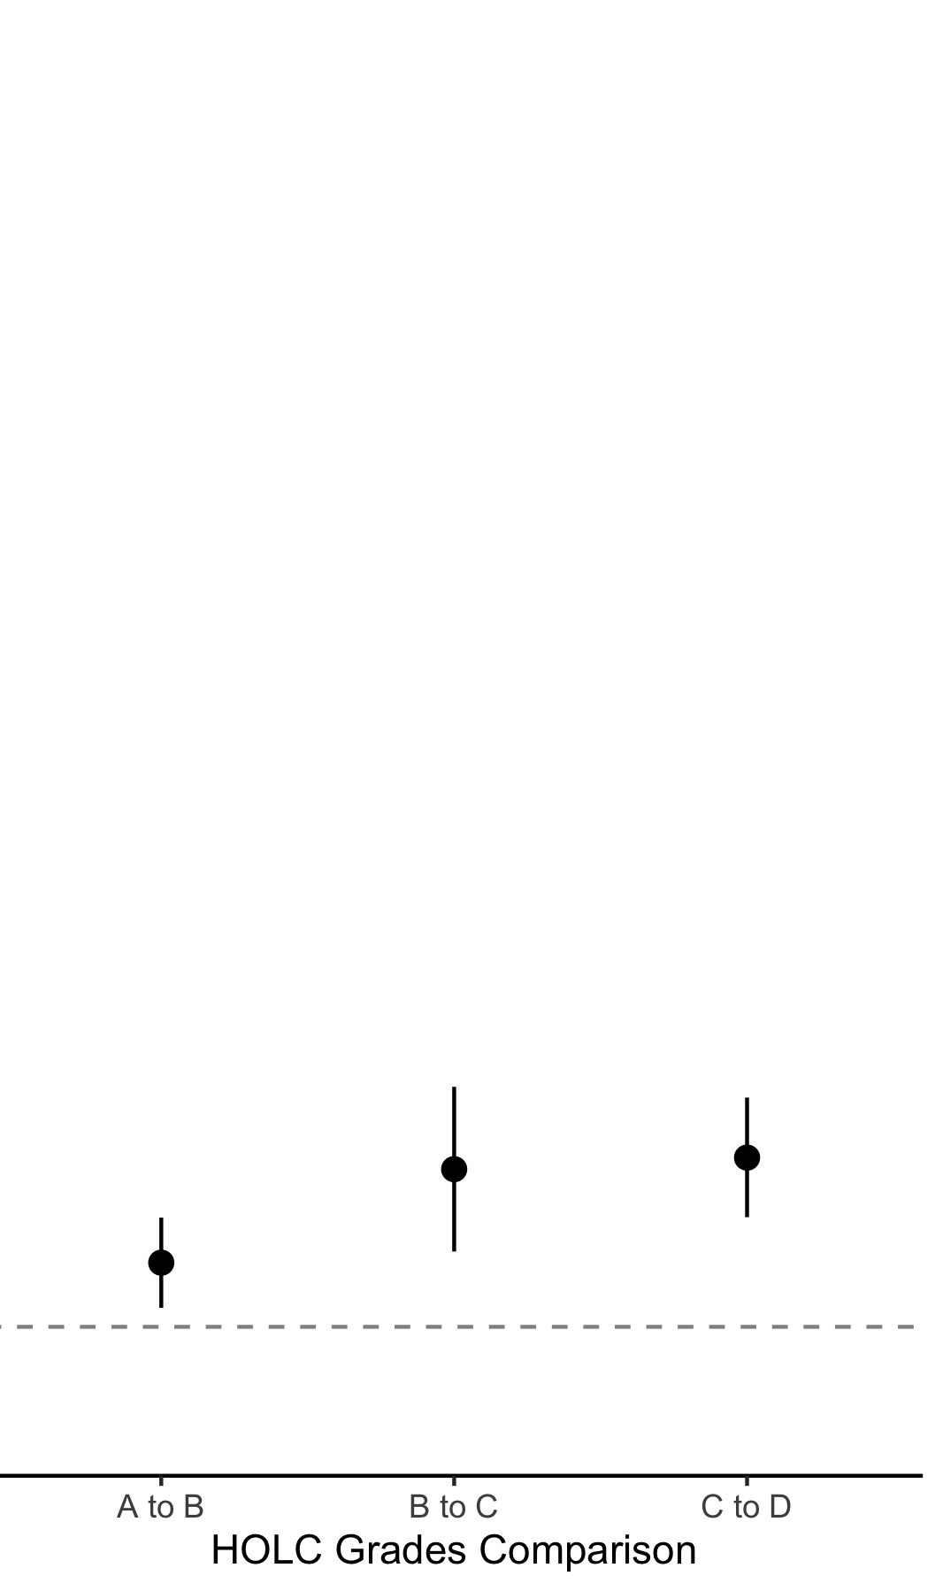
All Wells
Wells Before Appraisal
Wells After Appraisal
3
2
Well Density (n km⁻²)
1
0
B-A C-B D-C
B-A C-B D-C
B-A C-B D-C

