Slide 1
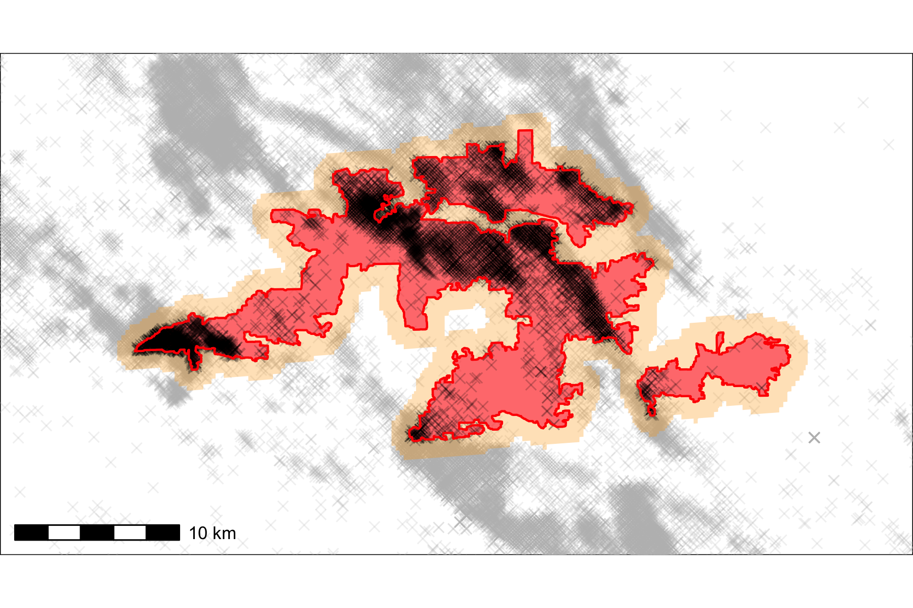
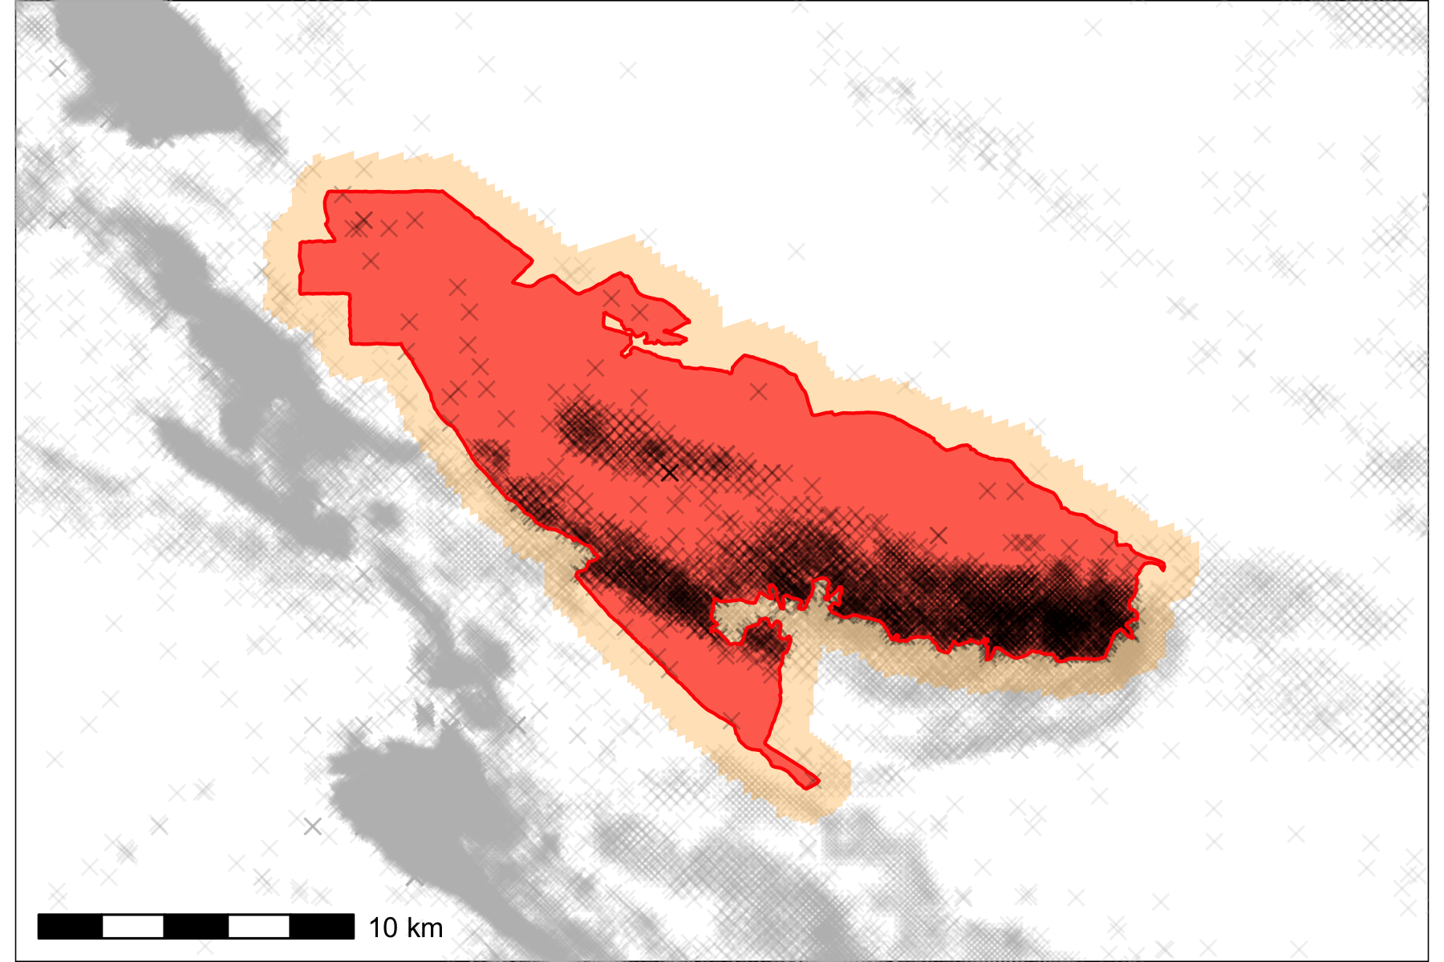
b.
a.
1 km buffers
Locations
New wells
✕
Active wells
✕
Retired wells
✕
Highlighted block group
•
Block group centroid and 1 km buffer

