Slide 1
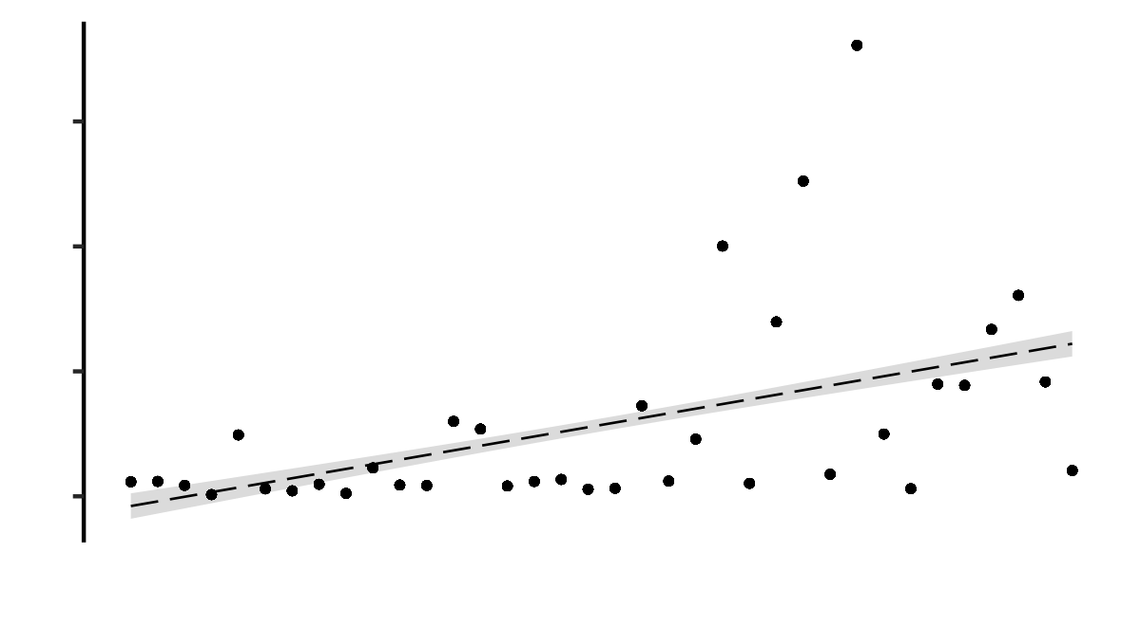
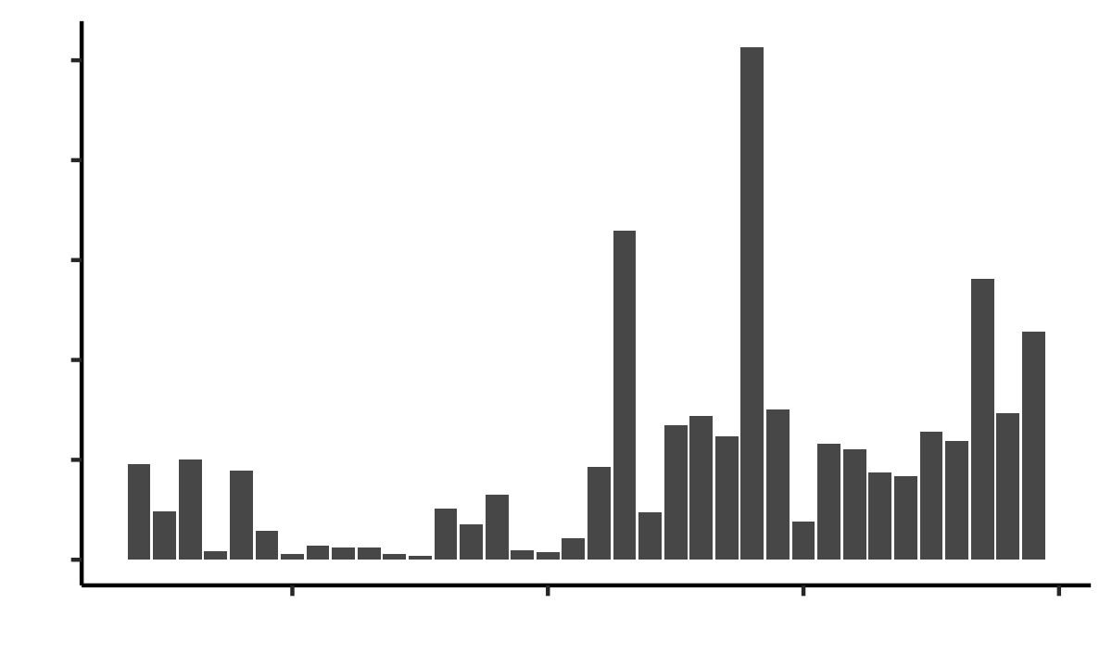
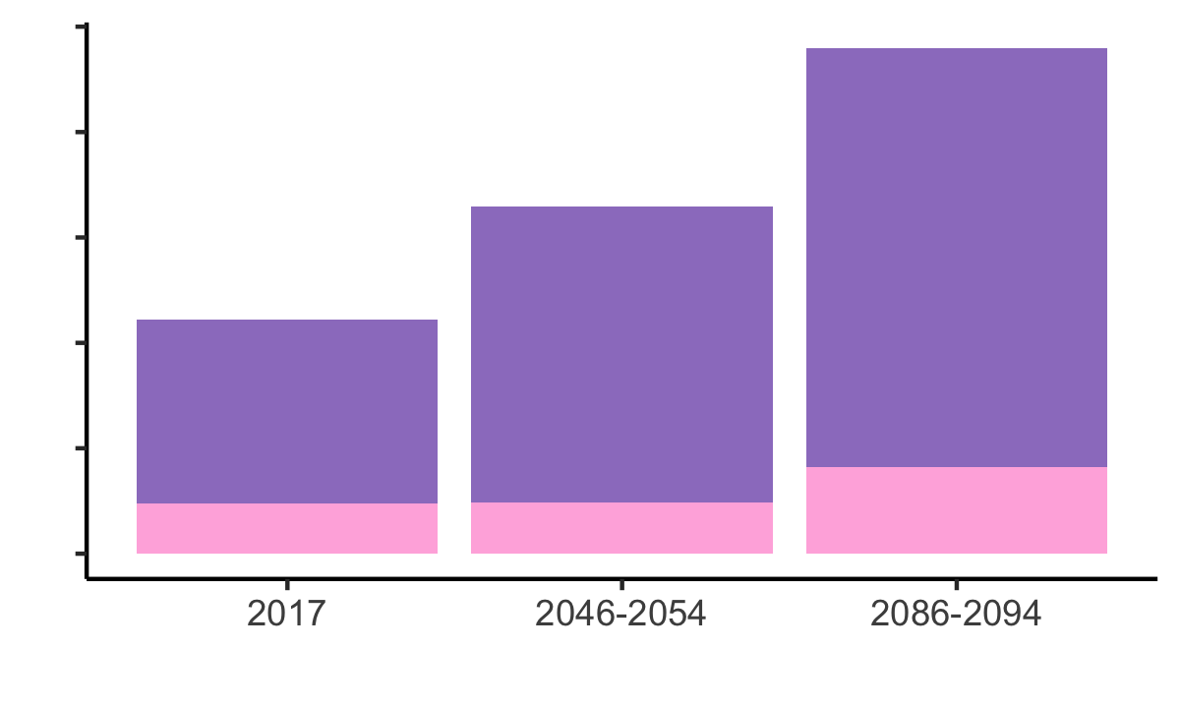
A
Best fit line
15,000
10,000
Wells in wildfire burn areas (n)
5,000
0
50,000
B
40,000
30,000
Pop. within 1 km of wells in burn areas (n)
20,000
10,000
0
1990
2000
2010
Year
C
Moderately high wildfire risk (KBDI ≥ 450)
1.0
High wildfire risk (KBDI ≥ 600)
Wells in areas with wildfire risk (millions)
0.5
0
Time Period

