Slide 1
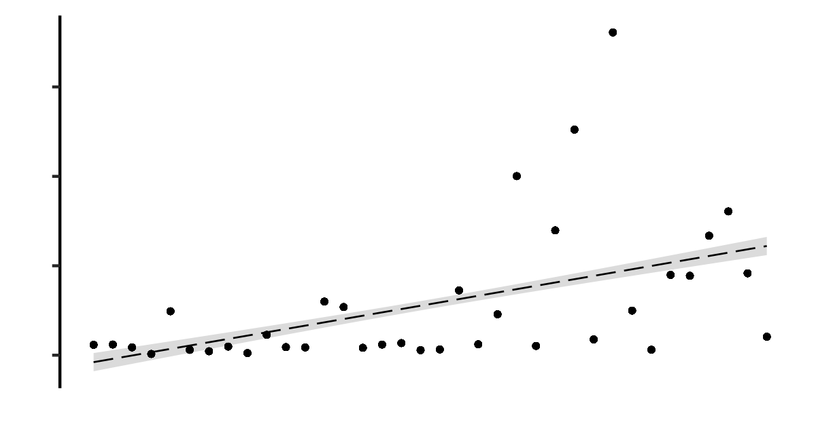
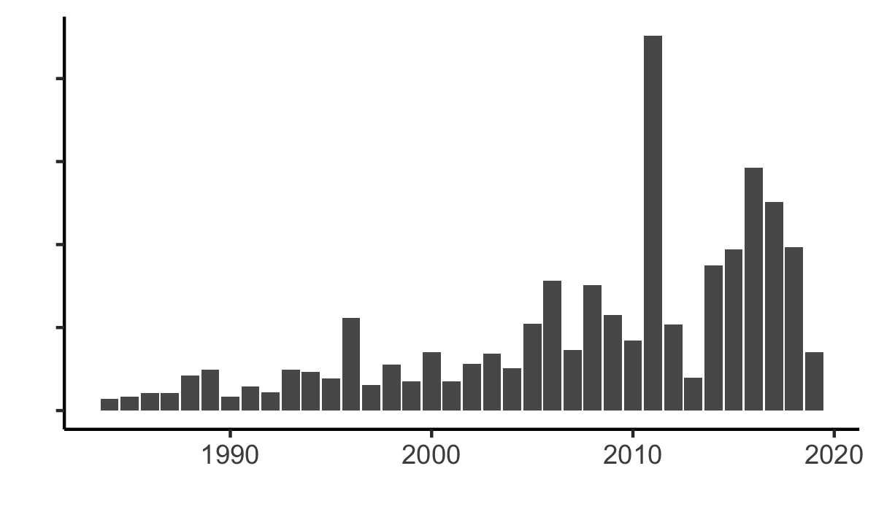
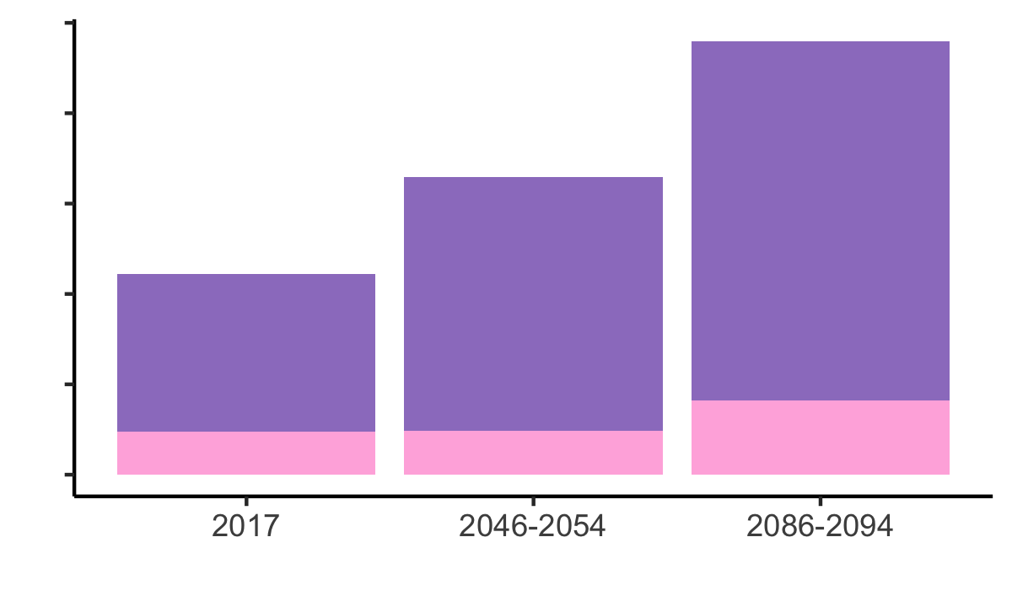
A
15
10
Wells in wildfire burn areas (thousands)
5
0
B
15
Pop. within 1 km of wells in burn areas (millions)
10
5
0
Year
C
Moderately high wildfire risk (KBDI ≥ 450)
1.0
High wildfire risk (KBDI ≥ 600)
Wells in areas with wildfire risk (millions)
0.5
0
Time Period

