Slide 1
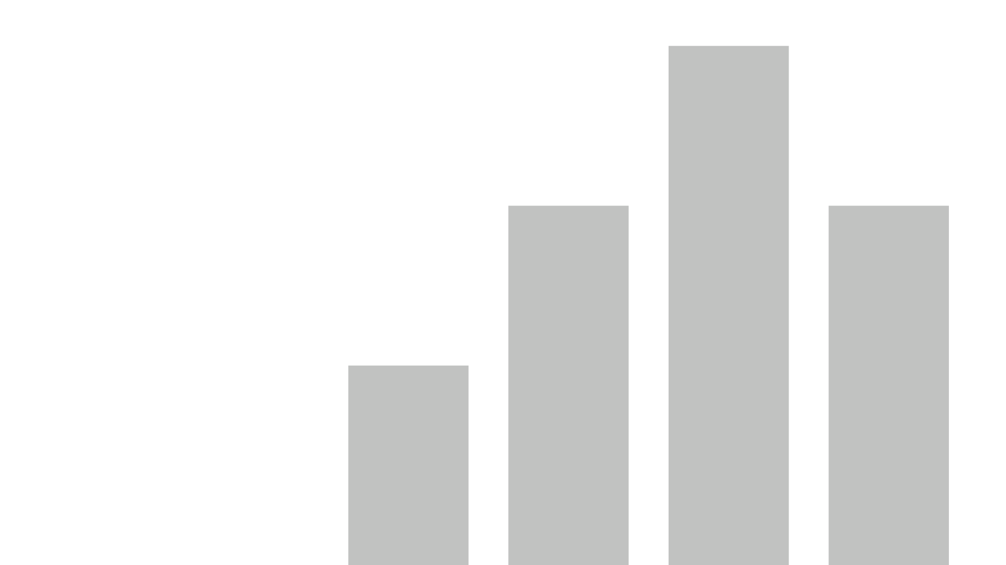


attendance
View in Power BI
Last data refresh:
4/30/2021 10:35:23 AM UTC
Downloaded at:
5/3/2021 10:14:57 PM UTC

Slide 2
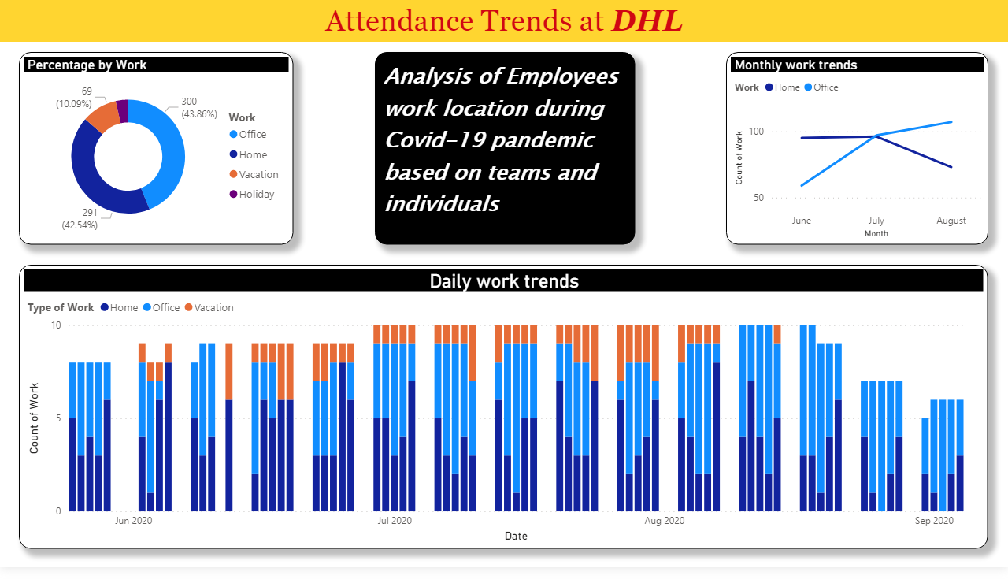
Page 1
Notes:
Daily work trends
No alt text provided.
donutChart
No alt text provided.
Monthly work trends
No alt text provided.
textbox
No alt text provided.
textbox
No alt text provided.

Slide 3
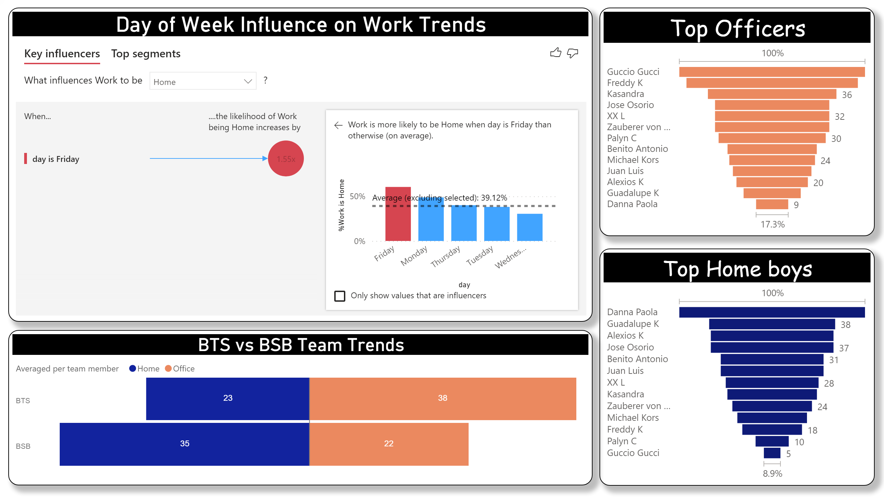
Page 2
Notes:
Top Home boys
No alt text provided.
Top Officers
No alt text provided.
Day of Week Influence on Work Trends
No alt text provided.
BTS vs BSB Team Trends
No alt text provided.

