Slide 1
Introduction
Brownian Motion is a physical phenomenon in which particles suspended in a fluid move on a random walk over time based on their interactions with the surrounding molecules
We attempted to simulate the Brownian Motion of a large, uniform, spherical mass by assuming the surrounding particles are relatively small masses, also spherical and uniform which interact with each other and the main mass only by hard-sphere (“billiard ball”) elastic collisions

Slide 2
Brownian Motion
One measure of the effect of Brownian Motion is the displacement of the main mass after a certain time
Brownian Motion predicts that this displacement will be normally distributed
By running our simulation a large number of times and analyzing the displacements, we can compare them to a normal distribution and thus check whether the simulation is an accurate model of Brownian Motion

Slide 3
Simulation
The program was created using the Visual Python package, which adds three dimensional rendering and utilities to the popular language Python
The program runs in a loop updating the positions and velocities of each object and checking for collisions between objects
Collisions are handled by switching to a frame of reference in which one object is at rest and using projections to treat the three dimensional collision like a one dimensional one
The program can be run intensively, with no graphical display in order to simulate as many trials as possible, or in a demonstration mode to observe the actual motion of the mass
The project is open source and hosted on GitHub: https://github.com/djynth/brownian-motion

Slide 4
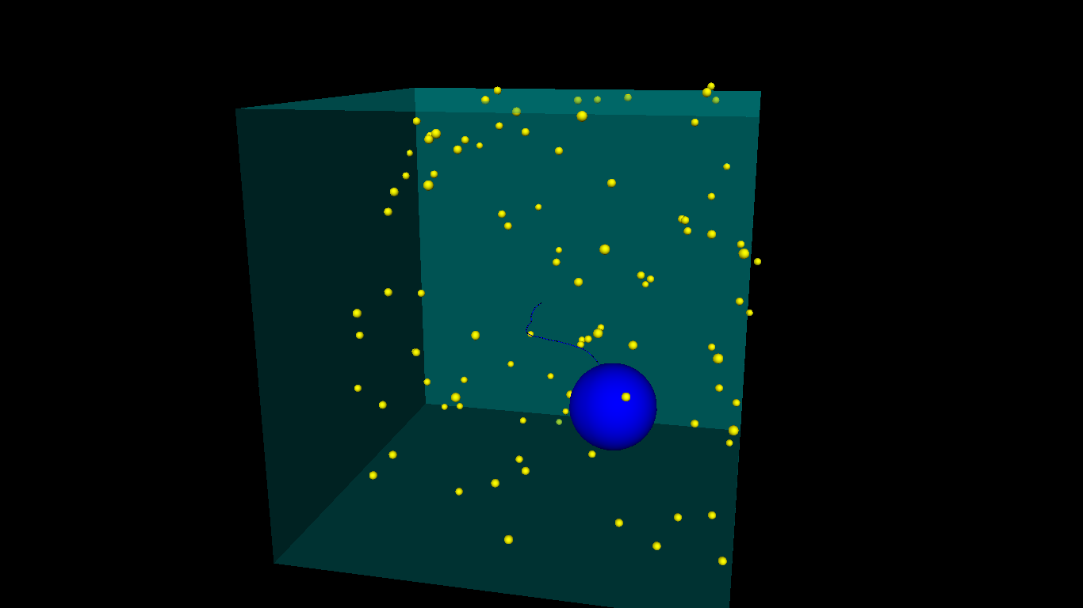

Slide 5
Standard deviations | Fraction of particles | Predicted fraction of particles
1 | 0.672 | 0.68268
2 | 0.956 | 0.9545
3 | 0.996 | 0.9973
4 | 1 | 0.99994
times run: 250
number of particles: 100
simulation time (s): 100
dt (s): 0.25
box size (m): 500.0
mass radius: 100
particle radius: 10
Since the fraction of particles within a certain number of standard deviations from the mean was similar to the predicted values, we can conclude that the data are normally distributed
  That is, the distance from the origin after a certain time is normally distributed

Slide 6
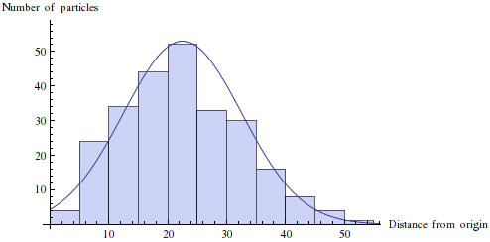
When there are many particles, the distribution of particles' distances from the origin approximates a normal curve
times run: 250
number of particles: 100
simulation time (s): 100
dt (s): 0.25
box size (m): 500.0
mass radius: 100
particle radius: 10

Slide 7
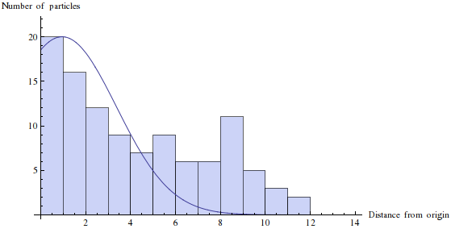
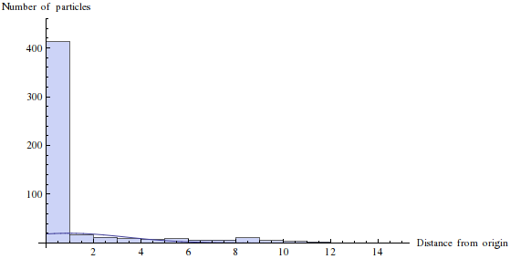
times run: 500
number of particles: 1
simulation time (s): 100
dt (s): 0.25
box size (m): 500.0
mass radius: 100
particle radius: 10
Zeros removed
Zeros not removed

Slide 8
Conclusion
As we hoped, the distribution of the displacement of the main mass is normal
With a smaller number of particles, the distribution is heavily skewed and no longer normal
We conclude that conventional Brownian Motion does arise in our simplified simulation, and so it could be appropriate for studying the random walks that arise by Brownian Motion

