Slide 1

Netflix Movie Recommendation
RNS INSTITUTE OF TECHNOLOGY
BENGALURU - 98
DEPARTMENT OF INFORMATION SCIENCE & ENGINEERING
Presentation on Internship Project
Jyothsna D
USN: 1RN18IS056
New Age Solutions Technologies
Internal Guide | External Guide
Mrs. Kusuma R | Mr. Aman Upadhyay
Asst. Prof, Dept of ISE, RNSIT | NASTECH

Slide 2
AGENDA
Abstract
About the Company
Introduction
Literature Survey
Requirements
System Design
Implementation
Results
Conclusion
Future Enhancements
References
Q & A

Slide 3
ABSTRACT
Recommendation Systems are a type of information filtering systems as they improve the quality of search results and provides items that are more relevant to the search item or are related to the search history of the user.
They are used to predict the rating or preference that a user would give to an item.
This recommender system is a simple algorithm whose aim is to provide the most relevant information to a user by discovering patterns in a dataset.

Slide 4
About the Company
Established in 1998, NASTECH is one of the leading providers of IT solutions and services that specializes in offering up to-date technological solutions aimed at facilitating the digital transformation of SMEs and global corporations.
NASTECH is specialized in creating effective solutions through proper analysis, consultation, design and testing. The company is able to successfully address the challenges that stand in the clients way.
Goal of the company is to keep clients on the leading edge of information transfer technologies, adding significant value to their business and accomplish this by creating a long-term relationship with each partner by combining creative and cost effective solutions.

Slide 5
INTRODUCTION
A recommendation system or recommendation engine is a model used for information filtering where it tries to predict the preferences of a user and provide suggestion based on these preferences.
Movie Recommendation Systems helps us to search our preferred movies among all of these different types of movies and hence reduce the trouble of spending a lot of time searching for our favorable movies.
So, it requires that the movie recommendation system should be very reliable and should provide us with the recommendation of movies which are exactly same or most matched with our preferences. These systems collect information about a user's preferences and behavior, and then use this information to improve their suggestions in the future.

Slide 6
LITERATURE SURVEY
Over the years, many recommendation systems have been developed using many different algorithms, one of them is using K-Means Clustering and K-Nearest Neighbor. Clustering is a process to group a set of objects in such a way that objects in the same clusters are more similar to each other than to those in other clusters. K-Means Clustering along with K-Nearest Neighbor is implemented in order to obtain the best-optimized result[1].
The process of recommendation of a movie is optimized in the proposed scheme where the recommender system predicts the user’s preference of a movie on the basis of different parameters.

Slide 7
Requirements
Hardware requirements:
Processor: Pentium Dual Core (upgraded), AMD
Processor Speed: 1.3GHz
RAM: 1GB
Hard Disk Capacity: 40 GB
Standard Output Display and Keyboard
Software requirements:
Operating System: Windows 10
Anaconda Navigator
Jupyter Notebook/Jupyter Lab
Python3
Libraries: numpy, pandas, sklearn, surprise.

Slide 8
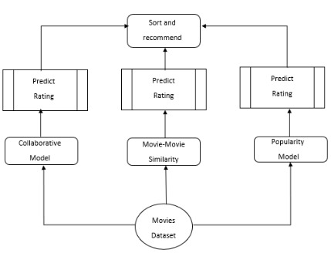
System Design
System Architecture

Slide 9
• Demographic Filtering- They offer generalized recommendations to every user, based on movie popularity and/or genre. The System recommends the same movies to users with similar demographic features. The basic idea behind this system is that movies that are more popular and critically acclaimed will have a higher probability of being liked by the average audience. Since each user is different, this approach is considered to be too simple.
• Content Based Filtering- They suggest similar items based on a particular item. This system uses item metadata, such as genre, director, description, actors, etc. for movies, to make these recommendations. The general idea behind these recommender systems is that if a person liked a particular item, he or she will also like an item that is similar to it.
• Collaborative Filtering- This system matches persons with similar interests and provides recommendations based on this matching. Collaborative filters do not require item metadata like its content-based counterparts.

Slide 10
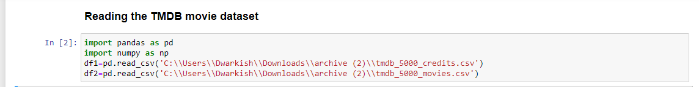
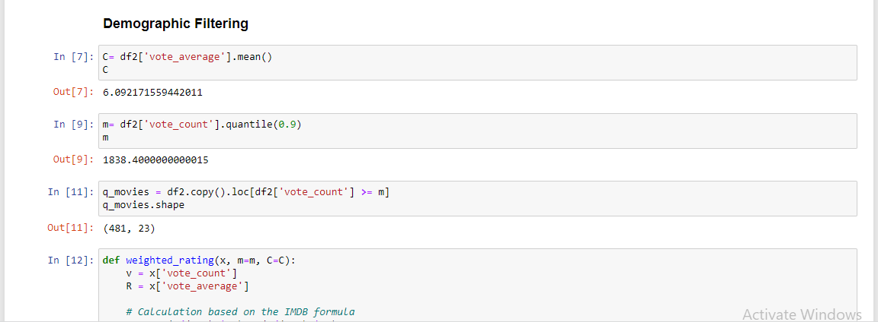
Implementation

Slide 11
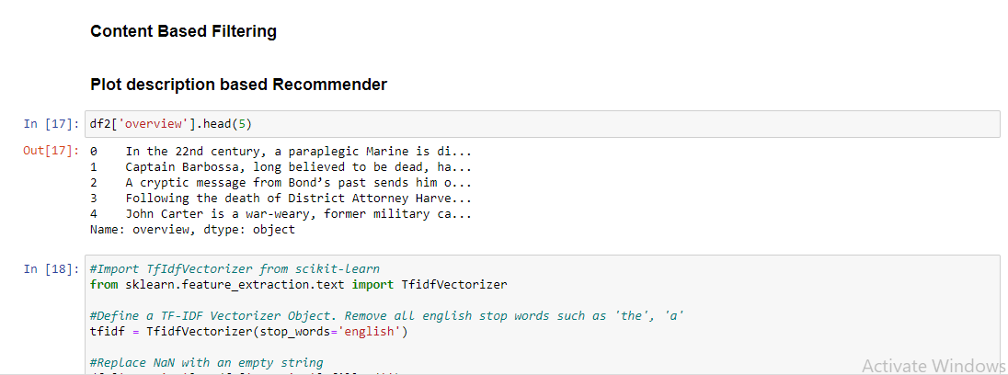
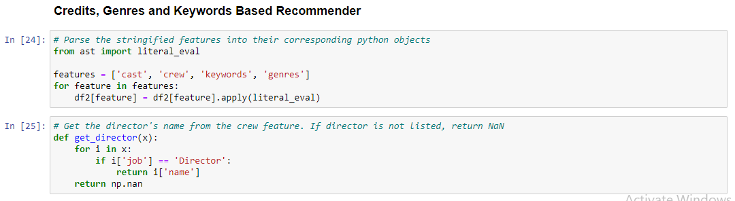

Slide 12
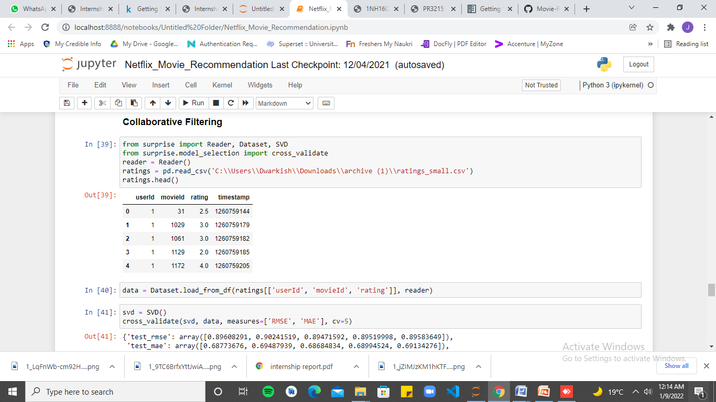

Slide 13
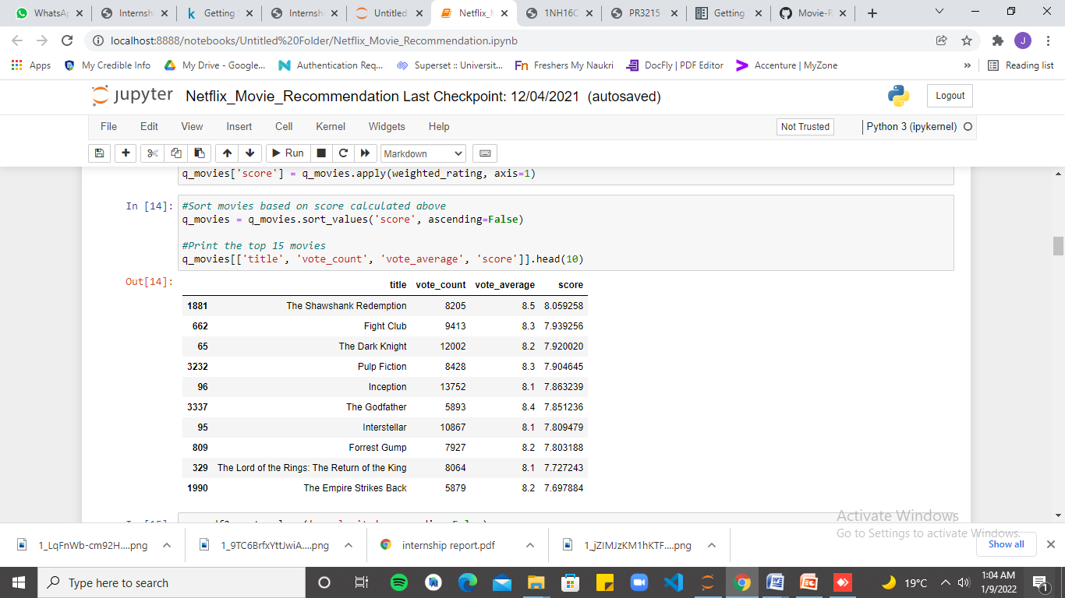
RESULTS

Slide 14
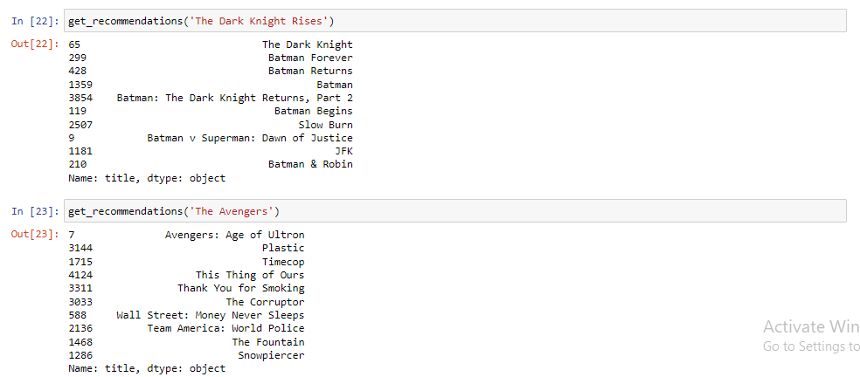

Slide 15
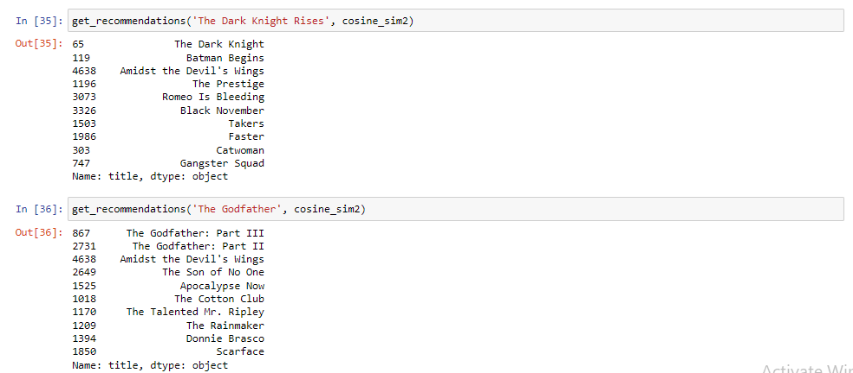
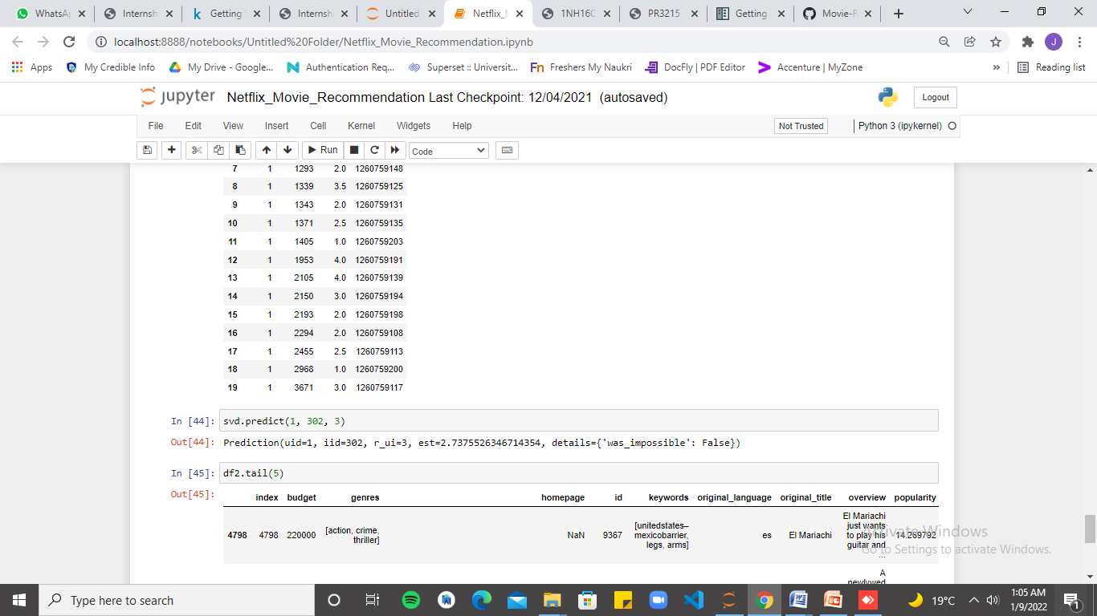

Slide 16
CONCLUSIONS
The recommender is created using demographic, content-based and collaborative filtering techniques. While demographic filtering is very elementary and cannot be used practically, the proposed systems can take advantage of content-based and collaborative filtering as the two approaches are proved to be almost complimentary.
In this project, the hybrid approach by unifying two filtering techniques i.e., content based filtering and collaborative filtering: using Singular Value Decomposition (SVD) as a classifier and Cosine Similarity is presented to improve the accuracy, quality and scalability of movie recommendation system.
Also, computing time of the proposed approach is lesser than the other two pure approaches.

Slide 17
FUTURE ENHANCEMENTS
A possible extension of the this model is creating a feature vector for model and training a neural network to learn the importance or the weights of each model. Such a linear combination model can highly improve the recommendations. Learning to rank using deep learning methods is another possible extension.
Currently, the implemented model is experimented using a small dataset. Extending this to the larger dataset and observing the results is yet another future task.

Slide 18
REFERENCES
[1] Ahuja, Rishabh, Solanki, Arun; Nayyar, Anand (2019). [IEEE 2019 9th International Conference on Cloud Computing, Data Science & Engineering (Confluence) - Noida, India (2019.1.10-2019.1.11)] Movie Recommender System Using K-Means Clustering AND K-Nearest Neighbor. doi:10.1109/CONFLUENCE.2019.8776969
[2] Sharma, Poonam and Yadav, Lokesh Yadav, Movie Recommendation System Using Item Based Collaborative Filtering (2020). International Journal of Innovative Research in Computer Science & Technology (IJIRCST), ISSN: 2347-5552, Volume-8, Issue-4, July 2020
[3] https://en.wikipedia.org/wiki/Recommender_system
[4] https://www.analyticssteps.com/blogs/what-are-recommendation-systemsmachine- learning
[5] https://www.kaggle.com

Slide 19
Question and Answer

Slide 20
THANK YOU

