Slide 1
Large-scale Particle Deposition Rate Parallel Computation Using Openmp and mapreduce
Jinze Du

Slide 2
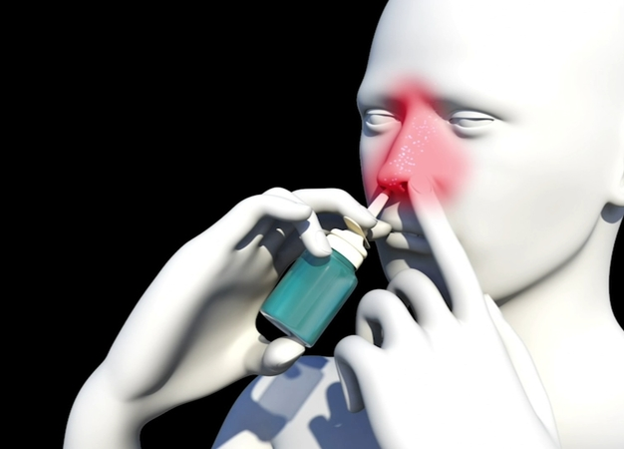
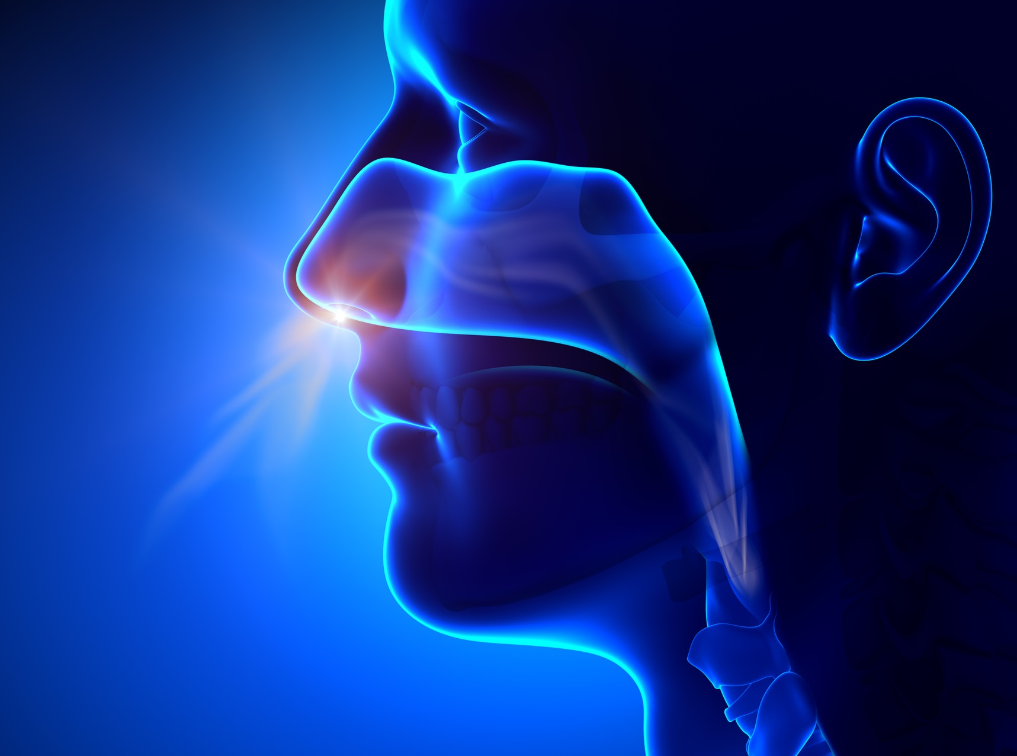
Application background:
Nasal spray show promise in preventing COVID-19 infections.
Computation modeling is needed to quantify is novel protection method.

Slide 3
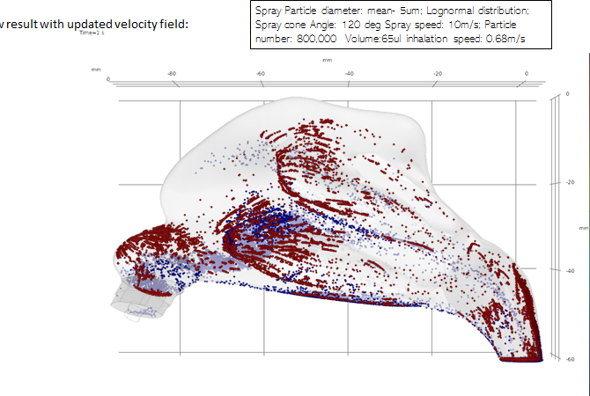
Spray particle and viral particle distribution:
Simulation parameters:
Volume: 102ul
Particles Diameter: Log normal distribution
Particle Number: 1.8M
Spray Speeds: 0, 3, 5, 9, 14, 18 (m/s)
Inhalation speed: 0.68, 1.74, 2.74 (m/s)
Cone angle: 30 to 90 degrees
Viral particles:
Uniform distribution
300,000 particles (volume 13 ul)

Slide 4
Data structure: Storing 3.6 million particles in total
 | X coordinate | Y coordinate | Z coordinate | Particle diameter
Viral particle #1 | -1.0007 | -0.00006 | 2.00008 | 0.000001
….
Viral particle #N | 2.00008 | -1.0007 | -0.00006 | 0.000005
 | X coordinate | Y coordinate | Z coordinate | Particle diameter
Spray particle #1 | -1.0007 | -0.00006 | 2.00008 | 0.000001
…
Spray particle #N | 2.00008 | -1.0007 | -0.00006 | 0.000005

Slide 5
Current implementation:
Viral Particle
For each viral particle, go through all spray particles to see if it is covered.
If covered, remove viral particle; Otherwise, keep it;
After loop is finished, compare the viral particles left with the original particle number, get the protection rate value;
Complexity: O(N^2)
Not covered
Spray Particle
Covered

Slide 6
Propose OpenMP implementation:
As calculation for each viral particle is independent from other viral particles, OpenMP and mapreduce would be a good option to alleviate the computation complexity faced.
Calculation speed benchmark comparison will be plotted.
If time allows, movie visualization of how particles flow and deposite inside nasal model will be conducted.

