Slide 1
A * routing
Mazen amr eid
900161021

Slide 2
The problem
The problem to solve is that after placing the cells, we need to create the shortest path for each pair of pins to be routed.
We can use Metal 1, Metal 2 and Metal 3 to wire them.
The Algorithm we will use is the A*.

Slide 3
Structure
The project is structured in 2 packages as follows:
GUI package containing:
GUI/Main class which calls the Algorithm/Main and when done, takes all its data and displays them on screen.
GUI/Controller class which is an interface between the GUI/Main and the Algorithm/Main. The Algorithm/Main transfers the data to the GUI/Main using the Controller instance.
Algorithm Package containing:
A Maze class which represents an abstraction of the AStar class to facilitate the methods that will be used by the Algorithm/Main class.
The A* algorithm in the AStar class and each node in its search area is represented in the Node class. The search area is a 3d array with each dimension representing a metal layer.

Slide 4
Algorithm/Main
The user is prompted to enter the source and target pins coordinates.
If they are valid, the shortest path is searched using the findShortestPath() method from the AStar class and the CPU time as well as the cost are calculated for each path.
If they are not valid, which may occur because the entered coordinates are either in an already occupied node or the coordinates are negative or exceeding the grid’s dimensions, the user is re-prompted to enter them again.
The updated grids are then displayed with the new path in it and with the cost and CPU time. Then if the user he wants to enter new pins, he can press on the new cells button.

Slide 5
Algorithm/Astar (1)
We have a priority queue (openList), we iterate until either it is empty or when the target has been polled (i.e. was at the top of the priority queue).
At every iteration, we add the polled node to the closedList, which is a set of the visited nodes in the path that we don’t want to check again, then check if it is the final node, if it is then we return the path, otherwise we add its adjacent nodes.
Adding the adjacent nodes is discussed in the next slide.
Returning the path is simply done by backtracking the parent of each node from the target element (last polled) all the way to the very first node (the source).

Slide 6
ALGorithm/astar (2)
To add the adjacent nodes of a current node:
If the current node is in Metal 1: we check the node that is in its left column, right column, and the node which is in the higher layer (Metal 2).
If the current node is in Metal 2: we check the node that is in its upper row, lower row, and the node which is in the higher layer (Metal 3) and lower layer (Metal 1).
If the current node is in Metal 3: we check the node that is in its left column, right column, and the node which is in the lower layer. (Metal 2).
Checking a node is checking if it is not an obstacle (already occupied) and not already in the closedList, if so, then if it was not in the openList, we add it to it, set the current node to be the parent of the node that we are checking (the adjacent node) and set its cost, otherwise just update it by removing it and re-adding it once more so the priority queue reorders itself with the modified final cost of the recently added node.
The Cost that we set to the node when we add it to the openList is either the cost of a movement in the same layer (in the case of a row movement in Metal 2 or column movement in Metal 1 or 3) or the cost of a metal to metal transition (via, in the case of a layer transition).

Slide 7
GUI
GUI/Main: Calls the Algorithm/Main and once it terminates, it takes each metal grid as well as a list of all the routed nodes and pins and displays them on screen.
GUI/Controller: Serves as the interface between the Algorithm/Main and GUI/Main the Algorithm/Main passes the data to the GUI/Main via this Controller class (and some static fields in the GUI/Main).

Slide 8
How to use?
From the src directory:
Run the code from the GUI/Main.class using your favorite IDE or command interpreter.
You will be prompted to enter the grids width, height and vias cost in the console.
Then enter the source and target coordinates (Please note that the coordinates start from index 0).
The path will then be displayed on a beautiful GUI and both the cost and the CPU Time will be in the console (will make it in the GUI later). To enter new cells, just press on new cells from the GUI and repeat step 3.
And when you are done just close the window.

Slide 9
TestCases

Slide 10
TestCase 1
Width: 8, Height: 8, Via Cost: 10
Source: (0,0,0), Target:(7,7,2), Cost = 37, CPU Time = 2977000ns
Source: (2,3,1), Target:(5,6,1), Cost = 29, CPU Time = 1100000ns
Source: (1,1,1), Target:(0,5,0),
Target cell in a node that is already occupied! (this is shown in the console)
Source: (2,3,0), Target:(4,4,2), Cost = 26, CPU Time = 805000ns

Slide 11
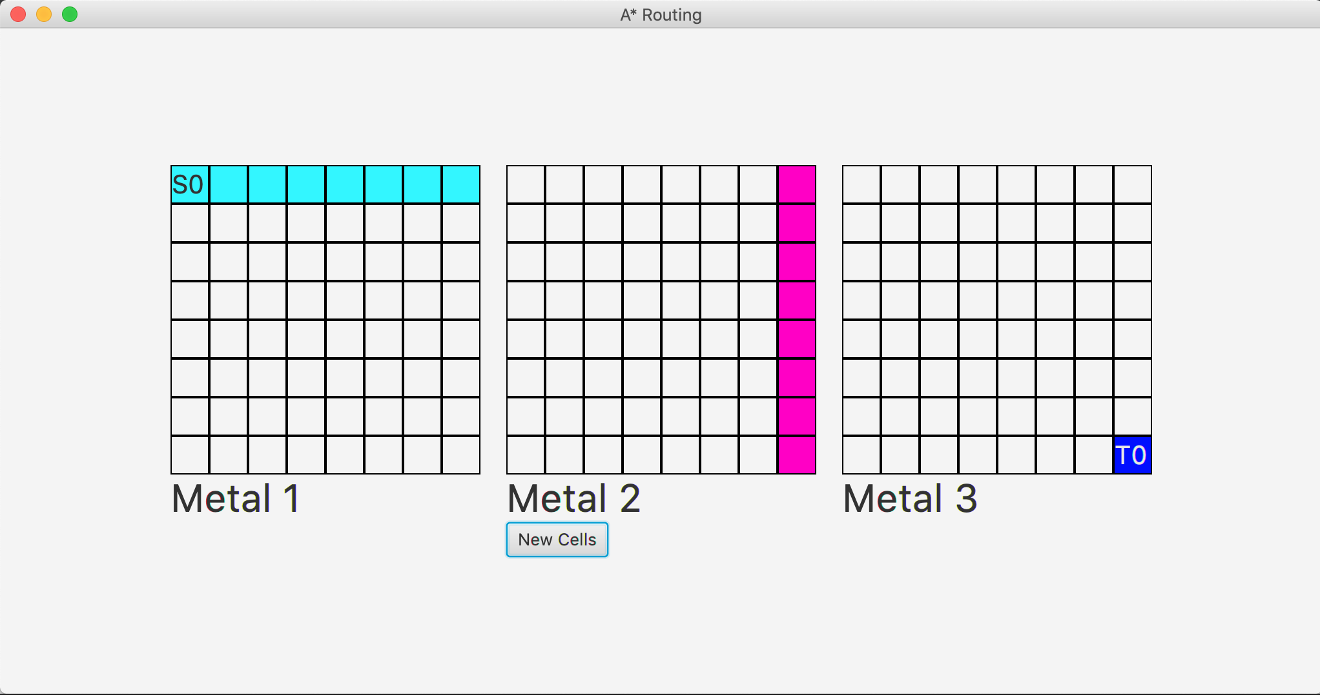
Source: (0,0,0), Target:(7,7,2), Cost = 37, CPU Time = 2977000ns

Slide 12
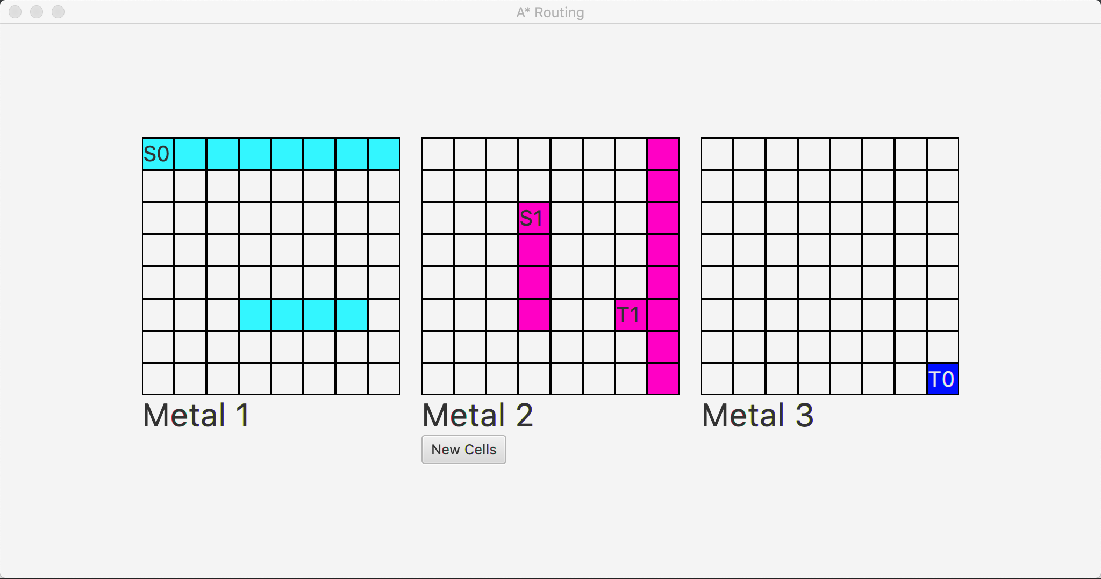
Source: (2,3,1), Target:(5,6,1), Cost = 29, CPU Time = 1100000ns

Slide 13
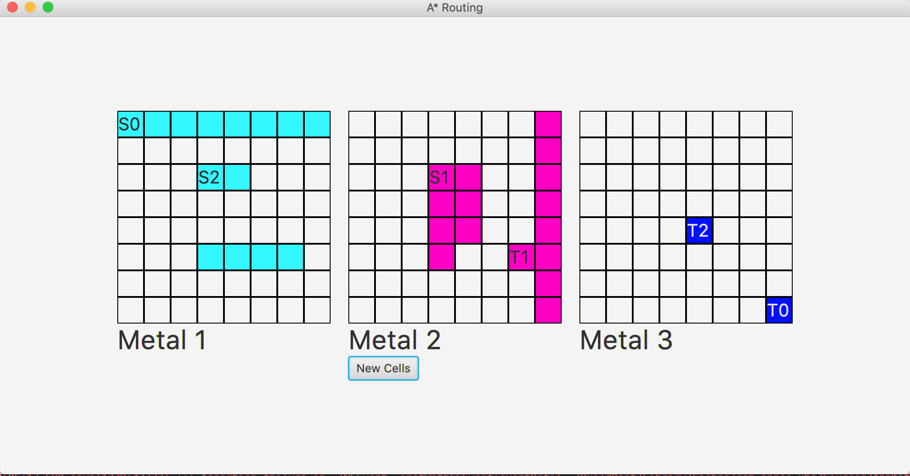
Source: (2,3,0), Target:(4,4,2), Cost = 26, CPU Time = 805000ns

Slide 14
Testcase 2
Width: 10, Height: 10, Via Cost: 20
Source: (4,2,1), Target:(7,6,0), Cost = 29, CPU Time = 1417000ns
Source: (2,3,1), Target:(7,9,0), Cost = 75, CPU Time = 3888000ns
Source: (9,9,0), Target:(6,5,1), Cost = 29, CPU Time = 473000ns
Source: (2,2,2), Target:(5,5,1), Cost = 28, CPU Time = 538000ns
Source: (1,1,1), Target:(0,0,0), Cost = 24, CPU Time = 190000ns
Source: (5,0,2), Target:(9,1,2), Cost = 48, CPU Time = 1065000ns

Slide 15
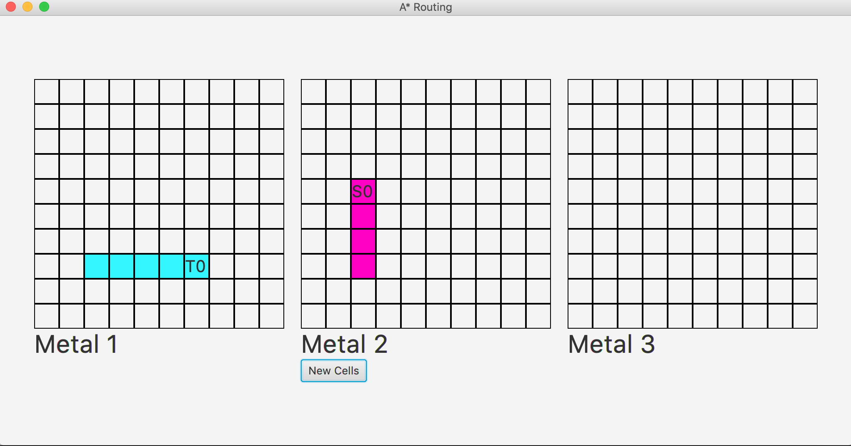
Source: (4,2,1), Target:(7,6,0), Cost = 29, CPU Time = 1417000ns

Slide 16
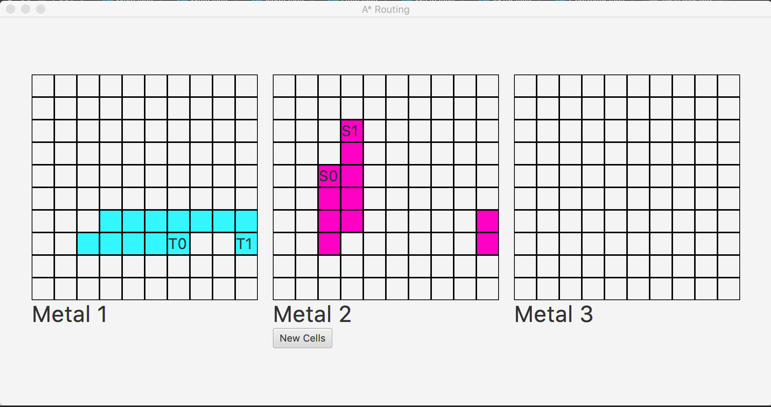
Source: (2,3,1), Target:(7,9,0), Cost = 75, CPU Time = 3888000ns

Slide 17
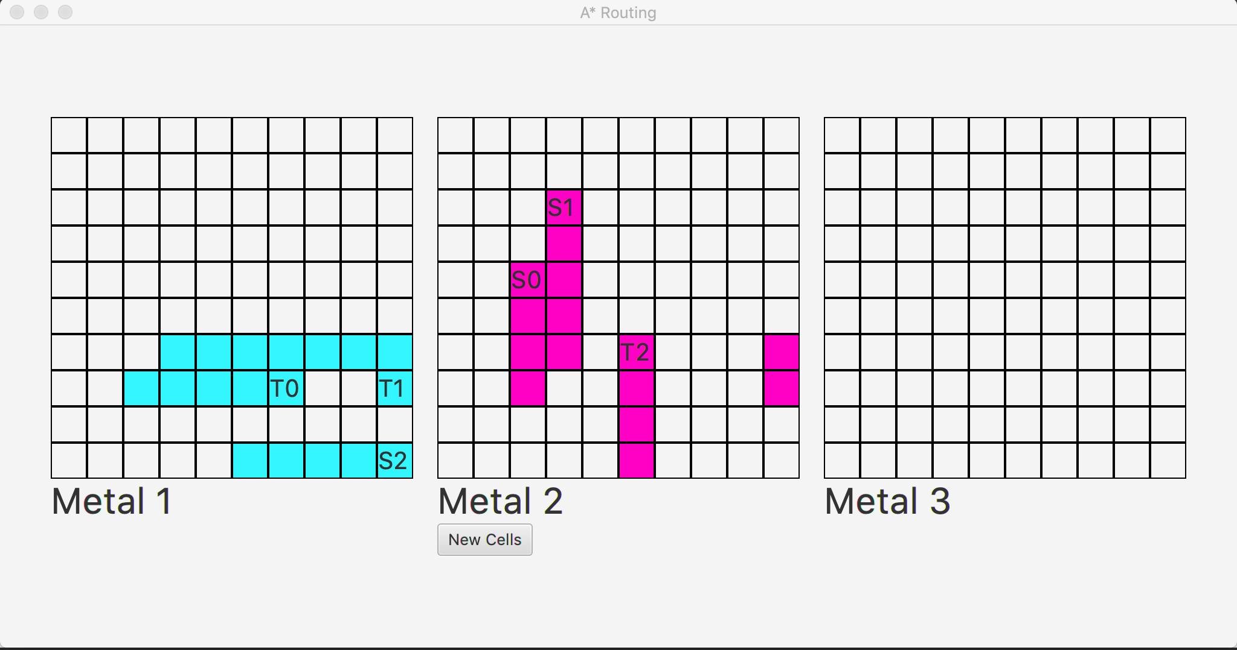
Source: (9,9,0), Target:(6,5,1), Cost = 29, CPU Time = 473000ns

Slide 18
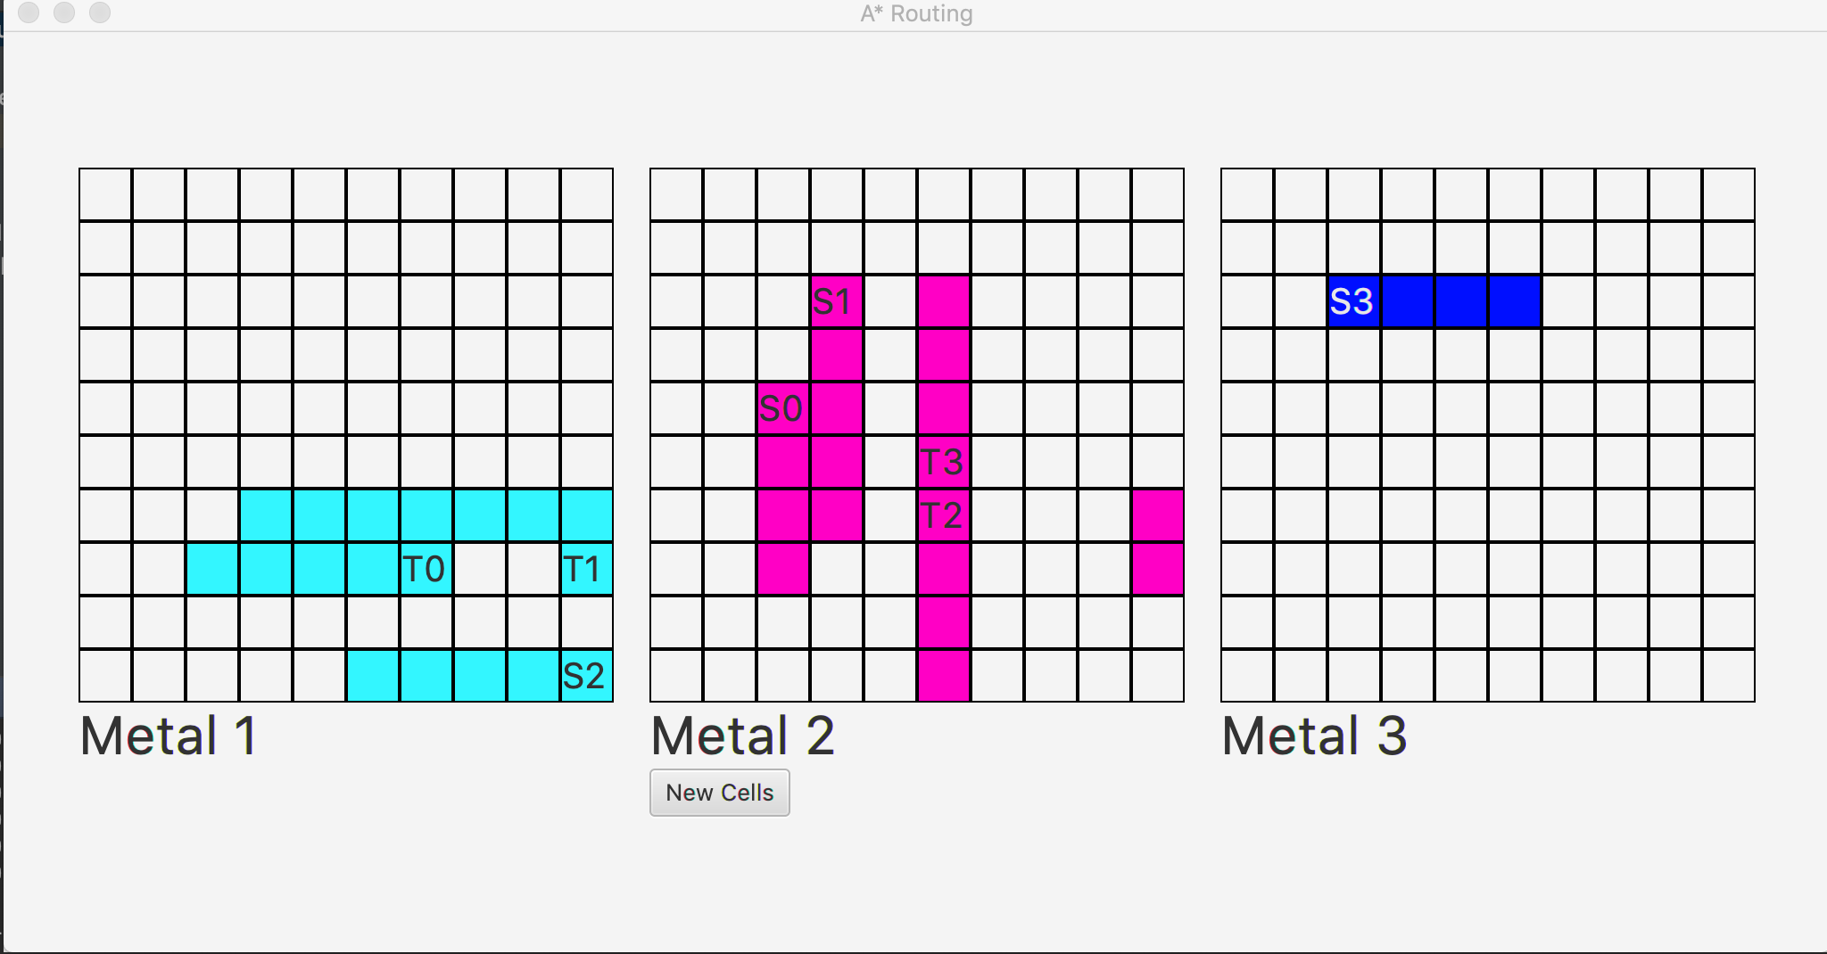
Source: (2,2,2), Target:(5,5,1), Cost = 28, CPU Time = 538000ns

Slide 19
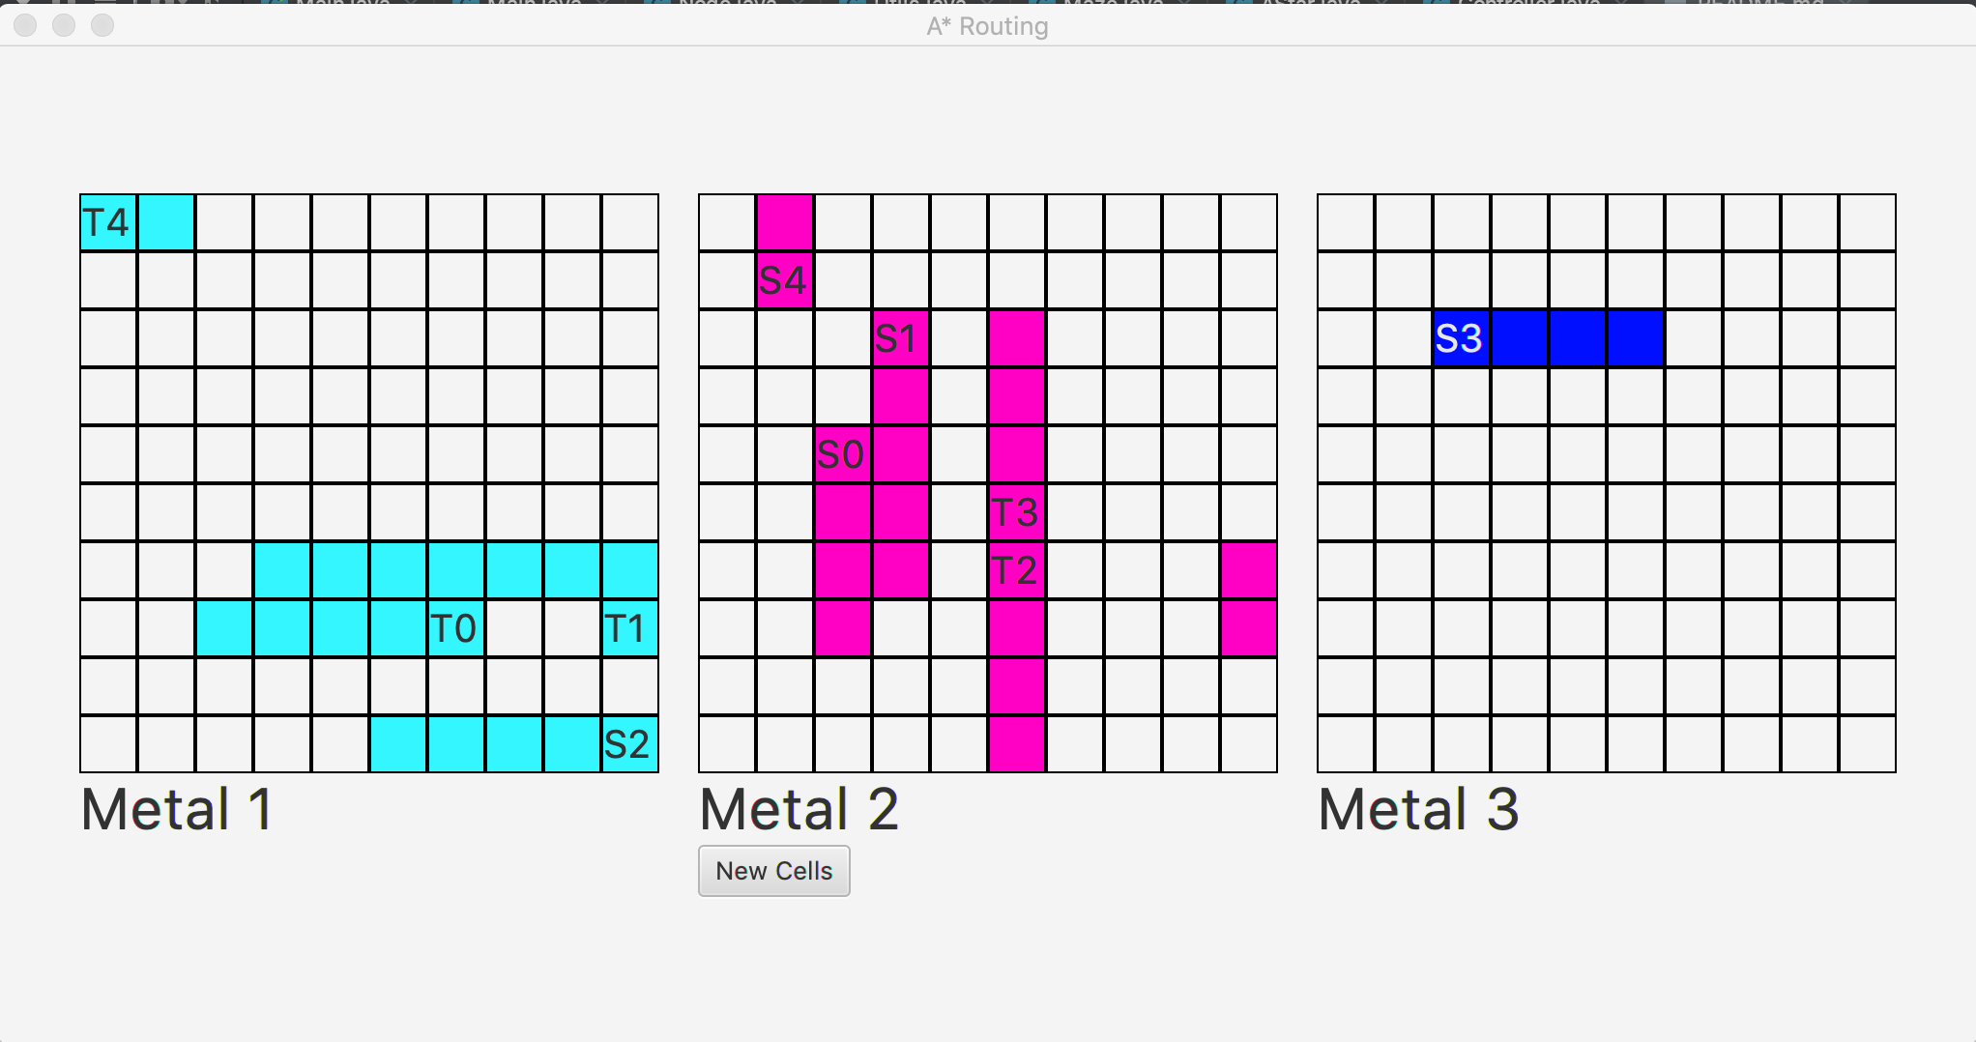
Source: (1,1,1), Target:(0,0,0), Cost = 24, CPU Time = 190000ns

Slide 20
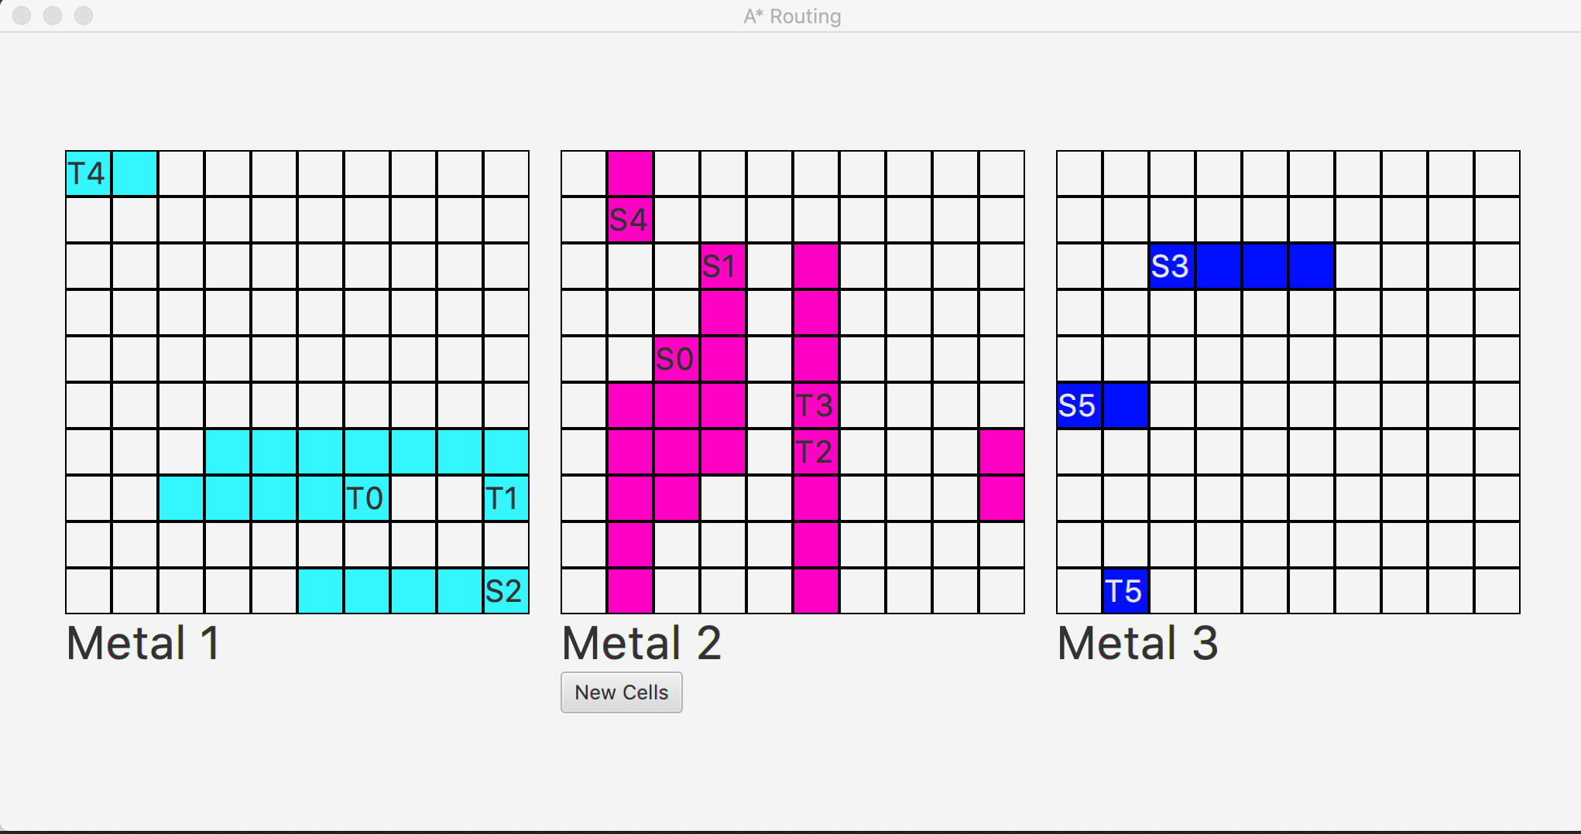
Source: (5,0,2), Target:(9,1,2), Cost = 48, CPU Time = 1065000ns

Slide 21
Testcase 3
Width: 4, Height: 2, Via Cost: 2
Source: (1,3,0), Target:(0,0,2), Cost = 11, CPU Time = 583000ns
Source: (0,0,0), Target:(1,3,2), Cost = 11, CPU Time = 287000ns

Slide 22
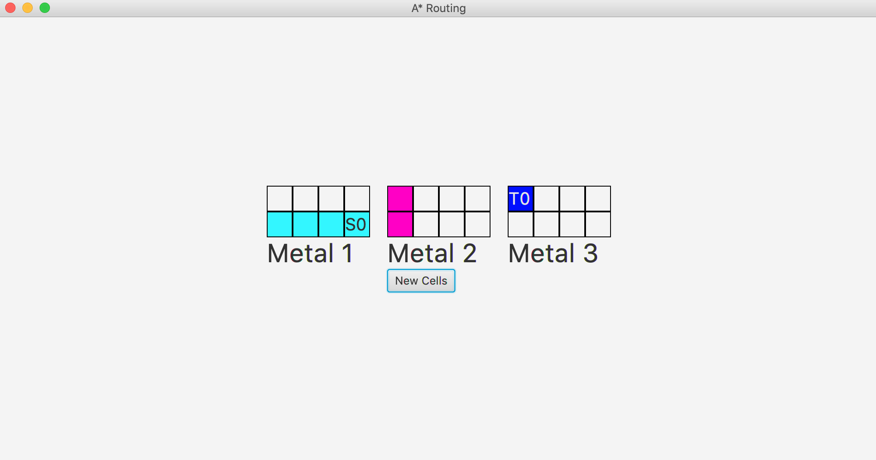
Source: (1,3,0), Target:(0,0,2), Cost = 11, CPU Time = 583000ns

Slide 23
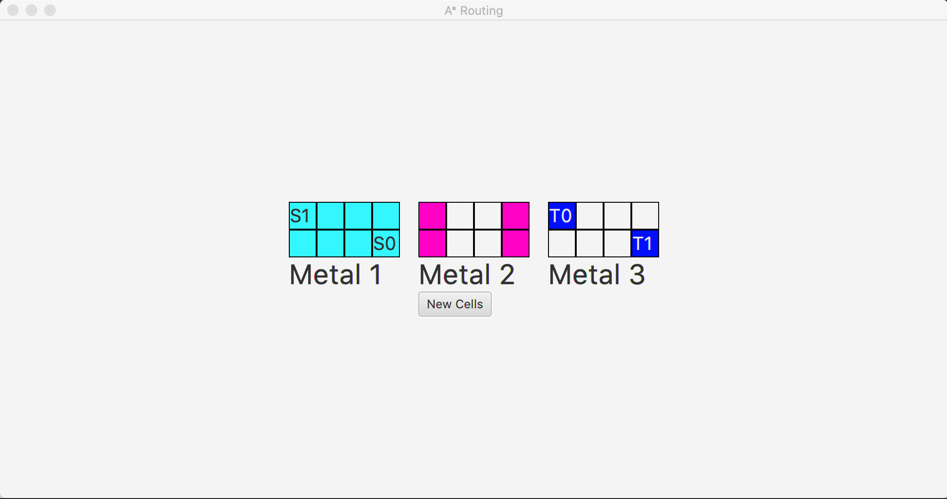
Source: (0,0,0), Target:(1,3,2), Cost = 11, CPU Time = 287000ns

Slide 24
Testcase 4
Width: 6, Height: 3, Via Cost: 2
Source: (2,5,2), Target:(0,0,0), Cost = 14, CPU Time = 1137000ns
Source: (0,3,0), Target:(2,5,2), Source cell in a node that is already occupied! (Console)
Source: (0,5,2), Target:(2,4,1), Cost = 7, CPU Time =182000ns
Source: (2,0,1), Target:(0,3,1), Cost = 12, CPU Time =414000ns
Source: (0,0,2), Target:(1,5,2), Cost = 13, CPU Time = 374000ns

Slide 25
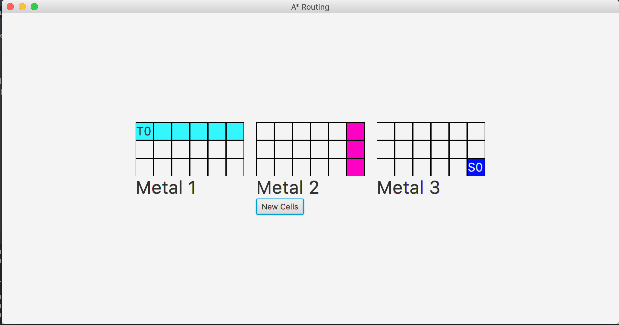
Source: (2,5,2), Target:(0,0,0), Cost = 14, CPU Time = 1137000ns

Slide 26
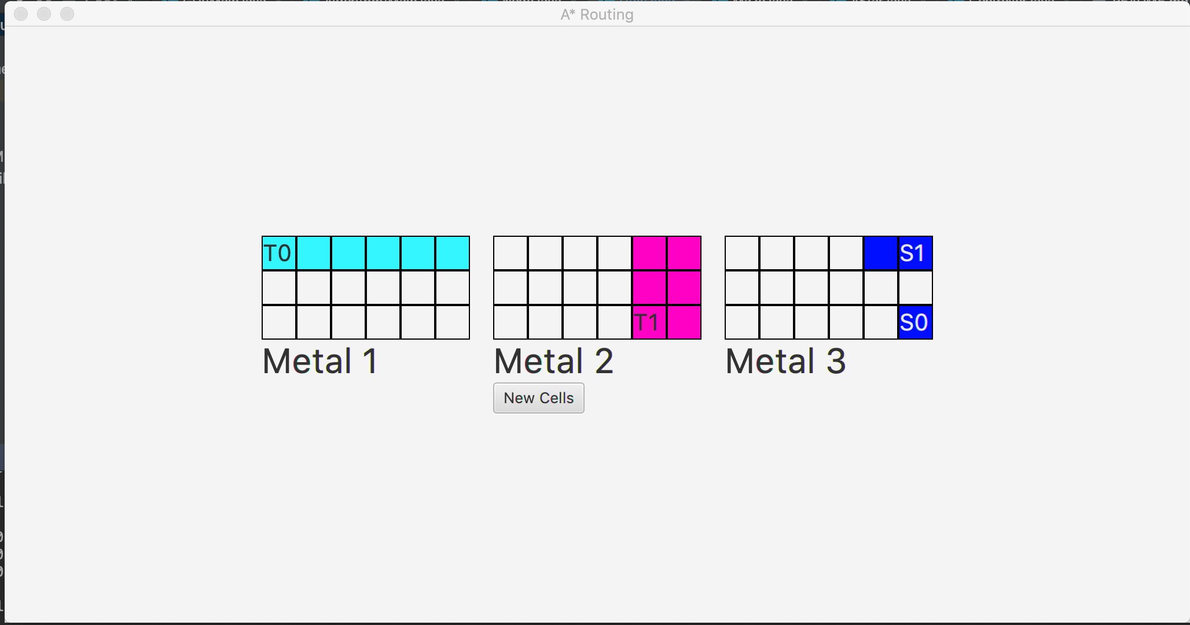
Source: (0,5,2), Target:(2,4,1), Cost = 7, CPU Time =182000ns

Slide 27
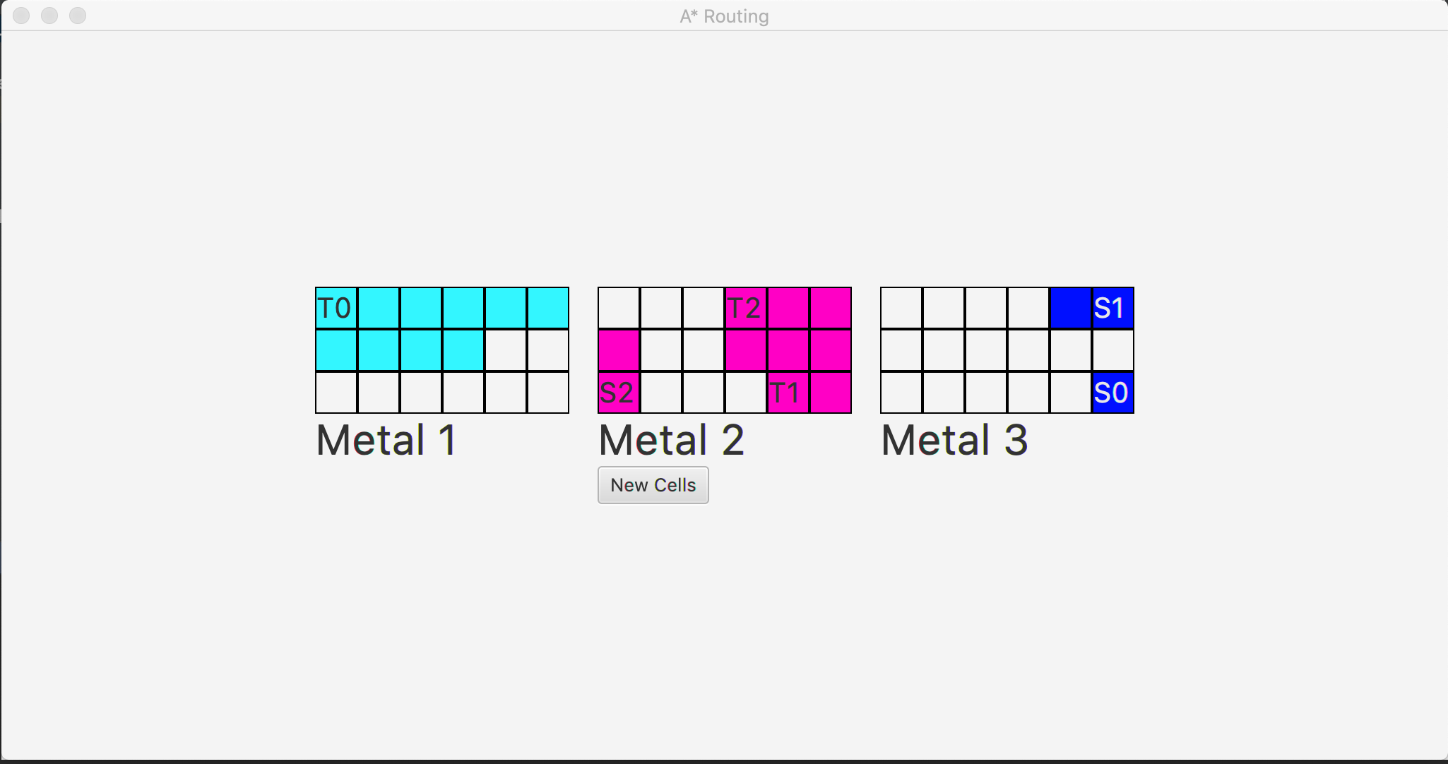
Source: (2,0,1), Target:(0,3,1), Cost = 12, CPU Time =414000ns

Slide 28
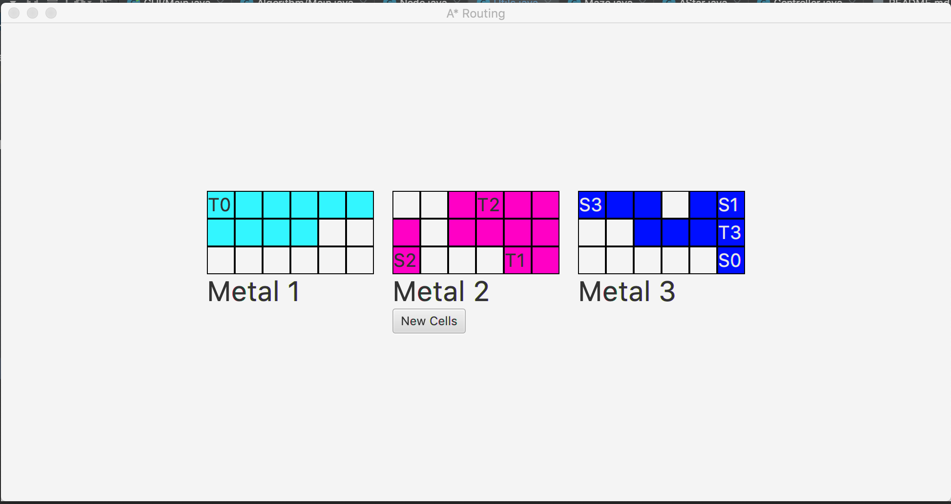
Source: (0,0,2), Target:(1,5,2), Cost = 13, CPU Time = 374000ns

Slide 29
Testcase 5
Width: 12, Height: 5, Via Cost: 5
Source: (4,11,2), Target:(0,0,0), Cost = 25, CPU Time = 2254000ns
Source: (4,11,2), Target:(0,0,0), Source cell in a node that is already occupied! (Console)
Source: (0,0,0), Target:(2,11,2), Target cell in a node that is already occupied!
Source: (2,2,2), Target:(3,4,1), Cost = 10, CPU Time = 405000ns
Source: (0,11,0), Target:(4,5,1), Cost = 17, CPU Time = 740000ns

Slide 30
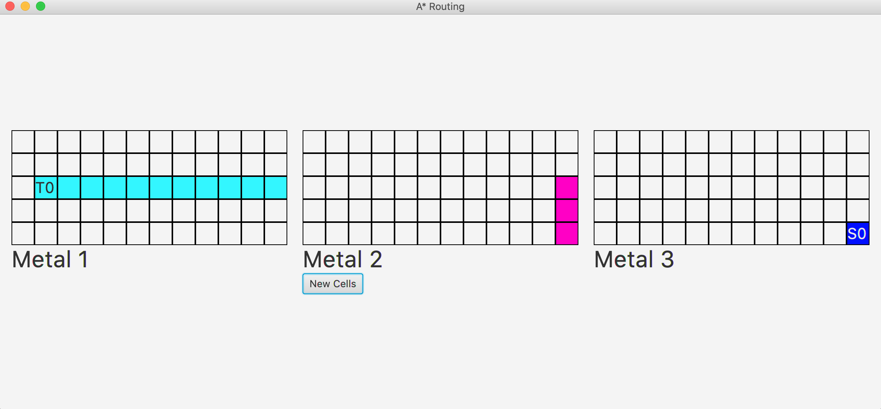
Source: (4,11,2), Target:(0,0,0), Cost = 25, CPU Time = 2254000ns

Slide 31
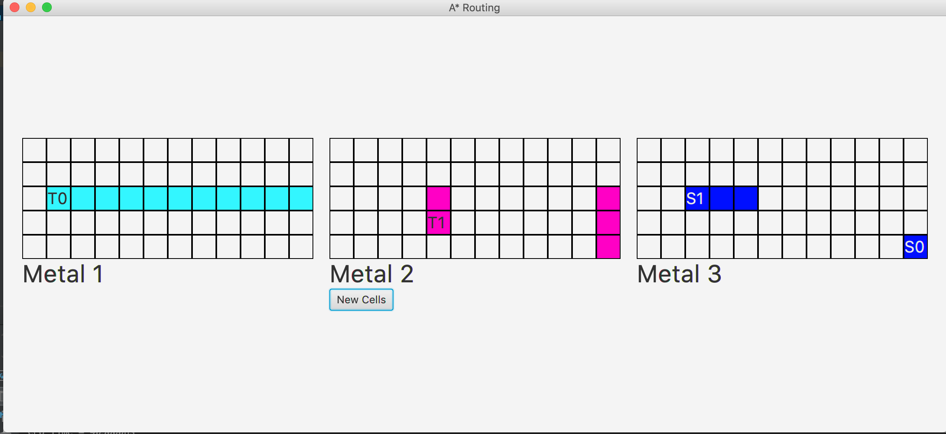
Source: (2,2,2), Target:(3,4,1), Cost = 10, CPU Time = 405000ns

Slide 32
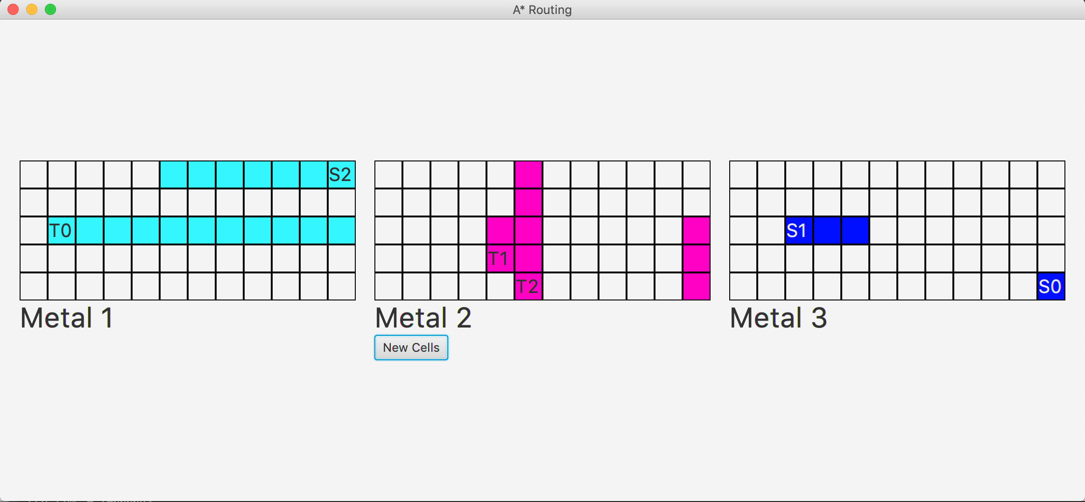
Source: (0,11,0), Target:(4,5,1), Cost = 17, CPU Time = 740000ns

Slide 33
Testcase 6
Width: 4, Height: 5, Via Cost: 2
Source: (3,2,1), Target:(1,2,1), Cost = 3, CPU Time = 288000ns
Source: (1,1,0), Target:(3,4,1), Invalid cells…
Source: (1,1,0), Target:(3,3,2), Cost = 11, CPU Time = 1130000ns
Source: (0,0,2), Target:(4,3,0), Cost = 14, CPU Time = 622000ns

Slide 34
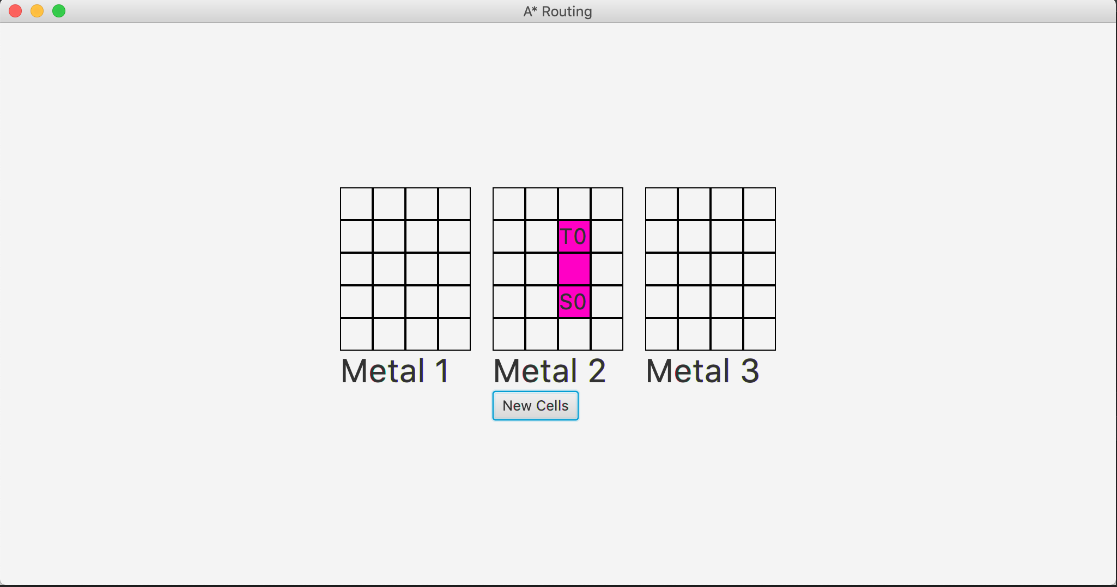
Source: (3,2,1), Target:(1,2,1), Cost = 3, CPU Time = 288000ns

Slide 35
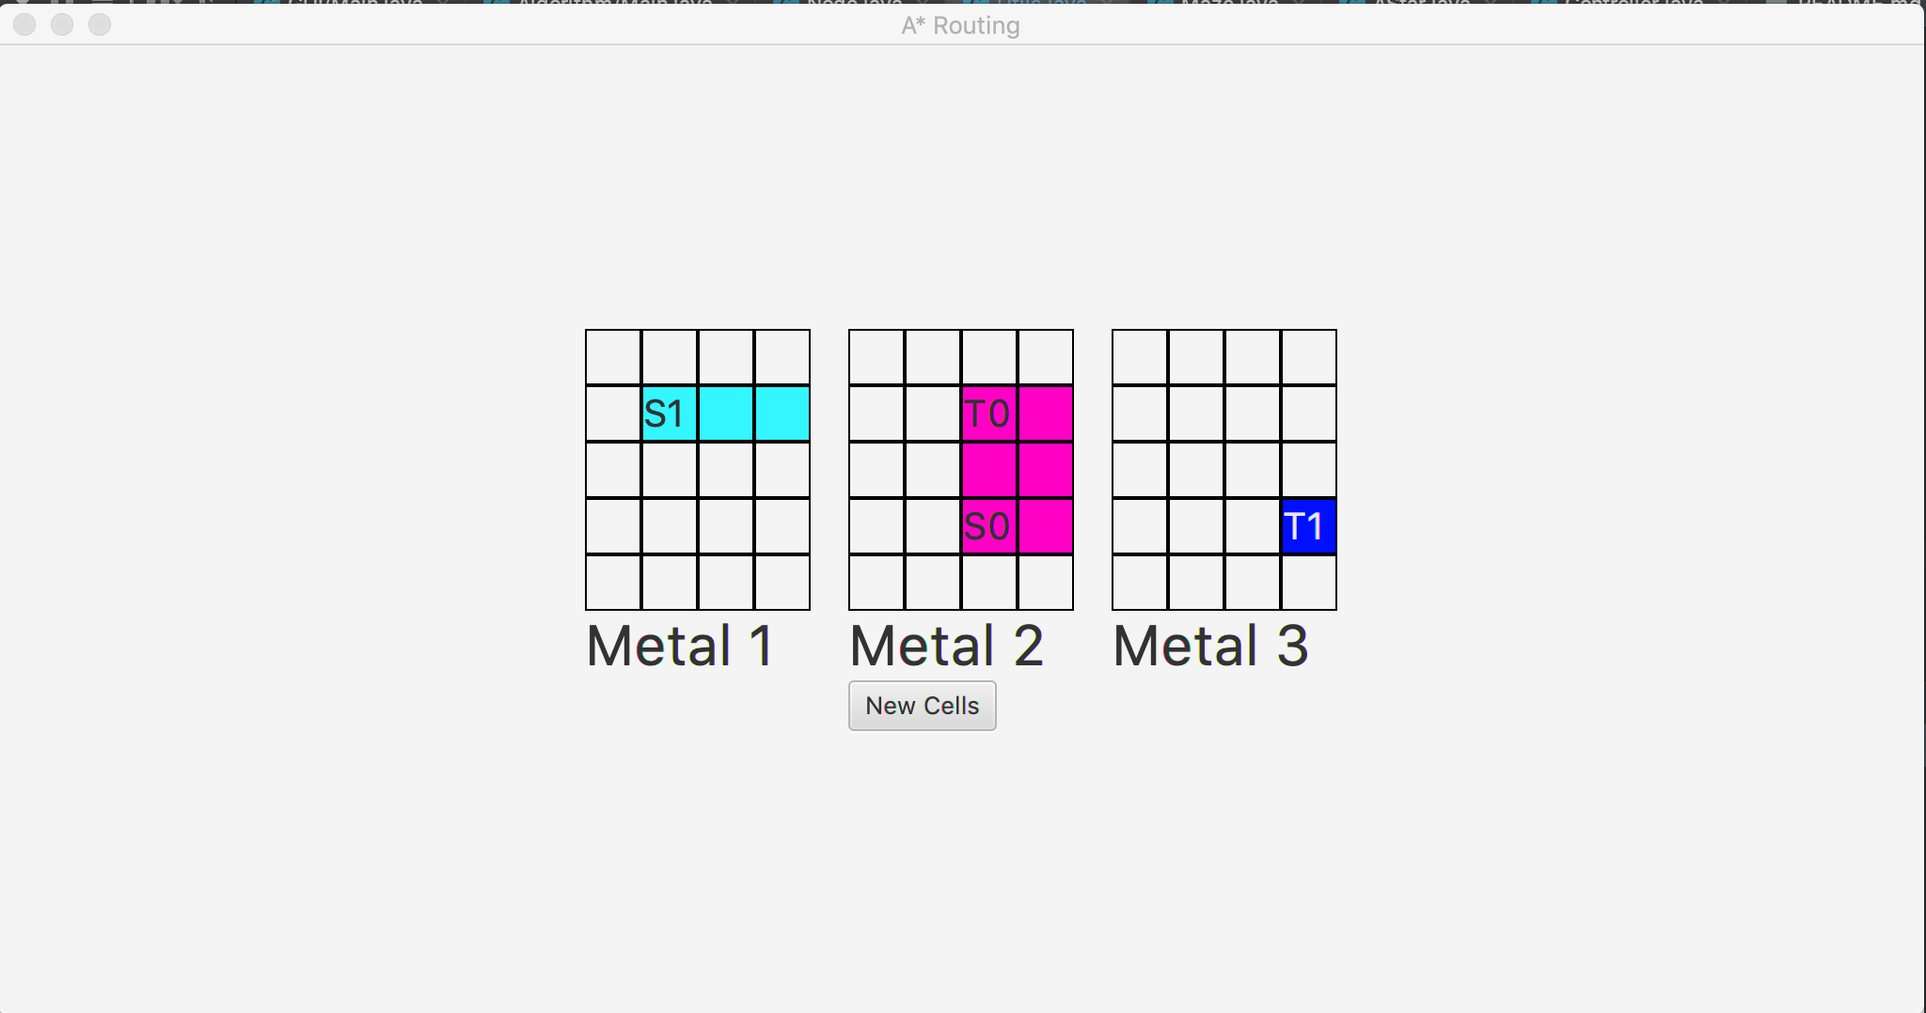
Source: (1,1,0), Target:(3,3,2), Cost = 11, CPU Time = 1130000ns

Slide 36
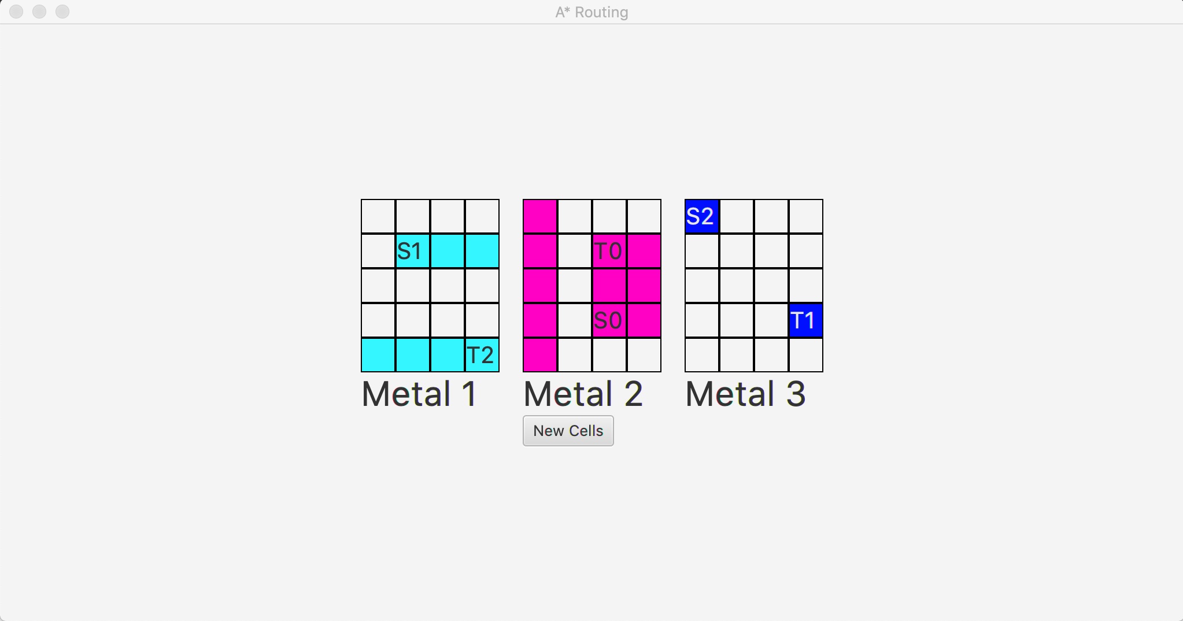
Source: (0,0,2), Target:(4,3,0), Cost = 14, CPU Time = 622000ns

Slide 37
Testcase 7
Width: 7, Height: 9, Via Cost: 7
Source: (8,6,2), Target:(0,0,2), Cost = 31, CPU Time = 2940000ns
Source: (2,5,1), Target:(0,6,0), Cost = 12, CPU Time = 355000ns
Source: (0,0,0), Target:(8,6,0), Cost = 31, CPU Time = 633000ns
Source: (0,6,2), Target:(7,0,2), Cost = 30, CPU Time = 988000ns

Slide 38
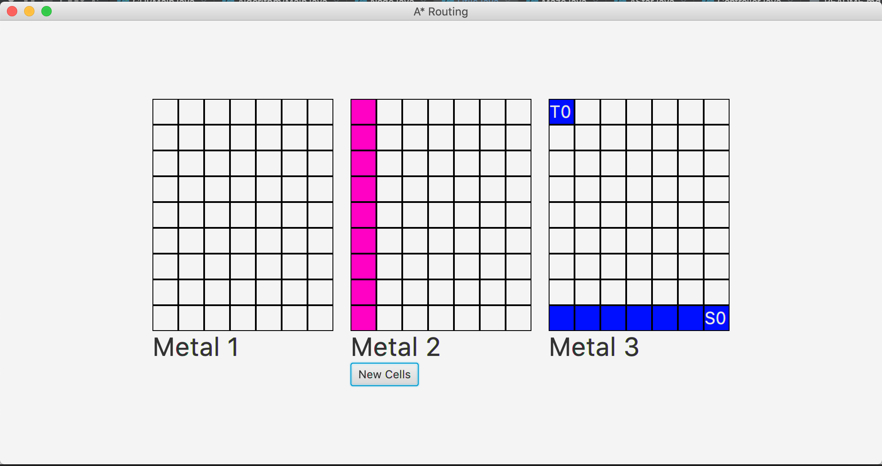
Source: (8,6,2), Target:(0,0,2), Cost = 31, CPU Time = 2940000ns

Slide 39
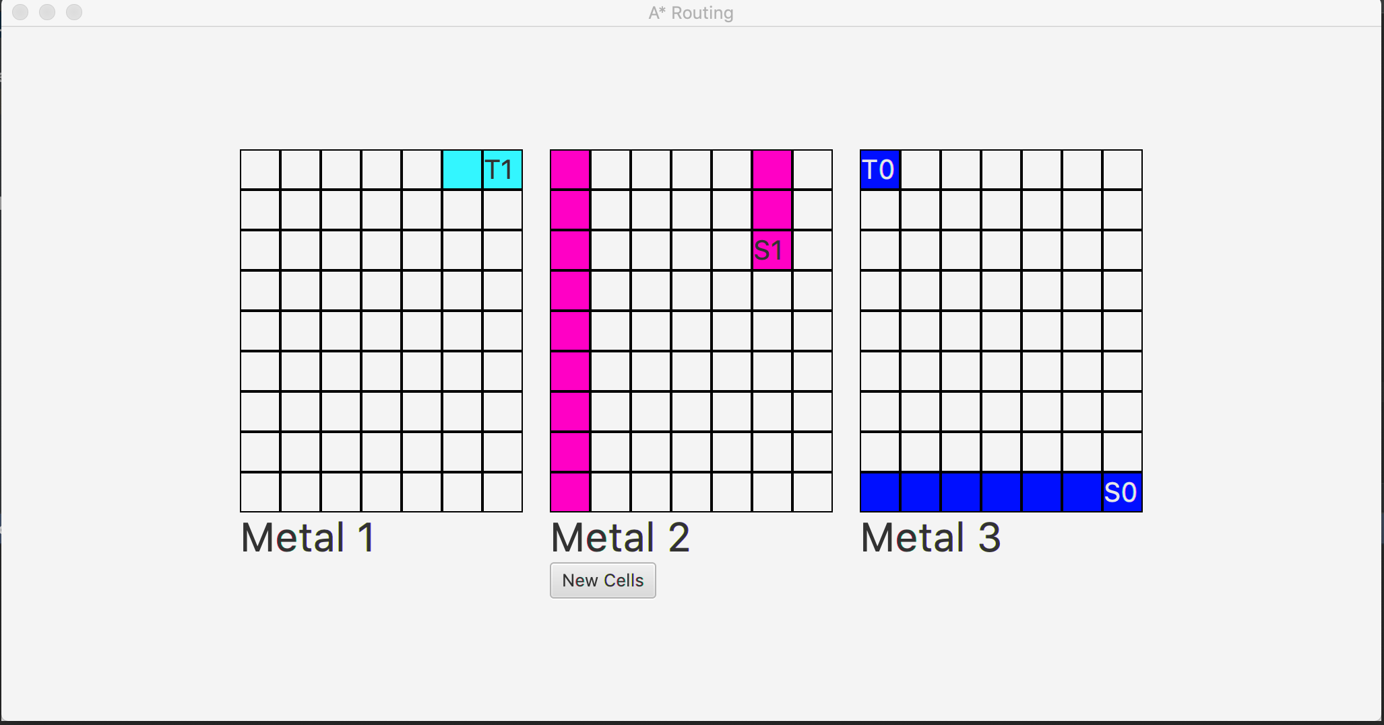
Source: (2,5,1), Target:(0,6,0), Cost = 12, CPU Time = 355000ns

Slide 40
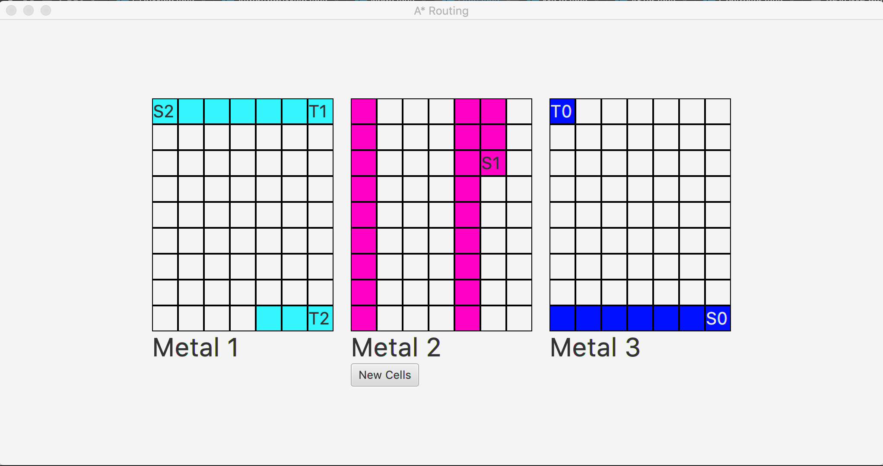
Source: (0,0,0), Target:(8,6,0), Cost = 31, CPU Time = 633000ns

Slide 41
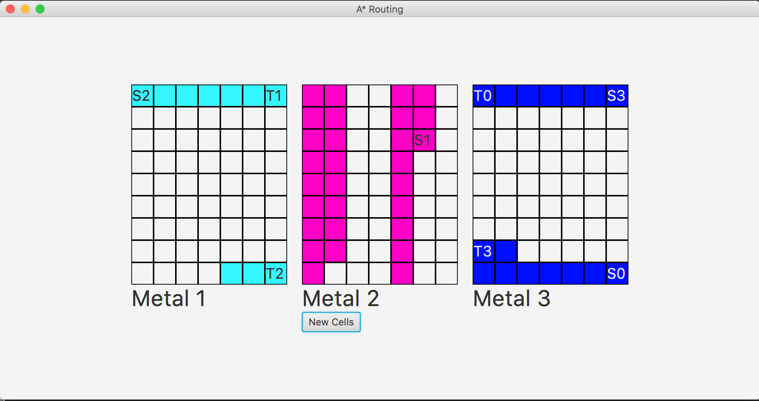
Source: (0,6,2), Target:(7,0,2), Cost = 30, CPU Time = 988000ns

Slide 42
Testcase 8
Width: 12, Height: 11, Via Cost: 9
Source: (7,3,2), Target:(9,4,0), Cost = 24, CPU Time = 9551000ns
Source: (0,11,2), Target:(10,0,0), Cost = 42, CPU Time = 3419000ns
Source: (5,5,1), Target:(1,1,0), Cost = 19, CPU Time = 796000ns
Source: (4,6,2), Target:(0,0,2), Cost = 31, CPU Time = 1478000ns
Source: (0,0,0), Target:(9,11,1), Target cell in a node that is already occupied! (Console)

Slide 43
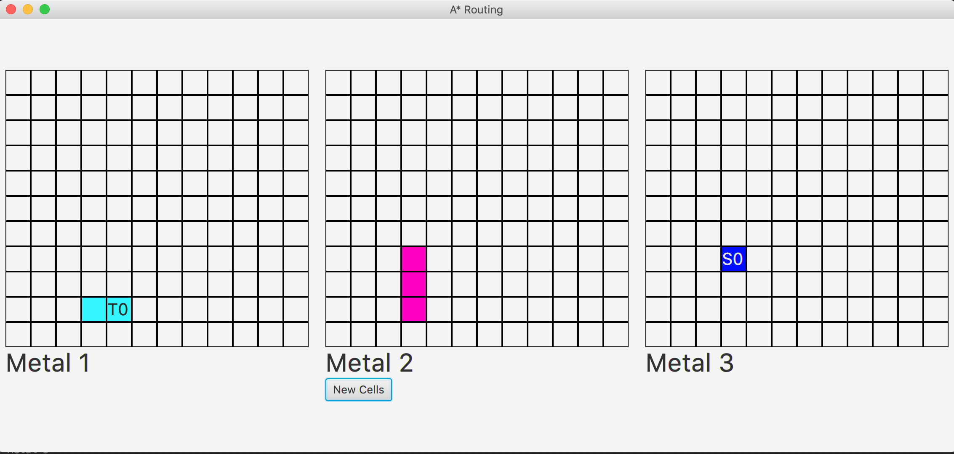
Source: (7,3,2), Target:(9,4,0), Cost = 24, CPU Time = 9551000ns

Slide 44
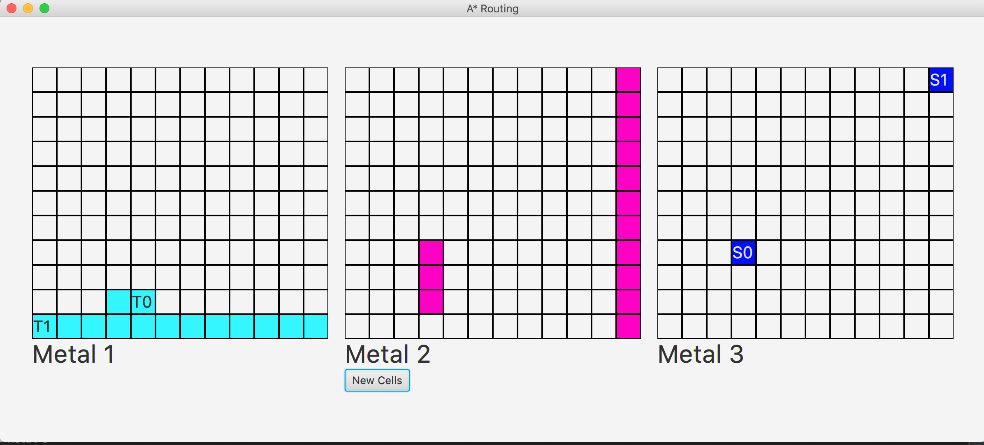
Source: (0,11,2), Target:(10,0,0), Cost = 42, CPU Time = 3419000ns

Slide 45
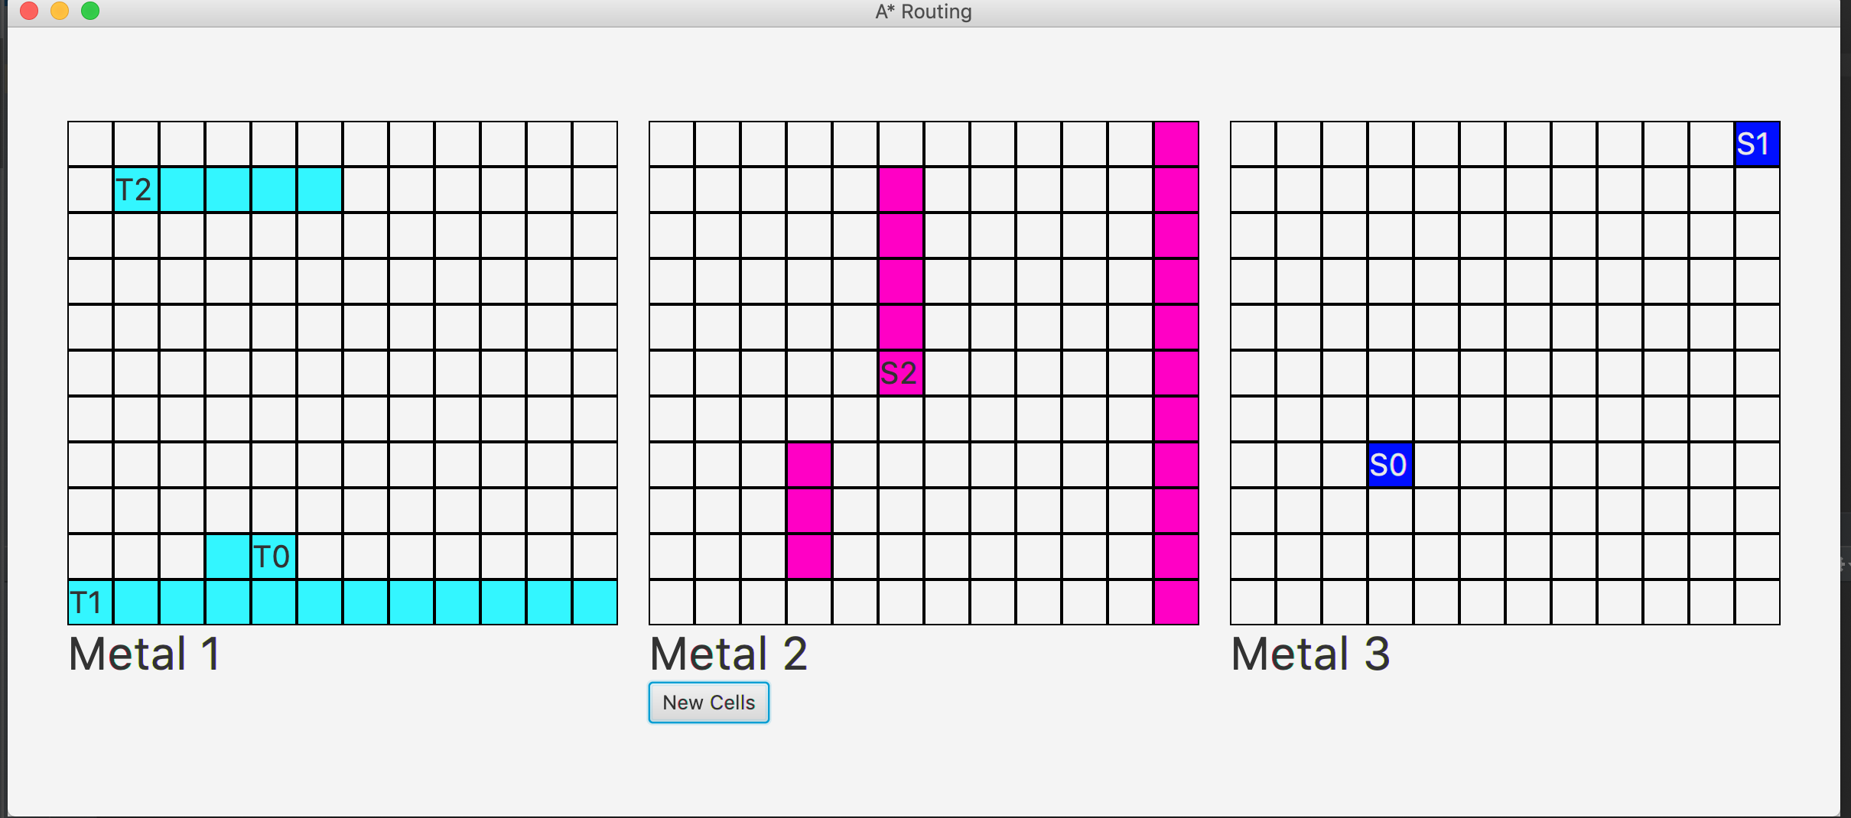
Source: (5,5,1), Target:(1,1,0), Cost = 19, CPU Time = 796000ns

Slide 46
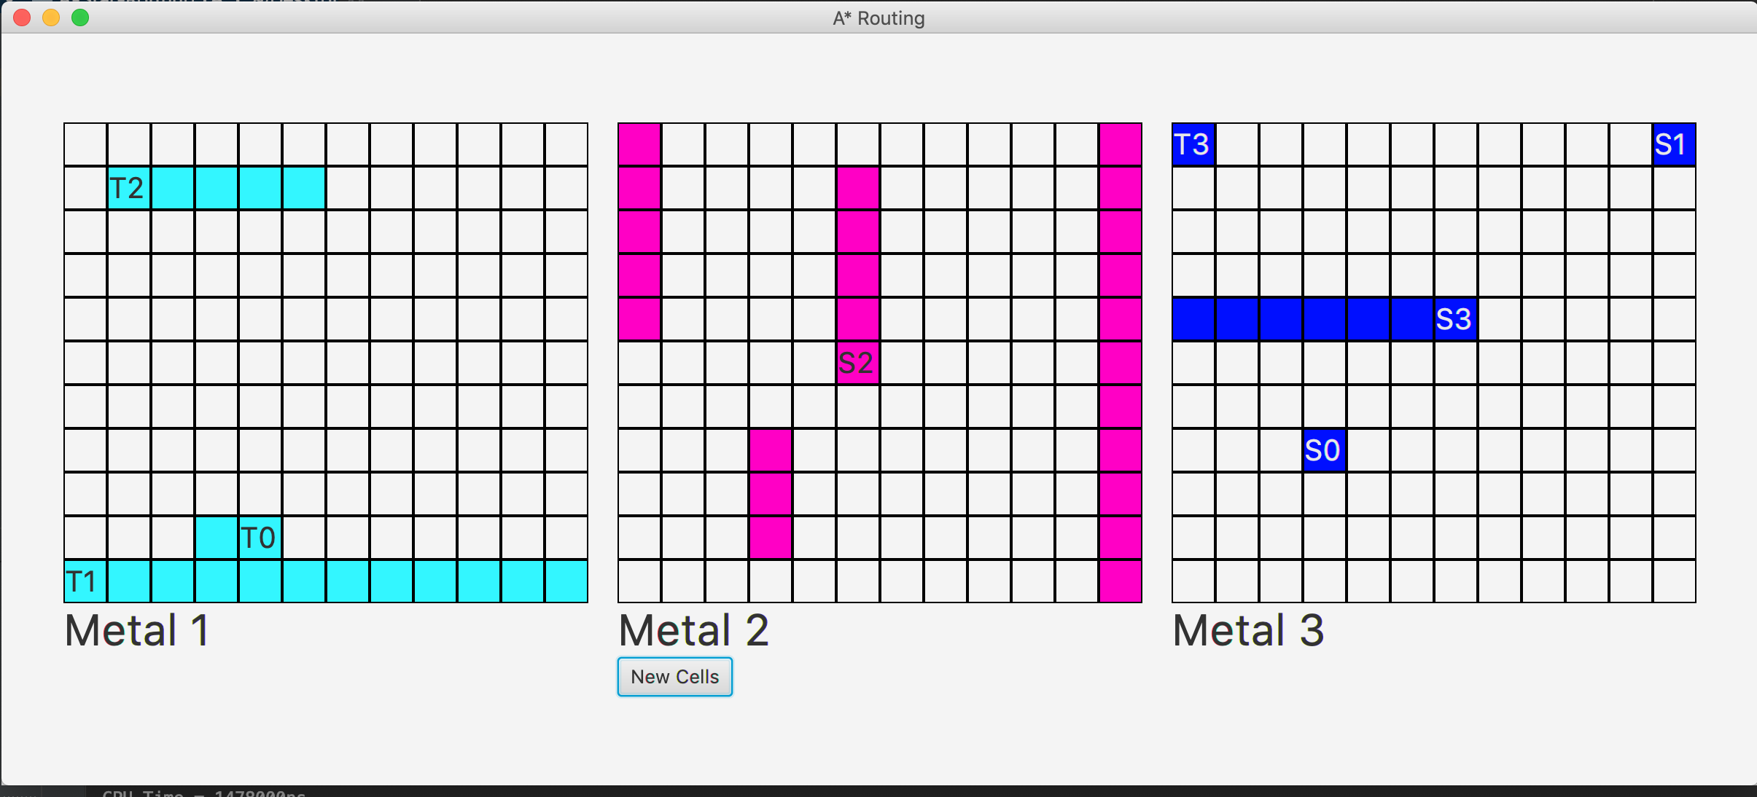
Source: (4,6,2), Target:(0,0,2), Cost = 31, CPU Time = 1478000ns

Slide 47
Resources
Github Link: https://github.com/djzenma/A-Star-Routing
Documentation : after cloning the repo, go to: documentation->index.html

