Slide 1
Heart Disease Detection in STM32 microcontroller
https://github.com/djzenma/ECG
Mazen Amr Gamaleldin Ahmed
900161021

Slide 2
Motivation
Embedded Systems are found everywhere, and you might even be interacting with some of them without even noticing that it is one. This is due to their large field of applications such as cars (ABS systems and others), Point-Of-Sale systems, anti-focus cameras, avionic systems, etc.... and this is just to name a few.
Embedded Systems are usually cheap as they are often part of a bigger system that should be cheap. This implies that embedded systems are accessible for anyone. Recently, embedded systems begun to support the implementation of Artificial Intelligence (we will discuss this later). Some of these microcontrollers are, of course, the STM32 family.

Slide 3
Motivation
Artificial Intelligence (AI) is called “The New Electricity” by some scientists, such as Andrew Ng. This is because AI has found its way in every domain of our lives, starting from our alarms to medicine and diseases detection. Indeed, AI has proven its excellence in medicine and helped in many developed countries to speed up diagnosis and increase the number of possible examinations per day.
If we focused in heart diseases, AI is able to diagnose heart problems as good as a human doctor but in just a few seconds. If we let a human do this same task, it will require him about 13 minutes per case, which is obviously a huge speed up.

Slide 4
Motivation
If we combined the power of both worlds, i.e. the diagnosis and speed power of AI and the computation power and accessibility of Embedded Systems, we will obtain our beautiful project:
Heart Disease Detection in STM32 microcontroller.

Slide 5
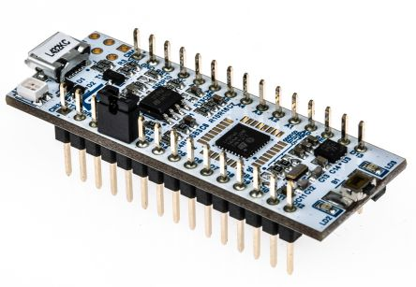
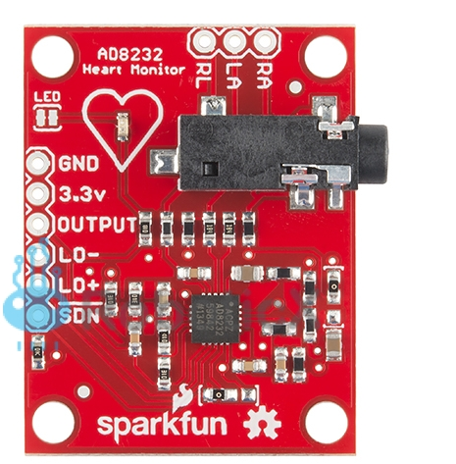
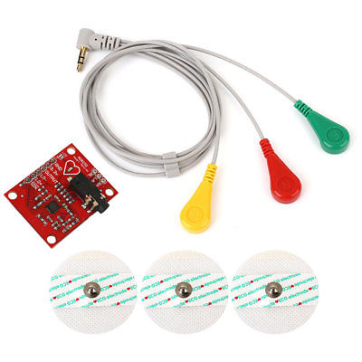
Components Needed (Hardware)
A Microcontroller, I will use the Nucleo STM32L432. The Nucleo has built-in ADC and UART modules, if your MCU doesn’t contain any of these modules you will have to acquire them and connect them to your MCU.
A Heart Monitor, I will use the Spark Fun AD8232
Breadboard
Some jumpers

Slide 6
Components Needed (Software)
Tensorflow Lite Support
An IDE, I will use Keil uVision 5
STM32CubeMX, this is not required but it facilitates the implementation a lot

Slide 7
Architecture
Firm Deadline
Our application’s deadlines are categorized as Firm deadlines. In other words, it is okay if a couple of deadlines are missed as this will not halt the performance of our system. The deadline in our case is to successfully collect 125 samples of ECG signal and classify the disease state of the patient.

Slide 8
Architecture
ADC
I used the built-in ADC in my Nucleo and configured it as follows:
Port: PA0
ADC1 channel IN5 Single-Ended mode
Resolution = 12 bits
Clk: 125Hz corresponding to a Prescaler of = (80MHz/125Hz) - 1 = 639999). However I will experiment with a faster clk to accommodate for any errors.

Slide 9
Architecture
Timer
TIM15
Its clock = 1KHz
Original Clock = 10MHz
Prescaler = 9,999
Resultant clock = 10MHz / 9,999+1 = 1KHz
Auto-Reload Register = 8
Sampling rate = 1KHz/8 = 125Hz

Slide 10
Architecture
GPIO
2 input Pins: PA9, PA10
1 output Pin: PB3
UART
Ports used: PA2 of Transmission and PA3 for Receiving
Baud Rate = 9600 bits/s
Internal Clock
SYSCLK = 80 MHz

Slide 11
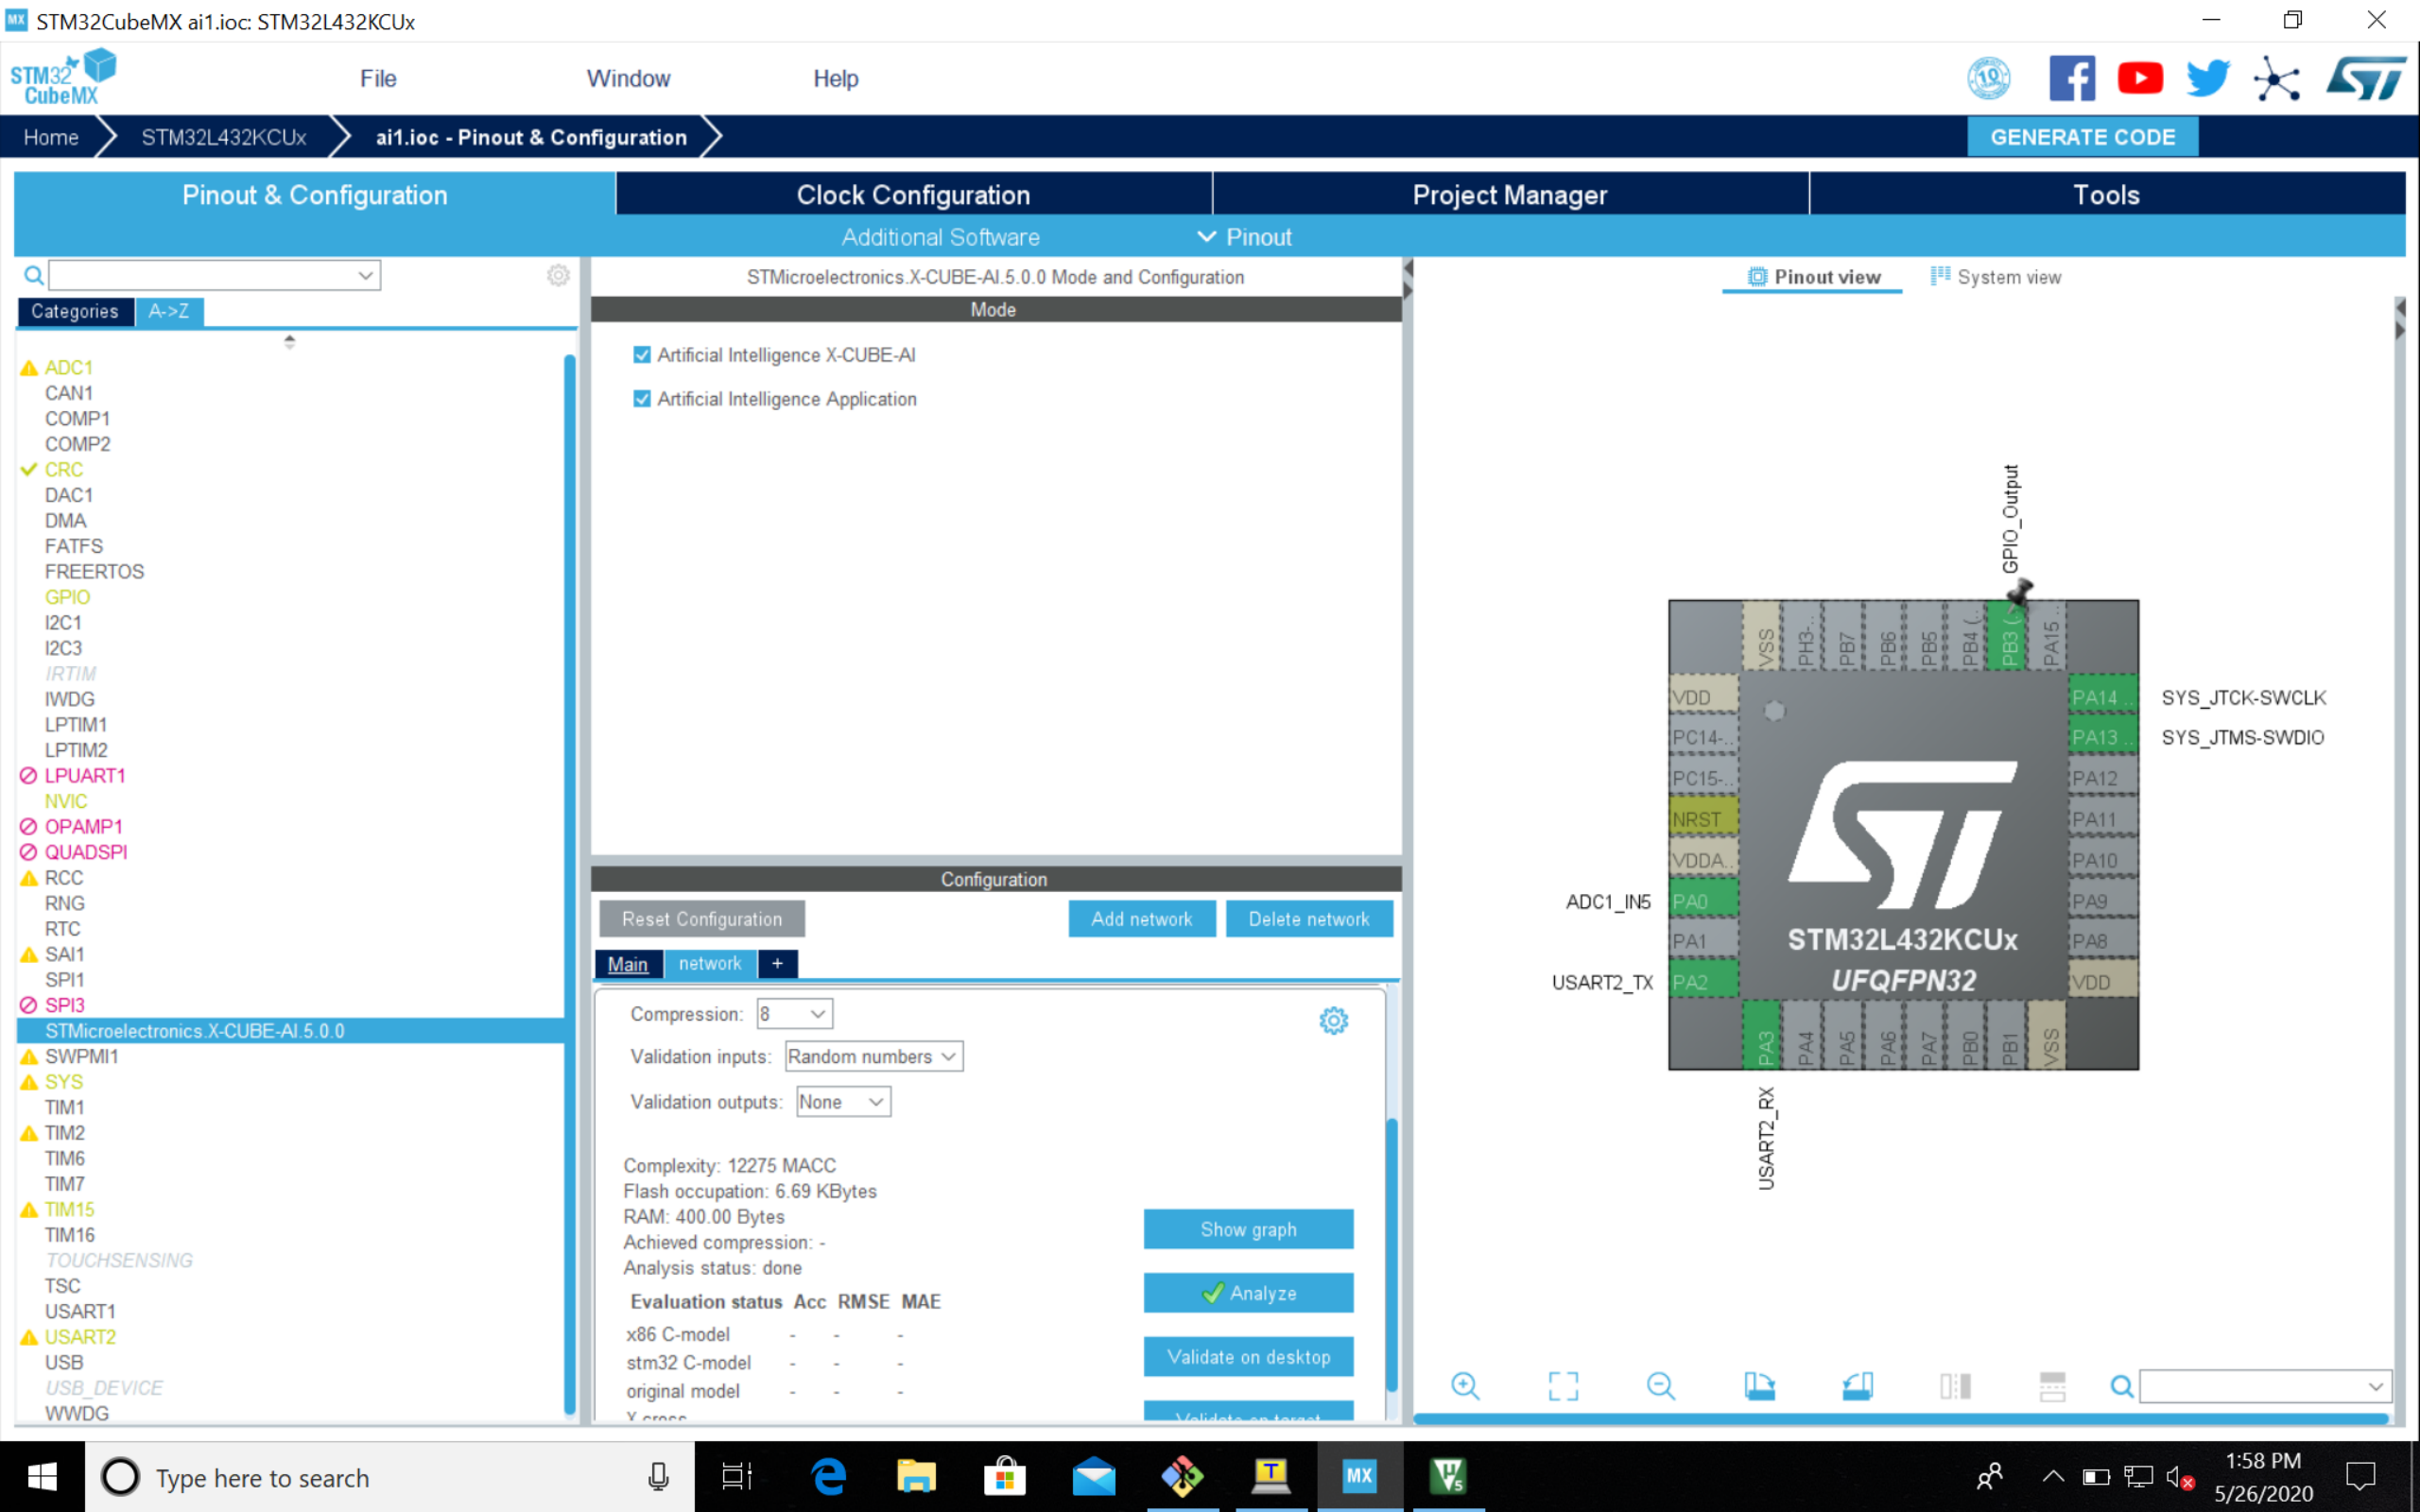

Slide 12
Architecture
Connections
Heart Monitor | Nucleo
GND | GND
3.3V | 3.3V
OUTPUT | PA0 (ADC1 CH1)
Lo- | PA9 (GPIO Input)
Lo+ | PA10 (GPIO Input)

Slide 13
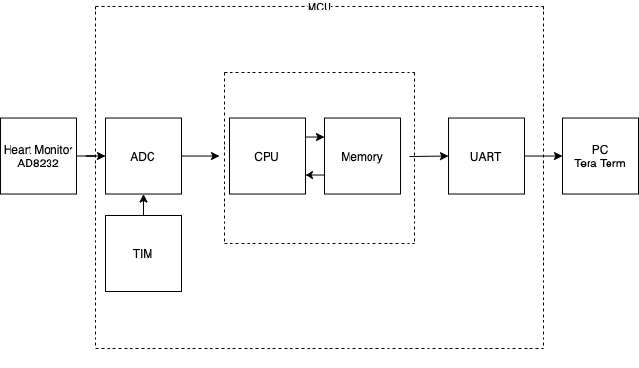
Architecture Overview

Slide 14
Architecture Overview
The Heart Monitor sends the ECG signal as an Analog signal through its OUTPUT pin.
The ADC samples it and converts it to a digital signal every 8ms.
This timing is done using a Timer that raises an interrupt every time the timer reaches the value set in the AR register, which is 8. This allows us to achieve 1000KHz/8 = 125Samples/Sec.
This digital sample is processed, saved in the memory until 125 signals are formed then fed to the ML model to predict the patient’s disease status.
This patient’s status is then sent through the UART to the PC Tera Term as a string specifying to which class does the patient belong.
Finally, the 125 signals are flushed and this cycle repeats.

Slide 15
Authors Signal Preprocessing*
1) Splitting the continuous ECG signal to 10s windows and select a 10s window from an ECG signal.
2) Normalizing the amplitude values to the range of between zero and one.
3) Finding the set of all local maximums based on zerocrossings of the first derivative.
4) Finding the set of ECG R-peak candidates by applying a threshold of 0.9 on the normalized value of the local maximums.
5) Finding the median of R-R time intervals as the nominal heartbeat period of that window (T).
6) For each R-peak, selecting a signal part with the length equal to 1.2T.
7) Padding each selected part with zeros to make its length equal to a predefined fixed length.
*ECG Heartbeat Classification: A Deep Transferable Representation, by Mohammad Kachuee, Shayan Fazeli, Majid Sarrafzadeh

Slide 16
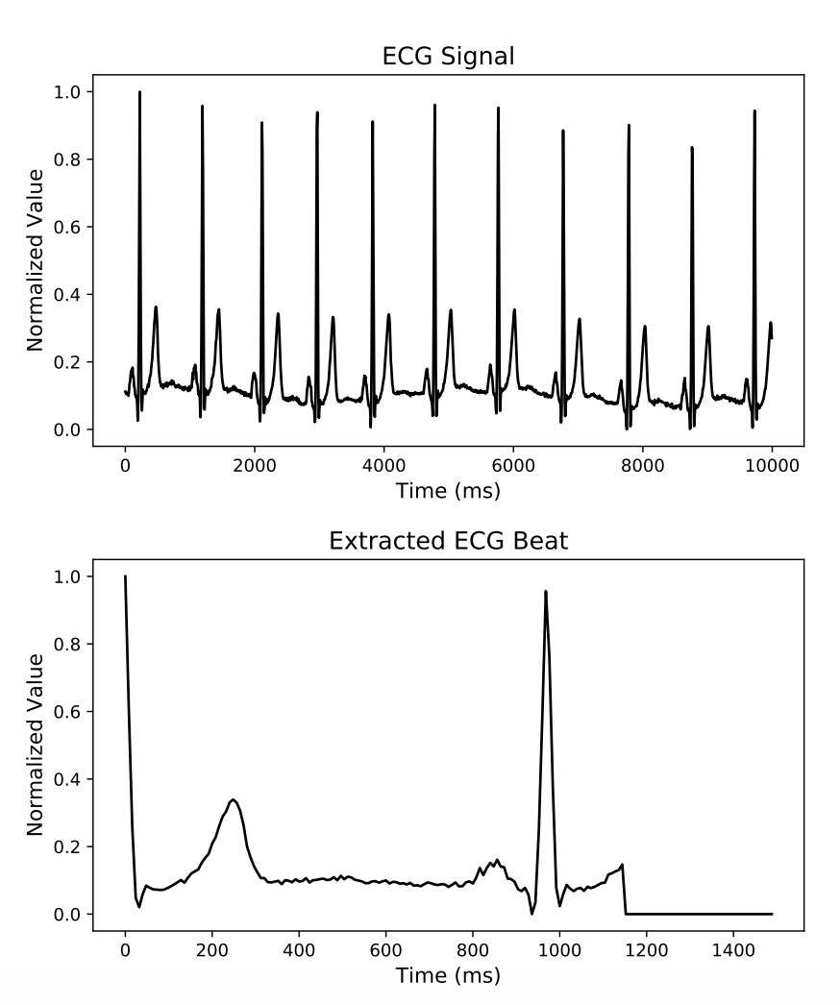
An example of a 10s ECG window and an extracted beat from it.

Slide 17
My Signal Preprocessing Modifications
T = 100 or more, depending on when a Peak arrives after 100x8=800ms
Hyperparameter
Chose Beat Fixed Length = 188
This is the length used by the training dataset*
*[5] ECG Heartbeat Categorization Dataset
https://www.kaggle.com/shayanfazeli/heartbeat

Slide 18
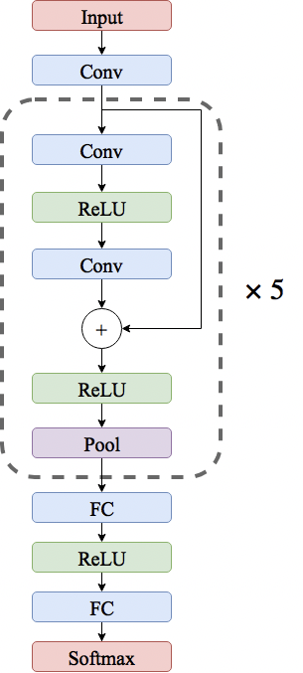
Machine Learning Model
I followed and implemented the ECG Heartbeat Classification paper’s model as it tackles the same ECG problem and classifies the same 5 classes that we are trying to predict.
I trained the model normally using Tensorflow Keras then migrated it to our MCU using Tensorflow Lite.

Slide 19
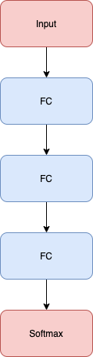
Machine Learning Model
Problem:
RAM size Limitation
Solution:
Changed the Model to 3 Fully Connected Layers

Slide 20
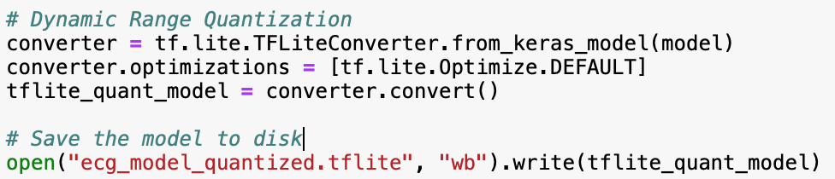
Tensorflow Lite
After training the model using Keras, it is converted to a TF Lite model using the TensorFlow Lite Converter that generates a FlatBuffer file (.tflite).
The flat buffer is then optimized using a method called Dynamic Range Quantization which reduces the size of the buffer. The buffer can go up to 4x smaller and can have 2-3x speedup in performance while having a very close accuracy to the original model. This is done by reducing the weights to 8-bit precision.
Then I included this FlatBuffer in the MCU C project.

Slide 21
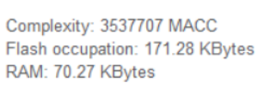
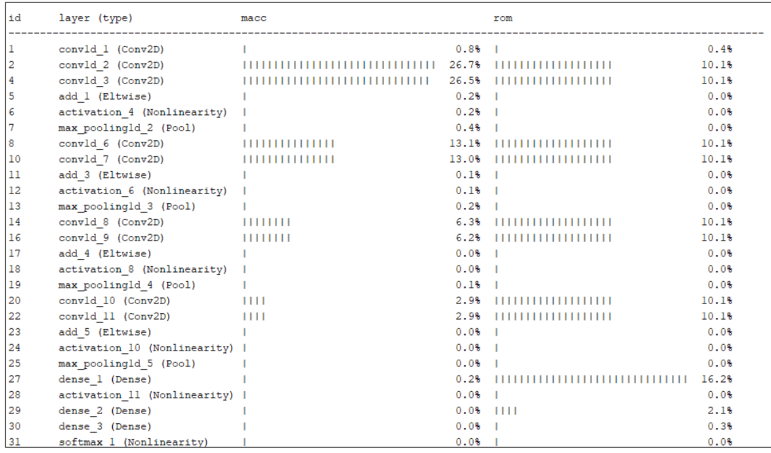
Analyzing the paper model

Slide 22
Analyzing the simple model
Compressed x8 because of maximum allowed hex file size

Slide 23
References
[1] ECG Heartbeat Classification: A Deep Transferable Representation, by Mohammad Kachuee, Shayan Fazeli, Majid Sarrafzadeh
https://arxiv.org/abs/1805.00794
[2] TinyML, by Pete Warden, Daniel Situnayake, ISBN: 9781492052043.
https://learning.oreilly.com/library/view/tinyml/9781492052036/
[3] Tensorflow Lite documentation.
https://www.tensorflow.org/lite
[4] STM32L432KCU Datasheet
https://www.st.com/resource/en/datasheet/stm32l432kc.pdf
[5] ECG Heartbeat Categorization Dataset
https://www.kaggle.com/shayanfazeli/heartbeat

