Slide 1
Android Programming Tutorial
Why Android?
How Android?

Slide 2
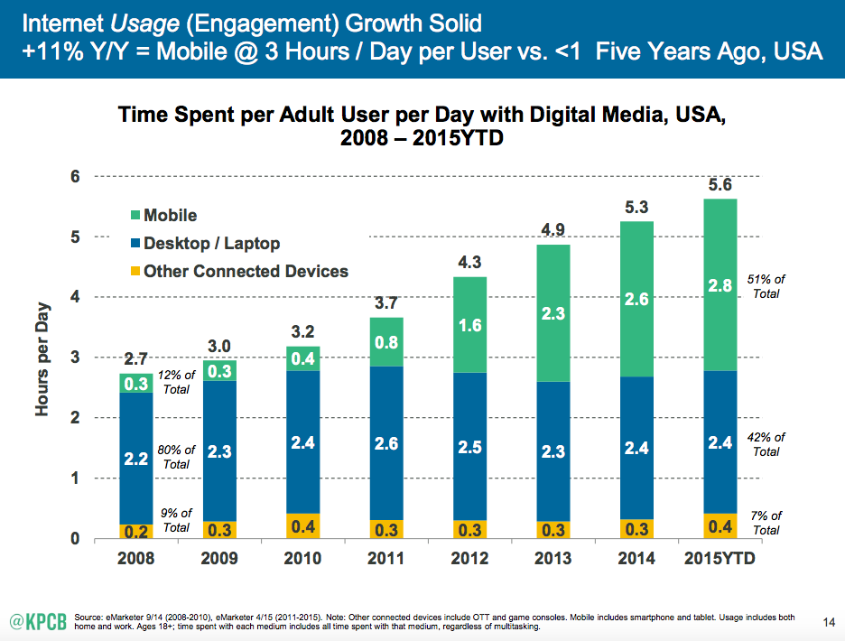
Introduction
Time spent on different terminals

Slide 3
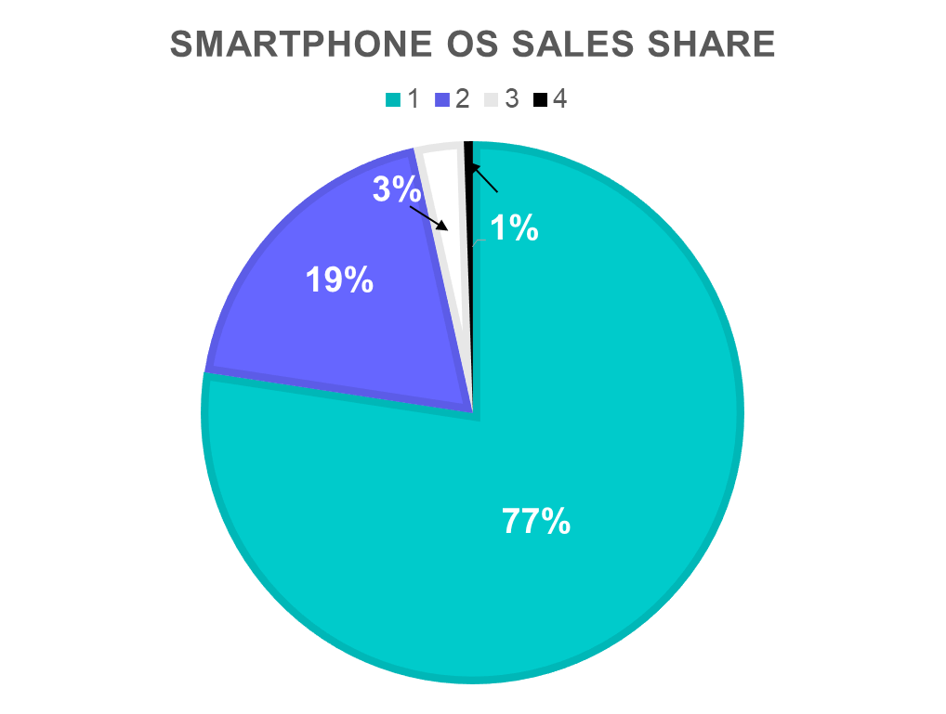
Introduction
Different Operating Systems
  Android
  iOS
  Windows Phone
  BlackBerry

Slide 4
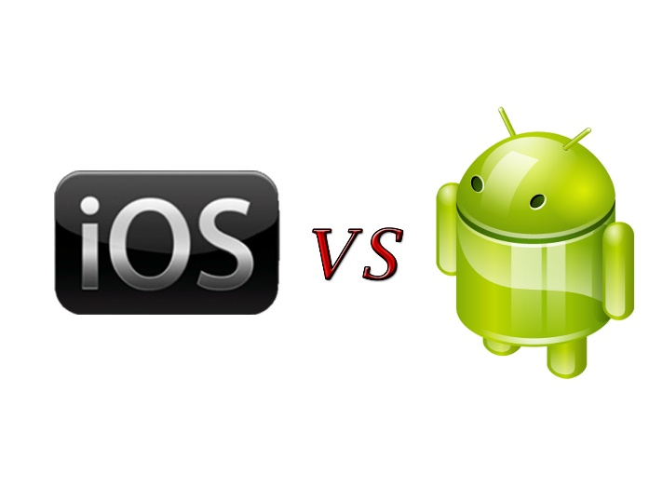
Introduction
Android or iOS?
Open source
  Explore low-level hardware functions
Huge Benefit with low cost
  No $99 startup pay
No requirement on development platform
    Version
  friendly to developers

Slide 5
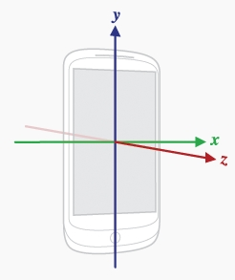

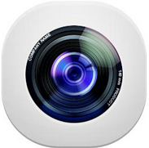



Introduction
What’s in Android?
3-axis Magnetometer: measures the geomagnetic field in device’s body coordinate system.
3-axis Gyroscope: measures angular velocity.
Global Positioning System: device’s longitude and latitude, speed (m/s), bearing (moving direction), time, and accuracy (in meters).
Wireless communication: Wi-Fi, Bluetooth, 3G/4G…
Camera (OpenCV).
Light sensor (auto-adjust), distance sensor (answering calls), temperature sensor (CPU).
Microphone/speaker (some can detect/emit ultrasound).
NFC (Near Field Communication)

Slide 6

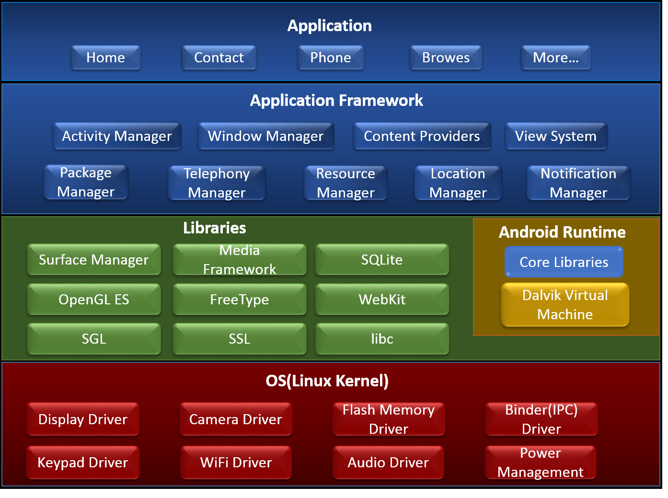
系统架构
最上层
体系结构图
中间层
底层

Slide 7
Android Programming Tutorial
Why Android?
How Android?

Slide 8
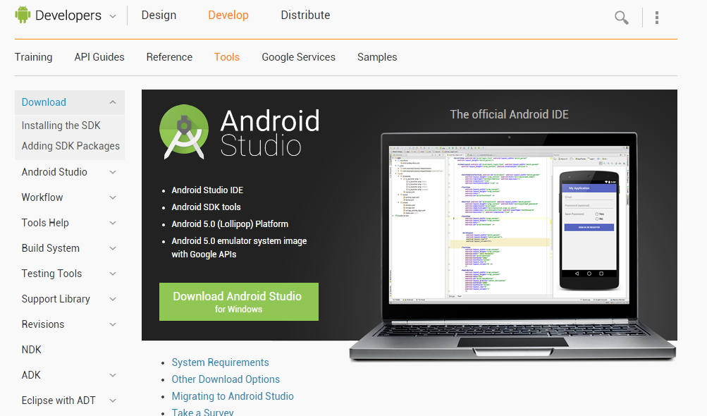
Getting Start
Apps are written in Java.
Software development kit: Android Studio on IntelliJ IDEA.
Seek instructions from http://developer.android.com/sdk/index.html.

Slide 9
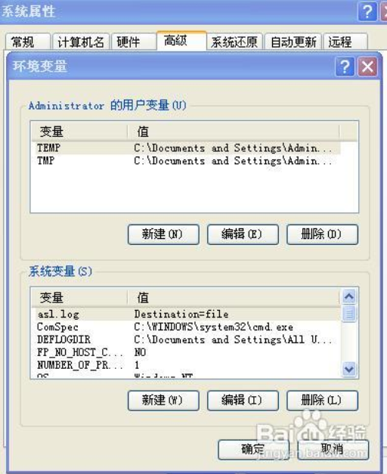
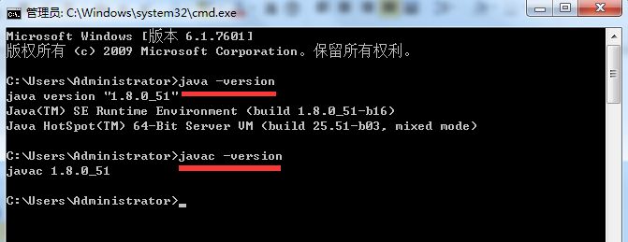
Getting Start
Set up develop environment
Step 1: Install Java JDK
Download and install JDK from
http://www.oracle.com/technetwork/java/javase/downloads/jdk8-downloads-2133151.html
Configure the environment variables
JAVA_HOME -> C:\jdk1.8.x_xx
Classpath ->
.;%JAVA_HOME%\lib;%JAVA_HOME%\ lib\tools.jar
Path -> %JAVA_HOME%\bin;%JAVA_HOME%\jre\bin
Test
Start->Run->input "javac -version"

Slide 10
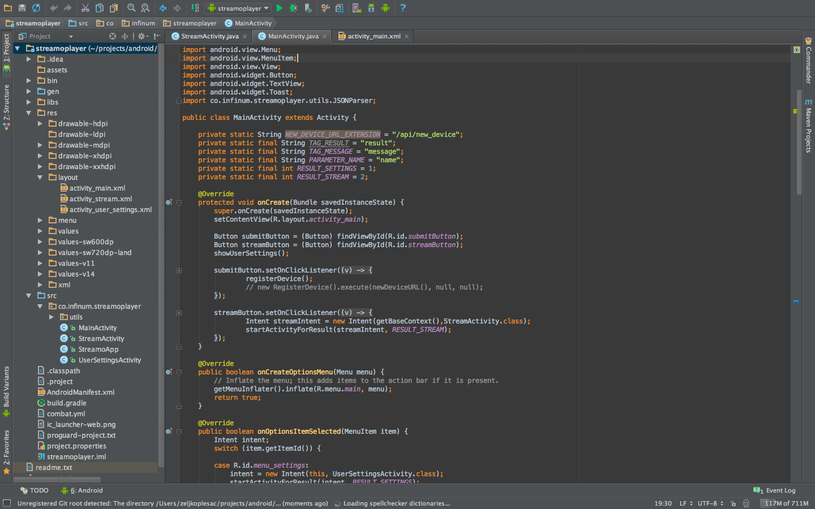
Getting Start
Set up develop environment
Step 2: Install Android Studio http://developer.android.com/sdk/index.html

Slide 11
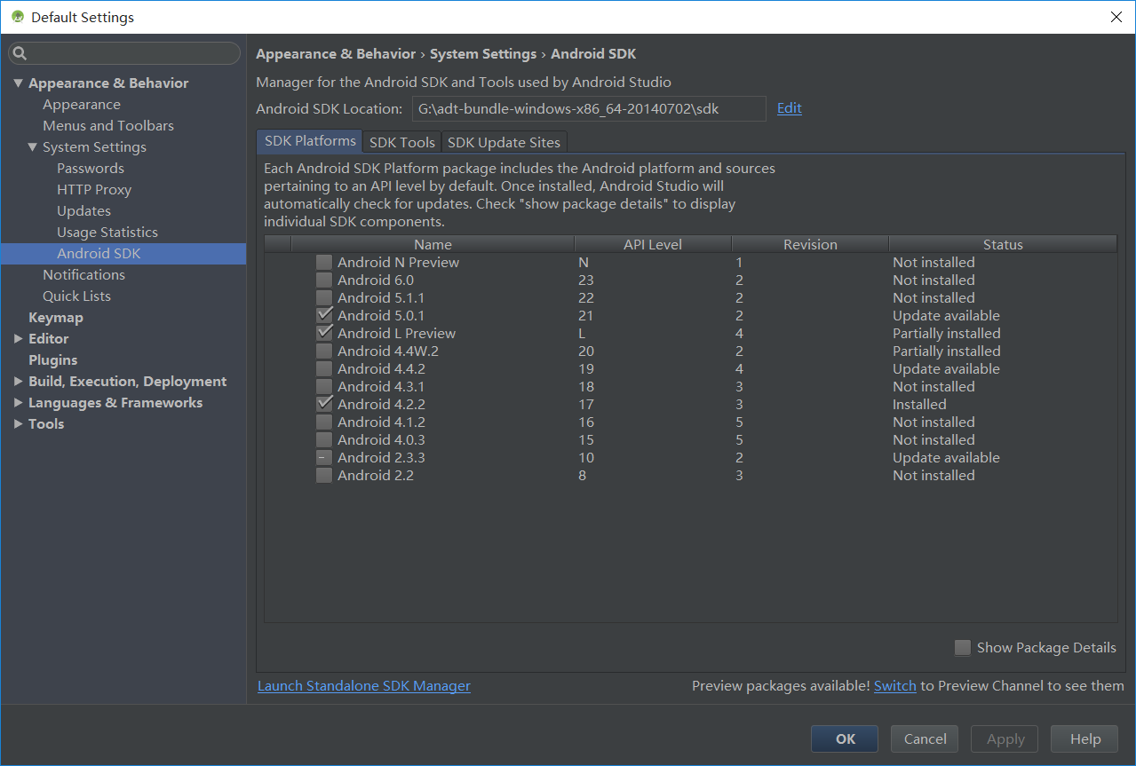
Getting Start
Set up develop environment
Step 3: Add Android SDK packages
In Android Studio, click SDK Manager in the toolbar

Slide 12
Getting Start
Learning Android Programming
Java
Easy to learn with basic knowledge of C++.
But there is no pointer in Java!
Android
Key Points:
User Interface Development
TextView, ListView, Toast, EditText，Button…
Network Programming
HTTP, Socket, WiFi…
Sensors
Acceleration sensor, gyroscope…

Slide 13
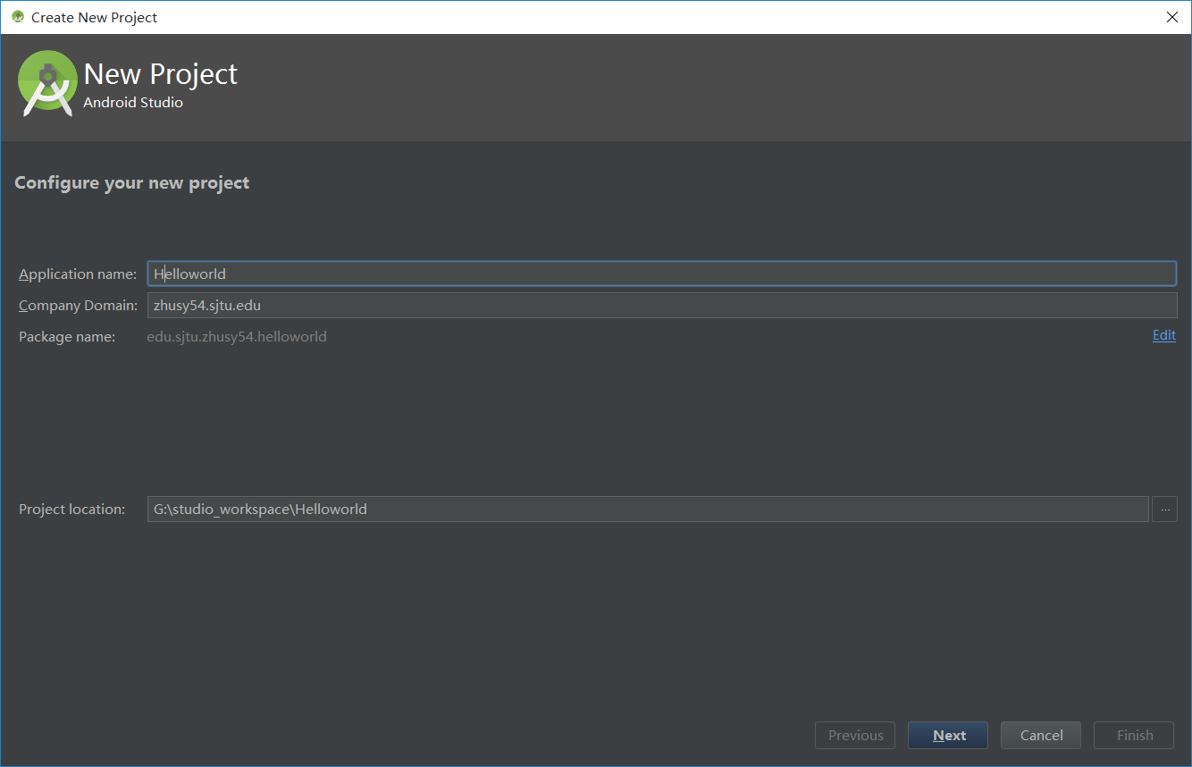
Getting Start
Hello, world!

Slide 14
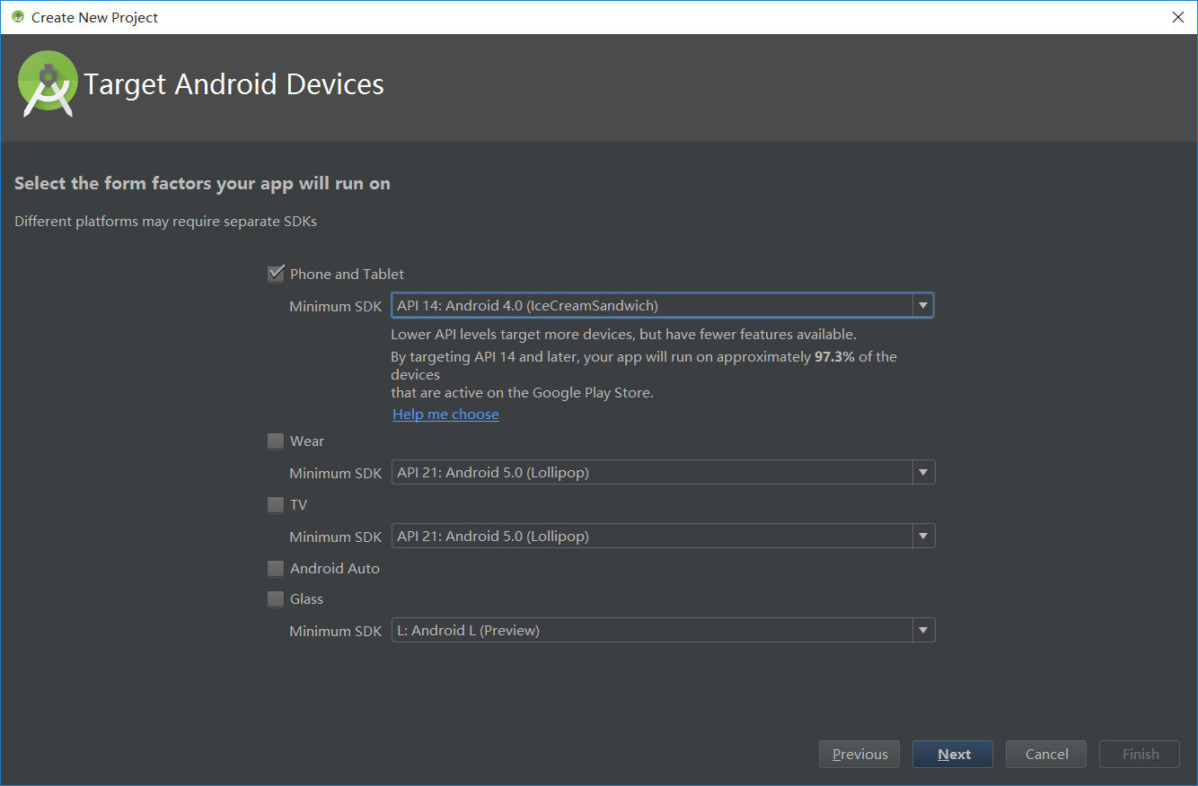
Getting Start
Hello, world!

Slide 15
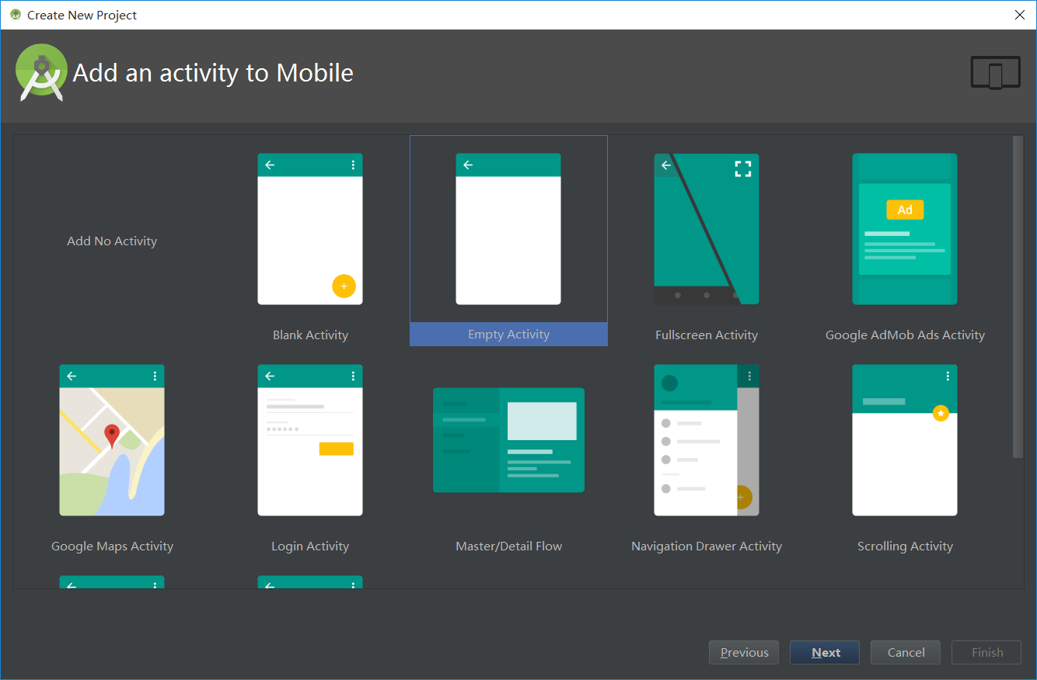
Getting Start
Hello, world!

Slide 16
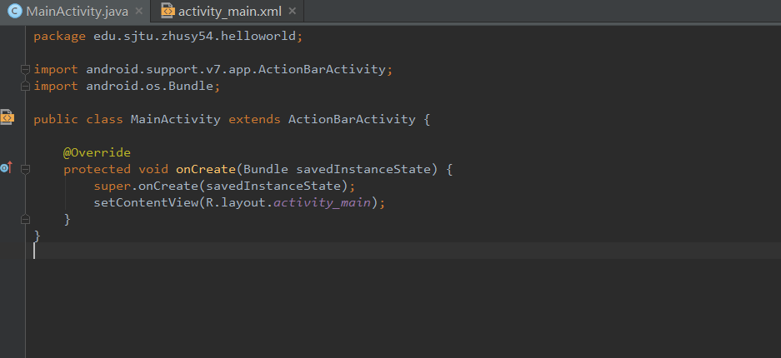
Getting Start
Hello, world!

Slide 17
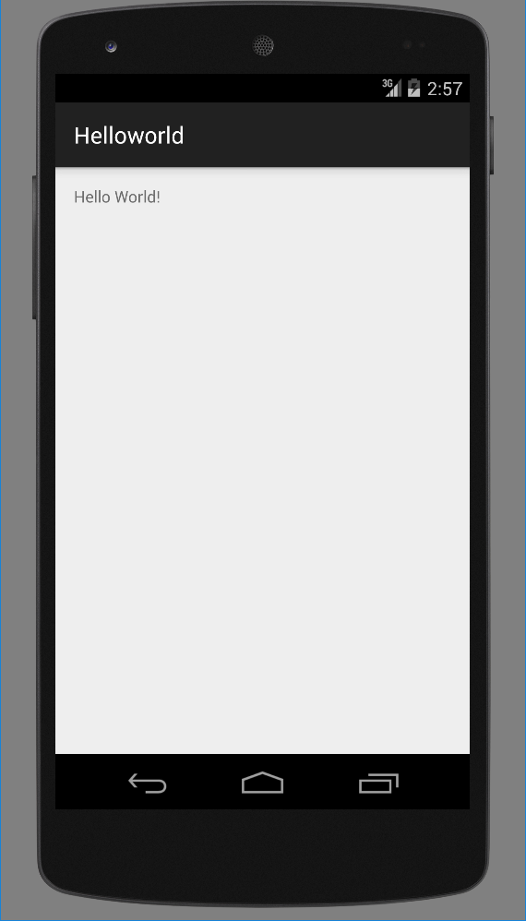
Getting Start
Hello, world!
What is the structure of an android project ?
What is each file in a project used for?
How does an application work?

Slide 18
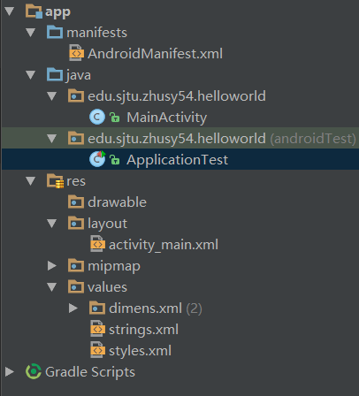
  Project Structure
configuration file
package
source code
layout
Values

Slide 19
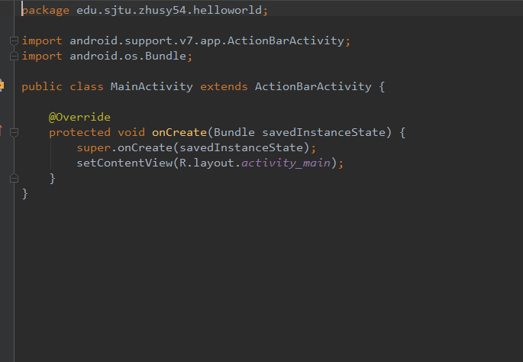
  Project Structure
MainActivity.java
onCreate

Slide 20
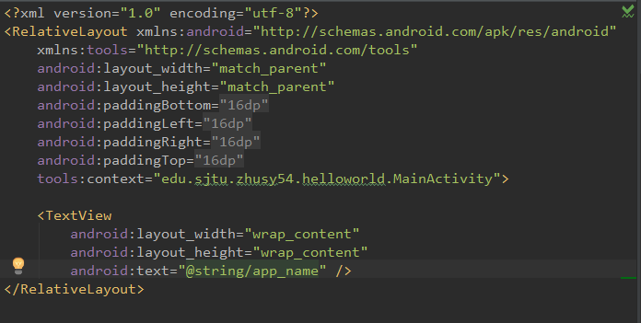
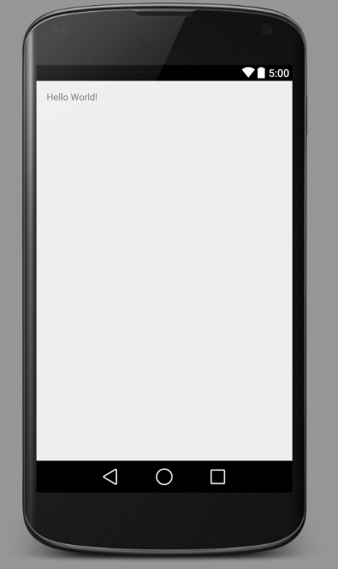
  Project Structure
activity_main.xml

Slide 21
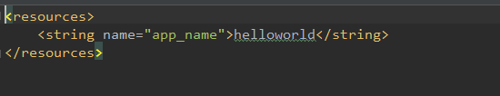
  Project Structure
strings.xml
Key-value pairs, so as other value files

Slide 22
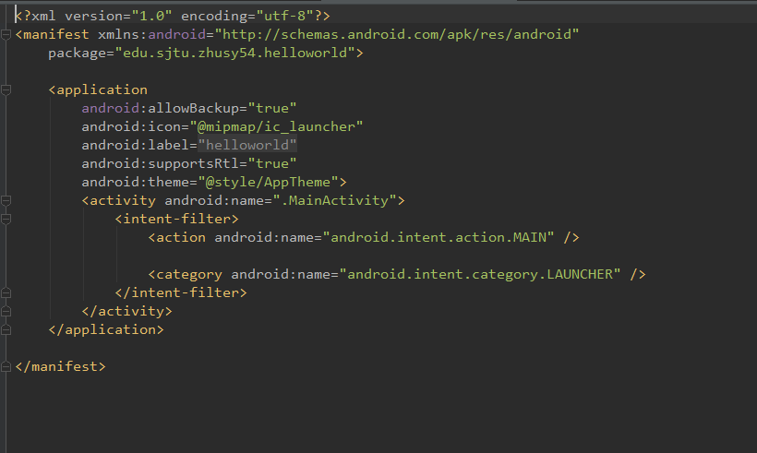
  Project Structure
AndroidManifest.xml
Permissions
API keys
activities

Slide 23
  Programming Guide
Basic components of Android
Activity
Interact with users. Runs in foreground.
Long-periodic process with no user interface.
Runs in background.
Service
Content Provider
Save/Load data from SQLite or other data owners
BroadcastReceiver
Receive broadcast messages.
Switch between different Activities.
Deliver messages.
Intent

Slide 24
  Programming Guide
Listener
Event Source
Places where events happen, like button, menu, etc.
Event
An action of a user.
Event Listener
Monitor events and take response actions

Slide 25
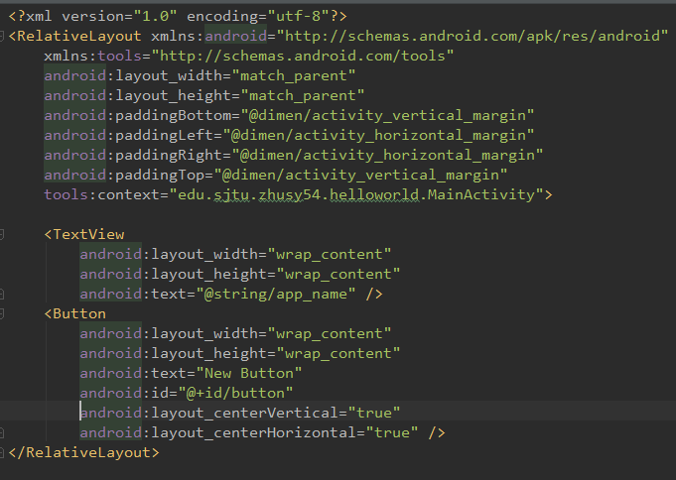
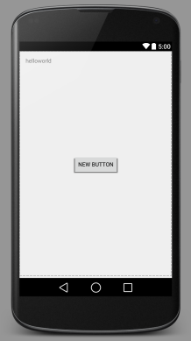
  Programming Guide
For a button: onClickListener

Slide 26
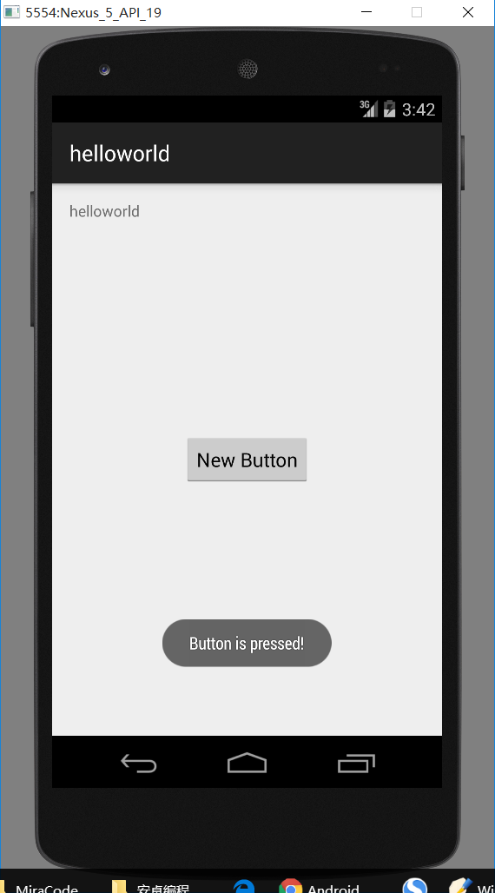
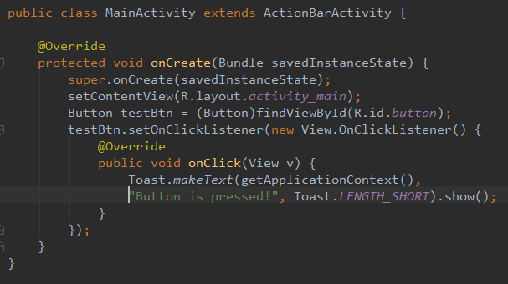
  Programming Guide
For a button: onClickListener

Slide 27
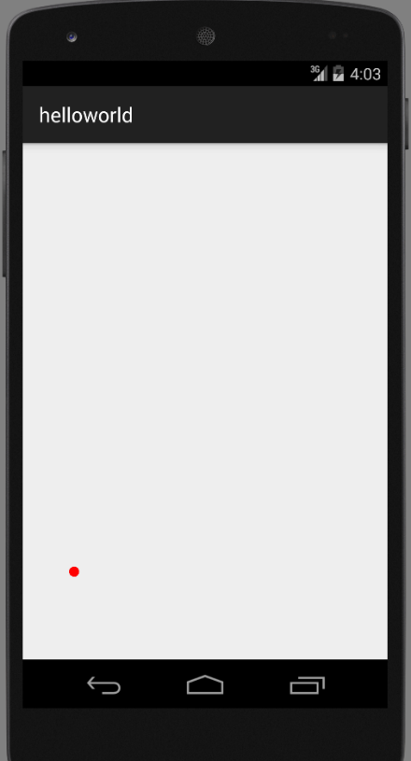
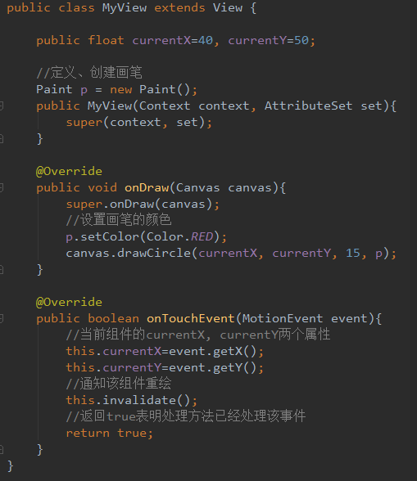
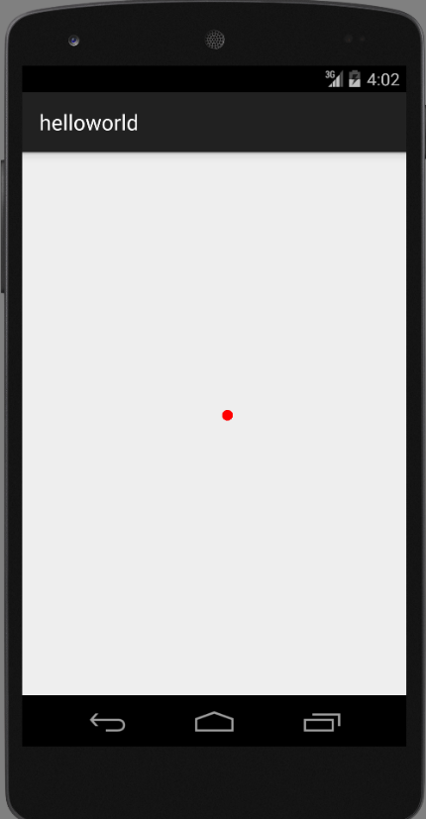
  Programming Guide
Override callback function

Slide 28
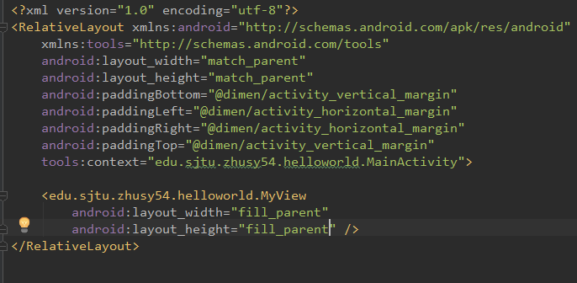
  Programming Guide
Override callback function

Slide 29
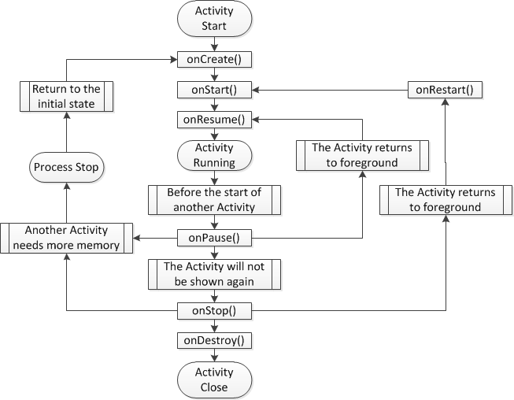
  Activity Lifecycle
Life-cycle of an Android Activity

Slide 30
Thank you !

