Slide 1
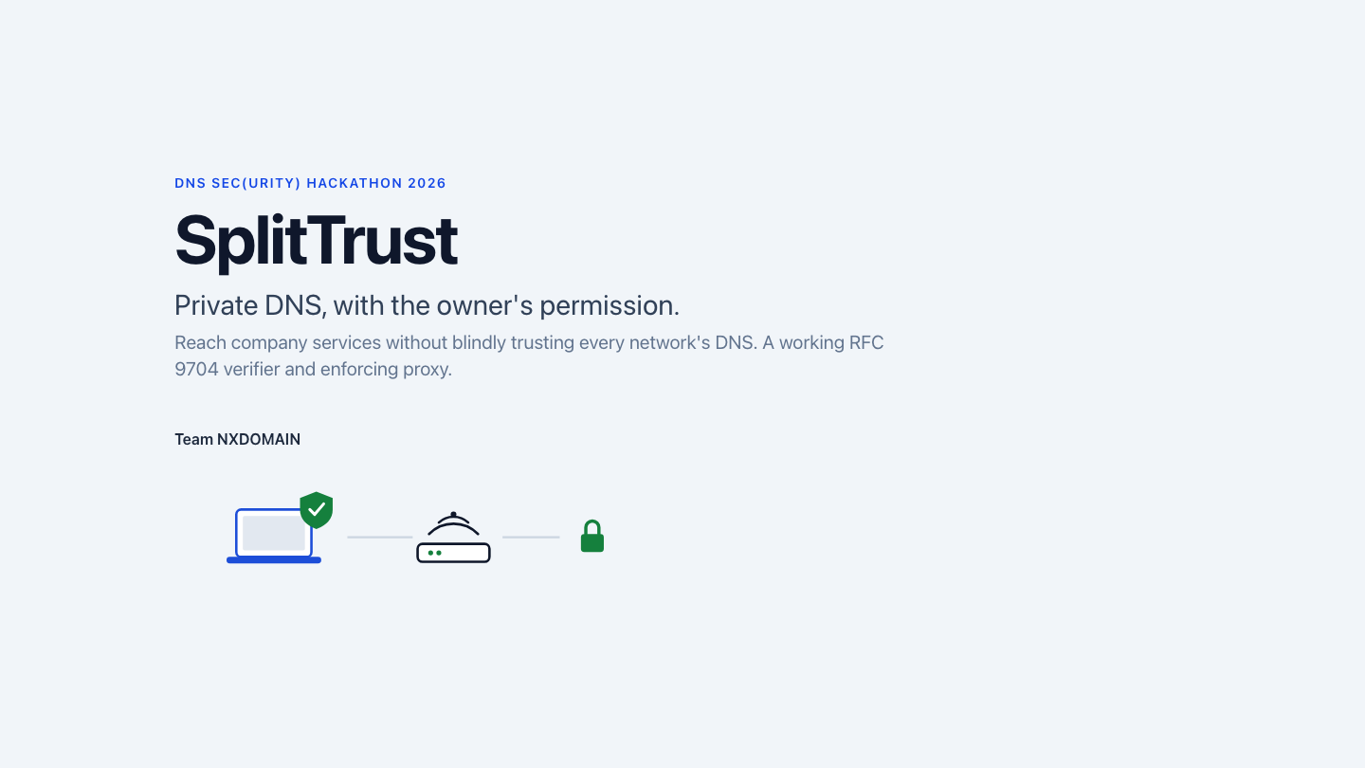
Notes:
Hi, we're Team NXDOMAIN and this is SplitTrust. It answers a question your laptop can't answer today. A network says: "my resolver answers for your company's names." Did the company actually agree?

Slide 2
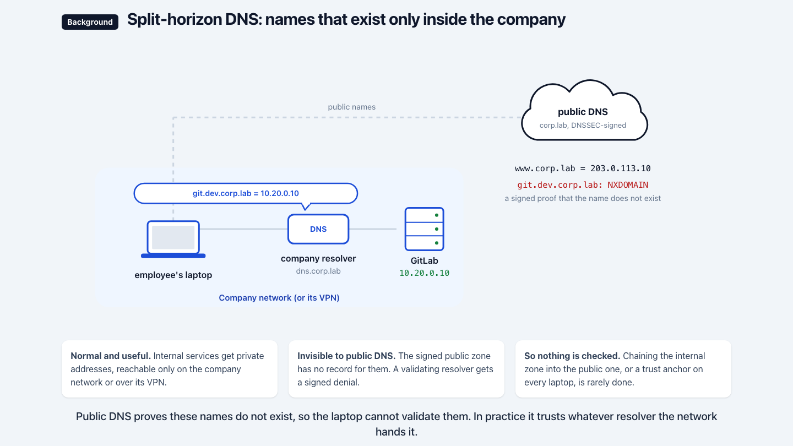
Notes:
Quick background. Companies run internal services, say a GitLab, with an internal DNS view: git.dev.corp.lab resolves to a private address, 10.20.0.10, only on the company network or its VPN. Public DNS has never heard of it; the signed public zone even proves the name does not exist.
That worked while laptops used whatever resolver the network gave them. That's changing: Private DNS on phones, encrypted DNS on Apple and Windows, DNS over HTTPS in browsers. Such a device never talks to the office resolver, so the private name doesn't resolve for it at all. The company has to ask the device for an exception: "for these names, use this resolver."

Slide 3
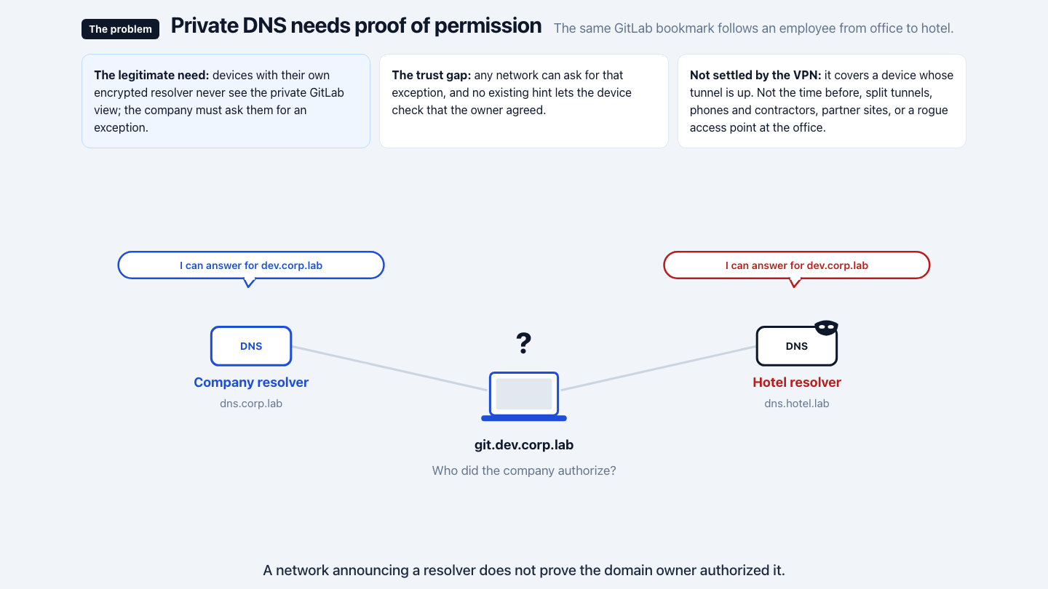
Notes:
And that exception is the problem, because any network can ask for it. A hotel router hands out a resolver claiming the same names, and, in the RFC's words, no existing hint mechanism lets the client find out whether the owner authorized it. Two bad options: trust every hint, and a hotel points git.dev.corp.lab wherever it likes; trust none, and the private view breaks whenever the device isn't on the network's resolver.
"Just use the VPN" covers a laptop whose tunnel is up and carrying DNS. Not the minutes after joining the Wi-Fi, captive portal open, mail client already resolving internal names. Not a split tunnel, not your phone, not a contractor, and not the office itself, where nobody runs a VPN and a rogue access point can hand out its own resolver. Requiring DNSSEC breaks the real intranet like the forged one. The device needs a way to ask the company: did you authorize this resolver?

Slide 4
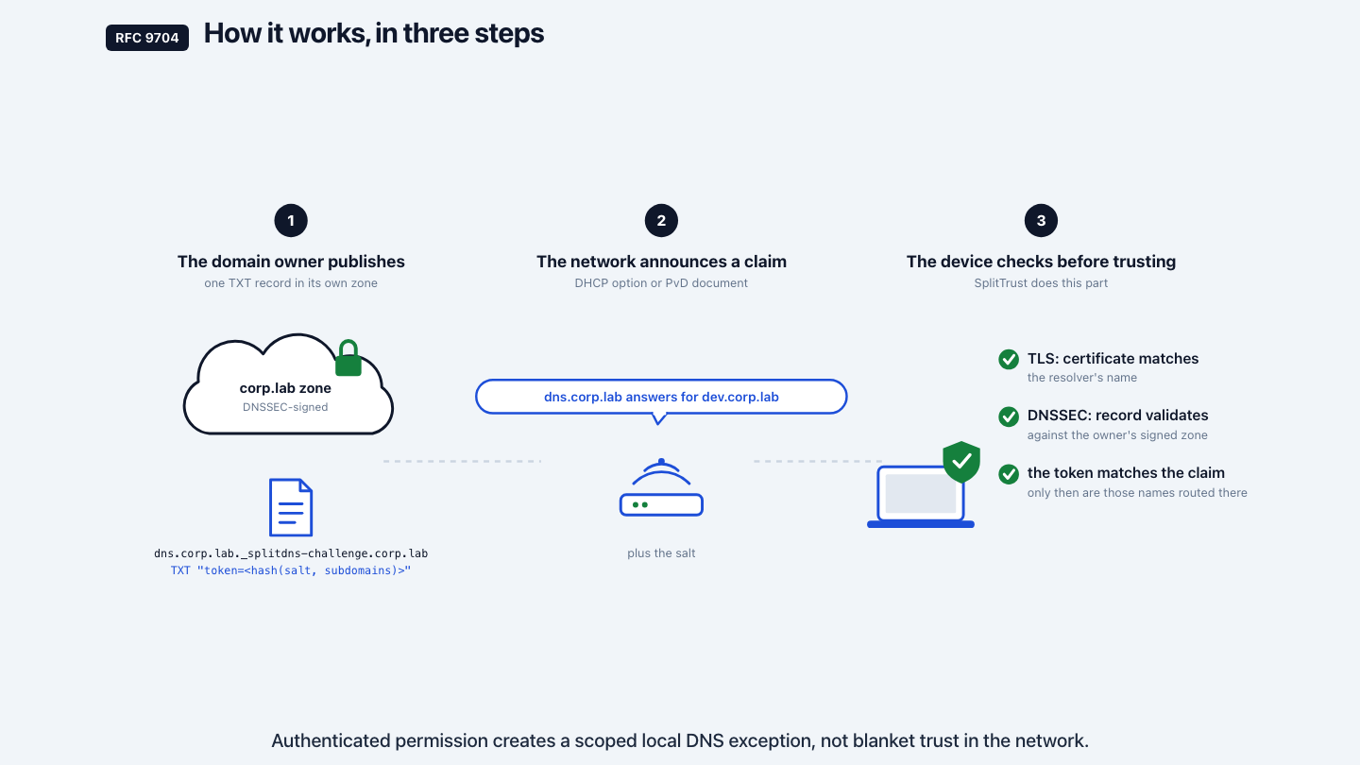
Notes:
RFC 9704, published in January, answers that in three steps. One, the owner publishes a Verification Record: one TXT record in its signed public zone, under the resolver's name, with a salted hash of the names that resolver may answer for. Two, the network makes its claim: this resolver, these names, this salt. Three, the client checks before it trusts: TLS to the resolver, certificate matching the name; the owner's record, validated with DNSSEC; the hash recomputed and compared. Only then does it send those names, and only those, to that resolver.

Slide 5
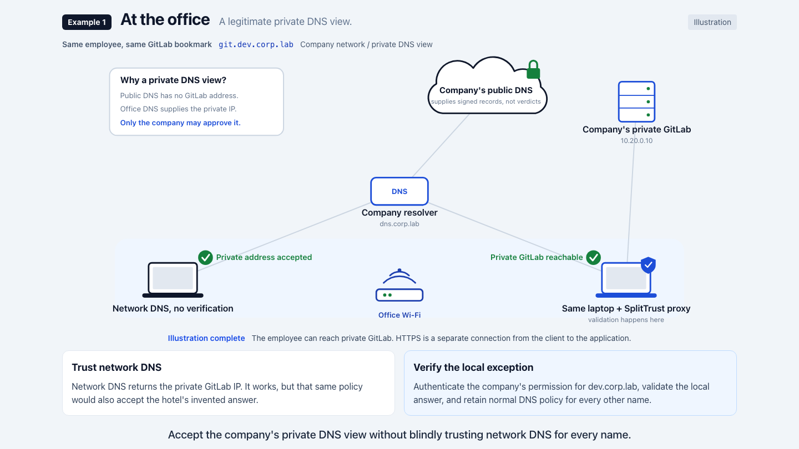
Notes:
Our employee at the office, GitLab bookmark open. [the animation runs] The laptop asks the company resolver to prove its name over TLS, fetches the company's record, validates it, compares the token. Accepted. The private answer, 10.20.0.10, is used; every other name keeps its normal DNS policy. The private view was always legitimate. Now it's also checked.

Slide 6
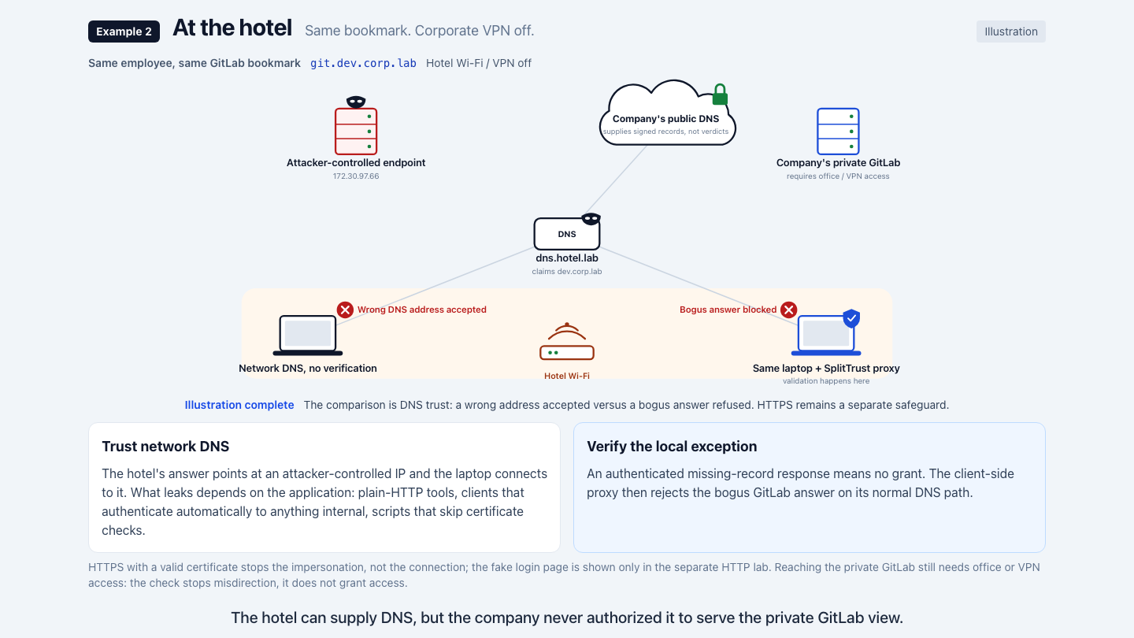
Notes:
Same laptop, same bookmark, hotel Wi-Fi, no tunnel. [the animation runs] Network DNS hands out an address the attacker controls, and a laptop that trusts the network connects to it. What leaks depends on the application: plain-HTTP tools, Windows clients that authenticate automatically to anything internal, scripts that skip certificate checks. HTTPS stops the impersonation, not the request.
With SplitTrust the laptop asks the public zone: is there a record authorizing the hotel's resolver? The company's signed answer: no. No exception; the invented address is thrown away. The name fails to resolve instead of resolving to the wrong place. This doesn't get you into GitLab from the hotel, you still need the office or the VPN. It makes sure the request never goes to the attacker.

Slide 7
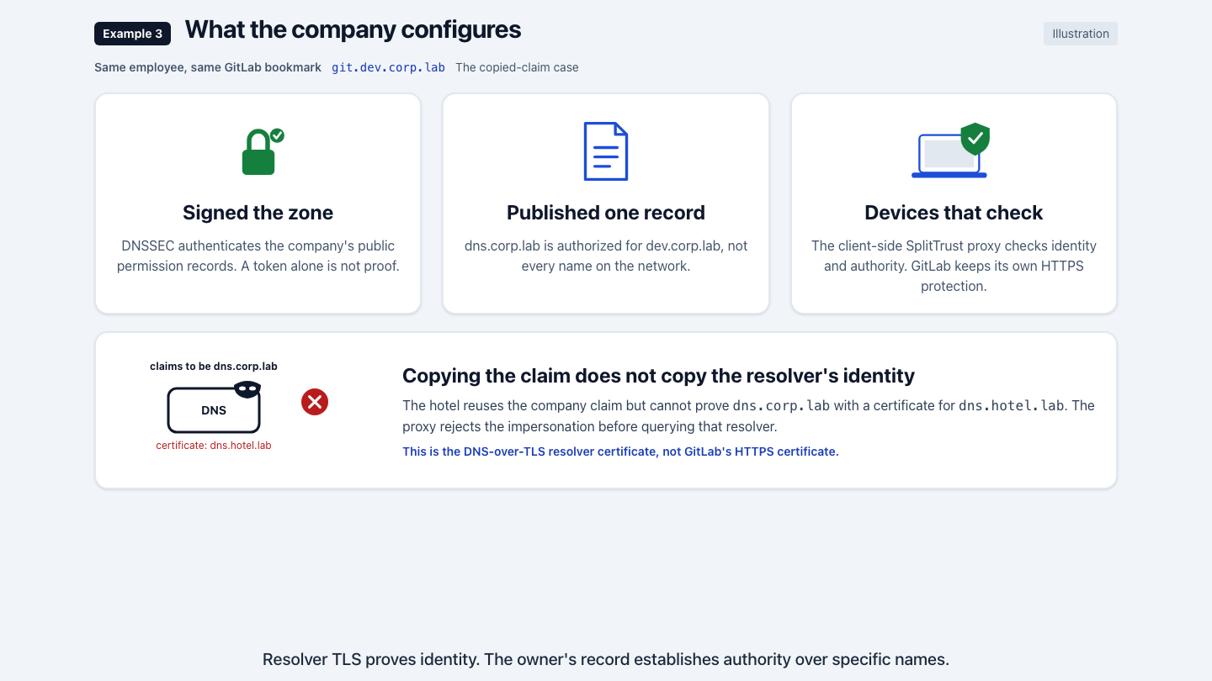
Notes:
Three things. DNSSEC on the zone. One Verification Record, built with our tool. Laptops that check, here through the SplitTrust proxy as their resolver. No application changed.
The record is public, so what if the hotel copies the whole claim? The laptop opens TLS to the announced resolver first: the certificate says dns.hotel.lab, not dns.corp.lab. Rejected before a single query.

Slide 8
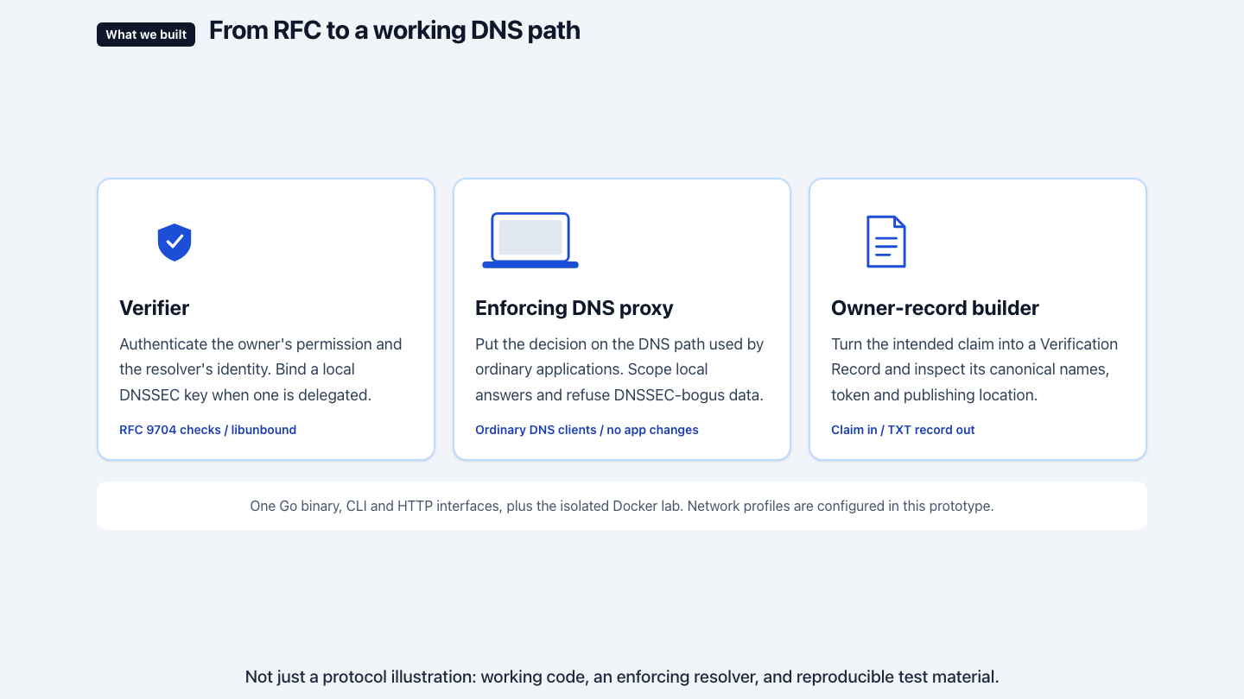
Notes:
A working DNS path, not a drawing of a protocol. The verifier: owner's permission, resolver's identity, the delegated key when there is one. An enforcing DNS proxy on the path ordinary applications use: scoped answers, anything DNSSEC-bogus refused with SERVFAIL and an Extended DNS Error. The record builder: claim in, TXT record out. One Go binary, CLI and HTTP, a Docker lab around it. One limit: network profiles are configured here, not discovered on the wire.

Slide 9
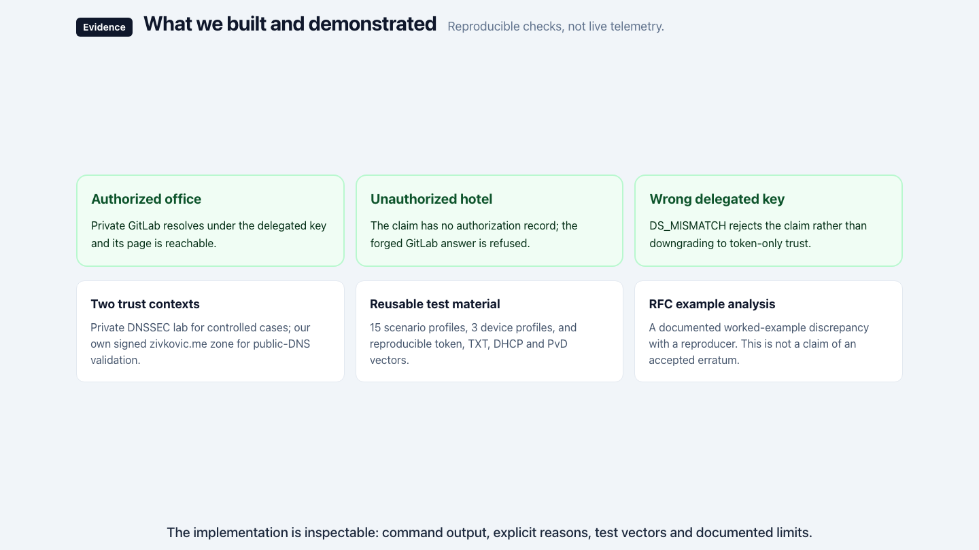
Notes:
What we showed: private GitLab access authorized under the delegated key; the hotel's claim rejected on the company's signed denial; a wrong delegated key refused instead of quietly downgrading. Behind it: fifteen scenarios, three device profiles, reproducible test vectors, a private DNSSEC lab plus our own signed zone on the public DNS, and a documented discrepancy in the RFC's worked example.

Slide 10
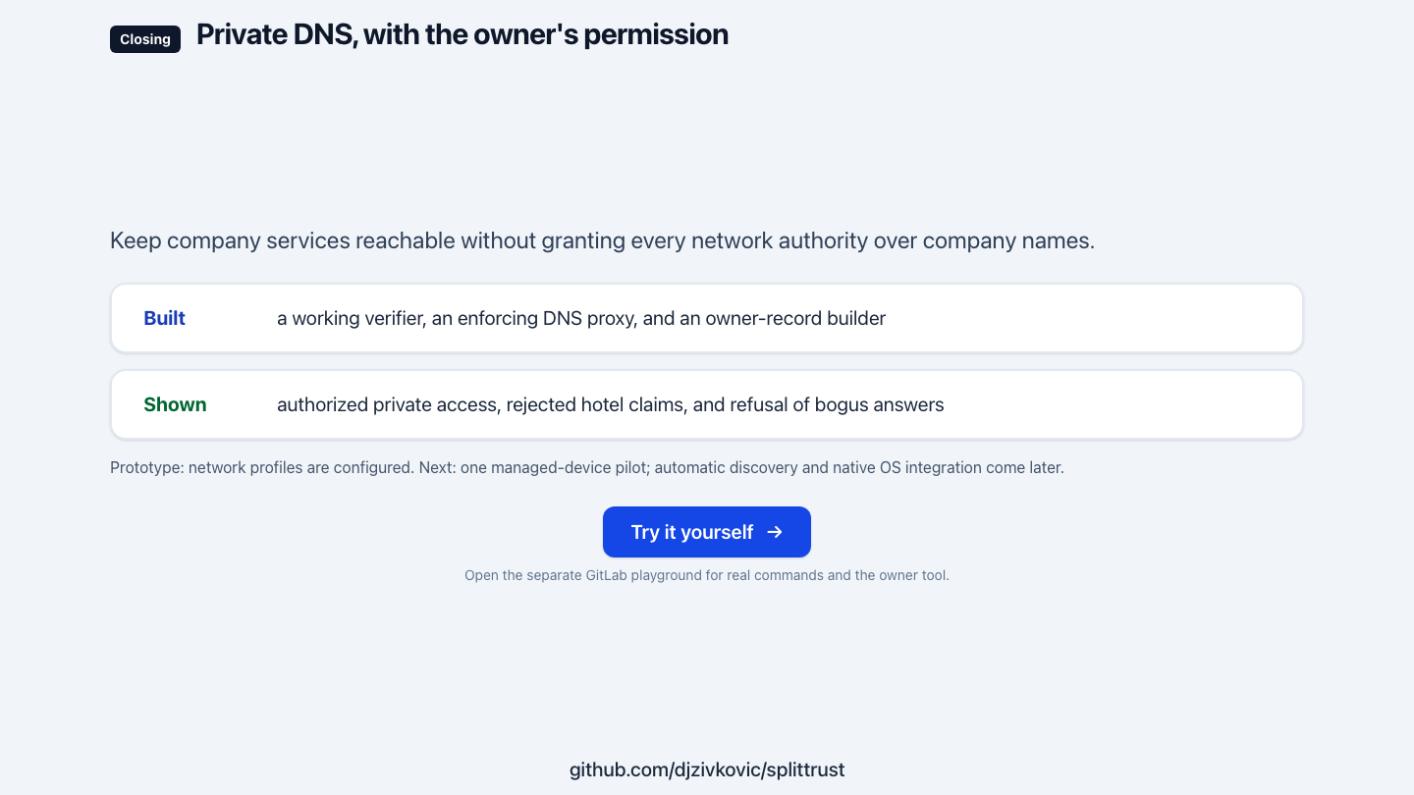
Notes:
Private DNS that works, without handing every network you join authority over your company's names. It's there to inspect in the playground. What we want next is one managed-device pilot with a company that runs split-horizon DNS. Thank you.

