Slide 1
Scmbug: Policy-based Integration of Software Configuration Management with Bug-tracking
Kristis Makris <kristis.makris@asu.edu>
Arizona State University
Kyung Dong Ryu <kryu@us.ibm.com>
IBM T.J. Watson Research Center

Slide 2
Motivation
Key software engineering issues in large software development
  Software Configuration Management (SCM)
    Create, store and label changesets
    Modifications traceability: what changed and how
    e.g. CVS, Subversion, Perforce, ClearCase
  Bug-tracking
    Document development and justify changes
    Defect and feature traceability: why make changes
    e.g. Bugzilla, Mantis, ClearQuest

Slide 3
SCM Example
$ vi readnet.c # Edit new source code
$ gcc readnet.c; ./a.out # Compile and test
$ cvs add readnet.c # Add this file in version control
cvs add: scheduling file `system.c' for addition
$ cvs commit readnet.c # Commit the 1st version of the file; enter a log message
Checking in readnet.c; initial revision: 1.1
$ vi readnet.c # Make more changes
$ gcc readnet.c; ./a.out # Compile and test
$ cvs commit # Commit the newer version; enter a log message
Checking in readnet.c; new revision: 1.2; previous revision: 1.1
$ cvs diff –r1.1 –r1.2 readnet.c # View what changed
85,87c85,97
< netstruct->type=htons(80);
< netstruct->app=htons(10);
---
> netstruct->m_sType=htons(800);
> netstruct->m_sApp=htons(10);
$ cvs log –r1.2 readnet.c # View log message
revision 1.2; date: 2004/06/07 22:00:23; author: kmakris; lines: +2 -0
Use the new field names from struct kernel_data.
Why use new field names ?
Which feature is implemented ?

Slide 4
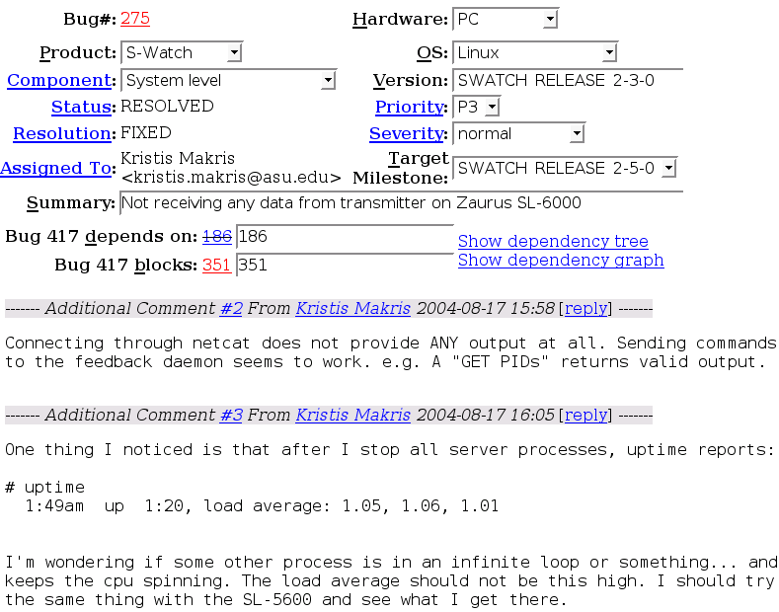
Bug-tracker example
How was it fixed ?
What changed ?

Slide 5
Motivation
Problem
  Given what changed, cannot determine why
  And vice versa
Solution
  Tie what with why
  Integrate SCM with bug-tracking. Improve:
    Changeset traceability
    Quality of defect reports
    Quality of release documents

Slide 6
Demand
Sourceforge.net
  98,000 projects, over 1 million users
GNU Savannah
  2,300 projects, 34,000 users
Public Internet
  CVS, Subversion, Bugzilla, Mantis mailing lists

Slide 7
Related Work
Bugzilla email gateway
  Asynchronous verification checks: error-prone
CVSZilla
  Modifies Bugzilla DB schema: breaks future releases
Perforce P4DTI, ClearCase/ClearQuest
  No abstract bug-tracker interface
All systems above
  Assume local network installation
    except Bugzilla email gateway
  No separation between policy and mechanism

Slide 8
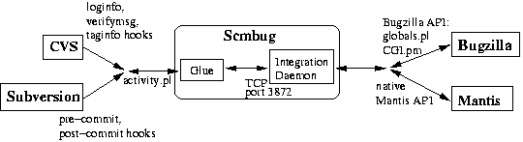
System Architecture
Policy-based
integration
Bug-tracker
integration backends
SCM integration frontends

Slide 9
Integration Example
Demo: http://bugzilla.mkgnu.net/
Σ-Watch bug 417
  No data received from a Zaurus SL-6000 PDA
  Bug reported on 2004-08-17
  Root of problem identified on 2004-8-19
  Bug fixed on 2004-08-21
  Can one trace
    What changed ? Bug id → Changeset
    Why is this a bug ? Changeset → Bug id

Slide 10
Integration Example
Demo: http://bugzilla.mkgnu.net/
A patch to bug 417
Only shows what changed
RCS file: /projects/sigmawatch/system/src/host_node/userspace/server/readnet.c,v
retrieving revision 1.8
retrieving revision 1.9
diff -u -r1.8 -r1.9
--- readnet.c 7 Jul 2004 19:03:02 -0000 1.8
+++ readnet.c 21 Aug 2004 18:47:22 -0000 1.9
@@ -32,7 +33,7 @@
fgets(netbuff,100,net);
while(fgets(netbuff,100,net)){
- if (strstr(netbuff,"eth0")) break;
+ if (strstr(netbuff, CONFIG_NETWORK_DEVICE)) break;
}
How is CONFIG_NETWORK_DEVICE defined ?

Slide 11
Integration Example
Demo: http://bugzilla.mkgnu.net/
SCM log comment for patch
$ cvs log –r1.9 readnet.c
revision 1.9
date: 2004/08/21 18:47:22; author: mkgnu; lines: +2 -1
SCMBUG ID: 417
SCMBUG NOTE:Now using the name of the network device that is
appropriate for each architecture on which the SigmaWatch backend
processes are deployed. This name is setup through an autoconf
variable.
How did configure.in change ? At which version ?
Why set the name through an autoconf variable ?
What else changed ?

Slide 12
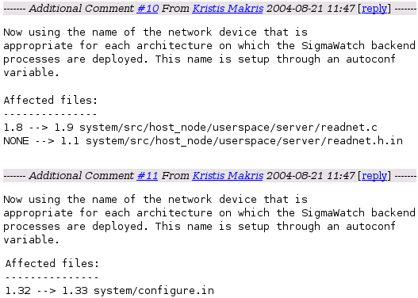
Integration Example
Demo: http://bugzilla.mkgnu.net/
Bug-tracker comments at bug 417
Improved changeset
traceability

Slide 13

Integration Example
Demo: http://bugzilla.mkgnu.net/
Why was a patch applied ?
  Root of problem:

Slide 14

Why an Integration Daemon ? (1)
Public internet deployment
  Mobile (laptop) local SCM repository; public bug-tracker; offline development
  Collaboration between mutually untrusted participants (no VPN access)
  No connections to bug-tracker database from glue
Stand-alone DB backends
  No TCP port listening (e.g. based on Berkley DB)
  Debian debbugs; file-based

Slide 15
Why an Integration Daemon ? (2)
Bug-tracker codebase reuse
  Safe from schema updates
Bug-tracker DB schema limitations
  No SCM username: maintain username mapping
SCM system limitations
  No atomic commits in CVS: duplicate log messages
    Cache integration requests
    Detect duplicate log messages
    Merge

Slide 16
Integration Policies (1)
Presence of bug ids
  Tie what changed with why
  Cannot commit without a bug id
Minimum log message size
  A commit log message must be > 50 characters
  Force developers to document changesets
Valid bug owner
  Assigned work conflict detection
Open bug state
  Formal bug dispositioning process

Slide 17
Integration Policies (2)
Valid product name
  Wrong bug id entered ?
Convention-based labeling
  Uniform labeling scheme
    Releases: SCMBUG_RELEASE_0-2-7
    Developer builds: SCMBUG_BUILD_29_mantis
    Forks: b_glue_side_policies
    Private labels: p_kpm_pre_bug353_fixes

Slide 18
Improved Release Documents
SCM Changelogs
  Lower, developer-level changeset documentation
  Lengthy, hard to decipher
  Do not reflect decisions to not add a feature
Version Description Document (VDD)
  High-level (bug summary) + low-level details
    List worked-on bugs between releases
  Reports newly identified bugs
  Supercedes SCM Changelogs

Slide 19
Integration Challenges (1)
Integration upgrades
  Four-stage upgrade process
    Disable glue
    Upgrade all SCM repositories
    Upgrade daemon
    Enable glue
  SCM glue library packaging (CVS)
    Can lead to dead-end hooks; correct manually
Bug-tracker schema
  No SCM fields (e.g. list of affected files or version)
    Insert directly in bug comments

Slide 20
Integration Challenges (2)
Subversion
  Labeling is just another commit (svn copy)
    Detect creation of new directories under tags, or branches
    Treat as labeling request
CVS
  Does not store release date
    Need heuristic to guess date
  No log comment on labeling
    Lose reason why label was applied

Slide 21
Early Experience
Used for 1 year in 3 projects
  Σ-Watch: 220 bugs, 3 developers
  Framework for Adaptive OS: 140 bugs, 4 developers
Verification check error breakdown (estimate)
  Valid log message size (~60%)
    Logs not long enough
  Valid bug owner (~20%)
    Developer miscommunication
  Open bug state + valid product name (~20%)
    Input error entering bug id

Slide 22
On-going Work
Study of effects on productivity
Version Description Document
Distributed repositories
  Arch, Bitkeeper
  Capture <branch, repository> in SCM frontend
Disconnected mode
  Used by OpenCM; explored by Subversion
  Local integration proxy daemon
    Cache bug-tracker’s metadata; integrate; synchronize

Slide 23
Conclusion
SCM and bug-tracking integration
  Changeset metadata
  Software labels
Benefits
  Changeset traceability
  Quality of defect reports
  Quality of release documents
Design modularity
  SCM frontends
  Synchronous, policy-based verification checks
  Bug-tracker backends

Slide 24
Questions ?
Download Scmbug from:
http://freshmeat.net/projects/scmbug/

