Slide 1
EMPLOYEE RECORD MANAGEMENT SYSTEM
By – Daneshwari Kankanwadi
B. Tech – Computer Sc. And Engineering
School of Engineering
Jawaharlal Nehru University

Slide 2
Tools and Technologies used
Programming Language - C++ is an object-oriented based programming language. It is close to the real world as it assumes objects which have features.
GNU gcc compiler : the FSF compiler, it converts the source code into executable instruction file. GCC stands for GNU Compiler Collections, the different options of gcc command allows users to stop the compilation process at different stages.
Visual Studio Code(VS code) - To edit and create the code for the system, VS Code IDE was used. It provides rich extensions and terminal and PowerShell compatible. The code can be executed and run there itself in the editor.
Text files - To store all the data
GNUplot - To plot and show the statistics

Slide 3
OOP concepts
used
Objects and Encapsulation
Polymorphism
Data Hiding
Inheritance
Abstraction and virtual function
Exception Handling
Default Parameters

Slide 4
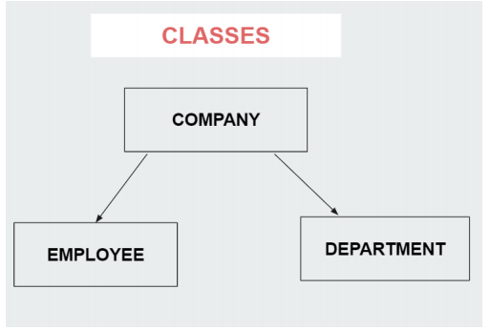

Slide 5
Login System to manage both Admin and Employee login
Basic CRUD operations
EMPLOYEE RECORD MANAGEMENT SYSTEM
Separate interface/portal for Employee and admin
Data Visualisation feature like –
a. How many employees were admitted in year 2018, 2019, 2020
b. How many managers or Workers or Executives are there in the company and to which department they belong, along with their year of recruitment
Leave filing facility for Employees – Their leave date, number of days and reason of leave gets highlighted in the employee records.
Menu based interface for both Admin and Employee
Data updating facility to employee in case he/she wants to update their personal details.

