Slide 1
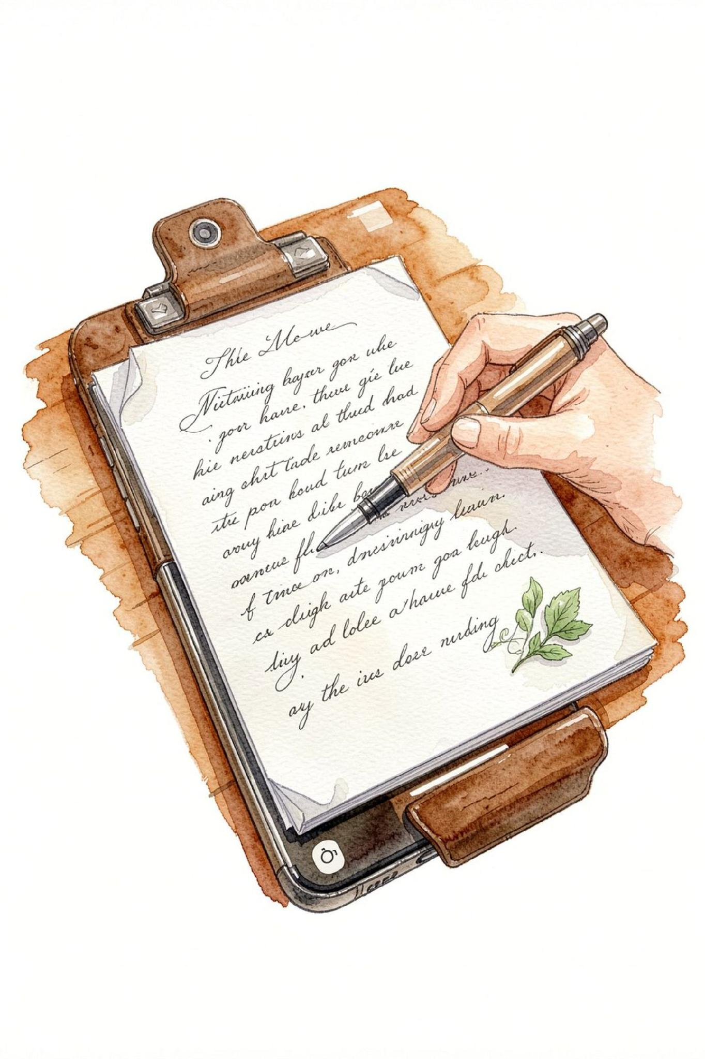
MedBridge
One Photo. One Clear Picture of Everything You're Taking.
HealthTech | iQOO Hackathon 2026 — Pune Battle 02 ·
Daksh Khandelwal
Khushi Kushwah

Slide 2
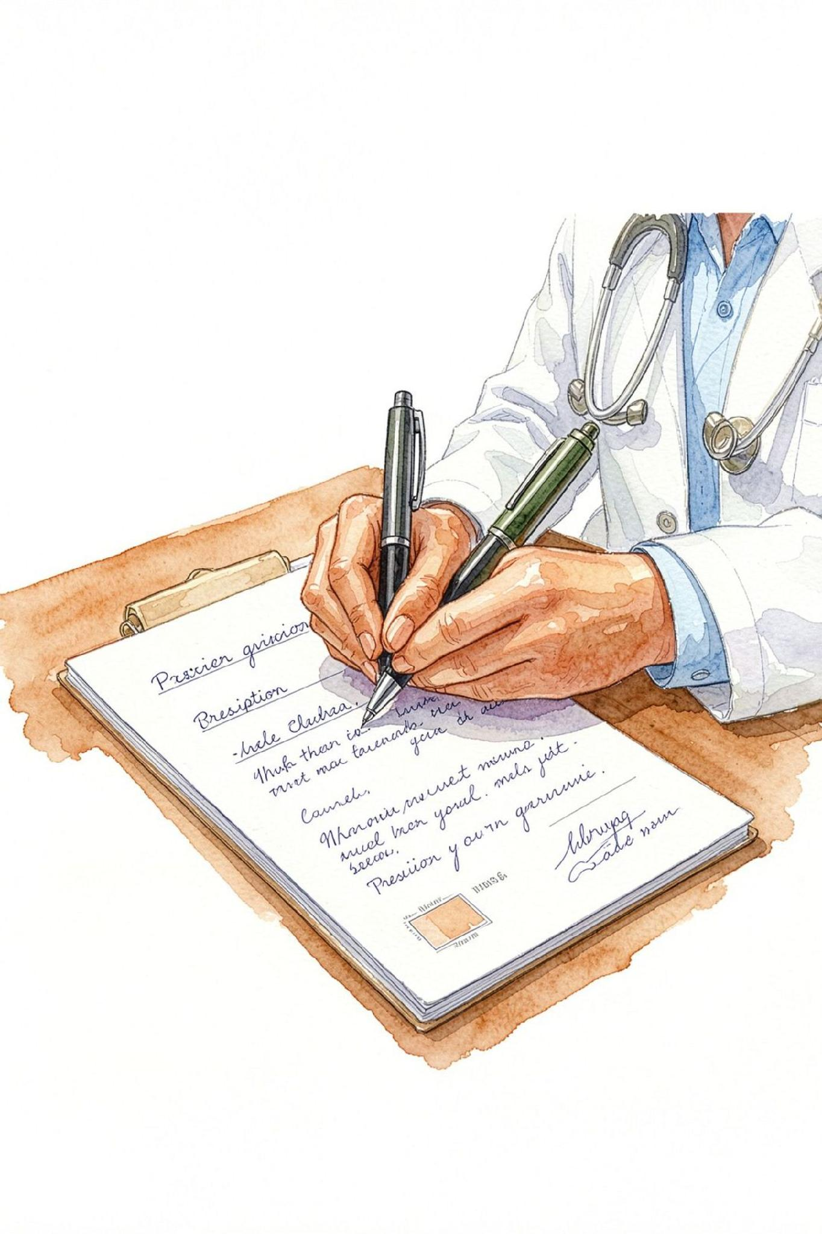
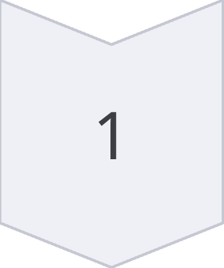
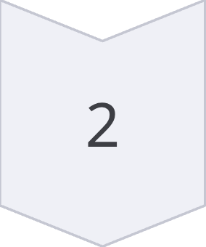
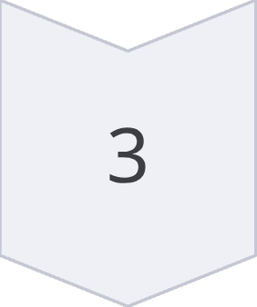
Can you read what your doctor wrote?
Reading
Confusion
Confusion
Fragmented information
Fragmented
Unsafe medication management
"The prescription is written for the doctor. The patient still has to live with it."

Slide 3
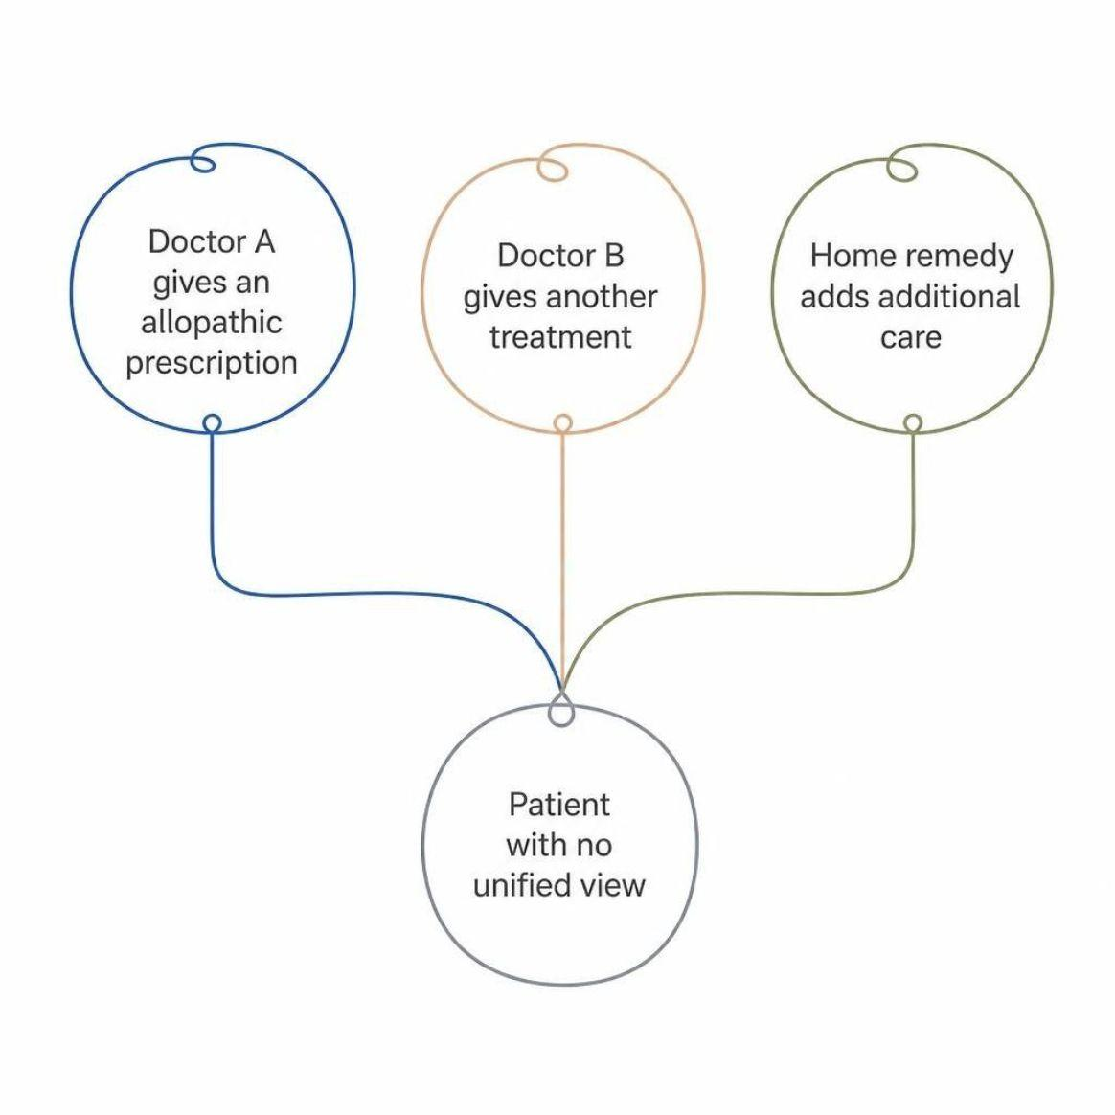
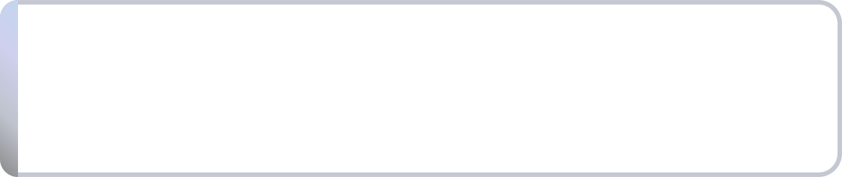
The problem doesn't end with the prescription.
One patient. Multiple practitioners. Fragmented information streams.
Different treatments. Different sources. No single picture.
MedBridge creates one clear medication picture.
Doctor A
Doctor B
Home Remedy
Allopathic prescription
Additional treatment
Parallel care

Slide 4
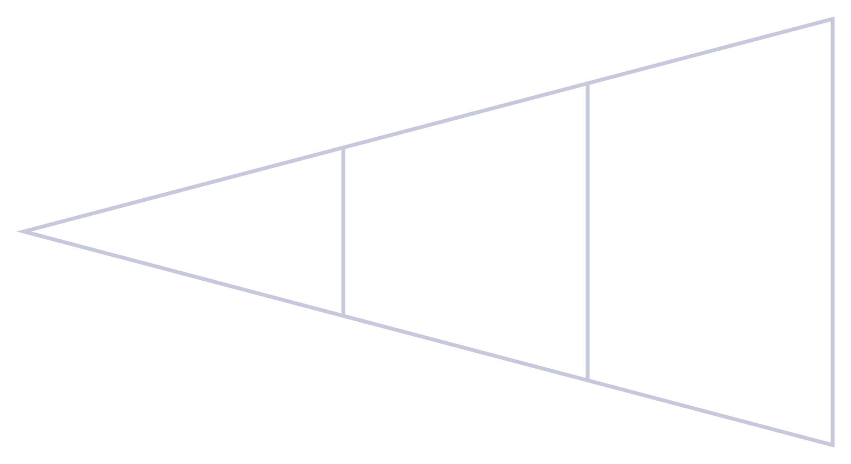
Meet MedBridge.
Smartphone-centered. One photo transforms everything.
Photo
Explain
Understand
📸 Photo
📖 Explain
Capture any prescription instantly
Simple language + voice read-aloud
📋 Organize
🔗 Reconcile
Clear medication timeline
Cross-system overlap surfaced

Slide 5
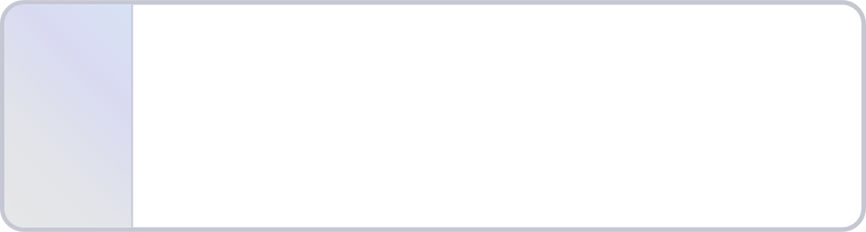
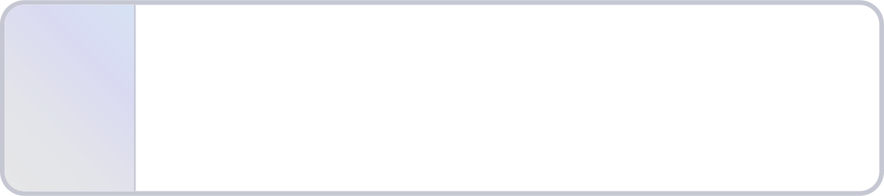
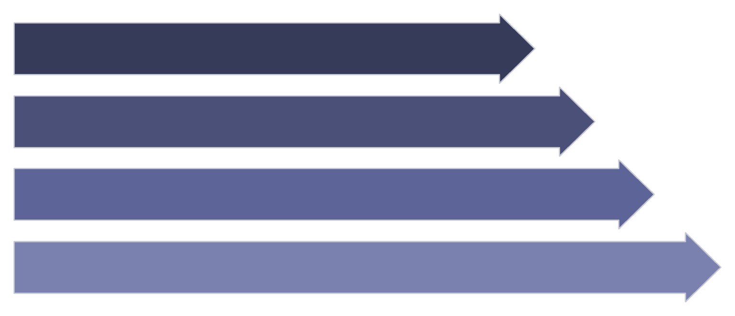

Not a chatbot. A multi-stage AI pipeline.
Vision OCR
1
Google Vision / Claude Vision reads raw handwriting
2
Structured Extraction
Capture
Medicine · Dosage · Frequency · Duration
OCR
Confidence Gate
Structure
3
Uncertain fields surfaced for patient confirmation
Normalize
4
LLM Explanation
Plain-language explanation + voice output
AI does not silently guess. Uncertain information is always surfaced for confirmation.

Slide 6
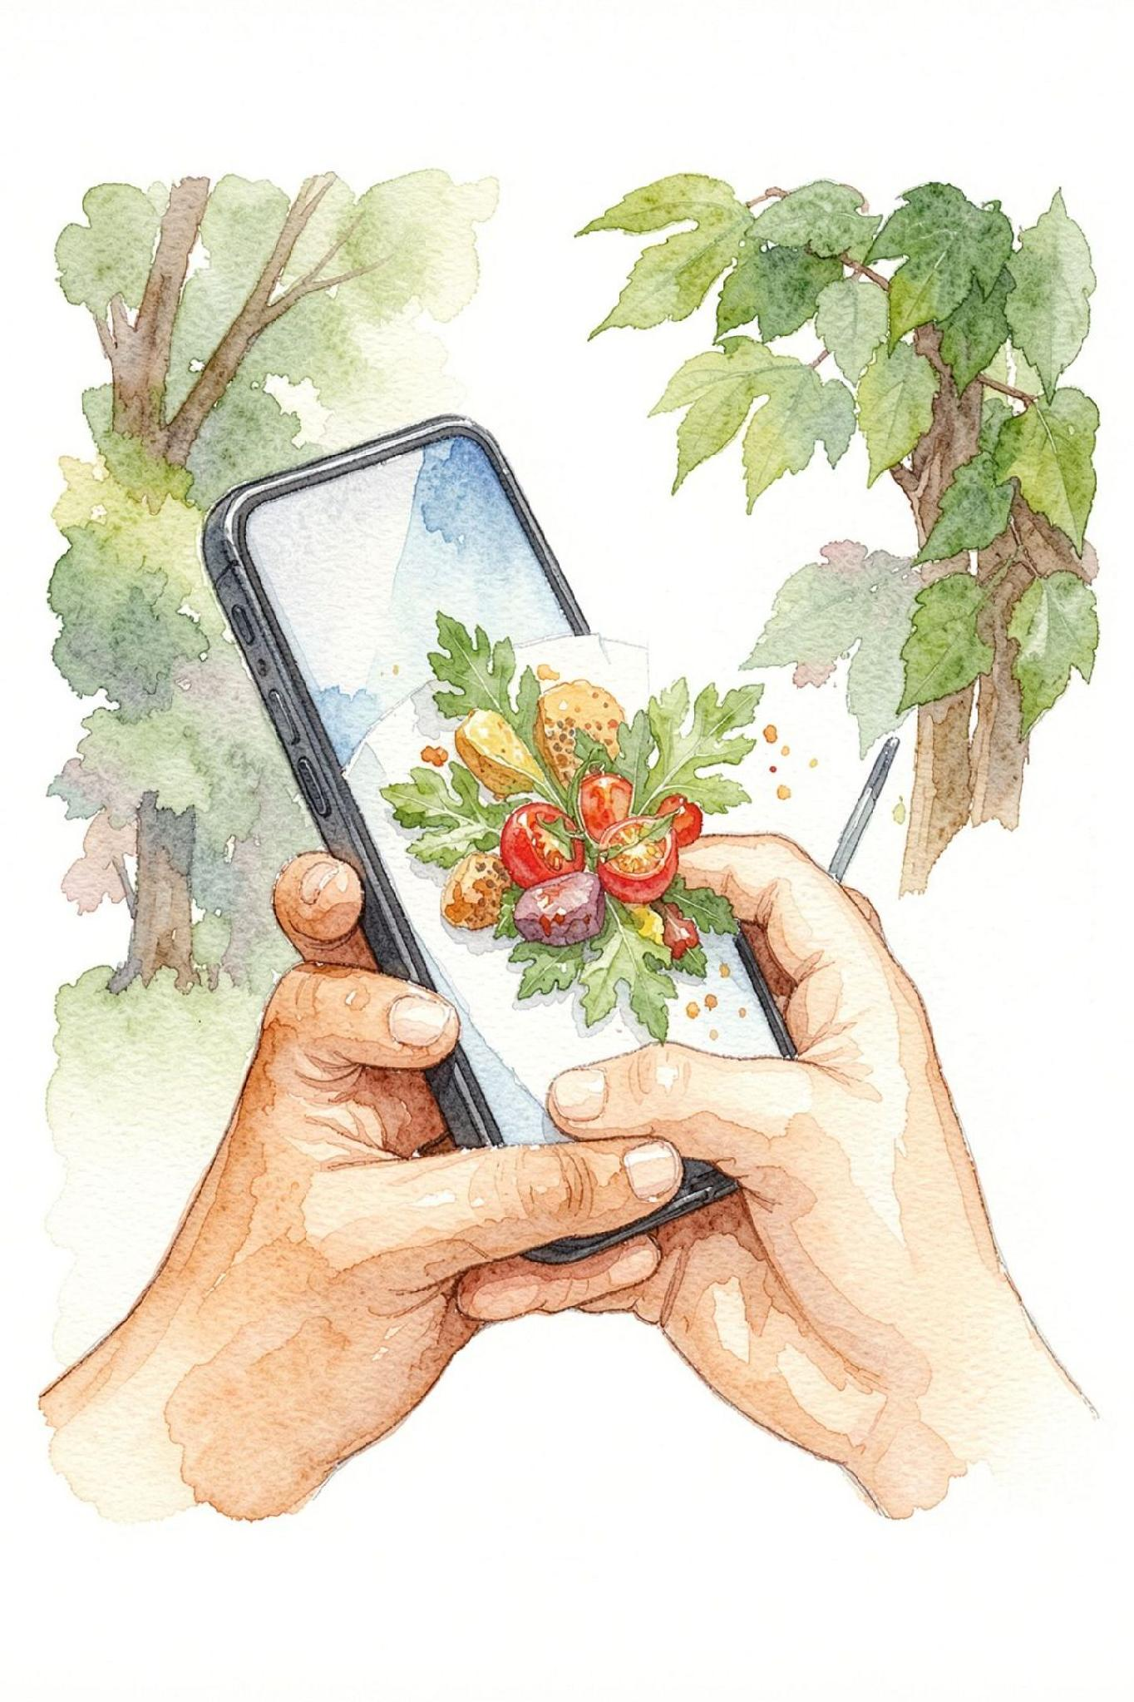




Why the phone matters.
"The input already exists in the patient's hand."
📷 Camera
Capture paper prescriptions instantly — no scanning, no manual entry
🔊 Voice
Hear explanations in Hindi or English
🧠 AI
Understand messy, handwritten medical notation
🎒 Portability
Carry one medication picture anywhere

Slide 7
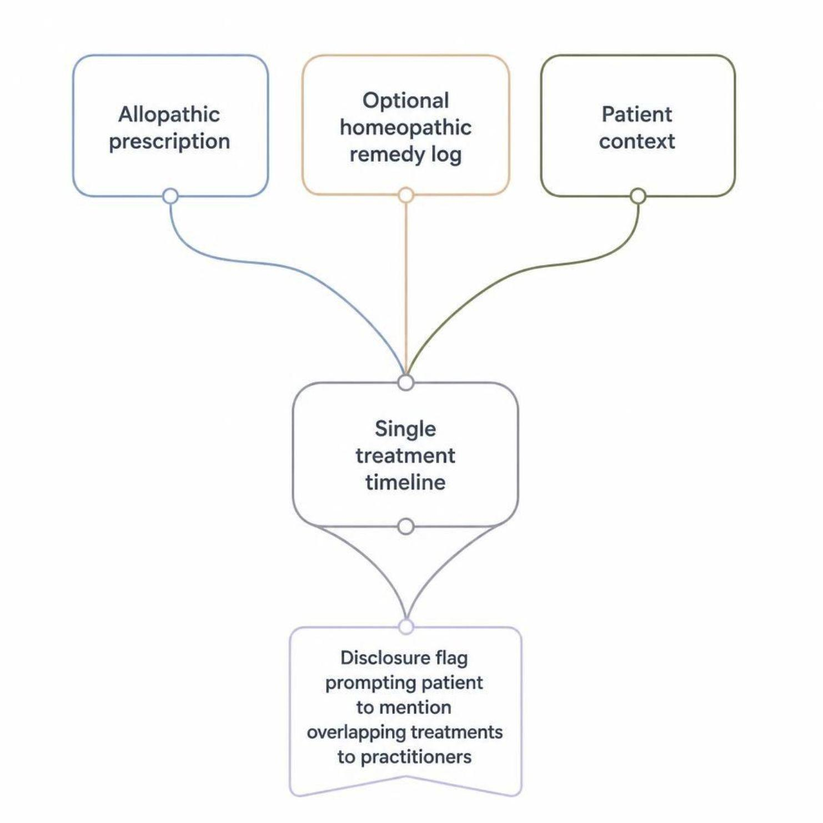



One patient. Multiple systems. One visible picture.
The unique MedBridge capability
Allopathic + Homeopathic Log
Unified Timeline
Single medication and treatment picture
Both systems logged in one place
Disclosure Flag
"You've logged treatments addressing the same symptom from different systems. Consider mentioning this to both practitioners."
⚠️ Traditional / educational information only. Not medical advice.

Slide 8
MedBridge explains. It never decides.
Clear boundaries for safety and trust.
✓ We Do
✕ We Don't
Read prescriptions
Extract information
Organize clearly
Explain simply
Track medications
Surface uncertainty
Encourage disclosure
Diagnose
Prescribe
Tell users to start / stop medication
Replace doctors
Make medical decisions
Claim equivalence between systems
Explain and organize — never decide.

Slide 9
Built for the hackathon. Designed for real life.
30-HOUR MVP
Prior Work
01
Narmada Basin Monitoring
Tech Stack
AI / remote-sensing research
02
Domain insight: Access to practicing homeopathic doctor for terminology and workflow validation.
Jarvis
Python voice assistant — STT, TTS, LLM
03
AI WhatsApp Bot
LLM integration at scale
04
IPL Analytics
Data analytics dashboard
05
ProofDeck
Startup product concept & pitching
Frontend
Backend
Vision
AI
React / PWA
Node / Python
Google Vision / Claude Vision
LLM + Structured Knowledge
Deploy
Vercel

Slide 10
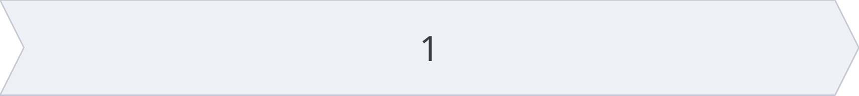
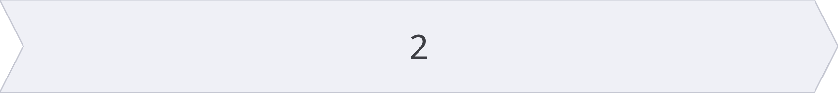
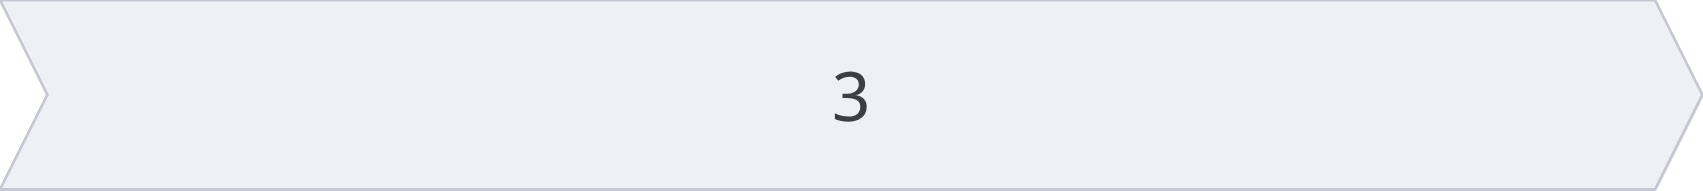
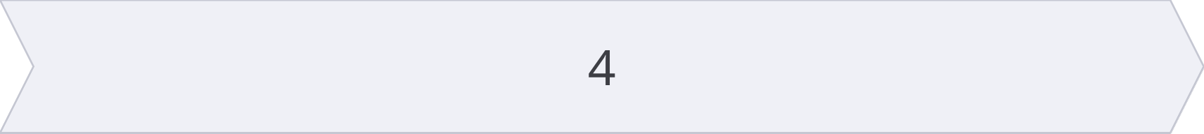
Nothing gets lost.
Between the doctor's pen and the patient's medicine cabinet.
📄 Paper Prescription
📱 Phone
🧠 AI
✅ Clear Medication Picture
Future
Interaction verification · Offline capability · More languages · Pharmacist workflows · Consent-based doctor collaboration
MedBridge
"One Photo. One Clear Picture."
Daksh Khandelwal × Khushi Kushwah

