Slide 1
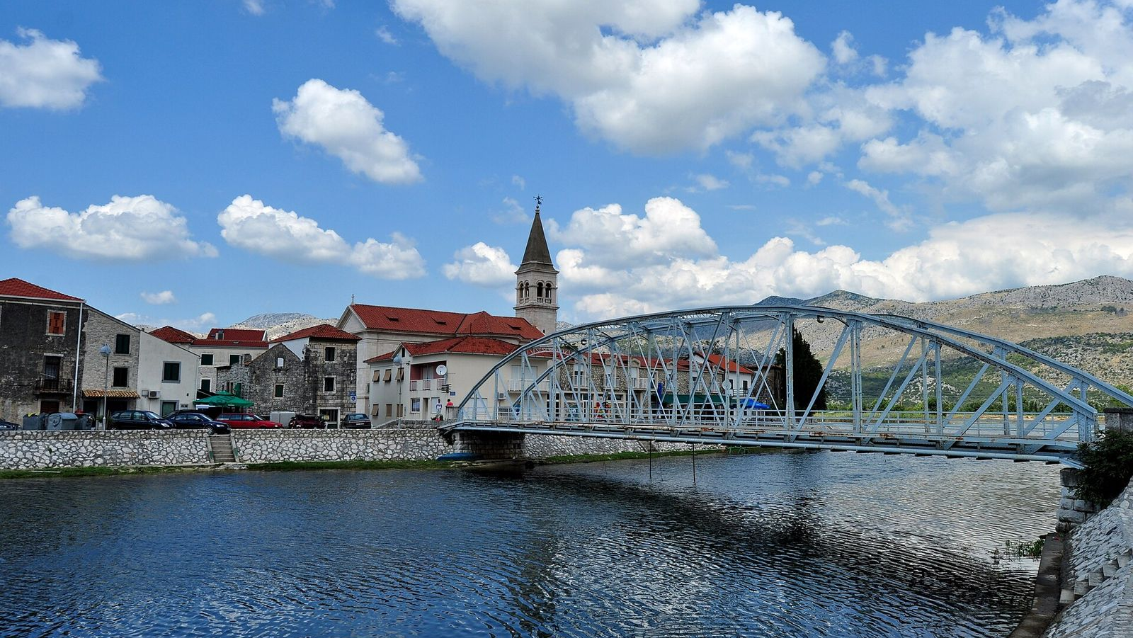
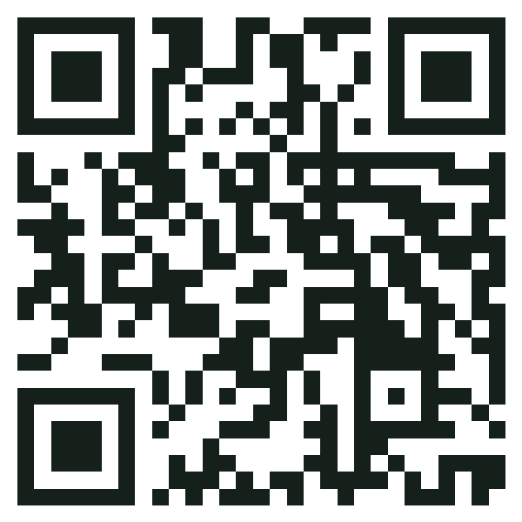
DUBROVNIK-NERETVA COUNTY · ALL YEAR
You travel.
We care.
We change the region around Dubrovnik so it works for visitors and locals in every season, not only in summer.
Scan to follow along
VitaNatura 365 · Tourism 365 hackathon
Notes:
20 s. Slogan, then the one-sentence idea: we are not a travel agency, we change the destination itself. The QR code opens our site so the jury can follow on their phones.

Slide 2
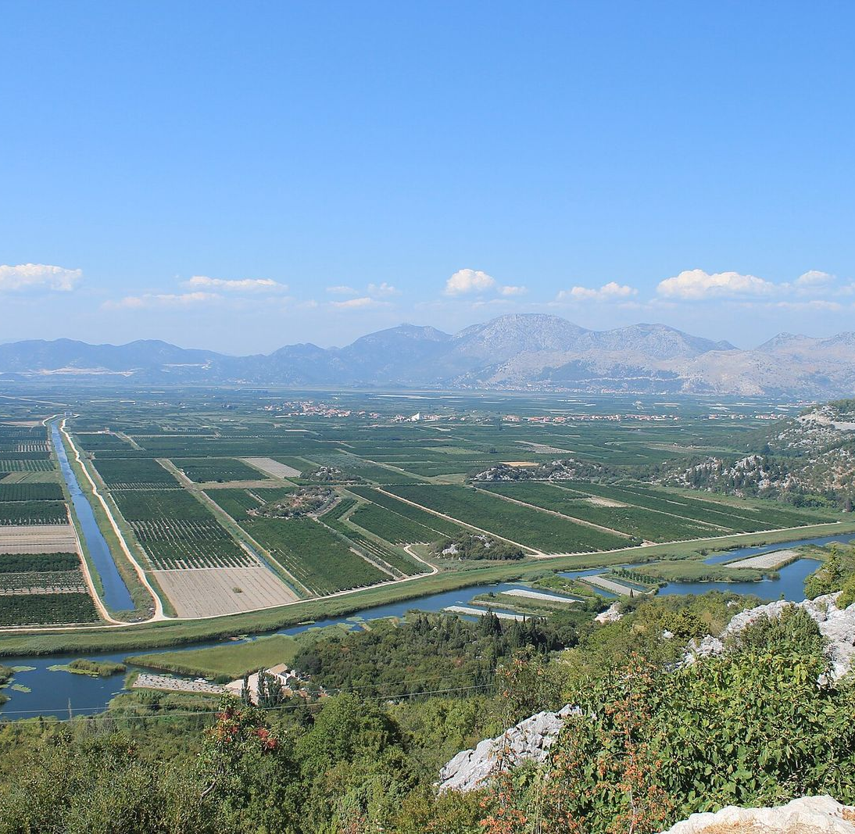



Full for 3 months. Empty for 6.
The destination
In summer the Old Town is packed. From November to March hotels close and the region goes quiet.
The local community
Boatmen, farmers, guides and hotel staff lose their income for half the year. Young people leave the valley.
What is already there
A delta full of birds, mandarin and olive harvests, Ston's walls and oysters, feasts like St. Blaise. All at their best outside summer.
The reasons to come exist. The destination just isn't set up for them.
Notes:
30 s. The need, for both sides: seasonality hurts the city and the people around it, and the region already has what visitors want outside summer.

Slide 3
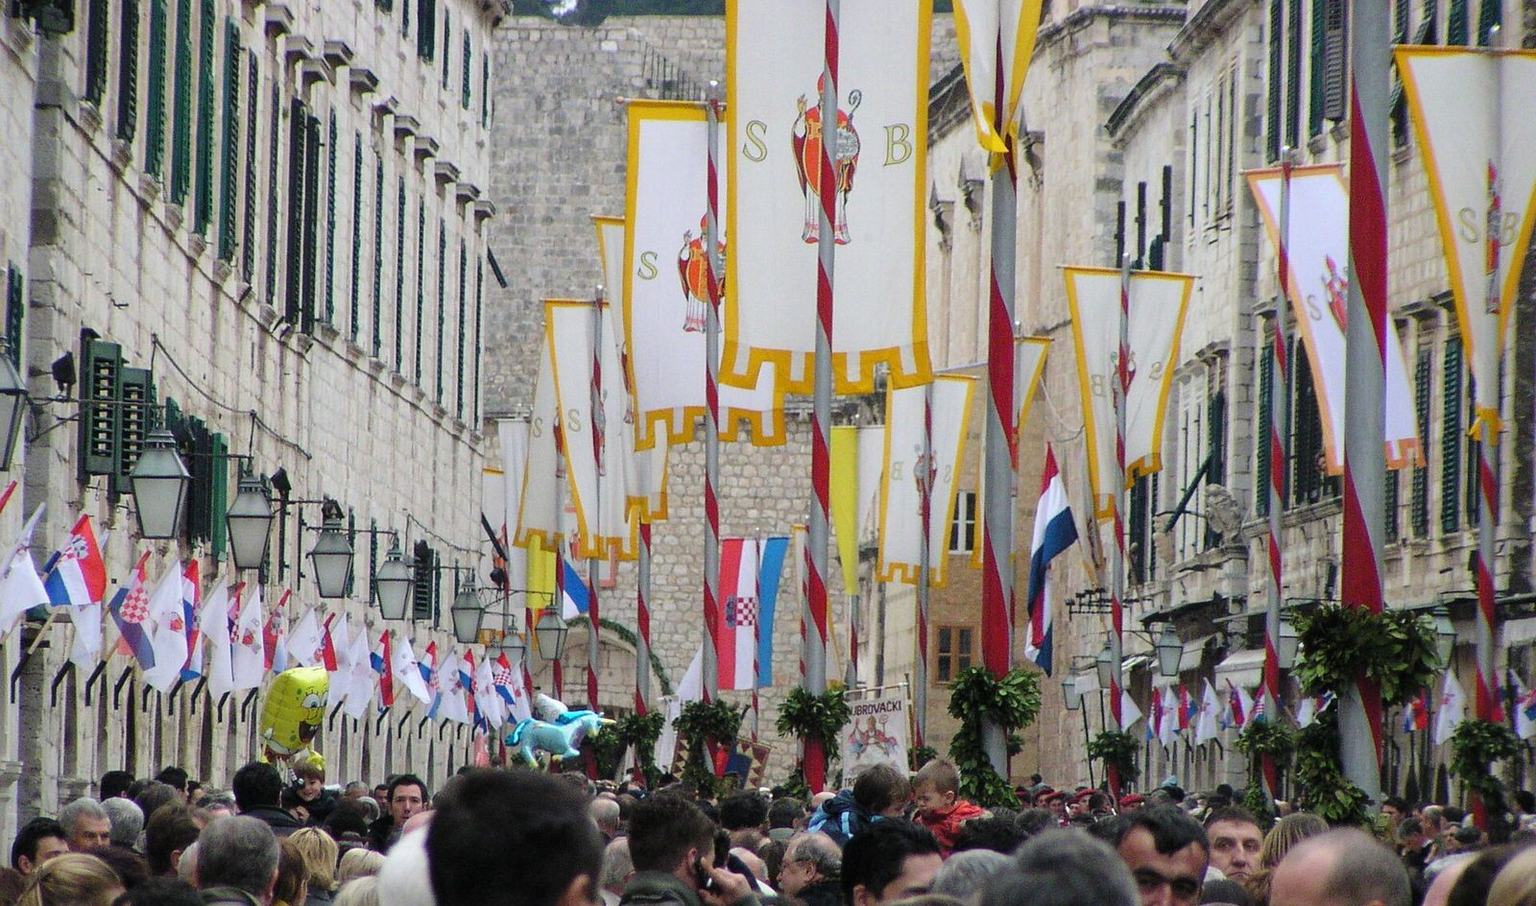
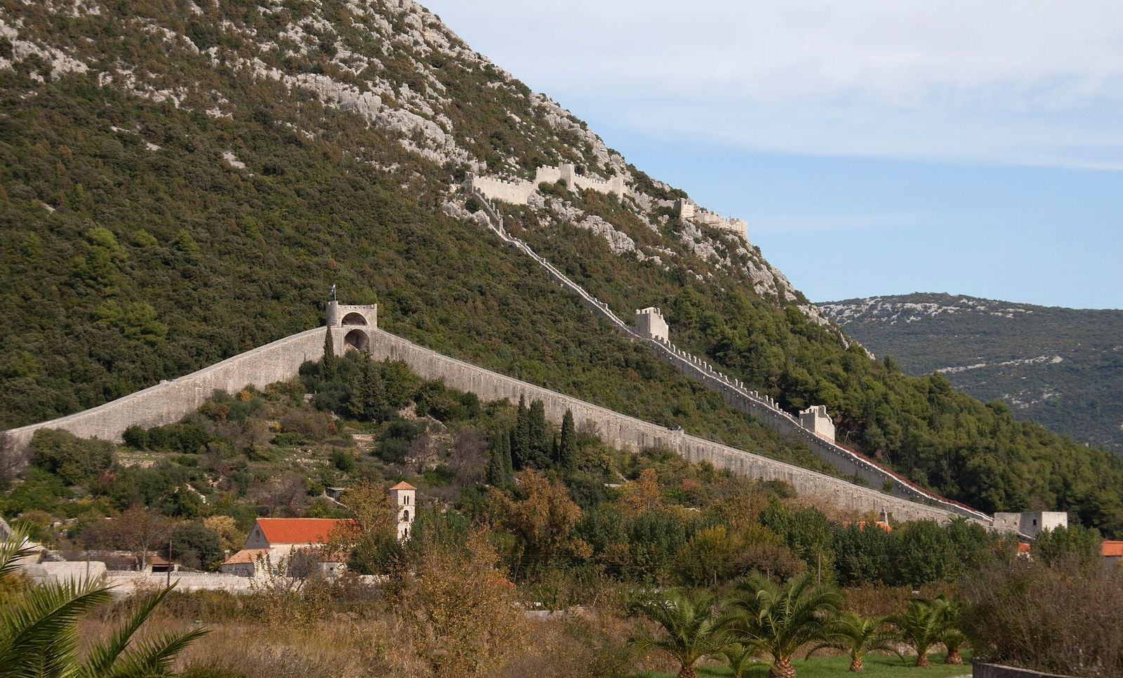



We change the destination, in three ways
1. Stretch the events
2. New activities in the countryside
3. Small things we build
One-day feasts become weeks of workshops and activities. St. Blaise and the Ston oysters first.
Photo safari by lađa, birdwatching and harvests in the Neretva valley, Pelješac and Konavle.
Photo hides, canoe launch points, a birdwatching route, benches and winter hours on the Ston walls.
Notes:
30 s. The core of the brief: concrete changes on the ground, not marketing. Three kinds of change, explained on the next slides.

Slide 4
St. Blaise: from one feast day to a festival week
TODAY
WITH US
3 February
St. Blaise Week, 3 to 9 Feb
Dubrovnik's patron saint feast, on the UNESCO intangible heritage list: processions, flags, the blessing of throats. Then everyone goes home.
3 Feb: the feast as it is today
4 to 5 Feb: workshops in festive cooking, flag and costume making, and a children's day
6 to 7 Feb: guided history walks and an exhibition of costumes and relics
8 to 9 Feb: day trips to Konavle and Ston, where the villages host lunch
Notes:
35 s. Example one of stretching an event. The feast stays as it is; we add days after it, run by local associations, cooks, folklore groups and guides, who are paid. Visitors stay a week instead of a day, in February.

Slide 5
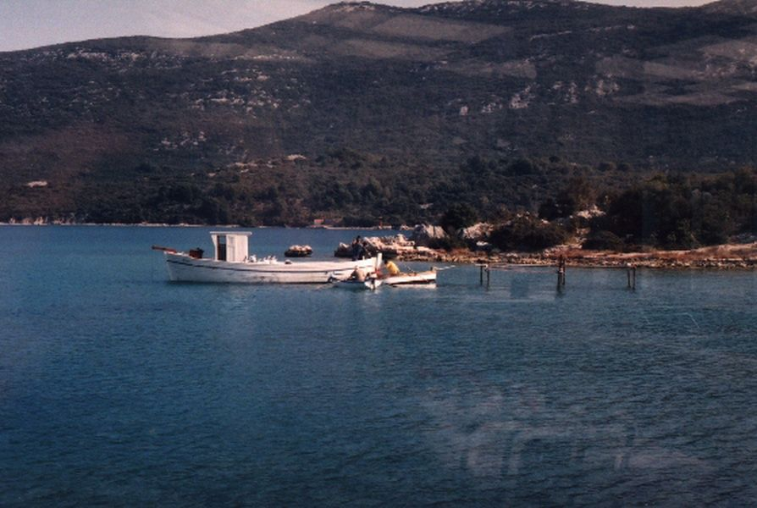
Ston: from Oyster Days to an oyster season
TODAY
WITH US
A few days in March
Every weekend, Feb to Apr
Ston Oyster Days happen around St. Joseph's Day (19 March). Yet Mali Ston oysters are at their best through the whole cool season.
Boat visits to the oyster farms in Mali Ston bay
Shucking and cooking workshops with the farmers
The salt works: how sea salt is made by hand
A walk on the Ston walls, with new benches, water and winter opening hours
Mussels and a bag of salt for the kids
Notes:
30 s. Example two. Same idea: a few festival days become a three-month season. Oyster farmers sell directly, restaurants open in winter, and the walls get benches and winter hours.

Slide 6
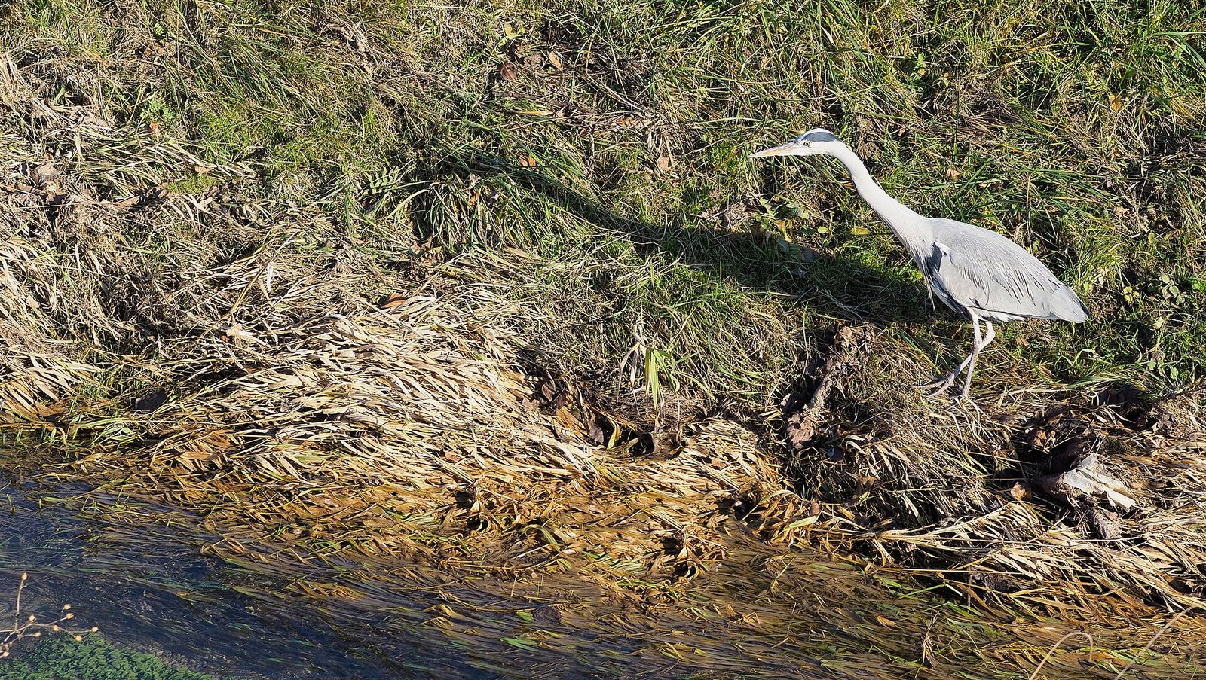
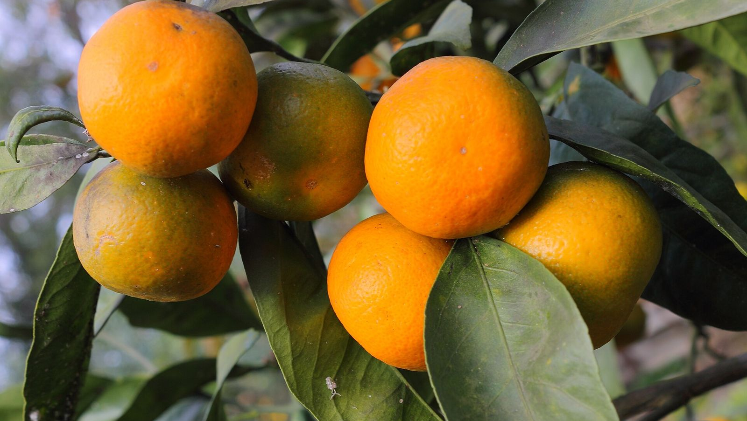



New in the Neretva valley, and what we build for it
Photo safari by lađa
Birdwatching
Harvests
Sunrise trips through the channels with a local boatman and a photographer.
Herons, cormorants and ducks winter in the delta, October to April.
Mandarins and olives, October to December, picked with the families.
We build: wooden photo hides at 3 viewpoints
We build: a marked route with boards in 4 languages
We build: shade, seats and step-free paths on the farms
Notes:
30 s. New activities in places tourists rarely see. Each one needs a small, concrete change on the ground: hides, a route, seating on the farms.

Slide 7


Locals earn from it, and use it too
The photo safari creates jobs
Harvests help the farms directly
Boatmen become certified photo-safari guides, with a first-aid course
Young people from the valley work as photographers and photo editors: every guest takes home edited photos
Farm families serve breakfast after the sunrise trip
Local drivers bring guests from Dubrovnik
Visitors help pick when farms are short of hands
Families sell mandarins and oil straight to the guests, for about 3 times what wholesale buyers pay
For residents too
The hides, paths and benches are public, and the festival weeks are for locals as much as for guests.
Notes:
40 s. Inclusion and work. The photo safari is a new local product: boatmen, young photographers, farm breakfasts, drivers. Harvests are the most direct help: in 2026 buyers paid about €0.65 a kilo for mandarins while they sold for about €2 at market, so selling to guests triples the farm's income per kilo.

Slide 8


Who we bring: empty nesters first
Empty nesters, 50 to 65
ALSO WELCOME
Families
Their children have left home. Our main focus, because they:
Autumn, February and Easter school holidays. Every activity is open to children.
Travel outside school holidays, so the off-season suits them
Have time and savings, and stay longer
Want culture, food and nature, at a slow pace
Come back, and tell their friends
ALSO WELCOME
Nature lovers
Photographers and birdwatchers, October to April.
Notes:
25 s. Everyone is welcome, but we focus on empty nesters: they are free to travel off-season and they stay longer.

Slide 9
Marketing: influencers who come and take part
WHO
HOW
1
Creator weeks
Slow travel, food and culture creators, 45+
We invite 6 to 8 creators to St. Blaise Week, the oyster season and the photo safari. They join the workshops, not a press tour.
For empty nesters
2
Local faces
They film the boatmen, oyster farmers and harvest families, so the story is about people, not ads.
Family travel creators
For families
3
Our markets
Austria, Germany, the UK and Scandinavia, where off-season travel is common.
Wildlife and landscape photographers
4
We measure it
For nature lovers
Every creator gets their own link: we count visits and bookings in February to April.
Notes:
35 s. Marketing through influencers, matched to each audience. They come in the off-season, take part in the new events and show the local people behind them. First creator week: St. Blaise Week, February 2027.

Slide 10
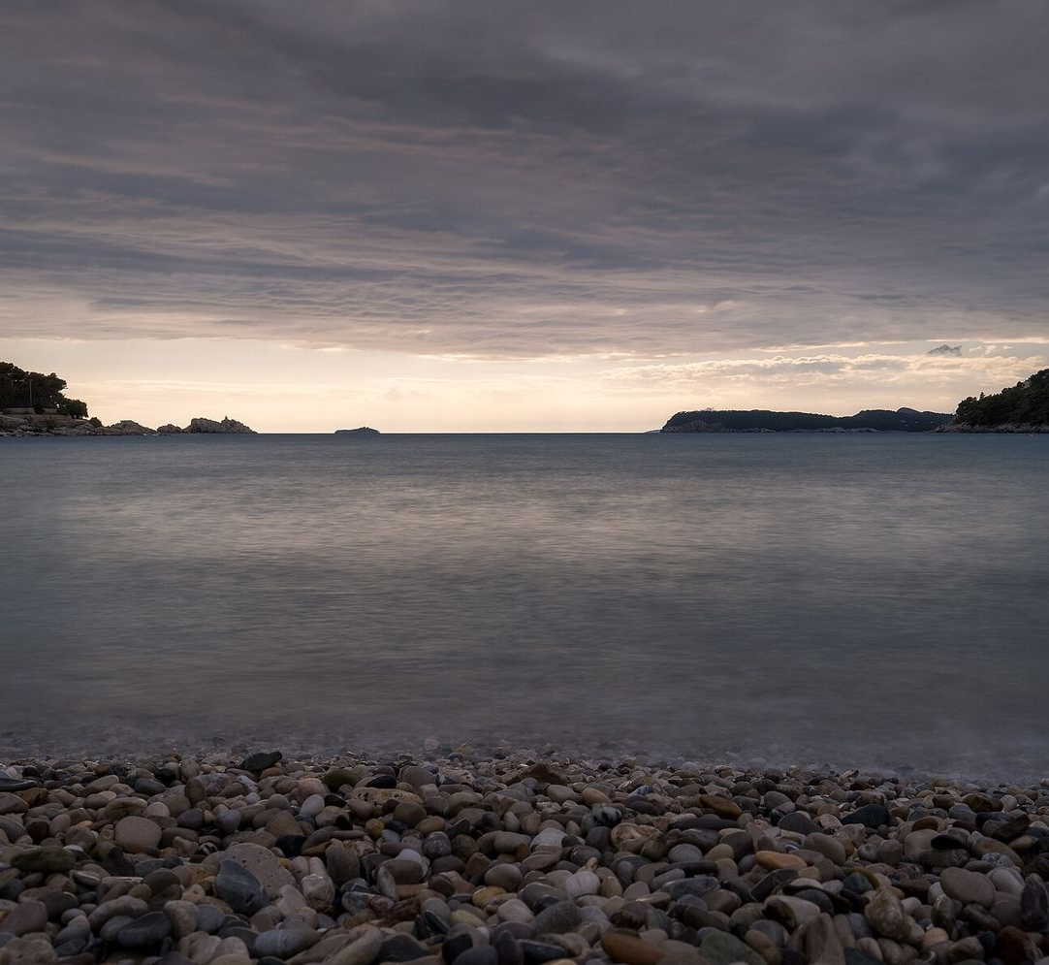



One partner hotel that stays open all winter
The deal
A contract with one hotel in Lapad: rooms for our guests from October to May, family rooms, early breakfast on activity days.
What the hotel gets
Guests in months it used to close, and staff kept on all year.
Step by step
Winter 2026/27: 10 rooms. 2027/28: 25 rooms every week. Then a second hotel in Ston or the Neretva valley.
Notes:
25 s. Feasibility: one hotel is enough to start. It learns to work off-season with guests guaranteed, and keeps its staff.

Slide 11




Why it works
Content
Innovation
Feasibility
Sustainability
Festival weeks, oyster season, photo safari, harvests
Stretching feasts into weeks; photo safari by lađa
Existing events and places, one hotel to start
Small groups, no new buildings, local income
Diversity
Uniqueness
Attractivity
Adaptability
Culture, food, nature, harvests
St. Blaise, Ston oysters and the Neretva exist only here
Real people, real food, quiet places
The same model fits any feast or harvest
Notes:
25 s. One line per jury criterion. Don't read them all: highlight innovation, feasibility and uniqueness.

Slide 12
You travel.
We care.
A region that works in every season, for visitors and for the people who live there.
dk129213.github.io/VitaNatura
Thank you. Questions?
Photos, Wikimedia Commons: Neretva at Opuzen, croatiatipscom (CC0); Neretva delta, Draceane (CC BY-SA 4.0); St. Blaise feast, Mariobonacic (public domain); Mali Ston bay, Eranyo (CC BY 3.0); Fortifications at Ston, Tony Hisgett (CC BY 2.0); Grey heron, Ljeto (CC BY-SA 4.0); Mandarins, SKas (CC BY-SA 4.0); Lapad, Jules Verne Times Two (CC BY 4.0).
Notes:
15 s, then questions. Likely questions: who pays for the hides and benches (tourism grants, the county and tourist boards, partners), who runs the workshops (local associations and families, paid per event), what if it rains (indoor workshops, the oil mill, the salt works).

