Slide 1
AI–POWERED GRIEVANCE MANAGEMENT SOLUTION SYSTEM
Done By
DHINESHKUMAR M (412720104012)
UDHAYA KUMAR A (412720104055)
THARUN KUMAR M (412720104053)
SOURAV ANAND N (412721104048)
Supervised by
Dr. B SELVALAKSHMI , B.E., MBA., M.E., Ph.D.,

Slide 2
ABSTRACT
The AI-Powered Grievance Management and Solution System (APGMSS) is a platform designed to streamline grievance submission, processing, and resolution for institutions like colleges, governments, etc.
Admin can manage users and see visualizations, employees can take up a grievance and add actions to it, while users (petitioners) can submit and track grievances.
Built using Next.js, Supabase, Python (for AI/NLP/OCR), and blockchain (Solidity), the system ensures transparency, and security
Features include multilingual support, AI-driven grievance analysis, blockchain-verified records, and real-time notifications.

Slide 3
LITERATURE REVIEW
AUTHOR/ YEAR | TITLE | CONCEPT | ISSUES
Department of Administrative Reforms and Public Grievances (DARPG) and Digital India Bhashini, 2021 | AI-Based Bhashini Integrated with CPGRAMS Portal for Grievance Redressal in Local Languages | Integration of AI-powered language tool Bhashini with CPGRAMS for multilingual grievance redressal. | Focus on translation, lacks intelligent categorization and blockchain integration.
A. Archana et al., 2024 | Automating Grievance Portal by Automating Central Grievance Redressal System using Artificial Intelligence | AI-driven automation for grievance categorization, prioritization, and routing using NLP and ML. | Lacks multilingual support and blockchain for data integrity.
A. Raj & N. Kulkarni, 2022 | Supabase-Enabled Role-Based Access in Grievance Portals | Role-based access control (RBAC) using Supabase for secure grievance management | Lacks AI and blockchain features.
Notes:
z

Slide 4
AUTHOR/ YEAR | TITLE | CONCEPT | ISSUES
R. Bhatia et al., 2020 | AI-Driven Complaint Classification System in Indian Universities | AI-driven complaint classification in universities using NLP and ML. | Limited to digital inputs, lacks blockchain and multilingual support.
S. Nair et al., 2021 | Blockchain-Based Grievance Redressal Mechanism | Blockchain for transparency and auditability in grievance redressal. | No AI automation or multilingual support.
H. Kumar et al., 2023 | Issues with Existing Grievance Redressal Systems and Blockchain-Based Mitigation Approaches | Blockchain to address transparency issues in grievance systems. | Limited focus on AI automation.
Notes:
z

Slide 5
EXISTING SYSTEM
Existing grievance systems are often manual or semi-automated, relying on paper-based submissions and delayed updates. [Eg: CPGRMS]
They lack scalability, real-time tracking, and transparency.
Multilingual support for regional languages (e.g., Tamil) is limited.
Data integrity and security are major concerns due to the absence of tamper-proof mechanisms.
User experience is hindered by delayed responses and lack of automation.

Slide 6
PROPOSED SYTEM
An AI Powered Grievance Management solution System that is easy to use and easy to extend for other organisations, not limited to just government organisation.
Built using Next.js (frontend), Supabase (backend/database), Python server(AI/NLP/OCR), and Solidity (blockchain).
Scalable, secure, and user-friendly, and reducing manual efforts.

Slide 7
Features include:
AI-driven grievance categorization and resolution suggestions using NLP (Transformers, Hugging Face).
Multilingual support with OCR for handwritten Tamil documents.
Blockchain-verified records for transparency using Ethereum testnets.
Role-based dashboards for petitioners, employees, and admins.
Real-time notifications via email and in-app alerts.

Slide 8
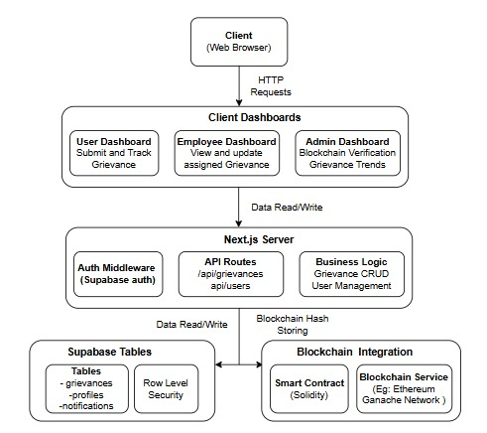
OVERALL SYSTEM ARCHITECTURE
Frontend: Next.js for responsive, role-based dashboards.
Backend: Supabase (PostgreSQL) for data storage, authentication, and real-time updates.
AI Layer: Python with transformers and Hugging Face for NLP-based grievance analysis.
Blockchain: Solidity smart contracts on Ethereum testnets for record integrity.

Slide 9
Algorithm / Procedure
Requirements Gathering and Planning.
Database Design (Supabase PostgreSQL).
User Interface Design (Next.js, Tailwind CSS).
Backend Development (Supabase, Node.js).
AI Integration (Python, transformers, Tesseract OCR).
Blockchain Integration (Solidity, Ethers.js).
Testing and Debugging.

Slide 10
MODULES
Module 1: Admin
Manage Users, Kmeans categorization, Blockchain Verification
Module 2: User (Petitioner)
Register/Login, Submit Grievance, Track Status, Receive Notifications.
Module 3: Employee
Register/Login, Manage Assigned Grievances, Update Status.
Module 4: AI and Analytics
Grievance Categorization, Sentiment Analysis, Trend Detection.
Module 5: Blockchain Integrity
Tamper-proof logging of grievance details.

Slide 11
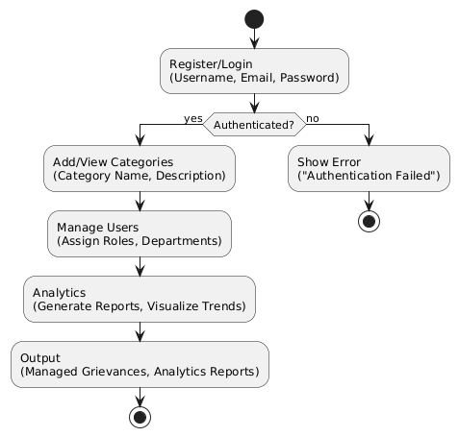
MODULE 1 ADMIN
Input: User Data, Grievance Categories, Department Details.
Features:
Register/Login: Username, Email, Password.
Add/View Categories: Category Name, Description.
Manage Users: Assign Roles, Departments.
Analytics: Generate Reports, Visualize Trends.
Output: Managed Grievances, Analytics Reports.

Slide 12
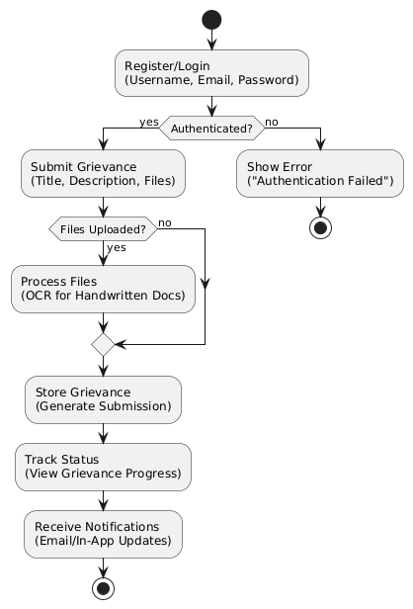
MODULE 2 USER (PETITIONER)
Input: Grievance Details (Title, Description, Files).
Output: Grievance Submission, Status Updates.
Features:
Register/Login: Username, Email, Password.
Submit Grievance: Text, File Uploads (e.g., Handwritten Documents).
Track Status: View Grievance Progress.
Notifications: Real-time Updates via Email/In-App.

Slide 13
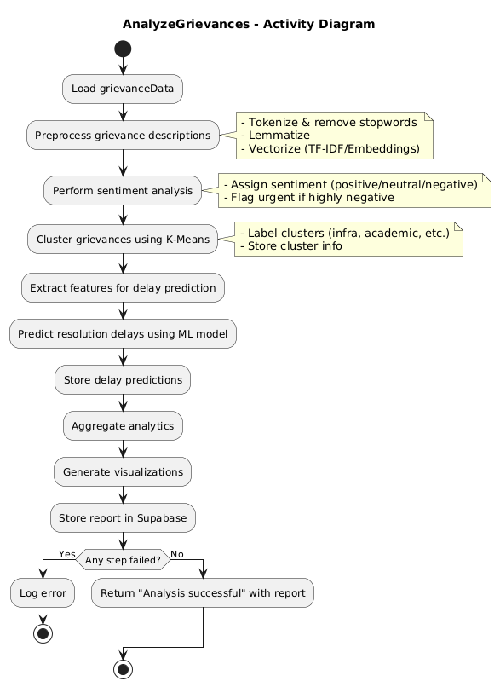
MODULE 3 EMPLOYEE
Input: Assigned Grievances.
Output: Status Updates, Resolutions.
Features:
Register/Login: Username, Email, Password.
View Grievances: Filtered by Role (Lead, Senior, Junior).
Update Status: Pending, In Progress, Resolved.

Slide 14
MODULE 4 - AI AND ANALYTICS
Input: Grievance Data.
Output: Insights, Predictions.
Features:
NLP Analysis: Categorization, Sentiment Analysis (Transformer, Hugging Face).
OCR: Extract Text from Handwritten Documents (Tesseract).
Clustering: Identify Trends (K-means).
Reports: Visualize Grievance Patterns.

Slide 15
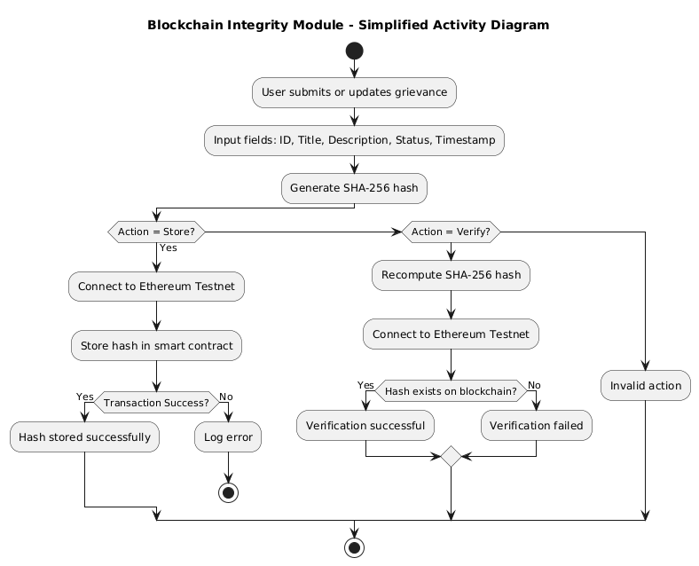
Module 5 - Blockchain Integration
Input: Grievance Data.(id, title, description, created at timestamp)
Output: Hash Value.
Features:
Hash Generation: SHA-256 for Grievance Data.
Blockchain Storage: Store Hashes on Ethereum testnet (ganache).
Verification: Compare Hashes to Ensure Integrity.

Slide 16
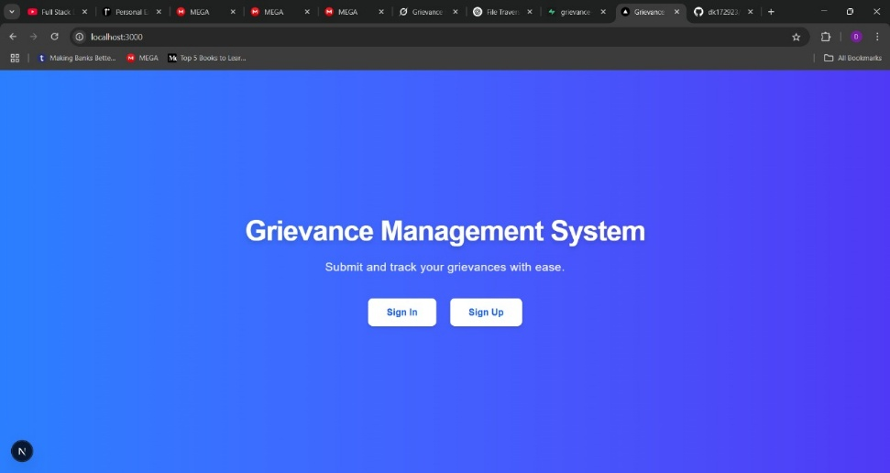
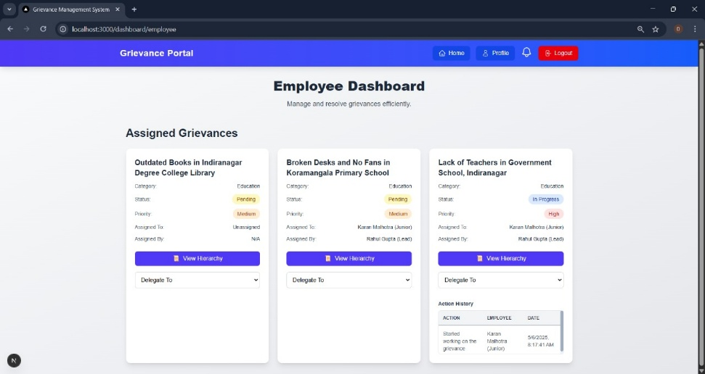
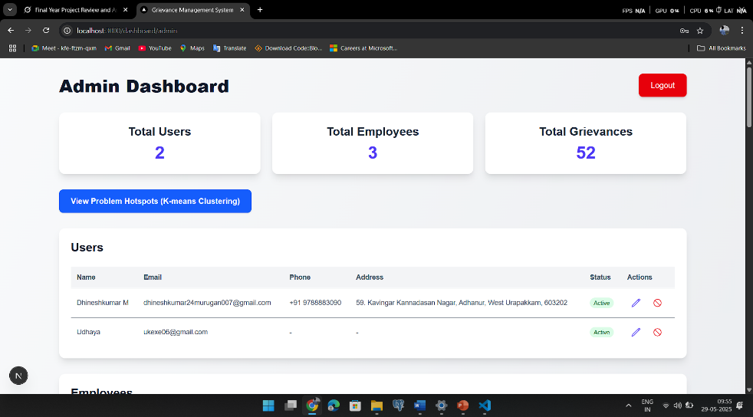
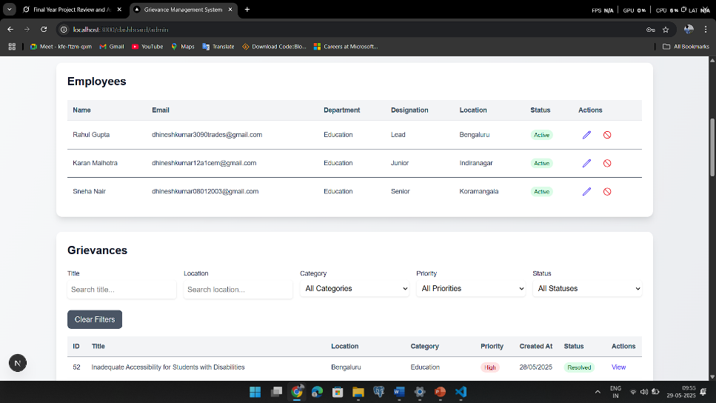
SCREEN SHOTS

Slide 17
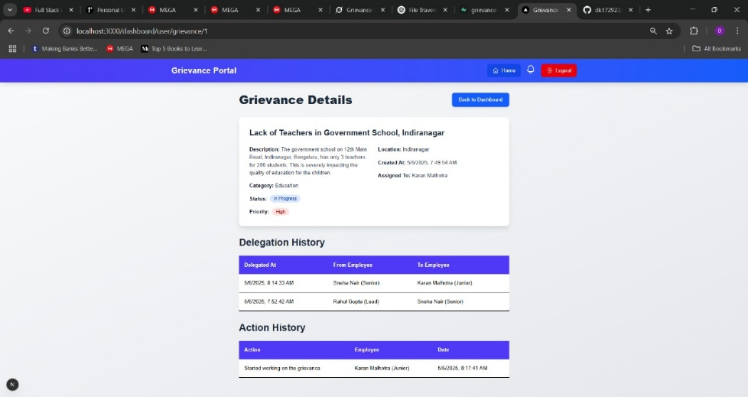
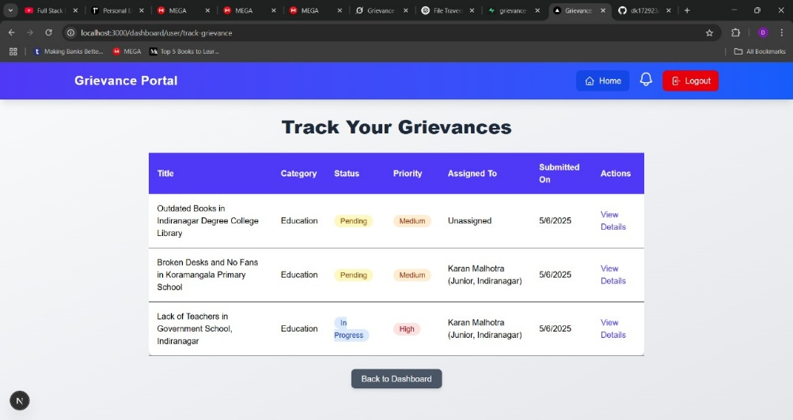
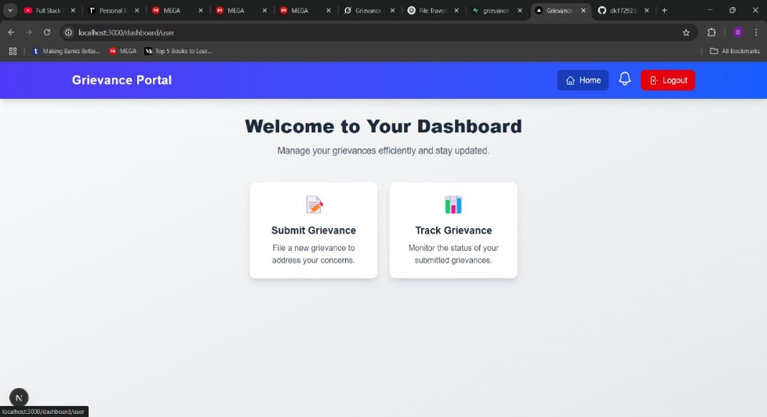
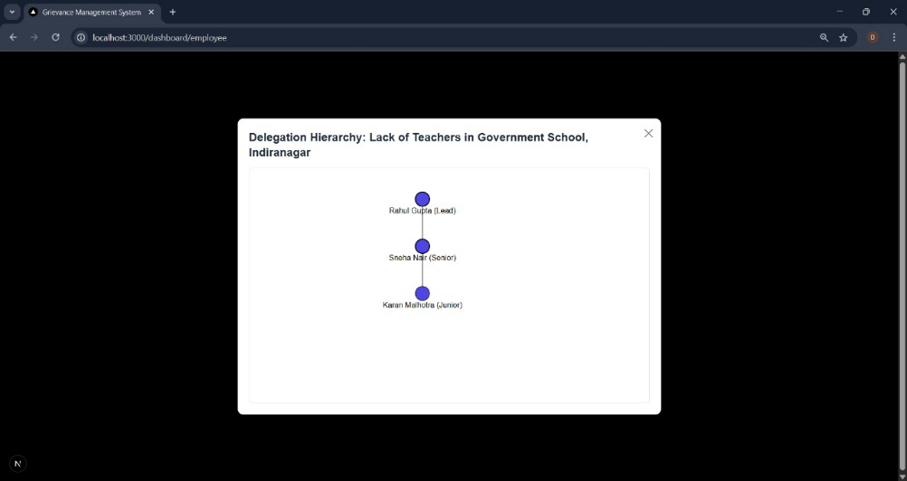
SCREEN SHOTS

Slide 18
CONCLUSION
Successfully developed a grievance management system using Next.js, Supabase, Python, and Blockchain.
Features like AI-driven analysis, multilingual support, and blockchain transparency enhance efficiency and trust.
The system streamlines grievance redressal, reduces manual efforts, and provides a user-friendly experience for all stakeholders.

Slide 19
FUTURE WORK
Integrate advanced AI models for predictive grievance resolution.
Expand blockchain support to main-net for production use.
Add a mobile app for enhanced accessibility.
Implement a feedback system for continuous improvement.
Enhance security with multi-factor authentication (MFA).

Slide 20
References
Department of Administrative Reforms and Public Grievances (DARPG) and Digital India Bhashini, “AI-Based Bhashini Integrated with CPGRAMS Portal for Grievance Redressal in Local Languages,” Press Information Bureau, Government of India, 2021.
A. Archana et al., “Automating Grievance Portal by Automating Central Grievance Redressal System using Artificial Intelligence,” International Research Journal of Computer Science (IRJCS), 2024.
R. Bhatia et al., “AI-Driven Complaint Classification System in Indian Universities,” International Journal of Intelligent Systems, 2020.
S. Nair et al., “Blockchain-Based Grievance Redressal Mechanism,” IEEE 6th International Conference on Computing Communication and Automation, 2021.
H. Kumar et al., “Issues with Existing Grievance Redressal Systems and Blockchain-Based Mitigation Approaches,” ResearchGate, 2023.
A. Raj & N. Kulkarni, “Supabase-Enabled Role-Based Access in Grievance Portals,” Journal of Software Architecture and Design, 2022.

Slide 21
THANK YOU

