Slide 1
MAST7210 Presentation
Deniz Korkmaz

Slide 2
Background
Adolescent Mental Health:
The 546 Adolescents in Ethiopia (ages 14–19) face biological, psychological, and social changes.
These can lead to depression due to factors like academic pressures, body image, and lack of social support.
Factors Influencing Depression:
Major contributors include BMI, negative self-image, health and low social support.
Addressing these can help mitigate depressive symptoms.
Purpose of Study:
To identify variables contributing to depression (e.g., social support, BMI, and health perceptions).
Enable early identification and preventive measures for at-risk adolescents.

Slide 3
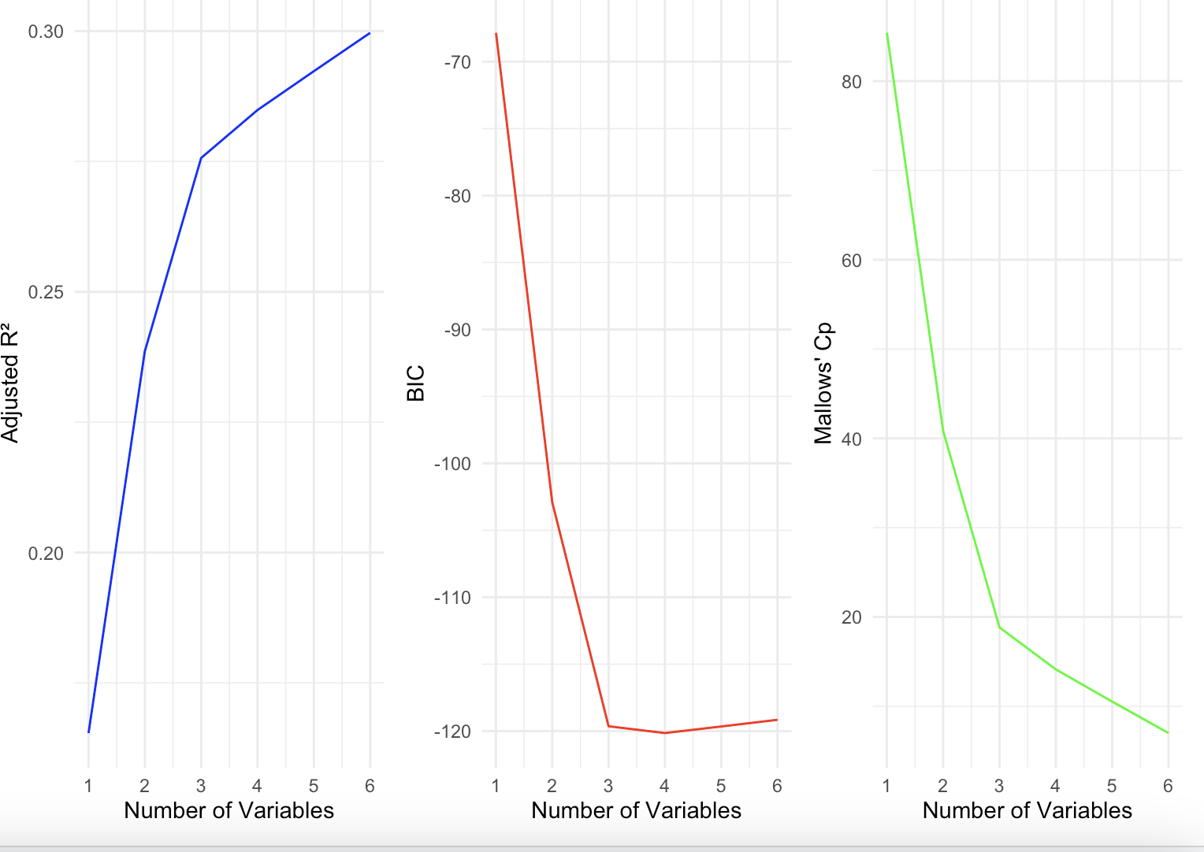
Model Selection Insights Using R², BIC, and Cp
Adjusted R² (Blue Plot):
A maximum of 6 variables yields the highest Adjusted R², suggesting the best explanatory power for the data.
BIC (Bayesian Information Criterion – Red Plot):
4 variables provide the optimal balance between model simplicity and fit, as BIC starts to increase beyond this point.
Mallows’ Cp (Green Plot):
At 6 variables, Mallows’ Cp is minimised, suggesting this model captures the data’s true structure effectively.
Notes:
Adjusted R² increases as more variables are added, but only up to the point where the additional variables improve model performance without adding unnecessary complexity.
BIC penalises model complexity more strongly than Adjusted R². Lower BIC values indicate better model fit with fewer parameters.
Mallows’ Cp assesses model fit and bias..

Slide 4
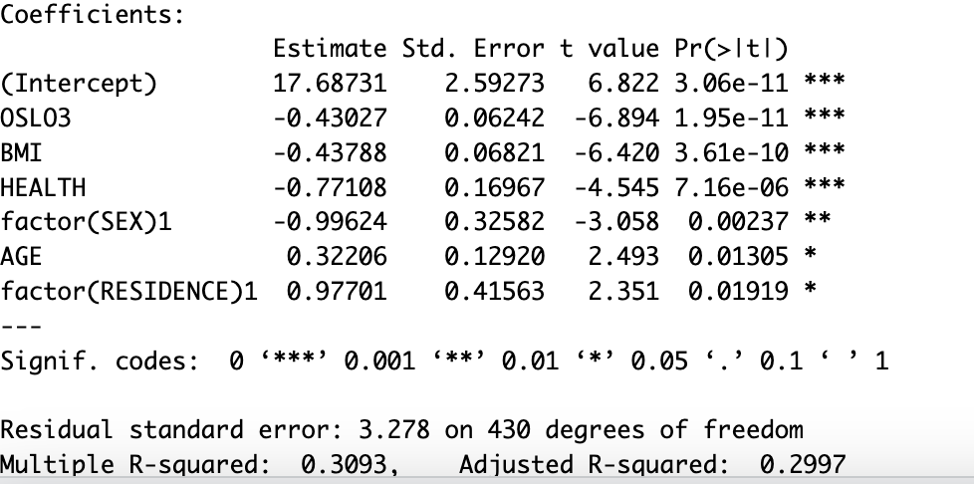
Why 6 Variables Are Preferred in the Model?
The preference for 6 variables is supported by:
All predictors being statistically significant.
Maximised Adjusted R-squared.
Minimised Residual Standard Error.
Theoretical relevance of all variables.
Notes:
1. Statistical Significance:
Each variable included in the model (OSLO3, BMI, HEALTH, factor(SEX), AGE, factor(RESIDENCE)) has a p-value below 0.05, indicating strong statistical significance.
Significance levels are highlighted with ***, **, or *, showing their contribution to predicting DEPSCORE.
2. Adjusted R-squared:
The Adjusted R-squared (0.2997) reflects that the model explains approximately 30% of the variation in DEPSCORE while penalising unnecessary predictors.
Including all 6 variables optimises this metric, indicating a well-fitting model without overfitting
3. Residual Standard Error:
The Residual Standard Error (3.278) is relatively low, suggesting that the model’s predictions closely match the observed values.
Adding these variables minimizes prediction errors.
p-value tells us how likely it is to see the data we have (or something more extreme) if our starting assumption (the "null hypothesis") is true. The null hypothesis usually represents "no effect" or "no difference."

Slide 5
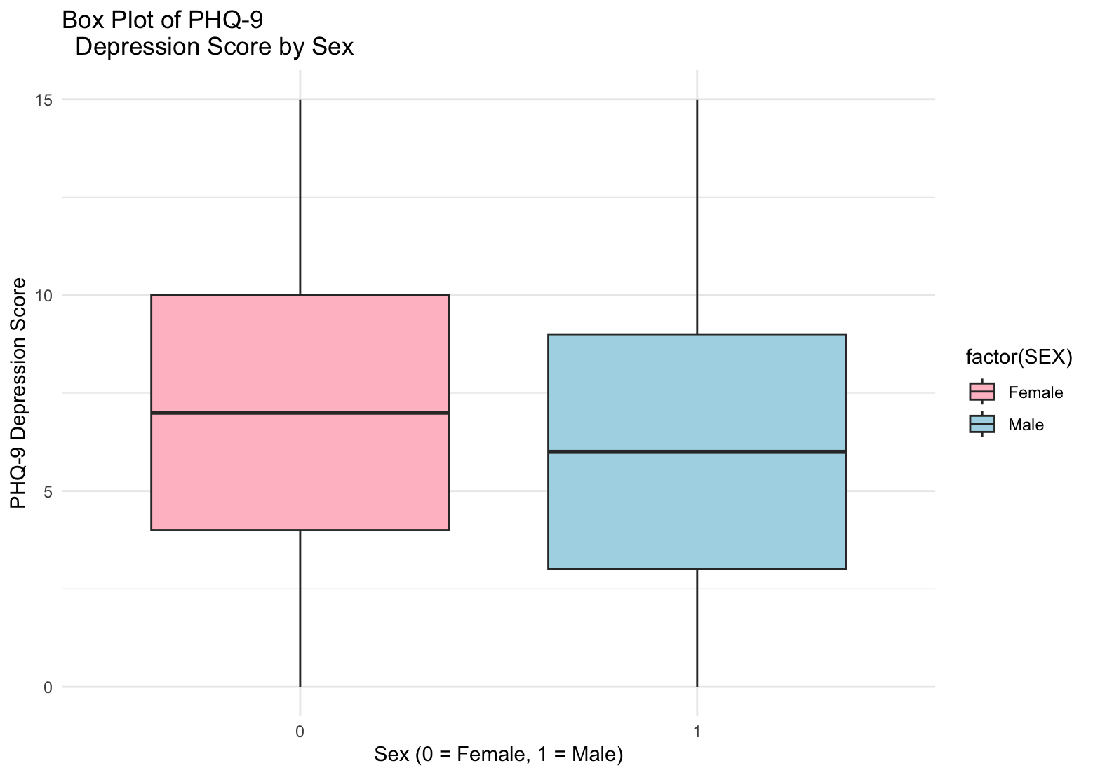
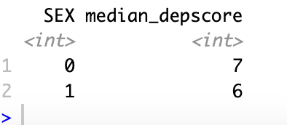
Measure of Depression score Using Box Plots
Median Values:
Females (0): Median depression score = 7.
Males (1): Median depression score = 6.
Distribution Insights:
Both sexes show a similar spread of scores (Interquartile Range - IQR).
Whiskers indicate data variability, with no outliers detected.
Sex-Based Differences:
Females have a slightly higher median depression score compared to males.
Overlap in IQR suggests differences may not be statistically significant.
Notes:
Box Plot Features:
Key Elements:
Median (dark horizontal line):
For females, the median depression score is 7. For males, it is 6.
Interquartile Range (IQR) (box height):
The box represents the middle 50% of the data (25th to 75th percentile).
Both males and females show similar variability in this range.
Whiskers:
Extend to capture data within 1.5 times the IQR. Whiskers indicate the range of most data points.
Outliers:
Any data points beyond the whiskers would be marked as individual dots (none appear here).
Sex Differences:
Females:
Show a slightly higher median depression score compared to males.
The spread of depression scores appears slightly wider, indicating more variability.
Males:
Have a slightly lower median depression score and a comparable variability to females.
Key Insights:
While the box plot suggests a small difference in median depression scores between sexes, the overlap in the interquartile ranges implies that the differences might not be significant.
Further statistical testing (e.g., t-test) would confirm whether these differences are statistically meaningful.

Slide 6
T-test for sex
Objective:
Test if there is a significant difference in PHQ-9 depression
scores between males (group 1) and females (group 0).
Key Results:
t-statistic: 1.59
p-value: 0.1132
Confidence Interval (95%): [-0.143, 1.35]
Males (group 1): 6.58
Interpretation:
The p-value (0.1132) is greater than the significance level (usually 0.05).
The confidence interval includes 0, indicating no evidence of a significant difference between the mean depression scores of males and females.
Conclusion:
Fails to reject the null hypothesis (H0): There is no significant difference in depression scores between males and females.
Degrees of Freedom (df): 380.49
Group Means:
Females (group 0): 7.19
Notes:
In this context, the t-test is a statistical method used to determine if there is a significant difference between the mean depression scores (DEPSCORE) of two independent groups, defined by SEX (Group 0 = Females, Group 1 = Males).
difference in means (7.19 for females vs. 6.59 for males) is approximately 1.59 standard errors away from a null hypothesis difference of 0.
The degrees of freedom (DF) are the amount of information your data provide that you can "spend" to estimate the values of unknown population parameters. A higher df value indicates more data and greater precision in estimating group differences.In this case, df is reasonably high, meaning the test is based on a relatively large amount of data.
Null Hypothesis (H₀): The mean depression scores are the same for both groups
Alternative Hypothesis (Hₐ): The mean depression scores are different between the two groups.
The test compares the sample means of the two groups while accounting for sample size and variability.The p-value (0.1132 in this case) indicates the probability of observing the data if the null hypothesis is true.Since the p-value > 0.05, we fail to reject the null hypothesis. This means there is no statistically significant difference in depression scores between Females and Males in the dataset.

Slide 7
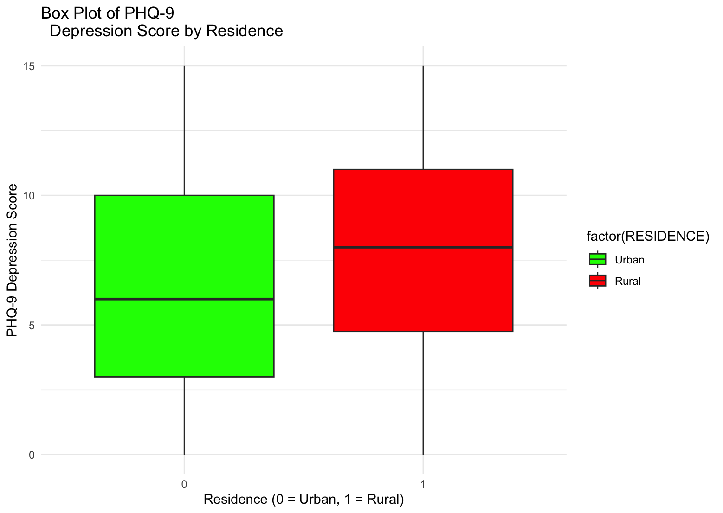
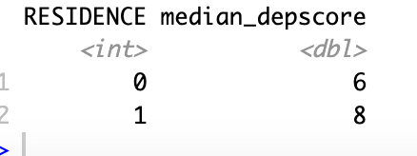
Depression Score by Residence
Median Values:
Urban (0): Median depression score = 6.
Rural (1): Median depression score = 8.
Distribution Insights:
Urban residences show a slightly wider spread of depression scores compared to rural.
Whiskers capture data variability effectively, with no significant outliers.
Residence-Based Differences:
Rural residents exhibit a higher median depression score than urban residents.

Slide 8
T-test for residence
Objective:
Test if there is a significant difference in PHQ-9 depression scores between students from urban residences (group 0) and rural residences (group 1).
Key Results:
t-statistic: -2.9741
Interpretation:
The p-value (0.0018) is less than the significance level (usually 0.05), indicating strong evidence against the null hypothesis.
Conclusion:
Rejects the null hypothesis (H0): There is a significant difference in depression scores, with students from rural residences having higher scores than those from urban residences..
Degrees of Freedom (df): 108.73
p-value: 0.00362108.73
Confidence Interval (95%): [--2.4947079, -0.4993639]
Group Means:
Urban residences (group 0): 6.68
Rural residences (group 1): 8.18
The confidence interval does not include 0, showing a significant difference in mean depression scores between urban and rural students.

Slide 9
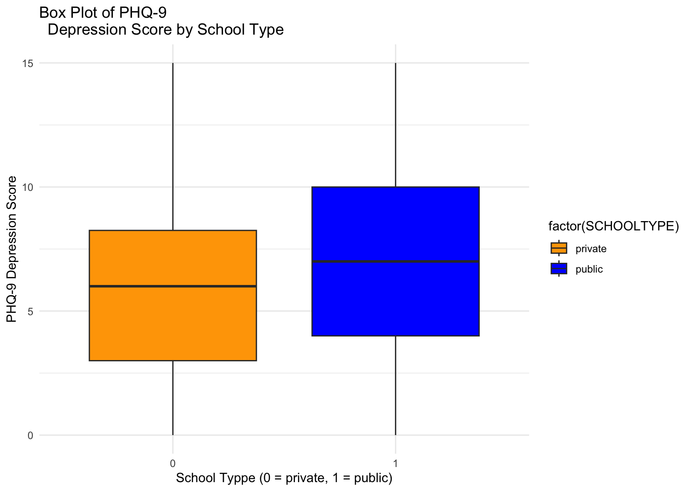
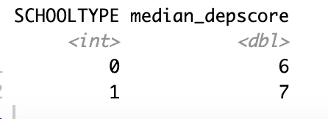
Depression Score by School Type
Median Values:
Private Schools (0): Median depression score = 6.
Public Schools (1): Median depression score = 7.
Distribution Insights:
Public schools show a slightly wider spread of depression scores compared to private schools.
Whiskers indicate variability without extreme outliers.
School Type Differences:
Students in public schools exhibit a slightly higher median depression score compared to those in private schools.

Slide 10
T-test for School Type
Objective:
Test if there is a significant difference in PHQ-9 depression scores between students from private schools (group 0) and public schools (group 1).
Key Results:
t-statistic: -1.6389
Interpretation:
The p-value (0.1039) is greater than the significance level (usually 0.05).
Conclusion:
Fails to reject the null hypothesis (H0): There is no significant difference in depression scores between private and public school students.
Degrees of Freedom (df): 119.28
p-value: 0.1039
Confidence Interval (95%): [-1.728, 0.163]
Group Means:
Private schools (group 0): 6.09
Public schools (group 1): 6.87
The confidence interval includes 0, indicating no evidence of a significant difference between the mean depression scores of private and public school students.

Slide 11
Prediction of depression score without covariates
Predicts depression scores using only the overall mean (6.95), without considering individual factors.
This represents the best estimate when no additional information (covariates) is available.
The standard deviation (3.92) reflects the typical variation of individual scores around the mean.
Ignores key predictors like BMI, sex, health, and social support.
Likely less accurate compared to models that include covariates.

Slide 12

Measure of Depression score using the covariates

Slide 13
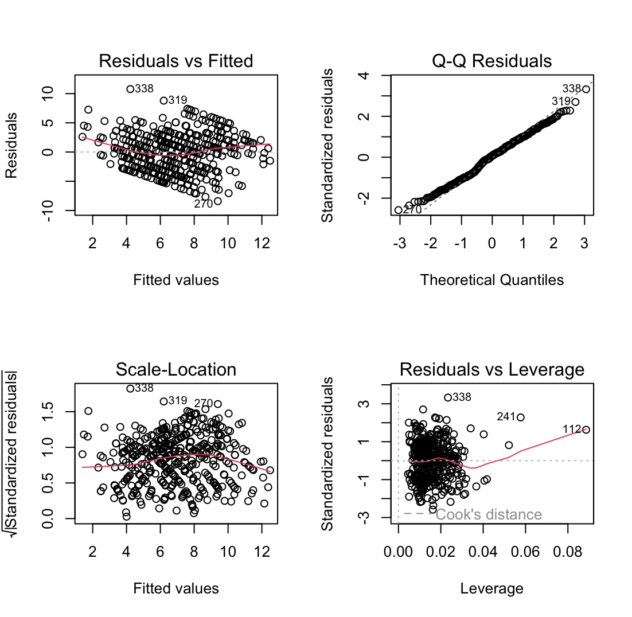
Evaluating Model Fit: Linear vs Quadratic Regression
The quadratic regression model is likely better for this dataset because:
It can capture the non-linear relationships indicated by the Residuals vs Fitted plot.
It addresses heteroscedasticity to some extent by accounting for curvature.
The linear model does not satisfy the assumptions of linearity and constant variance, as evident in the diagnostic plots.
Linear models can arise if average for the predictors and/or dependent variable is used reducing complexity of the model.
However, this comes at the cost of losing detailed individual-level information, which might be important for understanding nuances in the data.
Notes:
Residuals vs Fitted Plot:
Assesses linearity and homoscedasticity.
Key Observations:
Non-random pattern suggests non-linearity.
Changing residual variance indicates heteroscedasticity.
Interpretation: A linear model might not fully capture the relationship.
predictor-response
Normal Q-Q Plot
Purpose: Checks normality of residuals.
Key Observations:
Residuals follow the 45-degree line, with some deviations in the tails.
Interpretation: Residuals are mostly normal, but tail deviations suggest potential improvement with a complex model.
3. Scale-Location Plot
Purpose: Examines homoscedasticity.
Key Observations:
Funnel-shaped trend indicates heteroscedasticity.
Interpretation: Variability is not uniform, highlighting limitations of the linear model.
Residuals vs Leverage Plot
Purpose: Identifies influential points.
Key Observations:
Points near Cook's distance suggest high influence.
Interpretation: Influential points may overly affect model reliability.
Averaging within groups might make the residuals more normal since extreme outliers in individual data points (which can distort normality) are smoothed out in the grouping process. This aligns with the more linear trend observed when plotting group averages.

Slide 14
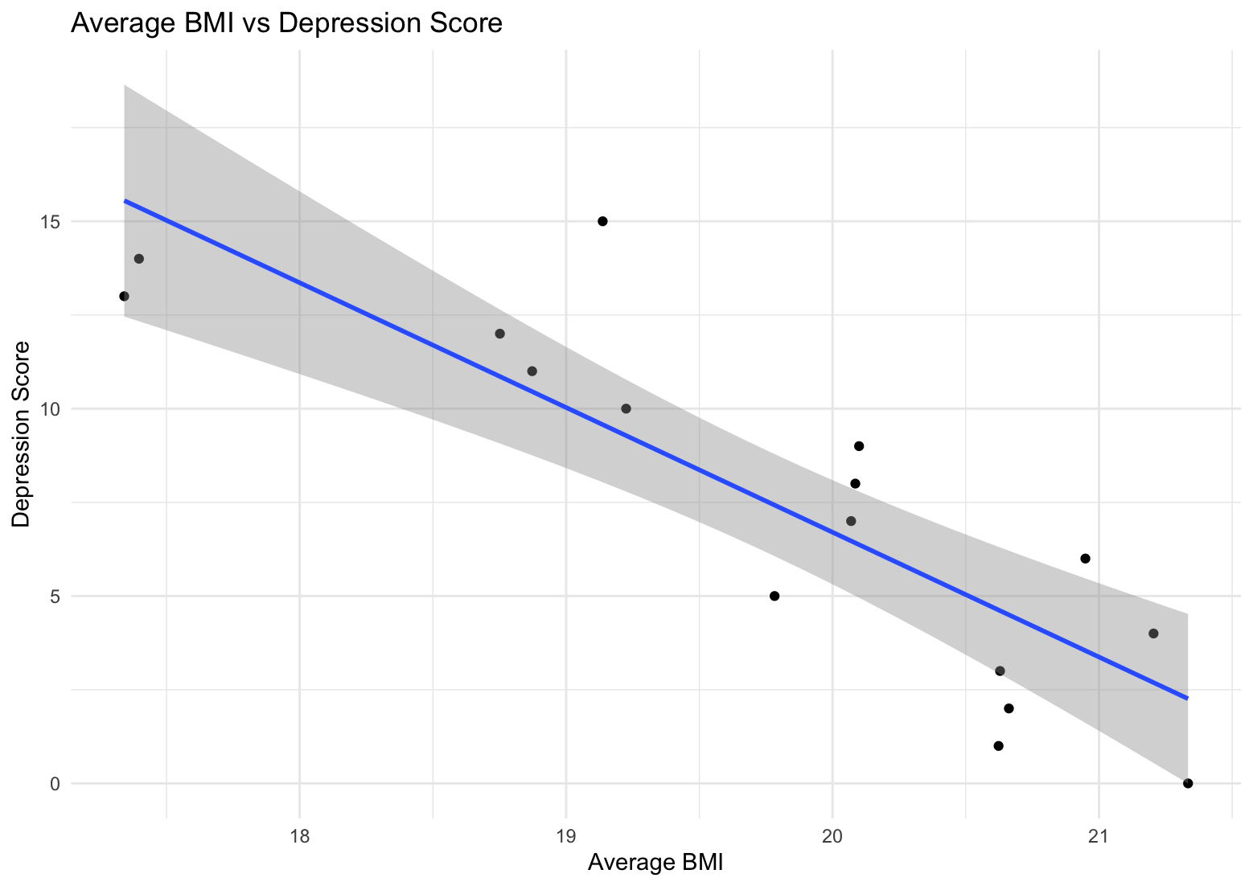
Depression Score and Average BMI Relationship
Plot Objective:
This scatter plot examines the relationship between average Body Mass Index (BMI) and PHQ-9 Depression Scores.
Observation of Trends:
A negative correlation is observed, as indicated by the downward trend in the regression line.
Higher BMI values are generally associated with lower depression scores.
Statistical Importance:
The data suggests BMI might influence depression scores, but further statistical testing is required to confirm causation.
Notes:
The blue line represents the linear regression model, showing the direction and strength of the relationship.
The shaded region is the confidence interval, reflecting the variability in predictions.

Slide 15
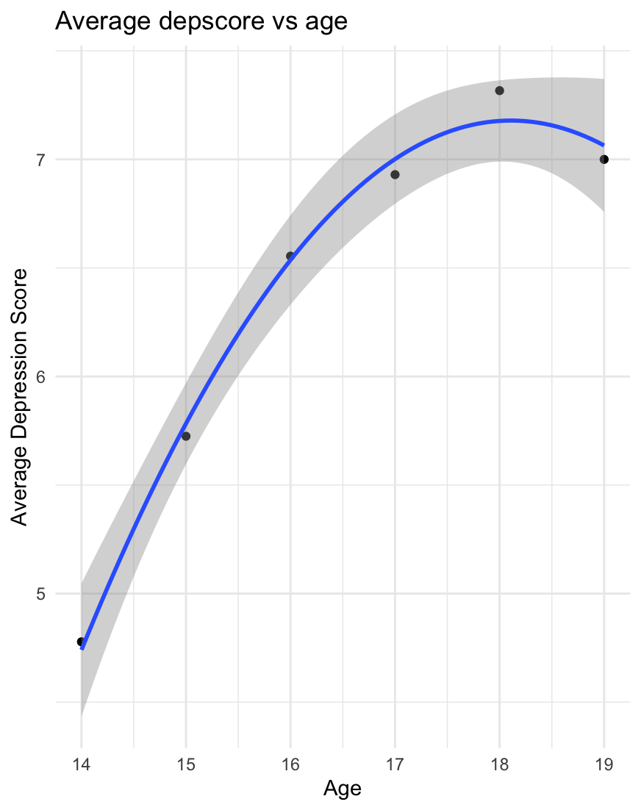
Depression Score and Average Age Relationship
1. Plot Objective:
This scatter plot examines the relationship between age and average PHQ-9 Depression Scores.
2. Observation of Trends:
An inverted U-shaped trend is observed, indicating that depression scores increase with age up to a peak and then slightly decline.
Younger individuals (e.g., ages 14-15) have lower depression scores compared to those aged 17-18.
3. Statistical Importance:
The shaded region represents the confidence interval, showing the variability in the regression line predictions.
The curvature of the regression line highlights a possible non-linear relationship between age and depression scores.

Slide 16
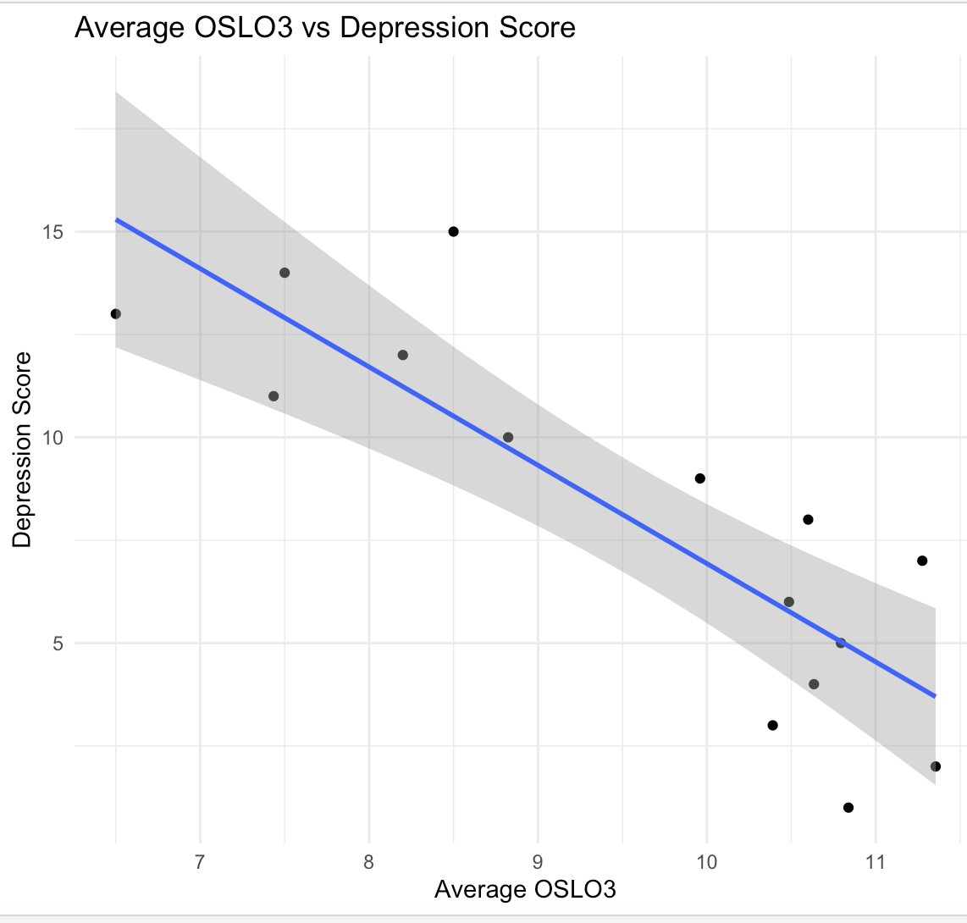
Depression Score and Average OSLO3 Relationship
Plot Objective:
This scatter plot examines the relationship between the average OSLO3 score (a measure of social support) and PHQ-9 Depression Scores.
Observation of Trends:
Negative correlation is observed, as shown by the downward trend of the regression line.
Higher OSLO3 values (indicating stronger social support) are generally associated with lower depression scores.
Statistical Importance:
The shaded region represents the confidence interval around the regression line, reflecting variability in predictions.
This analysis emphasizes the potential role of social support (OSLO3) in mitigating depression.

Slide 17
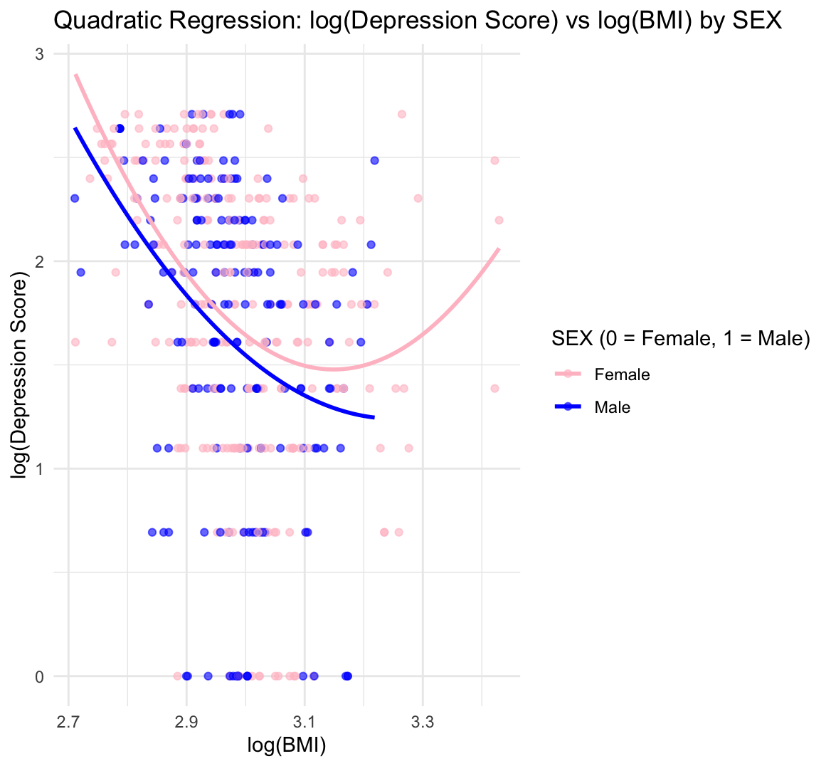
Quadratic Regression: log(Depression Score) vs log(BMI) by Sex
Logarithmic Trends: The log-transformed plot shows a smoother nonlinear relationship, reducing the influence of extreme values.
Sex-Specific Differences:
Females (Pink Line): Exhibit a more pronounced nonlinear trend compared to males.
Males (Blue Line): Show a gradual decrease in depression scores with increasing BMI in the log scale.
Interpretation:
Transforming variables helps stabilize variances and improve the model fit.
Sex remains an important factor, as trends differ significantly between males and females, reinforcing the need to include interaction terms in the model.

Slide 18
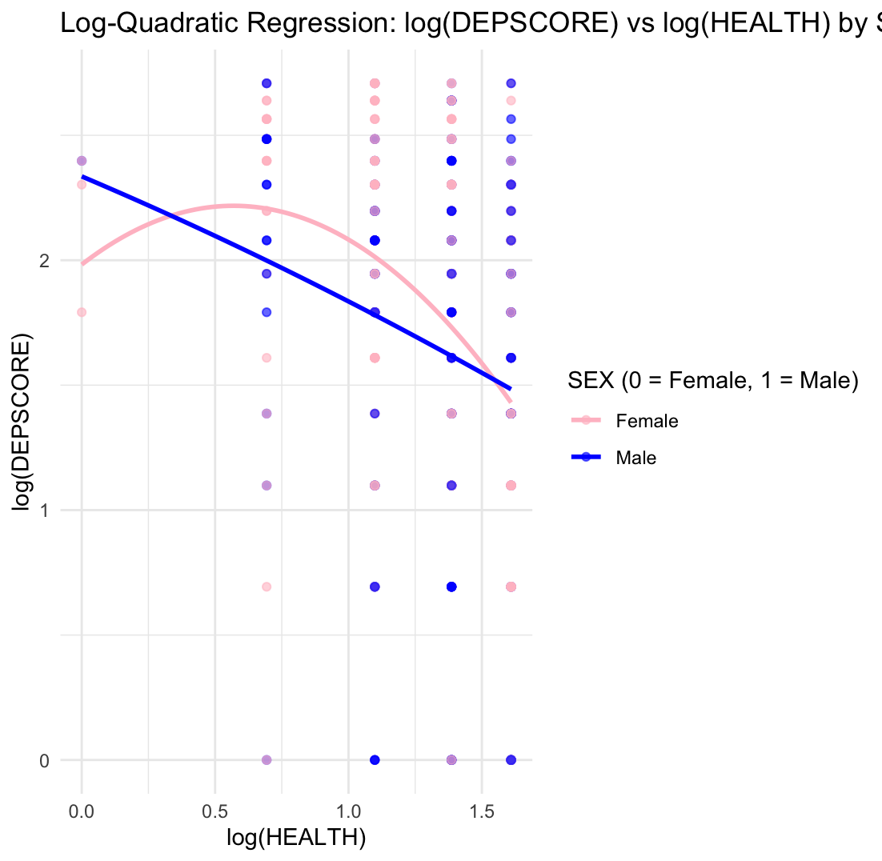
Log-Quadratic Regression: log(DEPSCORE) vs log(HEALTH) by SEX
Log transformation smooths the relationship, showing a nonlinear decrease in log(DEPSCORE) with increasing log(HEALTH).
The curve for males and females converges at higher HEALTH levels, suggesting consistent trends at extreme values.
Females (Pink Line): Display a slightly steeper initial decline, indicating a strong impact of HEALTH on depression scores at lower HEALTH levels.
Males (Blue Line): Show a more gradual relationship, with depression scores less sensitive to changes in HEALTH.
Log-quadratic regression provides a better fit compared to the quadratic model, stabilising variance and reducing the impact of extreme values.
Differences between sexes reinforce the need to consider interaction effects.

Slide 19
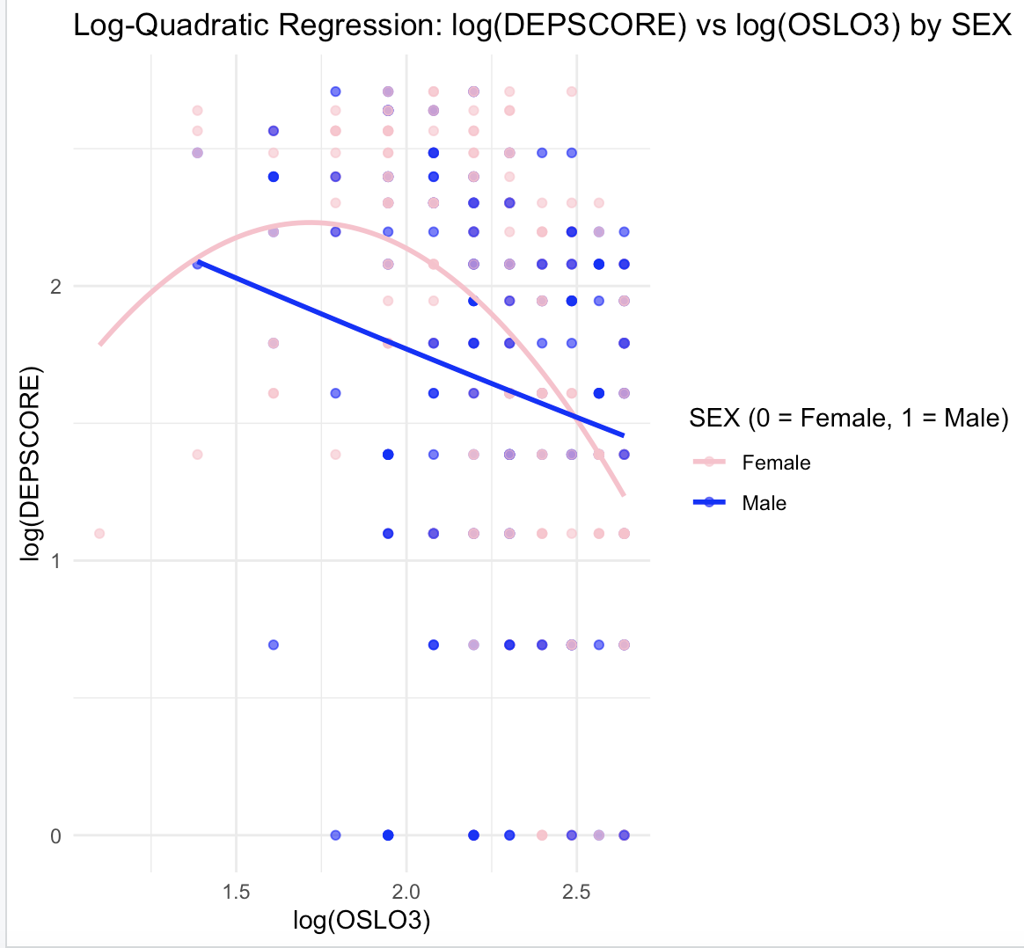
Log-Quadratic Regression: log(DEPSCORE) vs log(OSLO3) by SEX
The log-transformed model smooths out extreme values, providing a more stable representation of the nonlinear relationship.
Females (Pink Line): Show a gradual decline in depression scores with increasing OSLO3, followed by a steeper increase on the log scale.
Males (Blue Line): Display a similar trend but with less pronounced changes compared to females.
Log-transformations stabilise variances and improve the model's ability to account for nonlinear patterns.

Slide 20
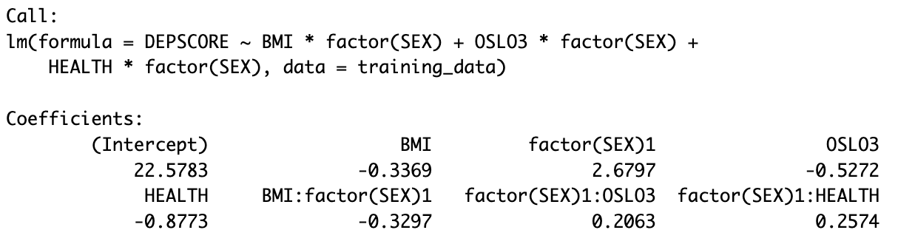
Interaction Terms with Sex
BMI, OSLO3, and HEALTH have negative relationships with DEPSCORE, indicating that better health, higher BMI, and stronger social support are associated with lower depression scores, particularly for females.
The reference level for SEX is 0 (Female). This means the coefficients of BMI, OSLO3, and HEALTH directly describe their effects on DEPSCORE for females. (-0.3369, -0.5272 and -0.8773 )
For males (SEX = 1), the coefficients are adjusted by adding the interaction terms (factor(SEX)1:*). The total effect for males is calculated as the sum of the base coefficient (for females) and the corresponding interaction term.
This means for males, for one unit, depression score decreases by −0.6666, OSLO3 decreases by −0.3209 and health decreases by −0.6199.

Slide 21
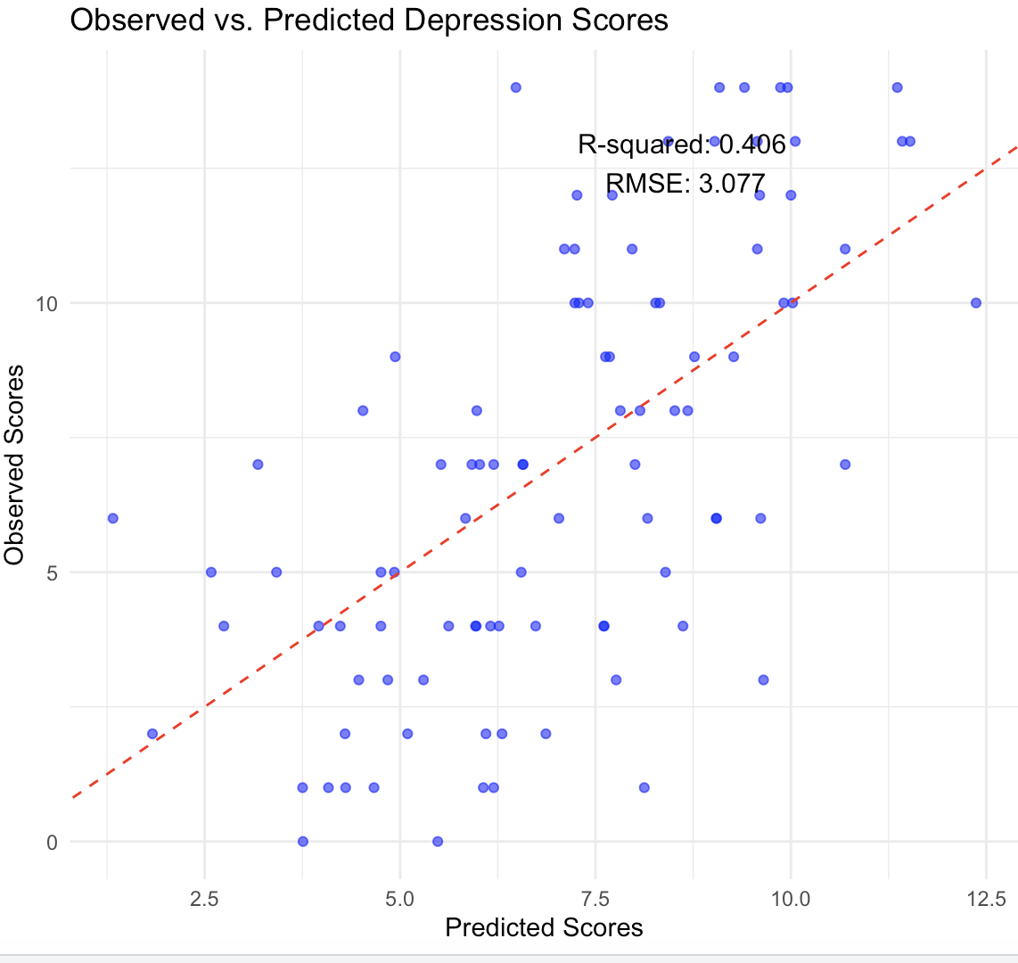
Model Performance: Observed vs. Predicted Depression Scores
R-squared (0.406): The model explains 41% of the variance in depression scores based on the predictors included. This indicates a moderate fit of the model.
RMSE (3.077): The Root Mean Square Error quantifies the average deviation of the predicted scores from the observed scores, providing a measure of prediction accuracy.
Points closely aligned with the dashed red line represent better predictions where observed and predicted values are similar.
Points deviating from the red line indicate larger prediction errors.
While the model captures some variability in depression scores, there is room for improvement. Including additional predictors or interaction terms may enhance predictive power.
Notes:
The predict() function uses the trained model to calculate predicted depression scores for the test dataset (testing_data).
These predictions are saved in the predicted column of testing_data.
Scatterplot: Shows the relationship between observed depression score (of testing data) and predicted depression scores (for the testing data.)
Diagonal Line: The closer the points are to the red line, the better the model's predictions.
R-squared (0.401): Indicates that 40.1% of the variance in observed depression scores is explained by the model.
RMSE (3.092): Represents the average prediction error. A smaller RMSE indicates more accurate predictions.
Interpretation: The model has moderate predictive power, as not all points align closely with the red line. There is room for improvement, possibly through additional predictors or more complex models.

Slide 22
Predicted Depression Scores Using Only SEX of the pupil
A simple regression model was used to predict depression scores based solely on the variable SEX (0 = Female, 1 = Male).
For a new pupil (SEX = 0, Female): Predicted depression score: 7.19.
For a new pupil (SEX = 1, Male): Predicted depression score: 6.59.
The model captures the mean differences in depression scores between females and males.
Females tend to have higher predicted depression scores compared to males based on the dataset.
The accuracy of predictions using only SEX was 75.79%, which highlights the significant role of sex in influencing depression scores in the dataset. The accuracy can be increased by adding more covariates.
Notes:
Females tend to have higher predicted depression scores than males.
Although the model is simplistic (based on just one variable), it highlights the significant association between sex and depression scores.
Predictions rely solely on sex and do not account for other important covariates such as BMI, health, or residence. As a result, it may not capture the full complexity of depression scores.

Slide 23
Prediction of Depression Score knowing all Covariates
New Pupil Characteristics:
BMI: 20
SEX: Female (SEX = 0)
RESIDENCE: Urban (RESIDENCE = 1)
OSLO3 Score: 10
AGE: 16
HEALTH: 3
Prediction for New Pupil:
Predicted Depression Score (Fit): 8.4438
95% Confidence Interval:
Lower Bound: 7.6047
Upper Bound: 9.2829
Model Accuracy:
Correct Predictions: 93.68%
Notes:
This slide demonstrates how the model predicts the depression score for a new individual (referred to as "new_pupil") using specific characteristics.
The model considers covariates like BMI, SEX, RESIDENCE, OSLO3 score, AGE, and HEALTH to make a prediction.
The predicted depression score (fit) is 8.4438.
The upper bound and lower bound indicates that the model is fairly confident in predicting a score close to 8.4438 for this individual.
This approach highlights how the model incorporates multiple predictors to estimate depression scores for specific individuals, emphasising the importance of covariates like BMI, sex, and social support.

Slide 24
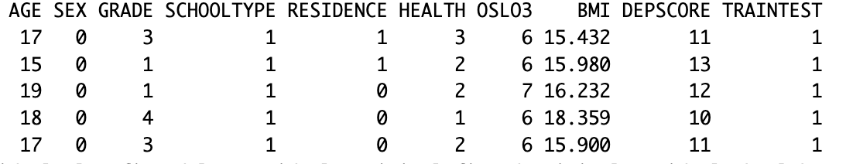
Pupils at most risk of Depression
By sorting pupils based on these predictions in descending order, the top 5 pupils at the highest risk of depression were identified.
Characteristics of High-Risk Pupils:
AGE: Primarily adolescents aged 15-19.
SEX: The sex was primarily female for the top 5 pupils of the highest depression scores.
Scores: Low HEALTH and OSLO3 scores are prevalent among these pupils, correlating with higher depression risk.
By identifying pupils with high predicted depression scores, targeted interventions can be designed, focusing on improving health and social support (OSLO3) for at-risk students.

Slide 25

Any Questions?

