Slide 1


Slide 2
Agenda
Installtion on Windows/Linux
Data types in SQL
Operators in SQL
DDL and DML Queries
Where filter

Slide 3
Installtion Linux/Windows
Windows Installtion :
Download the installer :
https://dev.mysql.com/downloads/installer/
2) Click to install , select the mysql server , mysql application (workbench and shell)
3) Select user as root initially and finish.
Linux Installation :
1) Installation using RPM/YUM package manager.
yum install mysql-server
i) Configure to start mysql server up automatically on reboot
chkconfig mysqld on
ii) Start the mysql server
systemctl start mysqld
iii) Set mysql root password
mysqladmin –uroot password ****
iv) Connect to the server
mysql –uroot –p
2) Installation using tar.gz
Download the tar ball unzip and start the server.
https://dev.mysql.com/downloads/mysql/

Slide 4
Introduction to my.cnf
my.cnf is the configuration file in linux to up the server from customized settings.
Similary,
My.ini helps in setting up the mysql server configuration in windows operating system.
Default my.cnf file will be located in /etc/my.cnf
Default Data directory will be located in /var/lib/mysql
Sample my.cnf
#mysql server
[mysqld]
port = 3306
socket = /tmp/mysql.sock
datadir = /home/mysql/data
server-id = 1
log-bin = mysql.bin
Innodb_data_home_dir = /home/mysql/data
Innodb_data_file_path = ibdata1:1G:autoextend
Innodb_log_group_home_dir = /home/mysql/data

Slide 5
Data types in SQL (MySQL)
A database table contains multiple columns with specific data types such as numeric or string.
MySQL provides more data types other than just numeric and string.
Each data type in MySQL can be determined by the following characteristics:
The kind of values it represents.
The space that takes up and whether the values are a fixed-length or variable length.
Numeric Data type:
Integer Types (Exact Value) - INTEGER, INT, SMALLINT, TINYINT, MEDIUMINT, BIGINT
Fixed-Point Types (Exact Value) - DECIMAL, NUMERIC
Floating-Point Types (Approximate Value) - FLOAT, DOUBLE
Bit-Value Type – BIT
Date and Time Data Types : DATE, DATETIME, TIMESTAMP , YEAR
String Data Types : CHAR,VARCHAR,BINARY,VARBINARY,BLOB,TEXT,ENUM,SET
Spatial Data Types : GEOMETRY
Data Type DEFAULT

Slide 6
Operators in SQL (MySQL)
Operators are used to specifying a condition in a statement in MySQL. Below are the different types of operators used in MySQL.
Arithmetic Operators :
+ , - , * , / , %
2. Comparison Operators :
< , > , = , != , >= , <= , !< , >! , <>
3. Logical Operators :
BETWEEN , Exists , OR , AND , NOT , IN , ALL , ANY , LIKE , IS NULL, UNIQUE

Slide 7
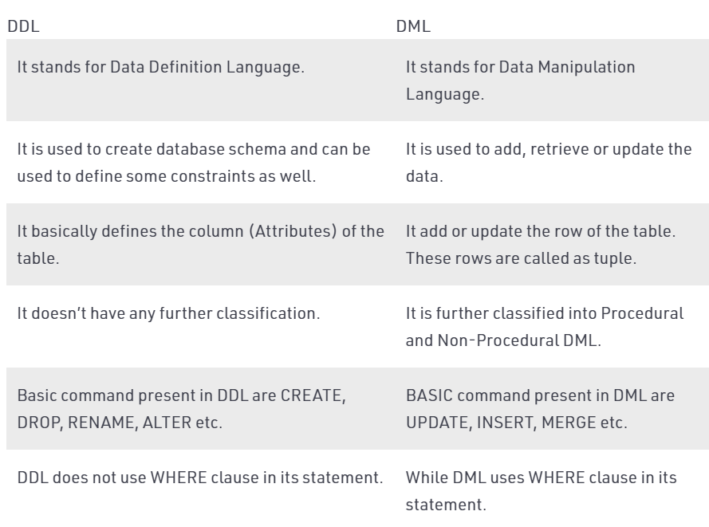
DDL and DML Queries
DDL: DDL is Data Definition Language which is used to define data structures. For example: create table, alter table are instructions in SQL.
DML: DML is Data Manipulation Language which is used to manipulate data itself. For example: insert, update, delete are instructions in SQL.

Slide 8
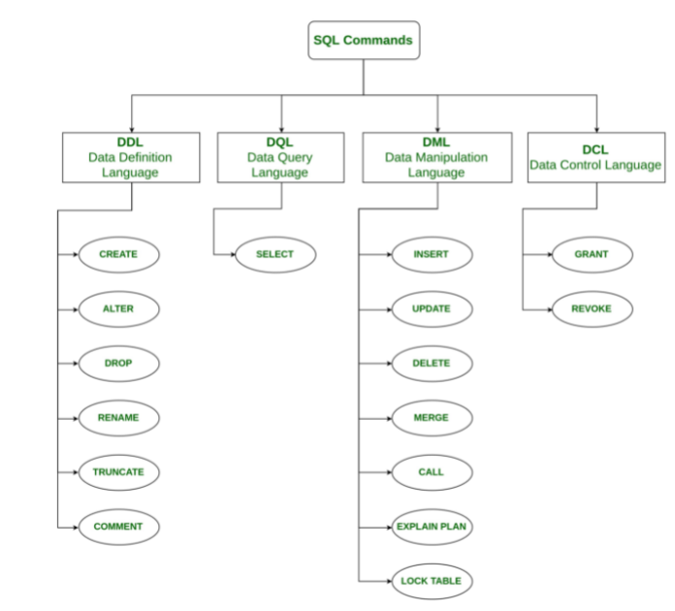
Types of SQL Commands (High Level)

Slide 9

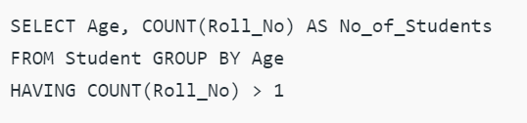
Where and Having Clause
WHERE Clause:
WHERE Clause is used to filter the records from the table or used while joining more than one table.
Only those records will be extracted who are satisfying the specified condition in WHERE clause.
It can be used with SELECT, UPDATE, DELETE statements.
HAVING Clause:
HAVING Clause is used to filter the records from the groups based on the given condition in the HAVING Clause.
Those groups who will satisfy the given condition will appear in the final result.
HAVING Clause can only be used with SELECT statement.
Eg :

Slide 10
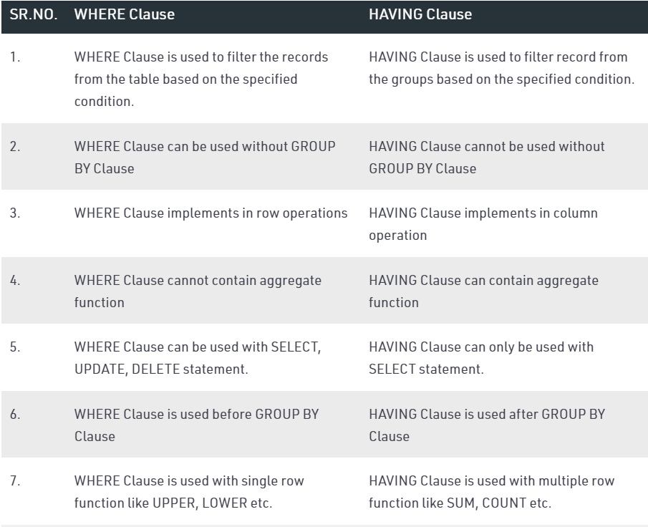
Where and Having Clause

Slide 11

Questions ?

Slide 12


