Slide 1


Slide 2
Agenda
SQL Constraints
Order by Clause
Indexing concept
Group by Clause
Views in SQL

Slide 3
SQL Constraints (MySQL)
Constraints are the rules enforced on the data columns of a table.
These are used to limit the type of data that can go into a table. This ensures the accuracy and reliability of the data in the database.
Constraints could be either on a column level or a table level.
The column level constraints are applied only to one column, whereas the table level constraints are applied to the whole table.
Following are some of the most commonly used constraints available in SQL.
NOT NULL − Ensures that a column cannot have NULL value.
DEFAULT − Provides a default value for a column when none is specified.
UNIQUE − Ensures that all values in a column are different.
PRIMARY Key − Uniquely identifies each row/record in a database table.
FOREIGN Key − Uniquely identifies a row/record in any of the given database table.
CHECK − The CHECK constraint ensures that all the values in a column satisfies certain conditions.
INDEX − Used to create and retrieve data from the database very quickly.
Constraints can be specified when a table is created with the CREATE TABLE statement or you can use the ALTER TABLE statement to create constraints even after the table is created or to drop constraint.

Slide 4
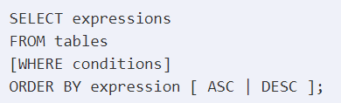
Order by And Group by
The ORDER BY keyword is used to sort the result-set in ascending or descending order.
The ORDER BY keyword sorts the records in ascending order by default.
To sort the records in descending order, use the DESC keyword.
The GROUP BY statement groups rows that have the same values into summary rows.
The GROUP BY statement is often used with aggregate functions (COUNT(), MAX(), MIN(), SUM(), AVG()) to group the result-set by one or more columns.

Slide 5
Indexing in SQL(MySQL)
A database index is a data structure that improves the speed of operations in a table. Indexes can be created using one or more columns, providing the basis for both rapid random lookups and efficient ordering of access to records.
While creating index, it should be taken into consideration which all columns will be used to make SQL queries and create one or more indexes on those columns.
The INSERT and UPDATE statements take more time on tables having indexes, whereas the SELECT statements become fast on those tables.
Using an index on tables that are frequently updated can result in poor performance.
This is because MySQL creates a new index block every time that data is added or updated in the table. Generally, indexes should be used on tables whose data does not change frequently but is used a lot in select search queries.

Slide 6
Views in SQL (MySQL)
VIEWS are virtual tables that do not store any data of their own but display data stored in other tables. In other words, VIEWS are nothing but SQL Queries. A view can contain all or a few rows from a table. A MySQL view can show data from one table or many tables.
view is unique in a database Because views and tables in the same database share the same namespace, the name a view cannot the same as the name of an existing table.
Why to use views :
VIEWS increase re-usability.
VIEWS help in data security. You can use views to show only authorized information to users and hide sensitive data like credit card numbers.
If you have any frequently used complex query, you can create a view based on it so that you can reference to the view by using a simple SELECT statement instead of typing the query all over again.

Slide 7
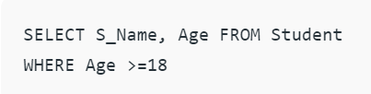
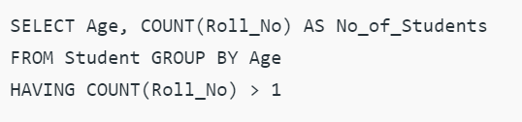
Where and Having Clause
WHERE Clause:
WHERE Clause is used to filter the records from the table or used while joining more than one table.
Only those records will be extracted who are satisfying the specified condition in WHERE clause.
It can be used with SELECT, UPDATE, DELETE statements.
HAVING Clause:
HAVING Clause is used to filter the records from the groups based on the given condition in the HAVING Clause.
Those groups who will satisfy the given condition will appear in the final result.
HAVING Clause can only be used with SELECT statement.
Eg :

Slide 8
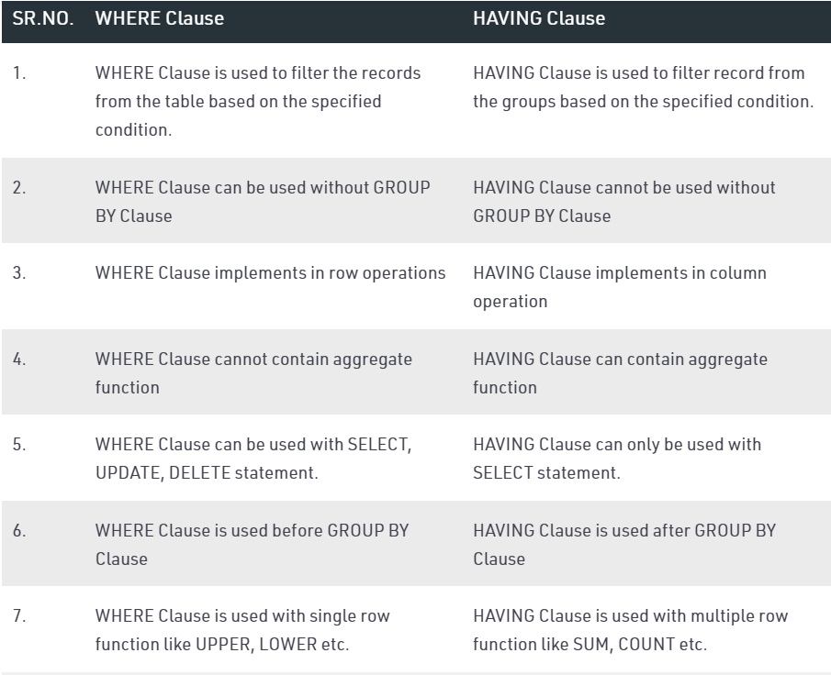
Where and Having Clause

Slide 9

Questions ?

Slide 10


