Slide 1

DWIGHT MARTIN MECHAL TERFIE DALYA KHATUN

Slide 2
Roles
Mechal Terfie Dwight Martin Dalya Khatun
Team coordinator Finalized code User Guide
Documents handler GUI tester Layout
Java coder/admin Java coder/seller Java coder/customer
Database Database Database

Slide 3
Overview
Develop a basic and functional online shopping system.
Build three modules. Customer, seller, and admin.
Allow customers to register, login, search, and purchase.
Allow sellers to register, login, and add/update/sell/ship products.
Allow admins to login, view and remove sellers/customers/products/, and generate sales.

Slide 4
Tools Used
Java, swing on eclipse IDE
Sqlite for database
Git
Skype

Slide 5
Metrics
Approximately 4000 lines of code
FPA: 305 FP
1FP about 8hrs on average, 305*8 = 2440 hours of coding
Averages to about 3 to 4 months for us

Slide 6
USERS/ACTORS
Seller
Customer/Guest
Admin

Slide 7
Seller Module Functions
Add Products
View Products
Update Products
Delete Products
View Orders
Confirm Shipment

Slide 8
Seller Module Demonstration

Slide 9
Customer Module Functions
View Products
Search Products
View Shopping Cart
Add Products to Shopping Cart
Update and Delete Products
Check out

Slide 10
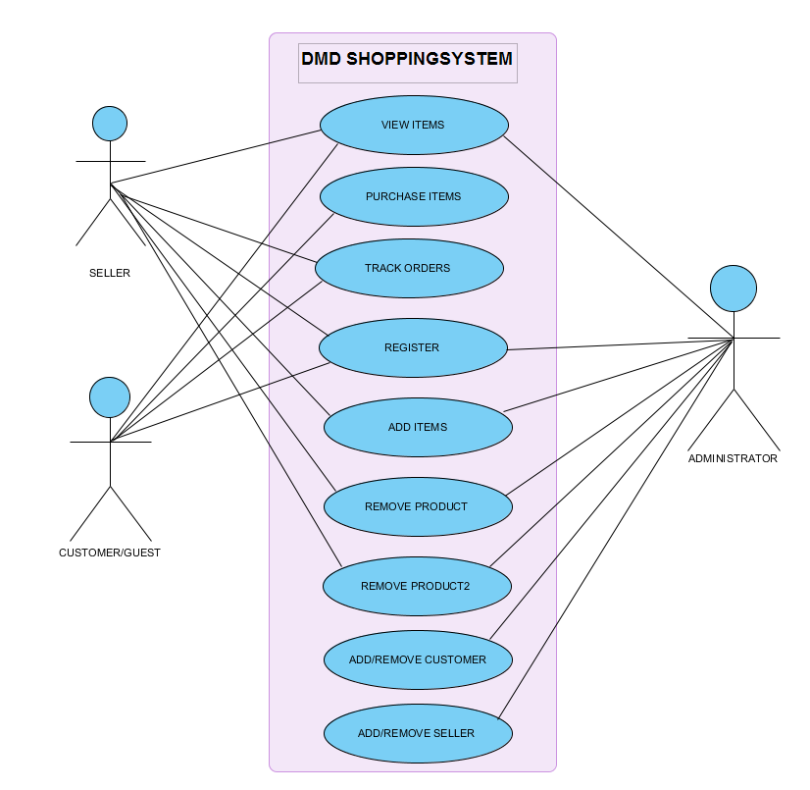
Use-Case Diagram for Main Actors

Slide 11
Use-Case Diagram for Shopper

Slide 12
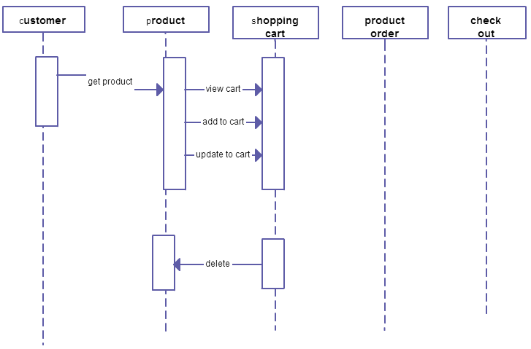
Cart Sequence Diagram

Slide 13
Customer Module Demonstration

Slide 14
Data Management (SQLite)
This database consists of:
Admin Info: Admin information is added to database with Unique ID based on their roles.
Customer Info: Stores information for all registered customers
Seller Info: Stores information for all registered customers
Product Info: Complete products information is stored in this table.
Shipment Info: stores information for orders and shipments.
Total Sales: stores information of all transaction made on the system.

Slide 15
Sequence Diagram for Admin (Login, View, and Remove Functions)
Login Page

Slide 16
Demonstration

Slide 17
Conclusion
We went over some of the functional requirements of our system.
Explained interactions within the system using of topic we’ve learned throughout the semester.
Then demonstrated our working software.
Skills built during the duration of project.
Became better problem solver and improved our coding skills.
Learned communication was an important necessity.

Slide 18

Questions?

