Slide 1


Insights On Telecommunications Customers Churn Data
David Ku
October 10, 2019

Slide 2
Topics
Scenario & Background Of Customer Churn Problem
Insights On Customer Churn Data
Recommendations For Reducing Customer Churn

Slide 3

Scenario & Background Of Telecommunications Customer Churn Problem

Slide 4
Customer Churn Problem
In any subscription based service (telecommunications), there are customers who do churn (cancel) their services.
Customer turnover cuts off future revenue streams, it can hurt brand reputation and increases marketing costs.
Goal: Determine types of customers who are likely to churn in the future & give recommendations.

Slide 5
About The Dataset
7043 customers in the dataset for US Telcom. Business.
Two services : Phone, Internet (DSL / Fiber Optic).
Contract Plans: Month-To-Month, One Year, Two Year
Variables Of Interest: MonthlyCharges, Tenure (Time In Months), Contract.

Slide 6

Insights On Customer Churn Data

Slide 7
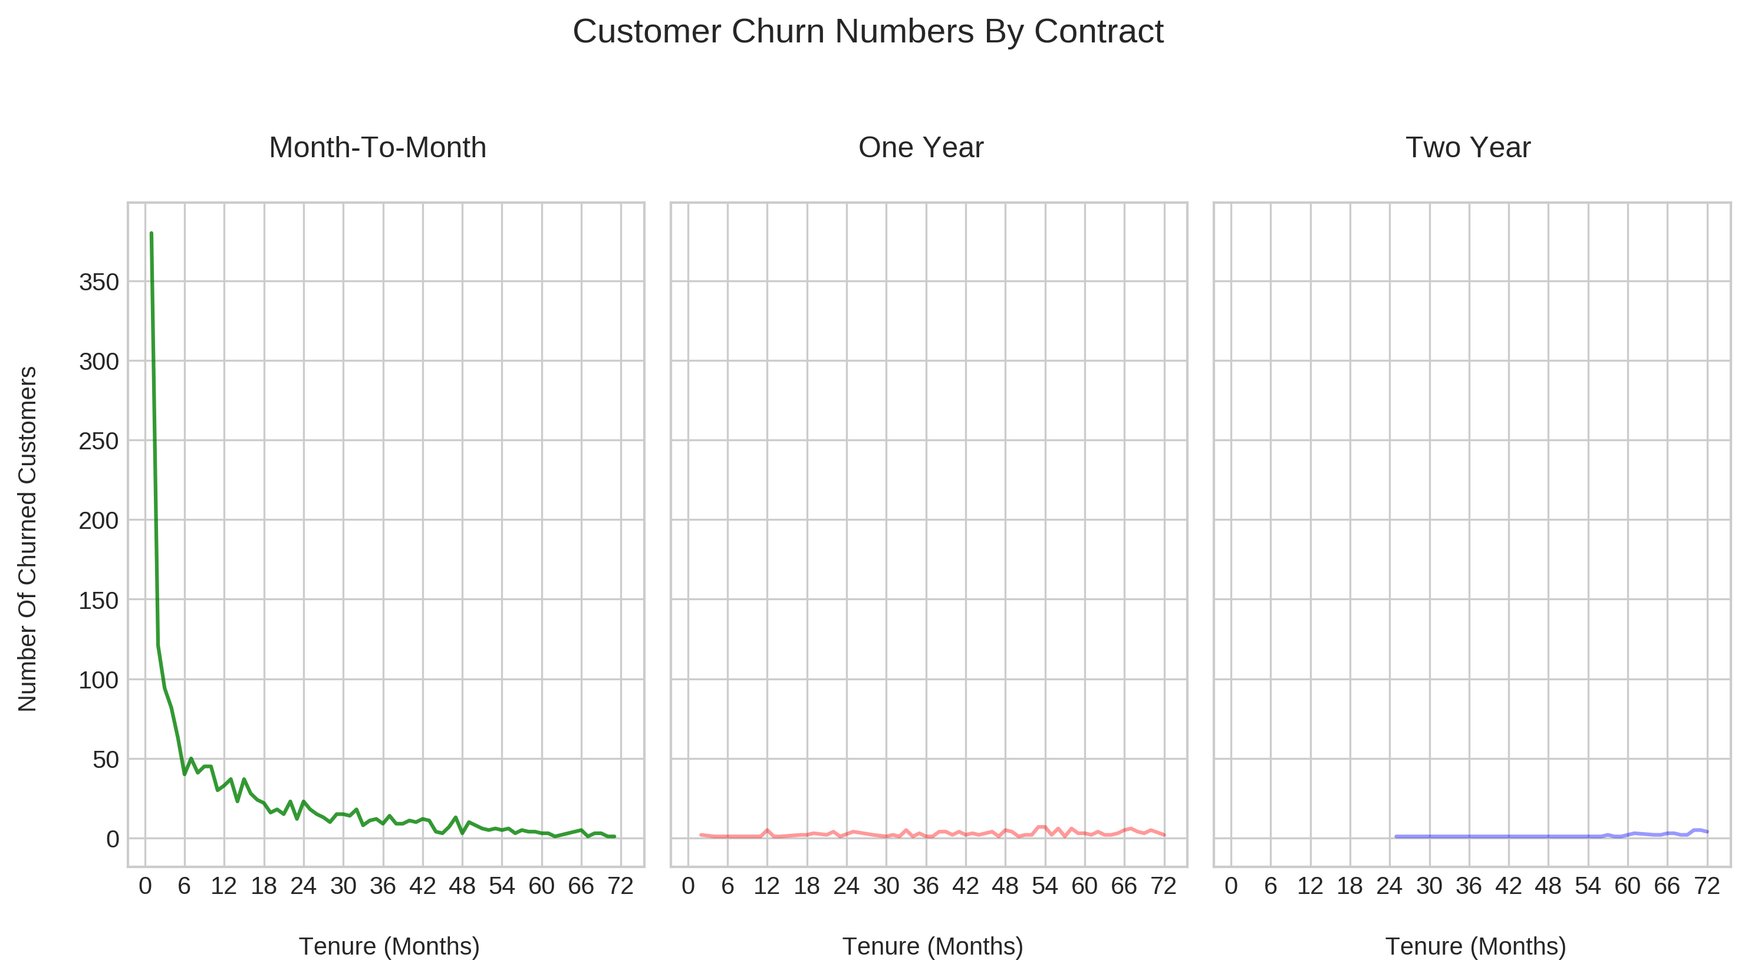
Month-To-Month Customers Churn The Most

Slide 8
Cost Of Losing Month-To-Month Customers
Contract Type | # Of Customers | Mean (Avg.) Monthly Charges | Median Monthly Charges
Month-To-Month | 3875 | $66.40 / mth | $73.25 / mth
1 Year | 1695 | $65.05 / mth | $ 68.75 / mth
2 Year | 1473 | $60.77 /mth | $ 64.35 / mth
Total Number Of Mth-Mth Customers who churn ≤ 6 months Is 780 (out of 7043)
Average Revenue Loss From These Churns Is About 780 x 66.40 ≈ 51,792 (USD)

Slide 9
Model Based Insights
A logistic regression model is used for determining which of MonthlyCharges, tenure or the customer being on a month-to-month plan contributes to churn the most.
A decision tree used to investigate causes for customer churn in dataset.
A Kaplan-Meier survival function curve (visualization) is used to predict probabilities of a customer staying past at a point in time.

Slide 10
Insights From Logistic Regression Model
As the customer stays longer (tenure), churn is less likely to occur.
Higher monthly charges leads to higher likelihood of churn.
If the customer is on a monthly plan they are more likely to churn versus not being on a monthly plan.

Slide 11
Insights From Decision Tree
340 churns from not month-to-month customers
393 churns where the customer was month-to-month, paying < $68/mth with customer tenure months < 3.5.
1747 churns from month-to-month & paying more than $68/mth

Slide 12
Survival Analysis Approach - Customer Churn Events Over Time
The statistical field of survival analysis involves time to event data.
Tenure: Customer service time (months)
Event Of Interest: Churn (Yes/ True)
Kaplan-Meier survival curve visualization for customer churn by contract.
Survival curve estimates the probability of the customer staying (non-churn) past a point in time.

Slide 13
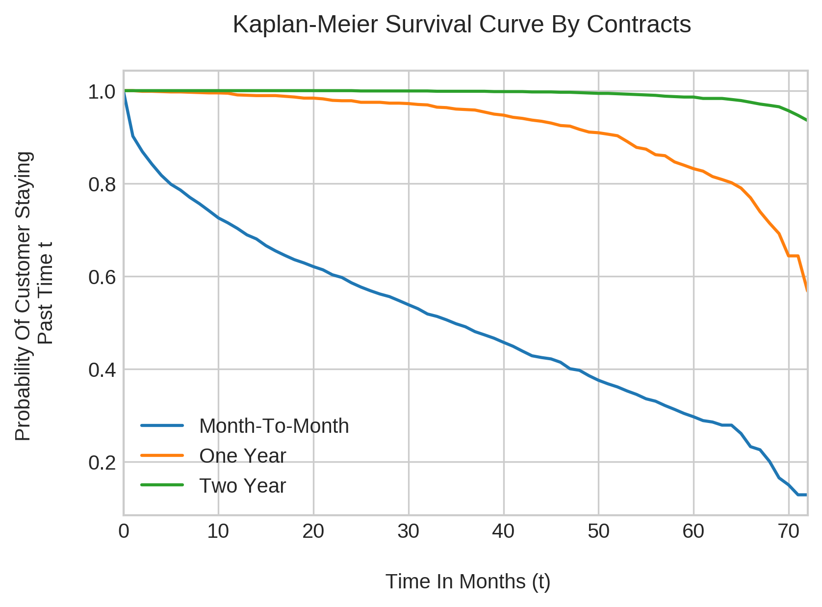
Probability Of A Month-To-Month Customer Staying Decreases Over Time

Slide 14

Recommendations For Reducing Customer Churn

Slide 15
Recommendations / Considerations
Many churns from mth-mth customers ≤ 6 months.
Offer one or two year promo plans to existing mth-mth customers during customer’s 5th month. (E-Mail)
Promo offer for customers to sign up for one/two year plans one month from end of one/two year contract.
Look at month-to-month & > $68 / mth. cases more closely. (1747 Churns)
Customer service, signal service, competitor pricing.

Slide 16
Thank You.

Slide 17
Appendix
Further Works
Decision Tree Model Selection
Survival Analysis Kaplan Meier Curve Explanation
K-Nearest Neighbors Model Results
Logistic Regression Model Selection Results
Super Grid Search

Slide 18
Further Works
Can deeply investigate the role of Internet Service plans for customers.
Internet plans include DSL & Fiber Optic. Does choice of internet plan contribute to churn? If so, combine this with month-to-month customers.
Decision trees and logistic regression models would be considered. No KNN.
With the survival analysis portion, can look at hazard function for likelihood of a customer to churn at a point in time.

Slide 19
Decision Tree Model Selection (Page 1)
Features: MonthlyCharges, is_monthly (0= F, 1 = T), Tenure
Grid Search was used for final model with F1-Score metric.
Parameter | Value
Class_weight | Balanced
Max Depth | 3
Max Features | 3
Max Leaf Nodes | 6

Slide 20
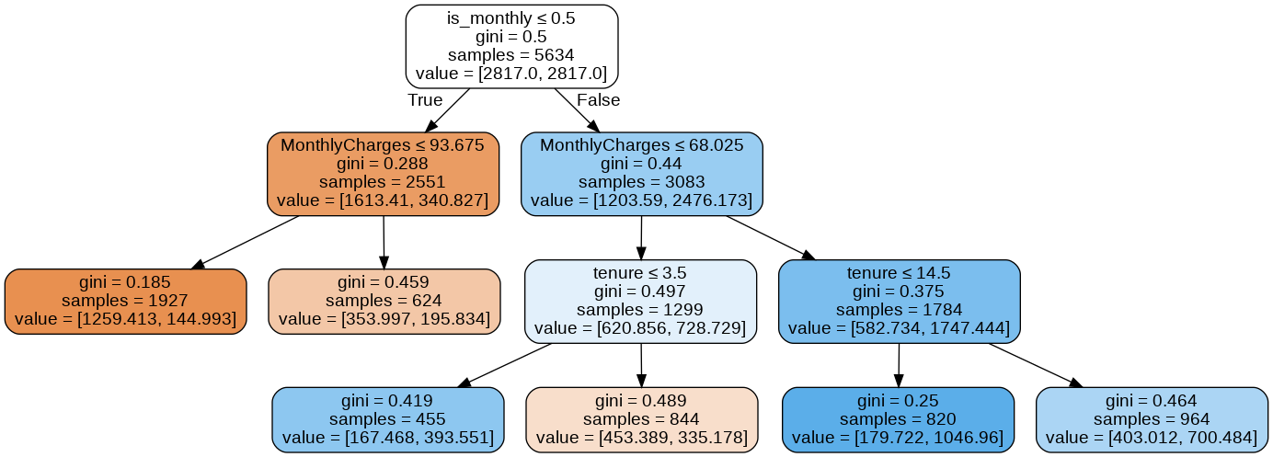
Decision Tree Model Selection (Page 2)

Slide 21
Decision Tree Model Selection (Page 3)
Metric | Metric Score
Training Set Accuracy | 0.741
Validation Set Accuracy | 0.748
Training Set Recall | 0.760
Validation Set Recall | 0.804
F1 Score
Train | 0.609
Validation | 0.628

Slide 22
Survival Analysis Approach - Customer Churn Events Over Time
The statistical field of survival analysis involves time to event data.
Tenure: Customer service time (months)
Event Of Interest: Churn (Yes/ True)
Kaplan-Meier survival curve visualization for customer churn by contract.
Survival curve estimates the probability of the customer staying (non-churn) past a point in time.

Slide 23
K-Nearest Neighbors (KNN) Model Results
Two KNN models were selected with a grid search. One for recall , other for f1.
Features of interest were MonthlyCharges, tenure (Months), is_monthly.
KNN models were not considered in the analysis as the model is biased to points near the test data points.
 | Model One | Model Two
N_neighbours | 1 | 21
P (For distance) | 2 | 2
Accuracy | 0.7318 | 0.7346
Recall | 0.9604 | 0.5217
F1 Score | 0.9538 | 0.5906

Slide 24
Logistic Regression Model Selection Results
Ridge Regression penalty used for final model with liblinear and C = 0.01
Coefficients for tenure, MonthlyCharges, is_monthly: -0.744, 0.735, 0.654
tenure coefficient is -0.74: As the customer stays longer there are less likely to churn.
MonthlyCharges coefficient is 0.735: Higher monthly charges can lead to churn.
is_monthly coefficient is 0.654: If the customer is on a monthly plan they are more likely to churn.

Slide 25
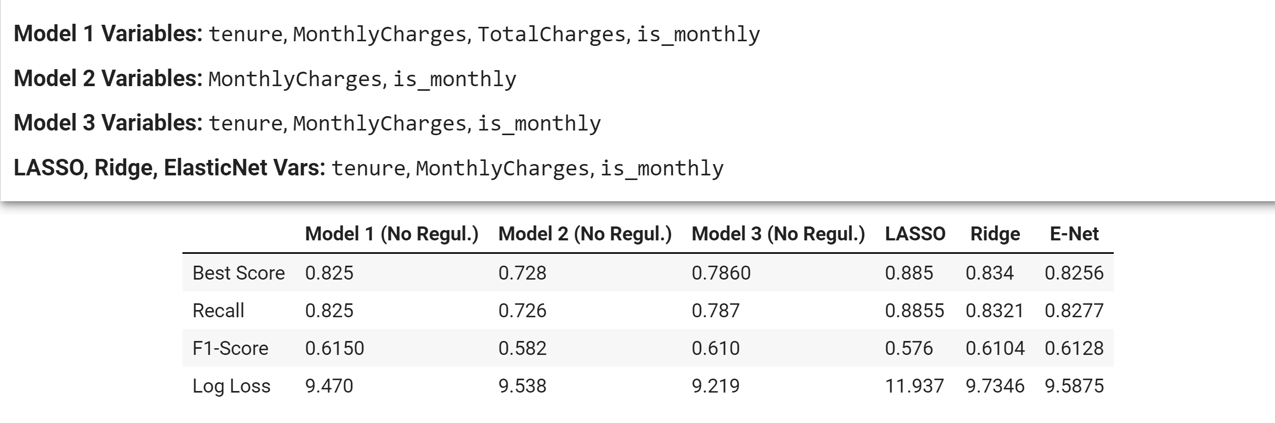
Super Grid Search Results

Slide 26
References
Python Lifelines Library https://lifelines.readthedocs.io/en/latest/Survival%20Analysis%20intro.html
Pixabay For Images
https://www.displayr.com/how-to-interpret-logistic-regression-coefficients/

