Slide 1
Results Analysis
Derrick Kempster

Slide 2
Weka
Waikato Environment for Knowledge Analysis
Preprocessing and classification capabilities
Works with .arff (Attribute-Relation File Format) files
A very accessible application for data identification and analysis tasks

Slide 3
Preprocessing
Used the provided preprocessed dataset
Data conversion programs created to change the format to .arff
Part 1 misuse classifier
Add the traffic type as a class attribute
Part 2 misuse classifier
Limit the types to the desired type and “Other”
Anomaly classifiers
Limit the types to “Anomaly” and “Normal”
Used Weka to divide master sets into 70% training and 30% test sets
Seed of 45 for part 1 and 378 for part 2

Slide 4
Part 1: Random Forest
100 trees
Depth of 100
IDS Type | Running Time (s) |  | Accuracy (%)
 | Model Building | Model Testing
Misuse | 386.18 | 5.50 | 99.9773
Anomaly | 368.32 | 3.75 | 99.9891

Slide 5
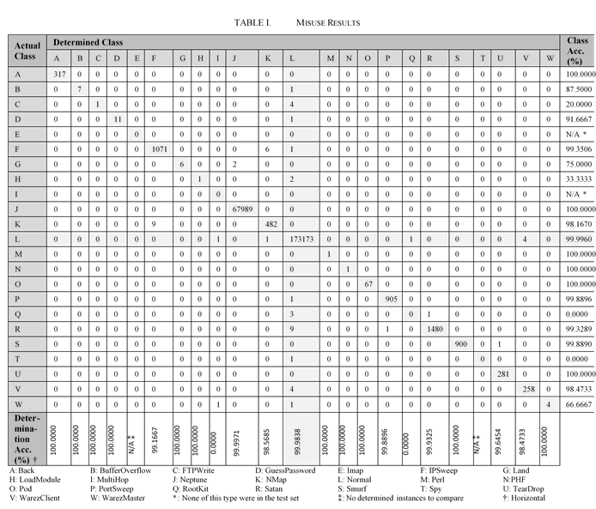
Part 1: Random Forest – Misuse

Slide 6
Part 1: Random Forest – Misuse
False Negatives were 0.0162% of deemed-normal traffic
Some effects of tracking everything on random split
Imap and MultiHop each had no entries in the test set
Perl, PHF, and Spy each had 1 entry in the test set
No traffic was deemed to be Imap or Spy
Data split should not be entirely random from the set of all traffic
Matters more when some types have a comparably small entry count
Could ensure that 70% of each traffic type gets in the training set
Remainder 30% put in the test set

Slide 7
Part 1: Random Forest – Anomaly
Actual Class | Determination Class |  | Class Acc. (%)
 | Normal | Anomaly
Normal | 173174 | 6 | 99.9965
Anomaly | 21 | 73810 | 99.9716
Deter-mination Acc. (%) † | 99.9879 | 99.9919
False Negatives were 0.0121% of deemed-safe traffic
False Positives were 0.0081% of deemed-unsafe traffic
Each type is of sufficient size to not need the special split
†: Horizontal

Slide 8
Part 1: Random Forest – Overview
The anomaly IDS classifier outperformed the misuse IDS classifier
Higher overall accuracy
Lower false negative ratio

Slide 9
Part 2: Multilayer Perceptron
5 chosen attacks have the most data (excluding Normal)
Training time of 500 epochs
1 hidden layer
Learning weight of 0.3
Momentum of 0.2
No validation set
IDS Type | Running Time (s) |  | Accuracy (%)
 | Model Building | Model Testing
IPSweep | 645.37 | 1.29 | 99.8652
Neptune | 641.42 | 1.31 | 99.9976
PortSweep | 642.36 | 1.27 | 99.9899
Satan | 656.95 | 1.26 | 99.9721
Smurf | 631.50 | 1.28 | 99.9895
Anomaly | 632.30 | 1.21 | 99.6956

Slide 10
Part 2: Multilayer Perceptron – IPSweep
Classified As | Actual Class |  | False (%)
 | IPSweep | Other
IPSweep | 1084 | 322 | 22.9018
Other | 11 | 245594 | 0.0045
99.8652% accuracy
Second Worst
Highest False Positive ratio

Slide 11
Part 2: Multilayer Perceptron – Neptune
Classified As | Actual Class |  | False (%)
 | Neptune | Other
Neptune | 68288 | 1 | 0.0015
Other | 5 | 178717 | 0.0028
99.9976% accuracy
Best
First classifier with a higher false negative ratio than false positive ratio
Still acceptable for small size

Slide 12
Part 2: Multilayer Perceptron – PortSweep
Classified As | Actual Class |  | False (%)
 | PortSweep | Other
PortSweep | 852 | 3 | 0.3509
Other | 22 | 246134 | 0.0089
99.9899% accuracy
Second Best

Slide 13
Part 2: Multilayer Perceptron – Satan
Classified As | Actual Class |  | False (%)
 | Satan | Other
Satan | 1427 | 15 | 1.0402
Other | 54 | 245515 | 0.0220
99.9721% accuracy
Third Worst

Slide 14
Part 2: Multilayer Perceptron – Smurf
Classified As | Actual Class |  | False (%)
 | Smurf | Other
Smurf | 912 | 23 | 2.4599
Other | 3 | 246073 | 0.0012
99.9895% accuracy
Third Best

Slide 15
Part 2: Multilayer Perceptron – Anomaly
Classified As | Actual Class |  | False (%)
 | Anomaly | Normal
Anomaly | 73391 | 128 | 0.1741
Normal | 624 | 172868 | 0.3597
99.6956% accuracy
Worst
Highest False Negative ratio
Second classifier with a higher false negative ratio than false positive ratio
Worse than Neptune, but still below 1%

Slide 16
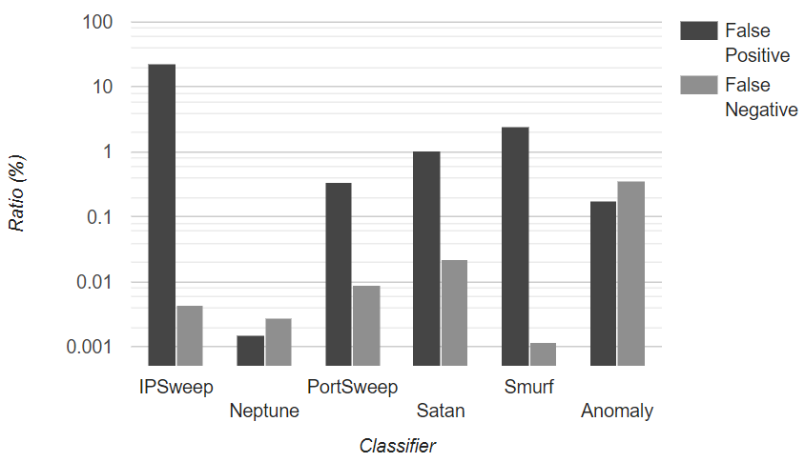
Part 2: Multilayer Perceptron – Overview
The misuse classifiers outperformed the anomaly classifier
Higher overall accuracy
Lower false negative ratio

Slide 17
Part Comparison

Slide 18
Improvement
Finding a way to save models / use a different classification tool
Models are built right before a testing a data set, and only for that test
Cannot export the model to run on other data
Test additional, more complex classifiers
Will cost additional time to construct

Slide 19
Conclusions
The random forest classifiers overall outperformed the multilayer perceptrons
With the given settings applied
The multilayer perceptron could reasonably be used for misuse
False negative ratio is lower
Accuracy is only slightly worse

