Slide 1
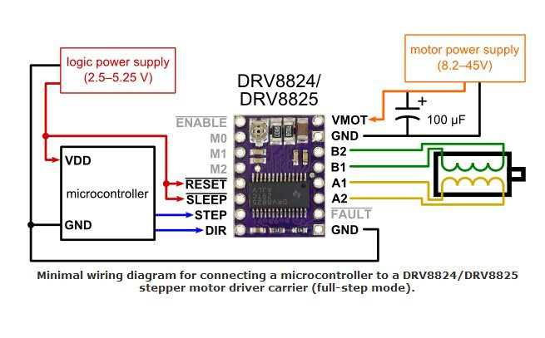

Slide 2
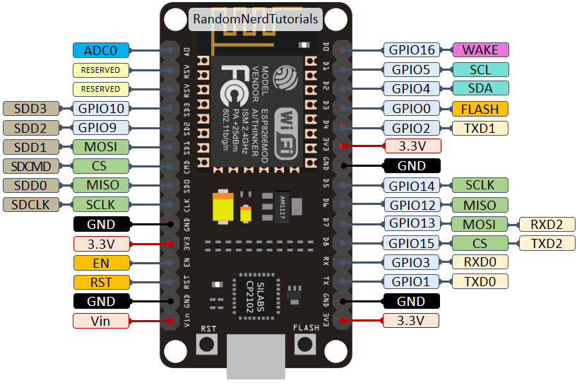
NodeMCU Pinout

Slide 3
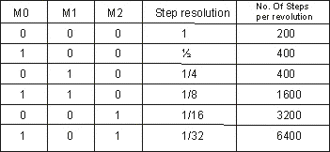

Slide 4
Limitswitch | D1 (Pin 5) |  |  | Opener
 |  | Pressed | high | Pull down (10K)
 |  | Not pressed | low | Pull down (10K)

Slide 5
GPIO | PIN
D1 | 5 | Limitswitch
D2 | 4 | Switch1
D4 | 2 | Switch 2

