Slide 1
Course: CS 513B
First Name: Daniel
Last Name: Kadyrov
ID: 10455680
Purpose: Midterm – Problems 1 and 8

Slide 2
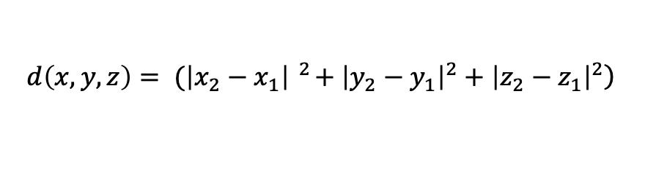
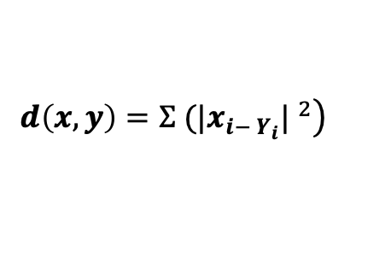


Problem 1
$$\left.d\left(x,y,z\right)= (\left|x_{2}−x_{1}\right| ^{2}+{\left|y_{2}−y_{1}\right|}^{2}+{\left|z_{2}−z_{1}\right|}^{2}\right)$$
$$\left.d\left(x,y\right)=Ʃ (|x_{i− Y_{i}}| ^{2}\right)$$
It is a distance function because its able to compute a non-negative distance, commutatively. The function would have to be altered for the second part of the problem
 | x | y | z | Distance to P1 | Distance to P2 | Distance to P3 | Distance to P4
Point 1 | 0 | 0 | 0 | 0 | 1 | 2 | 3
Point 2 | 0 | 1 | 0 | 1 | 0 | 1 | 2
Point 3 | 0 | 1 | 1 | 2 | 1 | 0 | 1
Point 4 | 1 | 1 | 1 | 3 | 2 | 1 | 0

Slide 3

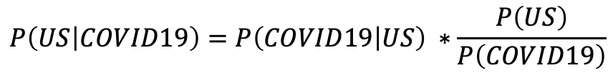
Problem 8
a. Estimate the number of cases in the US, Italy and Spain.
US 331*381.24 = 126190.44
Italy 60*1463.97 = 87838.2
Spain 47*1590.24 = 1590.24
b. Given that a person is living in the US, what is the probability that the person is infected with COVID19.
126190.44/(331*1,000,000) = 0.00038124 = 0.038124%
c. Given that a person is diagnosed with the COVID19, what is the probability that the person lives in the US.
 | Population | Prevalence
 | rounded to nearest | Cases
 | Million | Per Million
US | 331 | 381.24
Italy | 60 | 1463.97
Spain | 47 | 1590.24
 | 438 | 3435.45
$$P\left(US | COVID19\right)=P\left(COVID19 | US\right) ∗\frac{P\left(US\right)}{P\left(COVID19\right)}$$
$P\left(US | COVID19\right)$=0.75516=75.16%
P(US) = 331/438
P(COVID) = 381.24/1,000,000
P(COVID19|US) = 126190.44/(331.24*1,000,000)

