Slide 1

Predicting Employee Termination
Team Member: Daniel Kadyrov
Course Section: CS513B
Department: CS
Level: Graduate/Staff
ID: 10455680
Team Name: Red Snapper

Slide 2
Agenda
Preprocessing Data
Factorizing
Exploration of Data
Predicting Models
Random Forest
Support Vector Machine

Slide 3
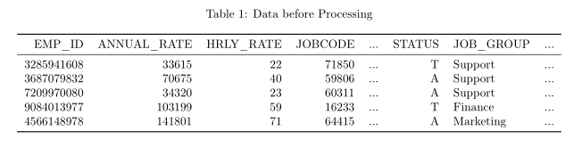
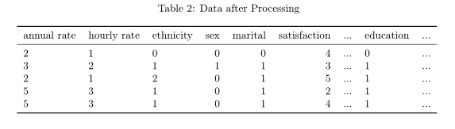
Data Preprocessing
Initial data features columns including annual and hourly rates, ethnicity, age, sex, job group, first job, education level.
Columns employee id, termination year, job code, and referral source are removed because they have missing data.
Status, whether kept or terminated, is selected as the target column and factorized.
Some features were factorized:
Annual rate is split based on $20,000, $50,000, $75,000, $100,000, and $2,000,000.
Hourly rate is split based on $25, $50, $75, $100, and $1000
Age was split based on 20, 30, 50, 60, 100.
Hire month was split based on months in Q1, Q2, Q3, and Q4
Ethnicity, sex, martial status, number of teams, first job, travel requirement, disabled, veteran, job group, and education were factorized

Slide 4
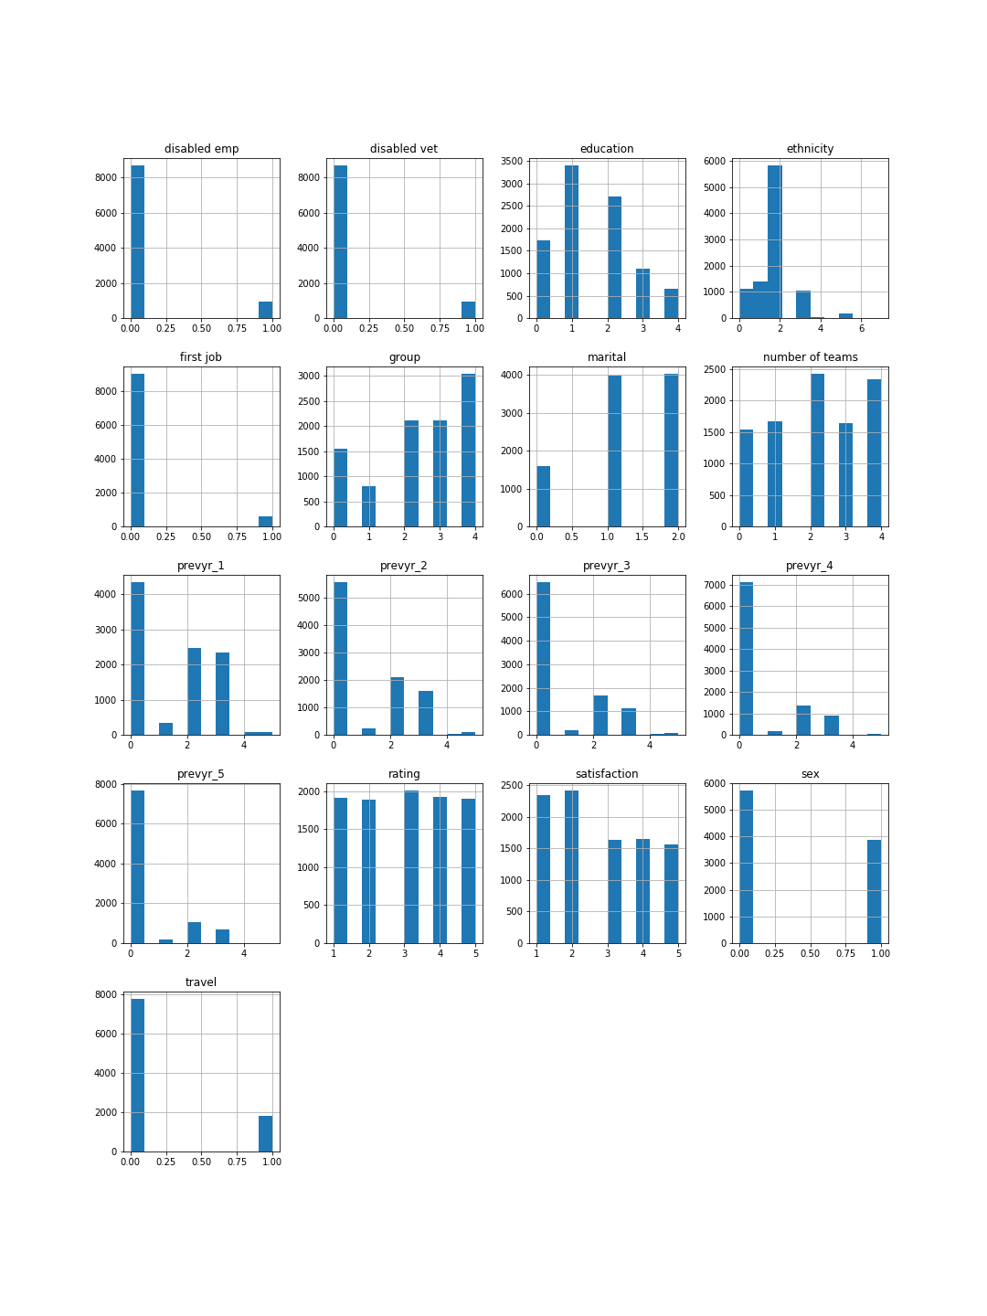
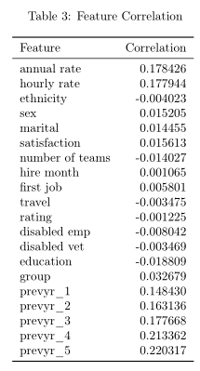
Exploration of Data
Examining the correlation between the different features and the status (target) of the employee.

Slide 5
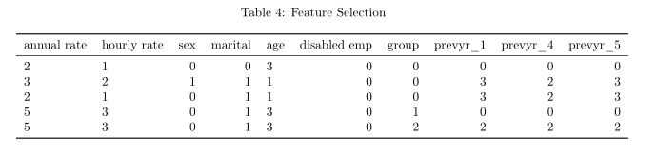
Preparing for Modeling
Feature selection was performed using Recursive Feature Elimination with a logistic regression model. 10 features were selected by the algorithm.
The data was split into 70% training and 30% test subsects.

Slide 6
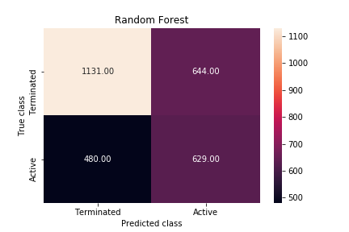
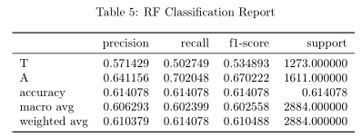
Random Forest
Random Forest classification was performed using the training data
The test data was used to measure accuracy of the model.

Slide 7
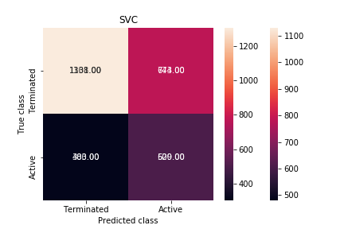
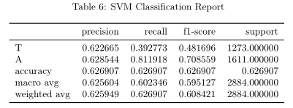
Support Vector Machine
Support Vector Machine classification was performed using the training data
The test data was used to measure accuracy of the model.

Slide 8

Results and Conclusion
The Support Vector Machine model performed better than the Random Forest model for this classification.

