Slide 1
CHAPTER 17:
File Management
The Architecture of Computer Hardware, Systems Software & Networking:
An Information Technology Approach
5th Edition, Irv Englander
John Wiley and Sons ©2013
PowerPoint slides authored by Angela Clark, University of South Alabama
PowerPoint slides for the 4th edition were authored by Wilson Wong, Bentley University

Slide 2
Introduction to Files
Collection of (usually related) data
Block
  Typically between 256 and 4096 bytes
  Files usually require a one-block minimum
Cluster
  Groups of one or more blocks
Blocks or clusters correspond to one or more sectors on a disk’s single track or cylinder
File extension
  Name of file includes identification of what type of file it is
File Association
  The file specifies which program it is to be used with
Copyright 2013 John Wiley & Sons, Inc.
17-<number>

Slide 3
Terminology
Logical view
  Contents and attributes of files viewed by the user
Physical view
  The actual way a file is stored within the computer system
Sequential access
  Data files whose records always have to be retrieved from the beginning
Random or relative access
  Data files whose records can be retrieved from anywhere in the file in random sequence
Contiguous
  The blocks that hold a particular file are stored together
Noncontiguous
  The blocks that hold a particular file are scattered all over the device
Copyright 2013 John Wiley & Sons, Inc.
17-<number>

Slide 4
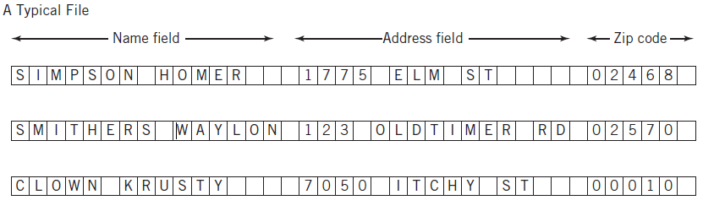
Database File – Table Image
Copyright 2013 John Wiley & Sons, Inc.
17-<number>

Slide 5
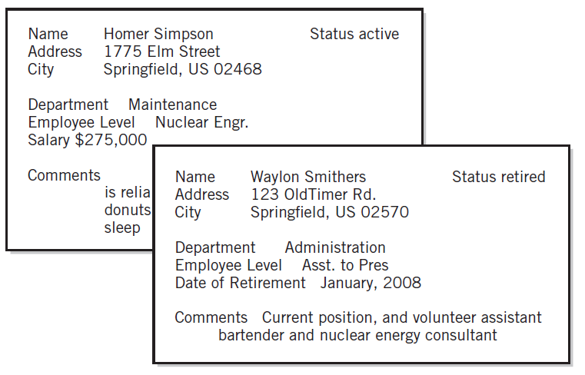
Database File – Form Image
Copyright 2013 John Wiley & Sons, Inc.
17-<number>

Slide 6
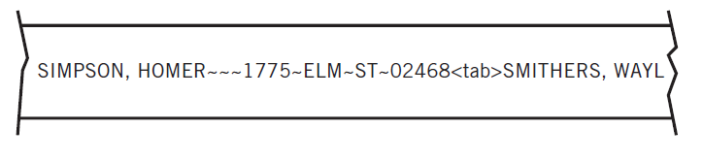
Database File – Stream Image
Closer to physical representation of file
Example: YouTube video
Copyright 2013 John Wiley & Sons, Inc.
17-<number>

Slide 7
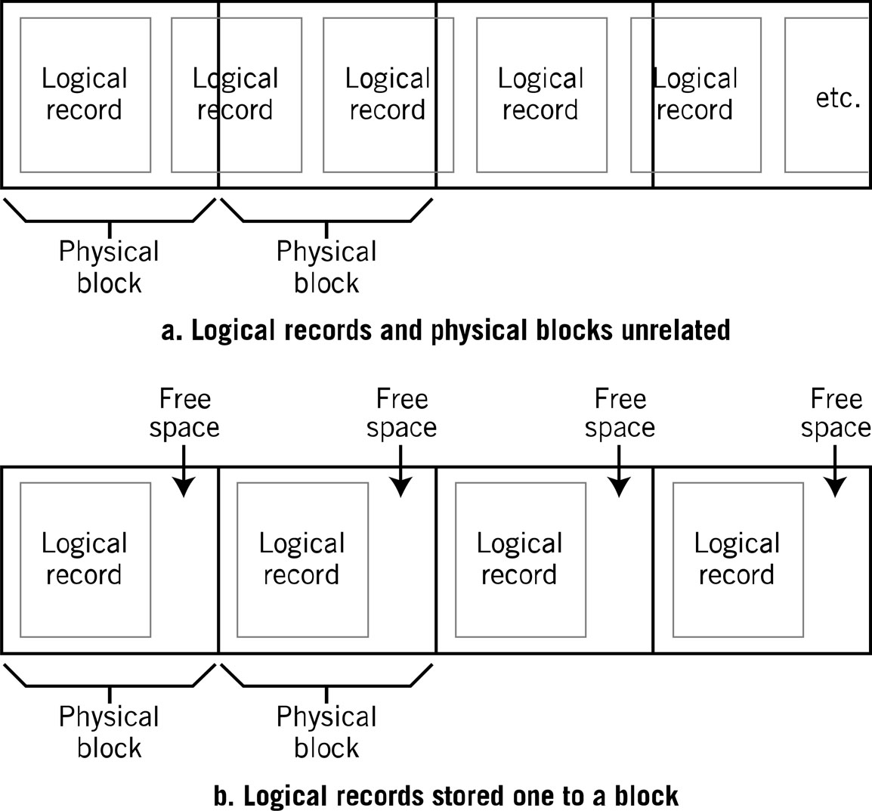
Logical View vs. Physical View
Copyright 2013 John Wiley & Sons, Inc.
17-<number>

Slide 8
File Management System
Provides a logical view for the user and hides the physical implementation
Consistent set of commands that are translated to a form appropriate for the device
Consistent view of files regardless of file type, file characteristics, or device
Supports manipulation of data within the file
Manages directory structures that are presented in a logical view
Command shell takes user file commands and program file requests and translates them for the file manager
Requests data transfers from I/O device drivers
File security and protection of file integrity
Copyright 2013 John Wiley & Sons, Inc.
17-<number>

Slide 9
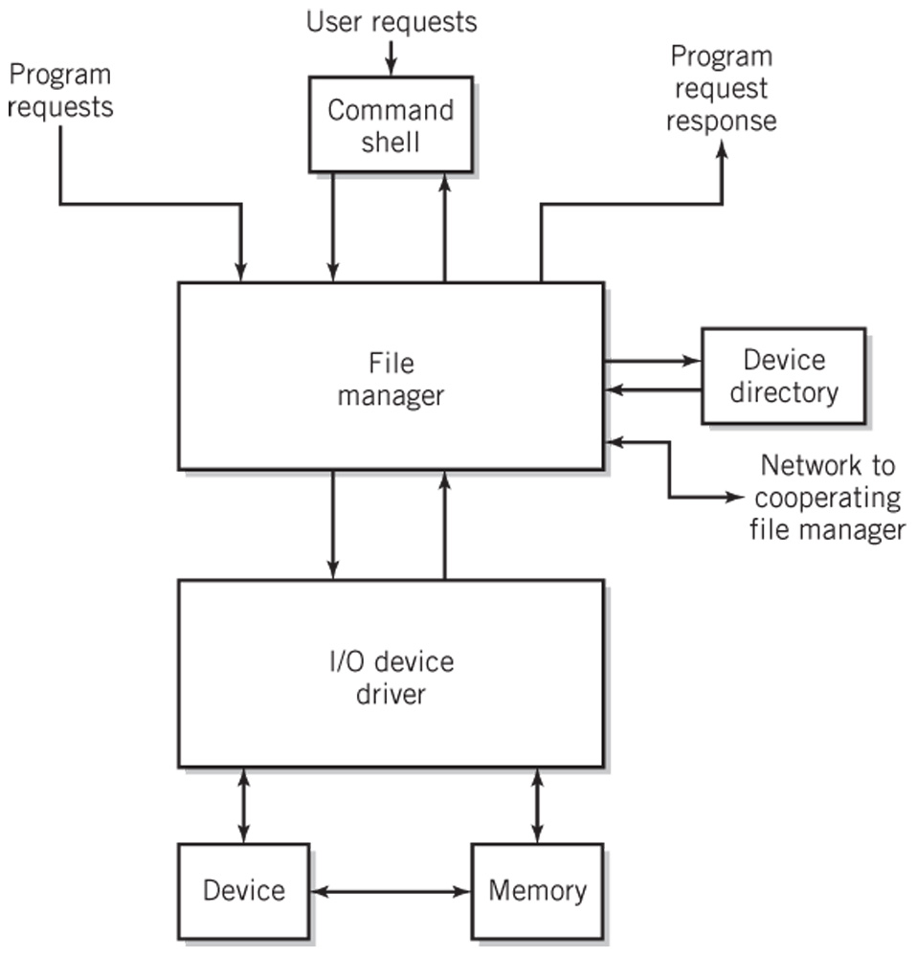
File Manager Request Handling
Copyright 2013 John Wiley & Sons, Inc.
17-<number>

Slide 10
File Operations (1)
File as a whole
  Copy, Move
  List, Print
  Load and execute a program
  Load file into memory
  Store file from memory
  Append data from memory to file
  Compile, assemble a file
Copyright 2013 John Wiley & Sons, Inc.
17-<number>

Slide 11
File Operations (2)
Within a file
  Open a file
  Read a number of bytes from file
  Write a number of bytes to a file
  Move the file pointer forward or backward
  Move file pointer to beginning of a file
  Close a file
Copyright 2013 John Wiley & Sons, Inc.
17-<number>

Slide 12
File Operations (3)
Record Storage
  Retrieve a record (read)
  Store a record (write)
  Add a record to a file
  Delete a record
  Modify contents of a record
Copyright 2013 John Wiley & Sons, Inc.
17-<number>

Slide 13
File Directory Operations
File Directory
  Create a new (empty) file
  Move a file from one directory to another
  Rename a file
  Append one file to another
  Delete a file
Copyright 2013 John Wiley & Sons, Inc.
17-<number>

Slide 14
File Management and I/O Functions
Separation between the two allows
I/O devices to change while keeping the file system the same
Simple redirection of data
Copyright 2013 John Wiley & Sons, Inc.
17-<number>

Slide 15
File Access Methods
Sequential Access
  File is read in sequence from beginning to end
  Majority of all files
  Program source and binary files
Random Access
  Assumes file is made up of fixed length logical records
  Hashing is a common method used to calculate the location of an internal logical record
Indexed Access
  Additional means for accessing and viewing records in a file
  Key indexes
  ISAM – indexed sequential access method
Copyright 2013 John Wiley & Sons, Inc.
17-<number>

Slide 16
Physical File Storage
Contiguous
Non-contiguous
  Linked
  Indexed
Examples
  DOS/Windows FAT
  UNIX i-nodes
  Windows NTFS
Free space management
Copyright 2013 John Wiley & Sons, Inc.
17-<number>

Slide 17
Contiguous Storage Allocation
Assign blocks (all in a row) to hold the file
Access is simple for both sequential and random methods
Disadvantages
  Space must be large enough
  Have to take into account file growth
  May need to be moved if it outgrows its space
  Fragmentation of disk
Allocation strategies to minimize fragmentation
  First-fit, best-fit
Eventually disk becomes fragmented
Copyright 2013 John Wiley & Sons, Inc.
17-<number>

Slide 18
Linked Allocation
Non-contiguous
Each block contains a link to the next physical block
Variant – links in both directions
Advantages
  No fragmentation
  Adding to a file is easy
Disadvantages
  Not usable for random access
  Additional disk head searching
  Overhead in storing the pointers
  Recovery of a defective block is difficult
Copyright 2013 John Wiley & Sons, Inc.
17-<number>

Slide 19
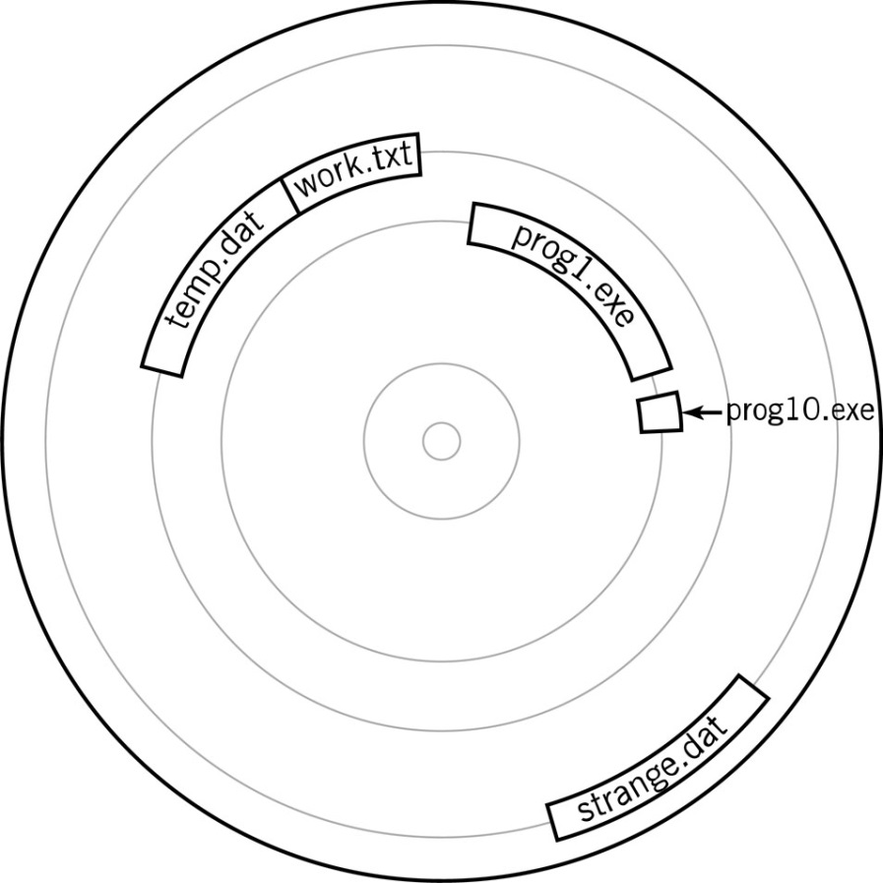
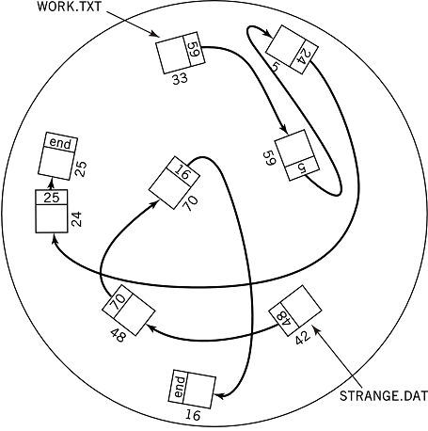
File Allocation
Contiguous Storage Allocation
Linked Allocation
Copyright 2013 John Wiley & Sons, Inc.
17-<number>

Slide 20
Windows FAT
File Allocation Table (FAT)
  Linked allocation with links stored in a table
  Table contains the first block of each file on the disk or disk partition
  Successive blocks contain a link to the next block
Disadvantages
  Requires a tremendous amount of space
  File integrity can be easily compromised
Copyright 2013 John Wiley & Sons, Inc.
17-<number>

Slide 21
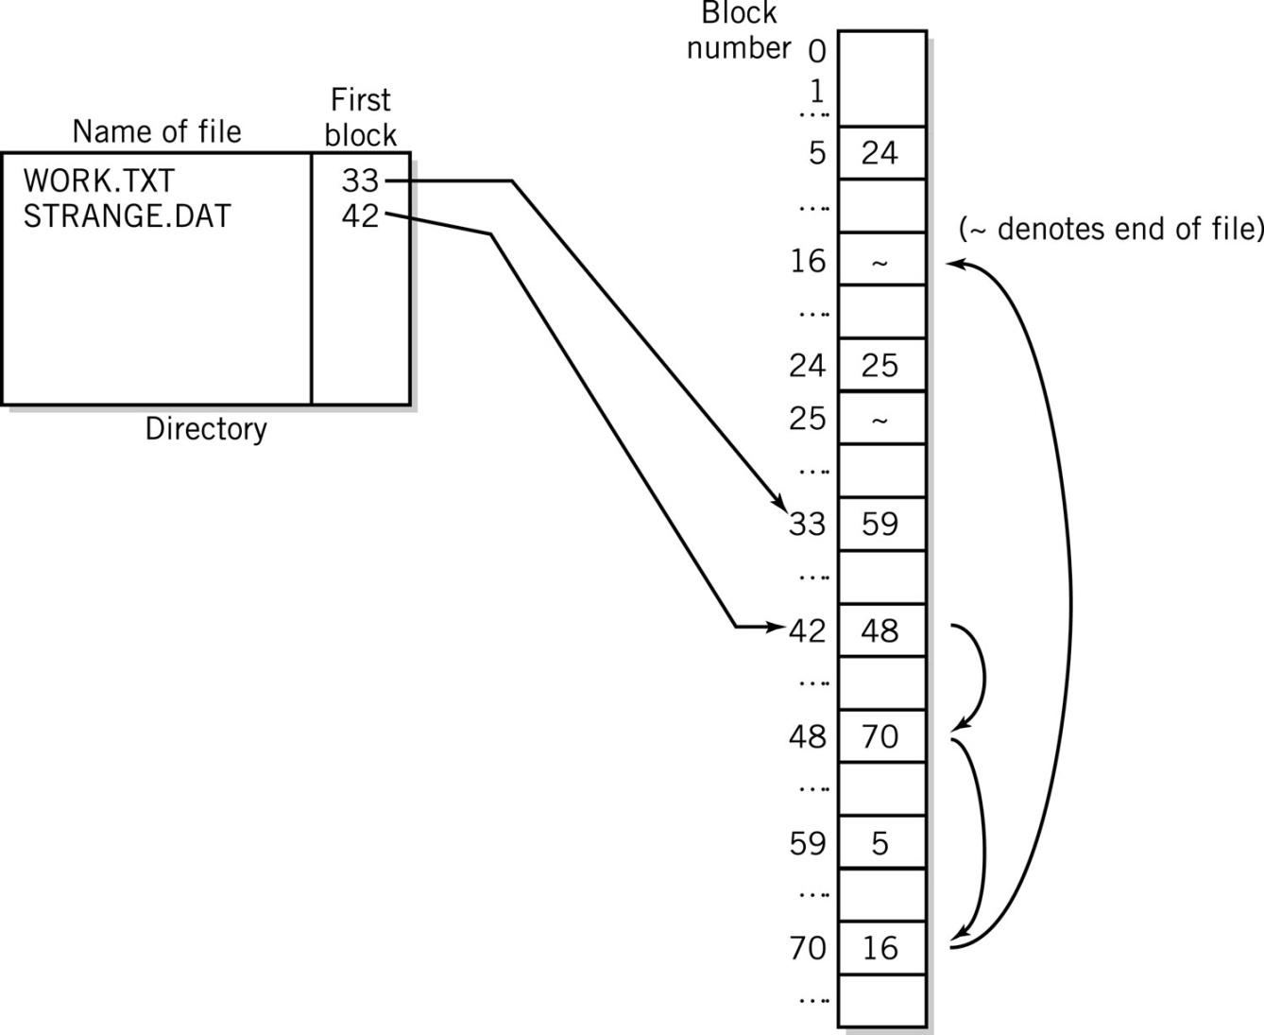
File Allocation Table
Linked Allocation and File Allocation Table
Copyright 2013 John Wiley & Sons, Inc.
17-<number>

Slide 22
Indexed Allocation
Non-contiguous
All link pointers for a file are stored together in a single block called the index block
One index block per file
Advantages
  No fragmentation
  Can be used for random access
Disadvantage
  Slower due to additional access of the index block
  Additional disk head searching
  Recovery of a defective block is difficult
Copyright 2013 John Wiley & Sons, Inc.
17-<number>

Slide 23
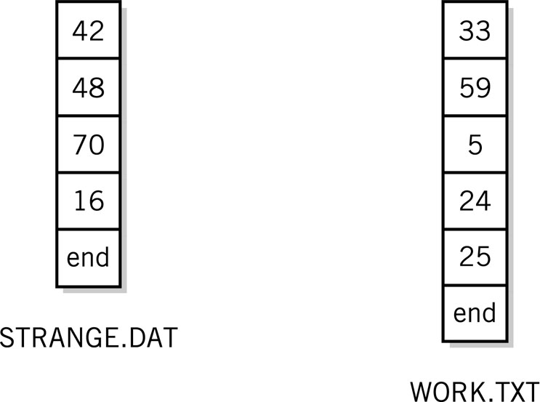
Indexed Allocation
Index blocks for indexed allocation of linked files shown in File Allocation Table diagram, Figure 17.7
Copyright 2013 John Wiley & Sons, Inc.
17-<number>

Slide 24
Unix i-nodes
Indexed file allocation
Index block contains
  File attributes
  10 direct blocks
  1 single indirect
  1 double indirect
  1 triple indirect
Advantages
  Fast for small blocks
  Can accommodate very large files—hundreds of gigabytes
Copyright 2013 John Wiley & Sons, Inc.
17-<number>

Slide 25
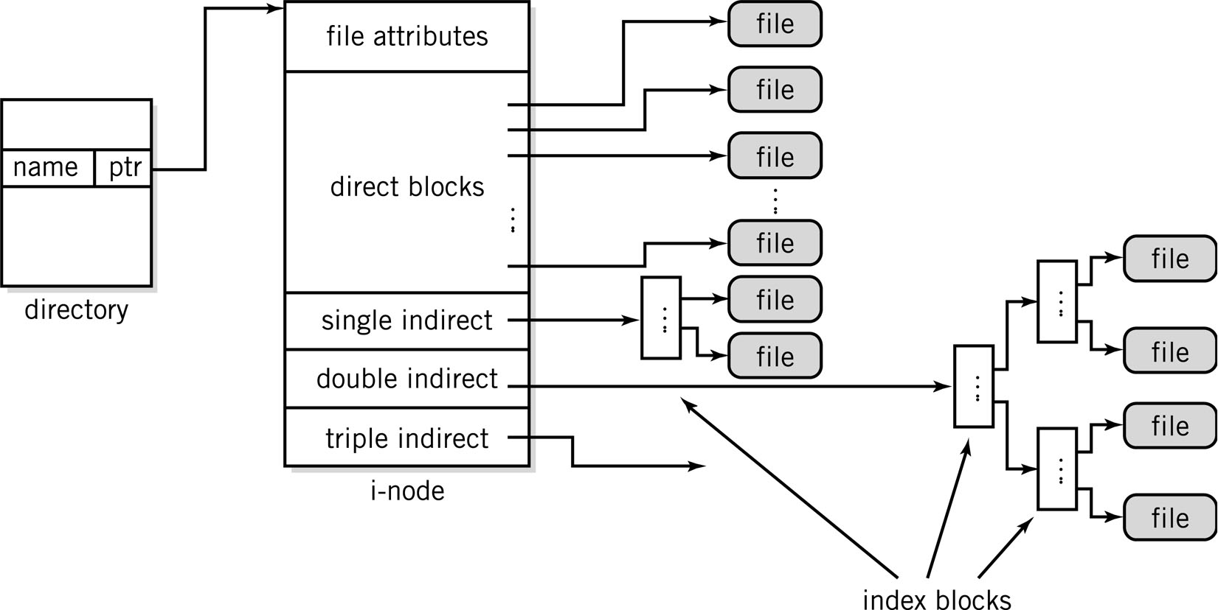
Unix i-nodes
Copyright 2013 John Wiley & Sons, Inc.
17-<number>

Slide 26
Windows NTFS
Dynamically sized volumes
Volumes may be a fraction of a disk or span many disks
Master File Table (MFT) of 1KB records
  First 16 records are metadata files that describe the volume
  First record stores the MFT attributes
  Each file has an MFT entry
File records made up of attributes, including file information and data
Copyright 2013 John Wiley & Sons, Inc.
17-<number>

Slide 27
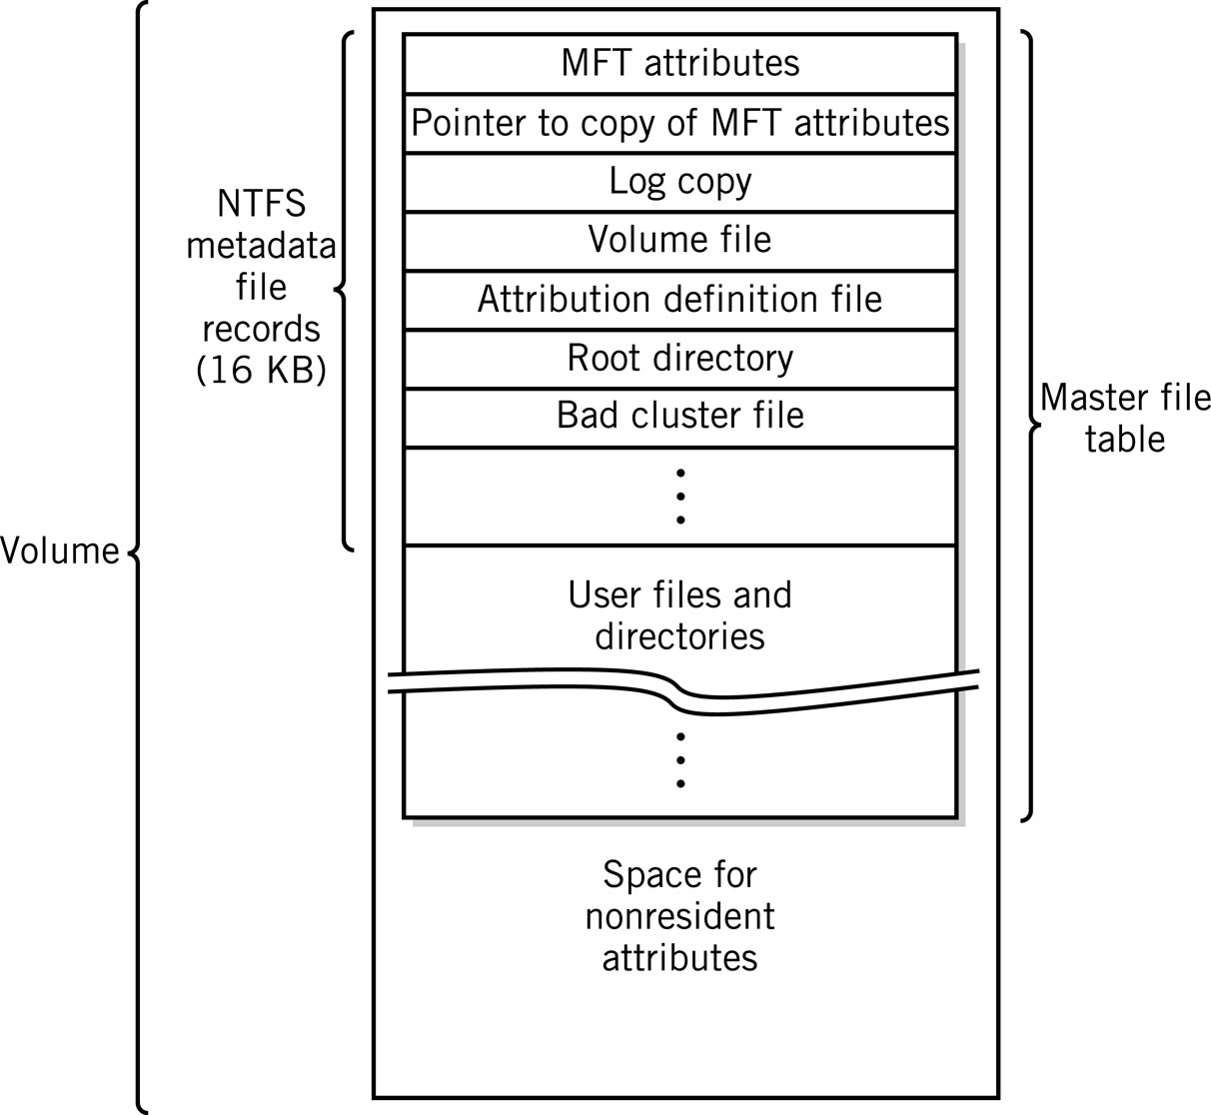
NTFS Volume Layout
Copyright 2013 John Wiley & Sons, Inc.
17-<number>

Slide 28
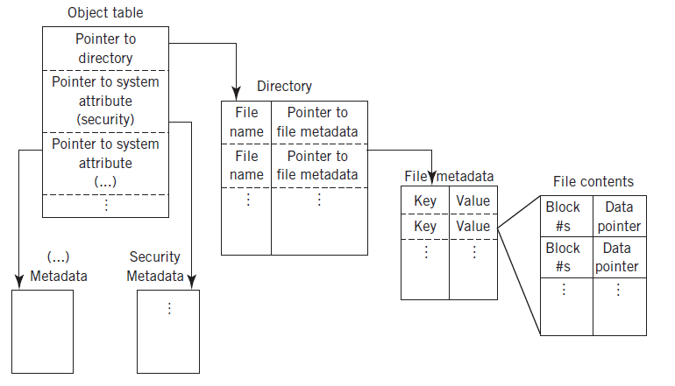
Microsoft Resilient File System (ReFS)
Copyright 2013 John Wiley & Sons, Inc.
17-<number>

Slide 29
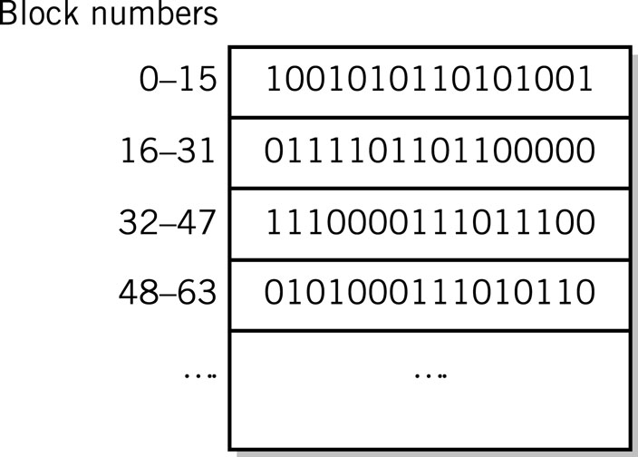
Free Space Management
Bit map method
  One bit for each block
  to indicate if it is used
  or free
Linked list method
  Pointer to first free block
  Each free block has a pointer to the next
  Blocks are allocated from the beginning
  Deleted files are placed at the end
Copyright 2013 John Wiley & Sons, Inc.
17-<number>

Slide 30
Other Secondary Storage Allocation
Tape Allocation
  Not practical to reallocate space in the middle of the tape
  Files that grow must be re-written
  Files are stored contiguously whenever possible
Optical drives and flash drive file allocation
  Similar to that of hard disks
  UDF (Universal Data Format) supports up to two terabytes of data
  Hierarchical directory format
  Support for both HD-DVD and Blu-Ray DVD formats
Copyright 2013 John Wiley & Sons, Inc.
17-<number>

Slide 31
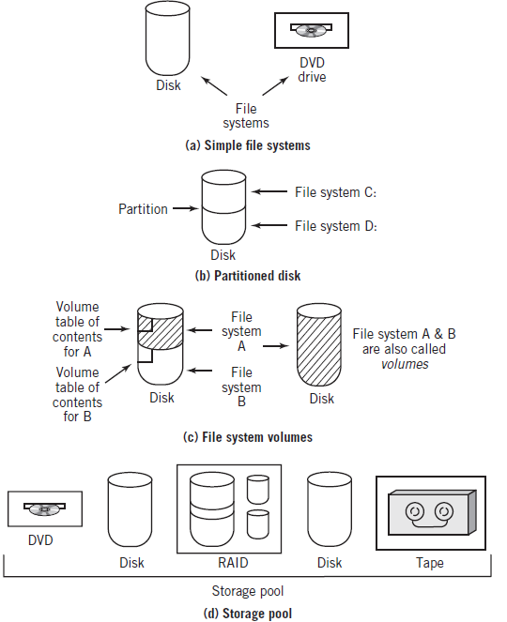
Partitions, File Systems, Volumes, and Pools
Copyright 2013 John Wiley & Sons, Inc.
17-<number>

Slide 32
Directory Structure
Provides a means of organization so that files can be located easily and efficiently
Hides the physical devices from the logical view of the files
Partitions
  Independent subsections of a device
Volume
  Directory structure for a particular partition
  Needs to be mounted to be incorporated into the overall file system structure
Contains file attributes
Copyright 2013 John Wiley & Sons, Inc.
17-<number>

Slide 33
Tree-Structure Directory
Hierarchical with a top-level root directory from which all other directories stem
All directories and files have names
Separator
  Used to indicate subdirectories and files located in a directory
  / UNIX
  \ DOS, Windows
Pathname
  Absolute – full pathname starting from the root directory
  Relative – pathname is created starting from the current directory
Search Paths
  Directory locations that the operating system uses to locate files
Copyright 2013 John Wiley & Sons, Inc.
17-<number>

Slide 34
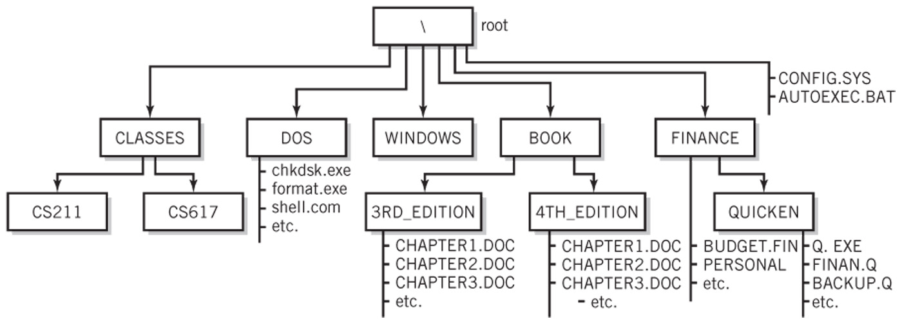
Tree-Structure Directory
For our examples, root is on disk device C:
Pathname Examples:
Absolute: C:\FINANCE\QUICKEN\Q.EXE
Relative from the FINANCE directory: QUICKEN\Q.EXE
Search Path: PATH=C:\DOS;C:\FINANCE\QUICKEN
  Now the programs in the two directories can be run by specifying the name of the program without the absolute or relative pathnames
Copyright 2013 John Wiley & Sons, Inc.
17-<number>

Slide 35
Acyclic Directory Structures
Tree-structure that permits links between separate branches of the tree
Advantage
  Easy user access
Disadvantages
  Cycles and dangling links
Examples
  Windows shortcuts
  Unix hard and symbolic links
  MacIntosh aliases
Copyright 2013 John Wiley & Sons, Inc.
17-<number>

Slide 36
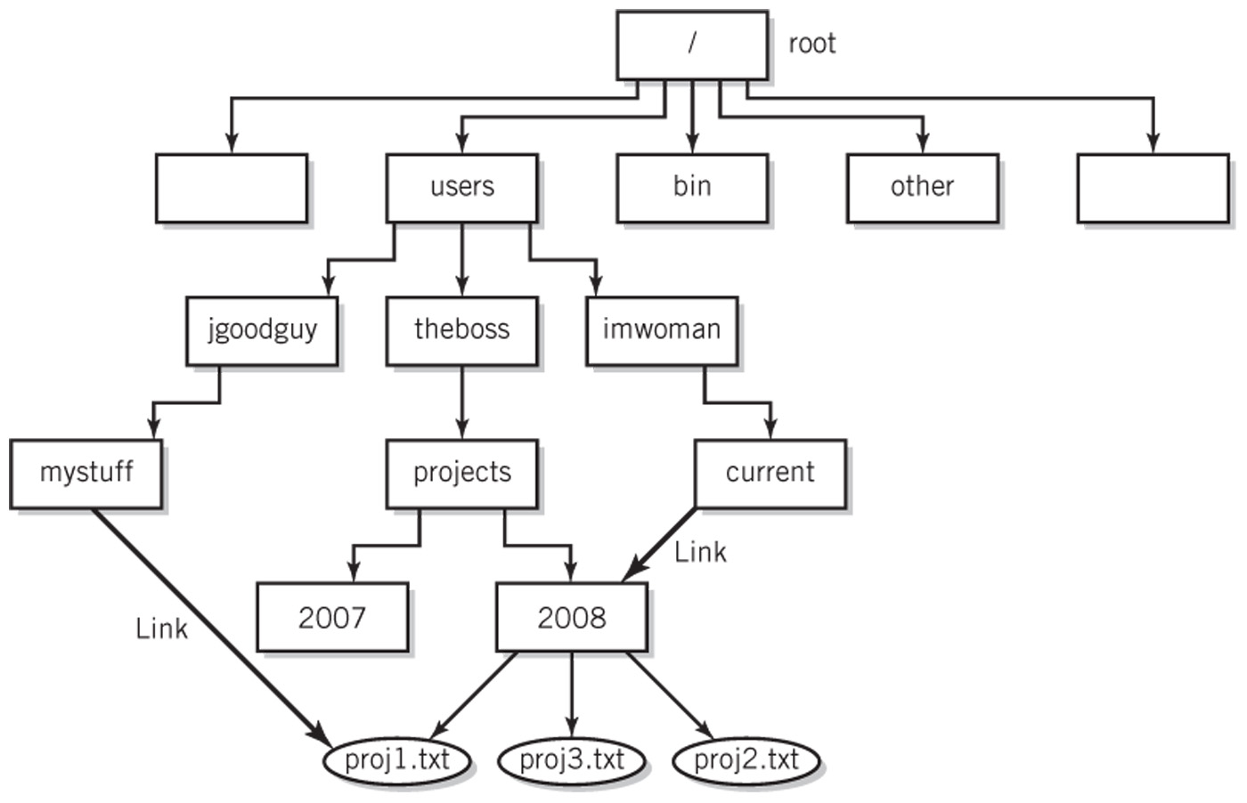
An Acyclic-Graph Directory
Copyright 2013 John Wiley & Sons, Inc.
17-<number>

Slide 37
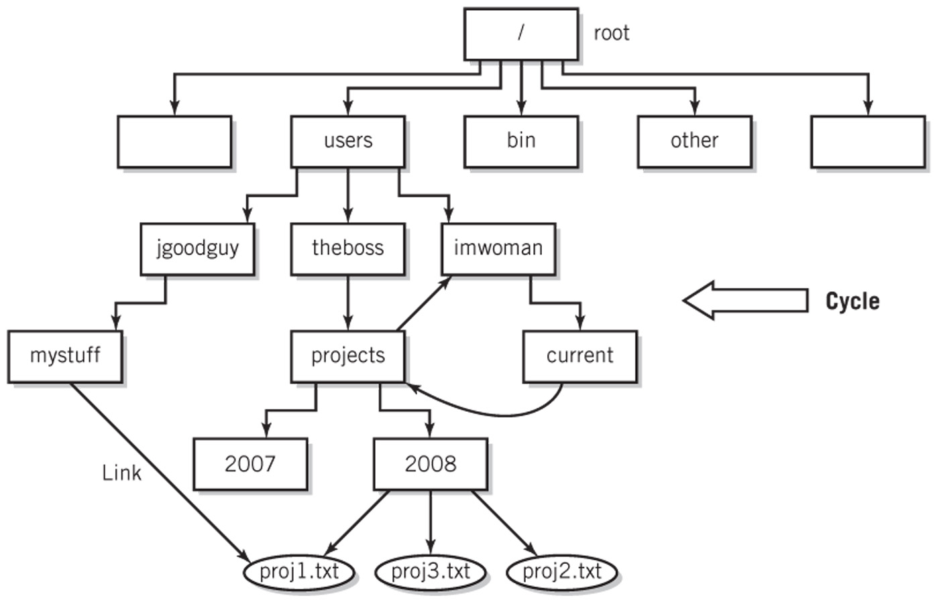
Graph with a Cycle
Copyright 2013 John Wiley & Sons, Inc.
17-<number>

Slide 38
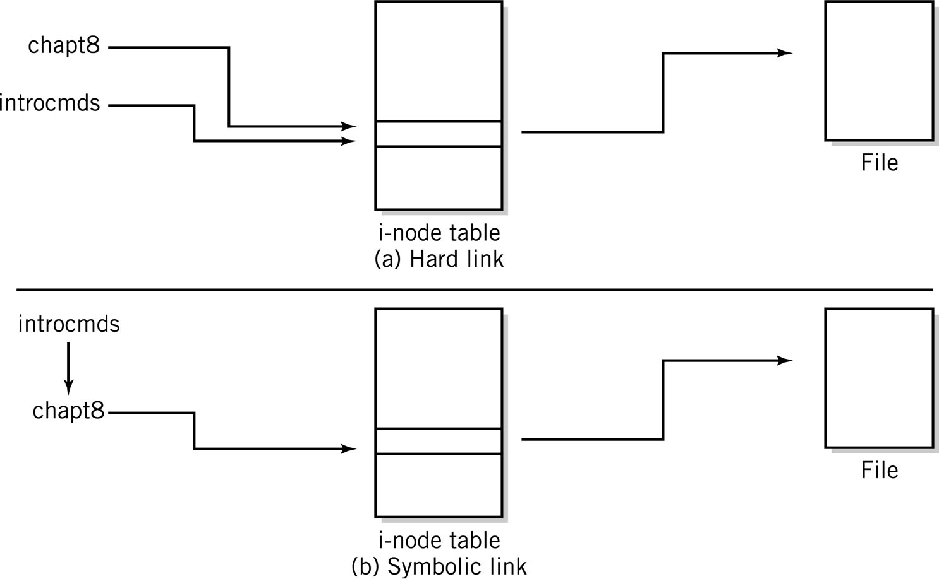
Hard Links vs. Symbolic Links
Copyright 2013 John Wiley & Sons, Inc.
17-<number>

Slide 39
Network File Access
FTP
  File Transfer Protocol
  Part of the TCP/IP protocol family
Network file systems
  Windows
    Drive letters aliased to remote file systems
  UNIX
    Network File System (NFS)
    Remote Procedure Call (RPC)
Copyright 2013 John Wiley & Sons, Inc.
17-<number>

Slide 40
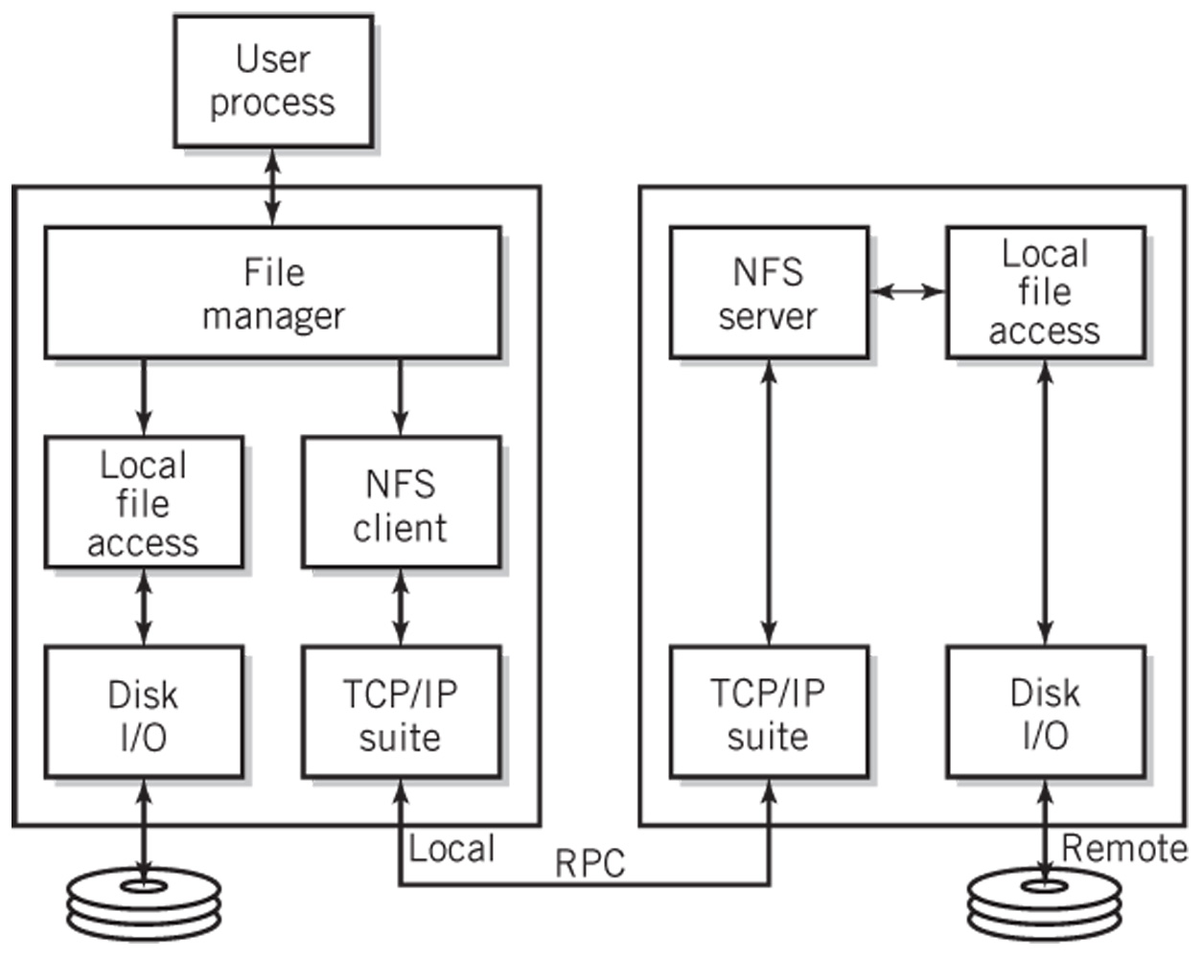
Typical NFS Configuration
Copyright 2013 John Wiley & Sons, Inc.
17-<number>

Slide 41
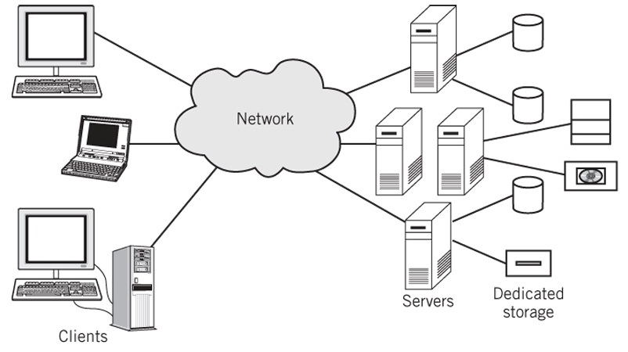
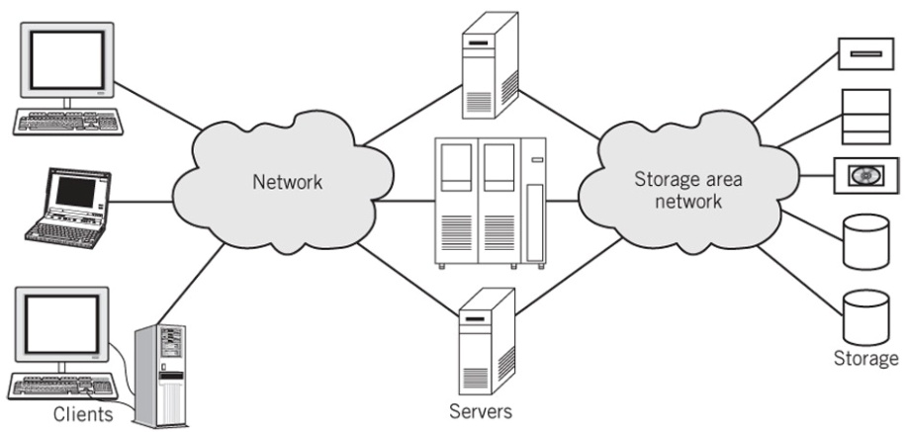
Data Storage Approaches
Standard client server configuration
Storage area network configuration
Copyright 2013 John Wiley & Sons, Inc.
17-<number>

Slide 42
File Protection
Logins and passwords
Most systems provide three forms of protection on files
  Read protection
  Write protection
  Execution protection
Access control list (ACL)
  List of users who may access the file for each of the forms of protection
  Tremendous overhead if there are a lot of users
Owner/Group/Everyone protection method
  UNIX, Linux
Copyright 2013 John Wiley & Sons, Inc.
17-<number>

Slide 43
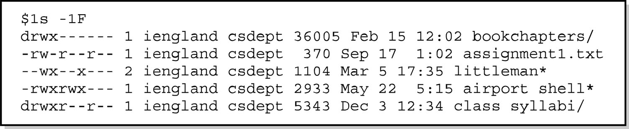
File Directory Showing Protection
ls –lF list files in directory using a long format and indicate file type
10-char code for file protection
1st char d for directory, - for file, s for symbolic link
2nd to 4th char permissions for the owner
5th to 7th char permissions for the group
8th to 10th char permissions for everyone
r - read permission, w - write permission, x - execute permission
Copyright 2013 John Wiley & Sons, Inc.
17-<number>

Slide 44
Journaling File Systems
Log file records every system transaction that requires a write access to the file system
Two levels of capability
  Protect the integrity of the file system structure only
    Example: Windows NTFS file system
  Also guarantees the integrity of data that has not yet been written to the disk
    Examples: Linux ext3 and ext4, IBM JFS
Copyright 2013 John Wiley & Sons, Inc.
17-<number>

Slide 45
Copyright 2013 John Wiley & Sons
All rights reserved. Reproduction or translation of this work beyond that permitted in section 117 of the 1976 United States Copyright Act without express permission of the copyright owner is unlawful. Request for further information should be addressed to the Permissions Department, John Wiley & Sons, Inc. The purchaser may make back-up copies for his/her own use only and not for distribution or resale. The Publisher assumes no responsibility for errors, omissions, or damages caused by the use of these programs or from the use of the information contained herein.
Copyright 2013 John Wiley & Sons, Inc.
17-<number>

