Slide 1
CHAPTER 14: Communication Channel Technology
The Architecture of Computer Hardware, Systems Software & Networking:
An Information Technology Approach
5th Edition, Irv Englander
John Wiley and Sons ©2013
PowerPoint slides authored by Angela Clark, University of South Alabama
PowerPoint slides for the 4th edition were authored by Wilson Wong, Bentley University

Slide 2
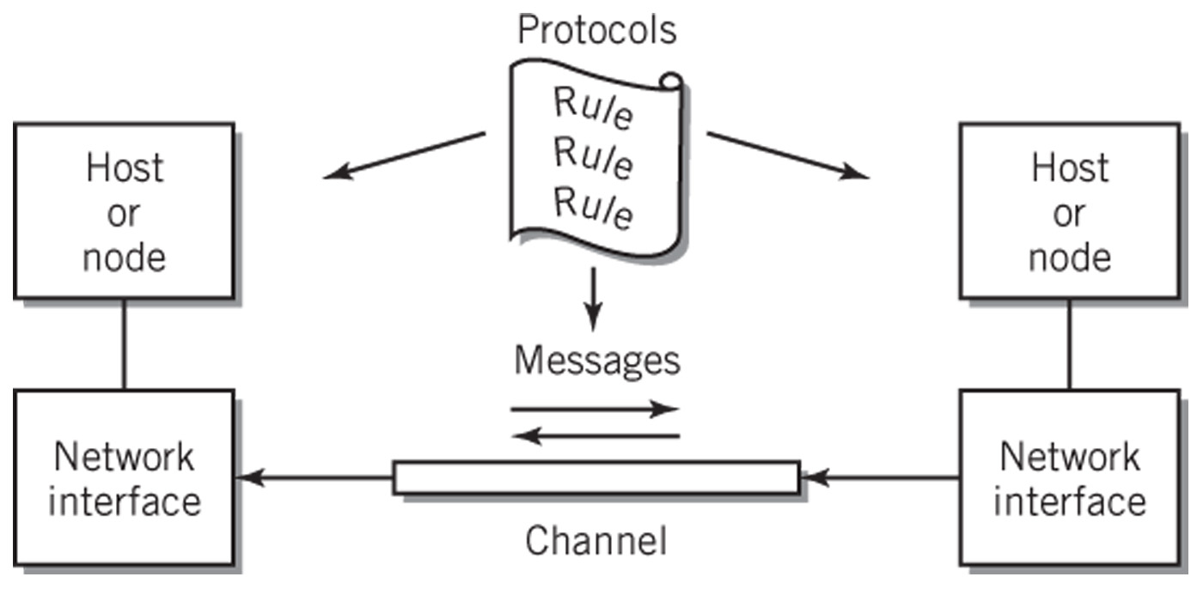
Communication Channel
Copyright 2013 John Wiley & Sons, Inc.
14-<number>

Slide 3
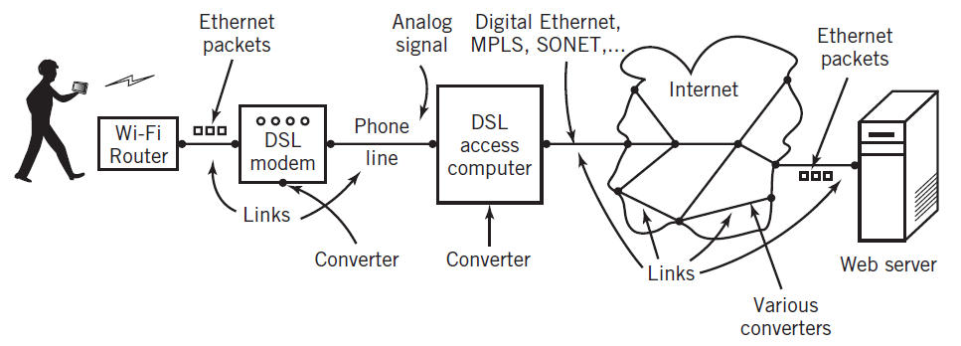
Communication Channels:
Many Ways to Implement
Signal: specific data transmitted
Diagram shows a multi-link channel connecting a computer and a wireless tablet
  Physically: signal passes through different channel forms including audio, digital, light, radio
  Converters between separate channel links
Copyright 2013 John Wiley & Sons, Inc.
14-<number>

Slide 4
Communication Channel
Characterized by
  Signaling transmission method
  Bandwidth: amount of data transmitted in a fixed amount of time
  Direction(s) in which signal can flow
  Noise, attenuation, and distortion characteristics
  Time delay and time jitter
  Medium used
Copyright 2013 John Wiley & Sons, Inc.
14-<number>

Slide 5
Multiplexing
Carrying multiple messages over a channel simultaneously
  TDM (time division multiplexing)
    Example: packet switching on the Internet
    Use: digital channels
  FDM (frequency division multiplexing)
    Example: Cable TV
    Analog channels
Synchronized switches or filters separate different data signals at receiving end
Copyright 2013 John Wiley & Sons, Inc.
14-<number>

Slide 6
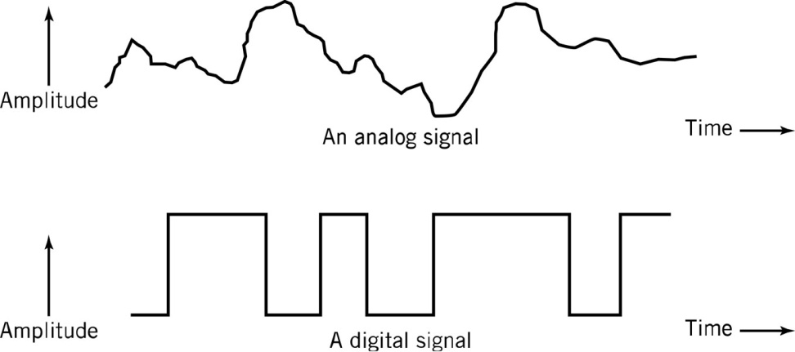
Signaling Transmission Method
Choice depends on medium and signal characteristics
Analog
  Signal takes on a continuous range of values
Discrete
  Signal takes on only finite, countable set of values
Digital
  Binary discrete signal
  Frequently preferred because less susceptible to noise and interference
Copyright 2013 John Wiley & Sons, Inc.
14-<number>

Slide 7
Signaling Technology
Signal carriers
  Electrical voltage
  Electromagnetic radio wave
  Switched light
Data represented by changes in the signal as a function of time
Copyright 2013 John Wiley & Sons, Inc.
14-<number>

Slide 8
Communicating between
Digital and Analog
Ideally conversion should be reversible
Limitations
  Noise: interference from sources like radio waves, electrical wires, and bad connections that alter the data
  Attenuation: normal reduction in signal strength during transmission caused by the transmission medium
  Distortion: alteration in the data signal caused by the communication channel
  Ability to perfectly represent analog data in digital form
Consequences
  Error correction required to compensate for transmission limitations
  Small information loss results from converting analog to digital
Copyright 2013 John Wiley & Sons, Inc.
14-<number>

Slide 9
Analog Signals
Wireless networking
Most telephones
Satellites
Microwave communications
Radio and sound
  Radio waves can be converted to electrical signals for use with wire media for mixed digital and analog data
    Example: Cable TV with digital Internet feed
Copyright 2013 John Wiley & Sons, Inc.
14-<number>

Slide 10
Sine Wave (1)
Common natural occurrence
Basic unit of analog transmission
  Amplitude: wave height or power
  Period: amount of time to trace one complete cycle of the wave
  Wavelength: distance spanned by a sine wave in space
  Frequency: cycles per second, i.e., number of times sine wave repeated per second
1 Hertz = 1 cycle/sec
  Unit of bandwidth for analog device
Copyright 2013 John Wiley & Sons, Inc.
14-<number>

Slide 11
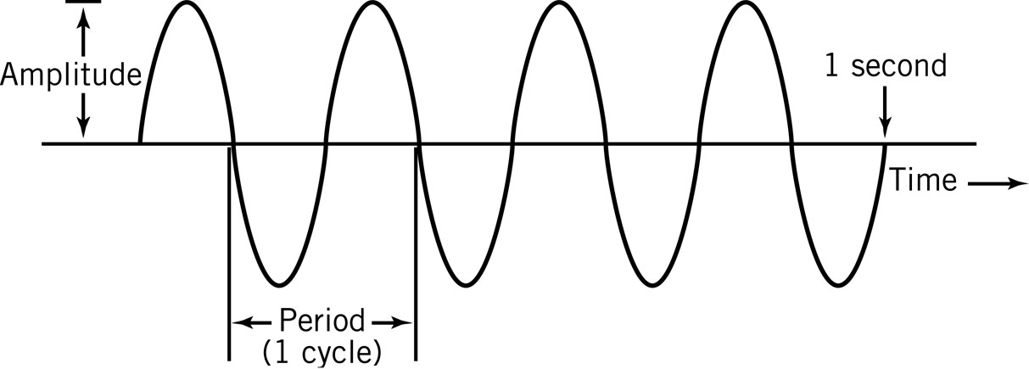
Sine Wave (2)
f = 1/T f is the frequency of the sine wave and where T is the
period measured in seconds
λ = c / f λ is the wavelength of the sine wave and c is the
speed of light
Copyright 2013 John Wiley & Sons, Inc.
14-<number>

Slide 12
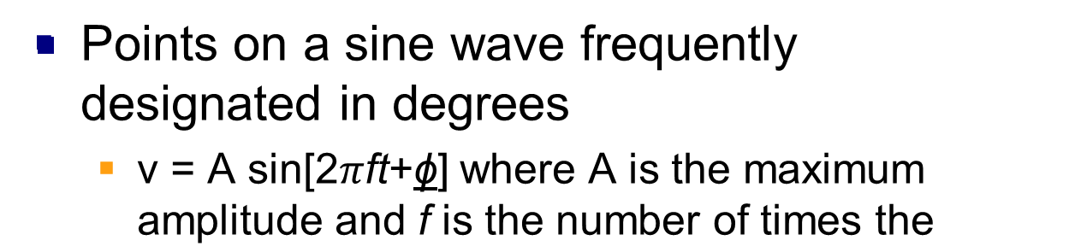
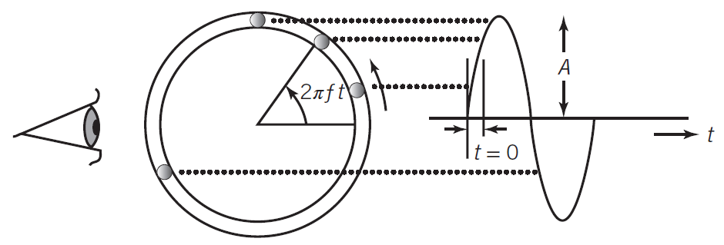
Circle and the Sine Wave
Copyright 2013 John Wiley & Sons, Inc.
14-<number>

Slide 13
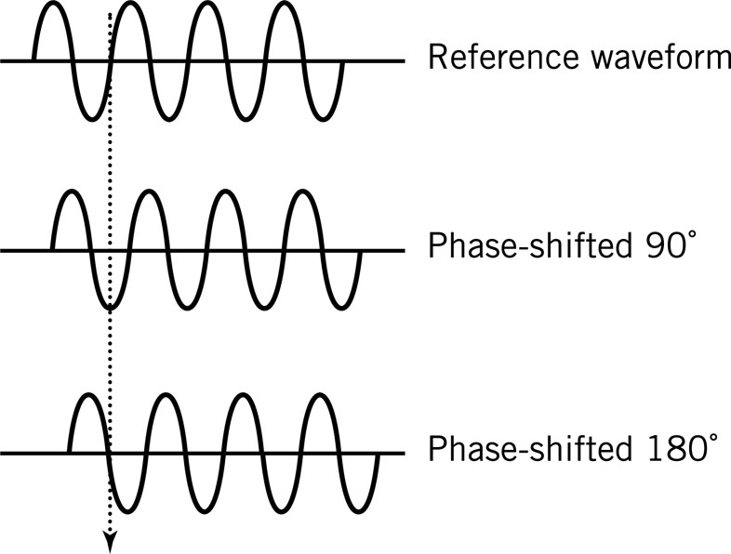
Phase-Shifted Sine Waves
Difference, measured in degrees, from a reference sine wave
Copyright 2013 John Wiley & Sons, Inc.
14-<number>

Slide 14
Waveform Representation
All can be represented as the sum of sine waves of different frequencies, phases, and amplitudes
Spectrum: frequencies that make up a signal
Bandwidth: range of frequencies passed by the channel with a small amount of attenuation
Filtering: controlling the channel bandwidth to prevent interference from other signals
Copyright 2013 John Wiley & Sons, Inc.
14-<number>

Slide 15
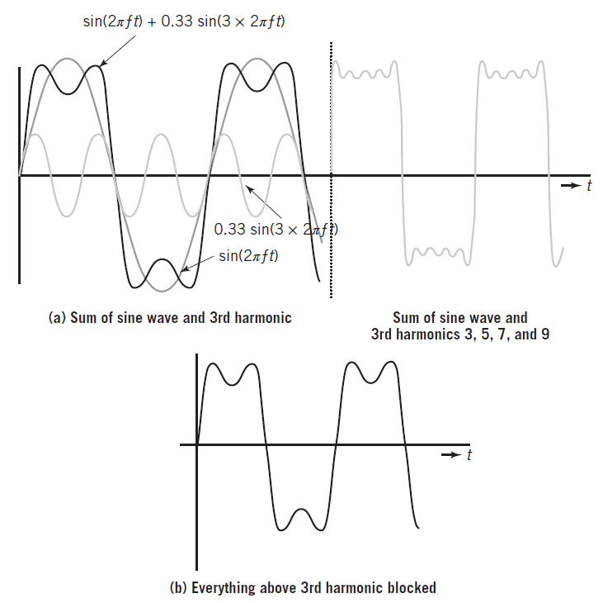
Creating a Square Wave from Sine Waves
Copyright 2013 John Wiley & Sons, Inc.
14-<number>

Slide 16
Signal Frequencies
Sound waves: approximately 20 Hz to 20 KHz
  Stereo systems: 20-20,000 Hz for high fidelity
  Phones: 20-4,000 Hz for voice but limits speed
Electromagnetic radio waves: 60 Hz to 300 GHz
  AM radio: 550 KHz to 1.6 MHz
    20 KHz bandwidth centered around dial frequency of the station
  FM radio: 88 MHz to 108 MHz
    100 KHz bandwidth per station
  TV: 54 MHz to 700 MHz
    >4.5 MHz bandwidth per channel
  Cell phones, Wi-Fi wireless networks: 800 MHz to 5.2Ghz
Copyright 2013 John Wiley & Sons, Inc.
14-<number>

Slide 17

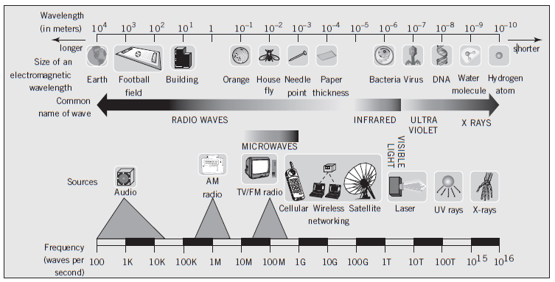
Signal Frequencies
Copyright 2013 John Wiley & Sons, Inc.
14-<number>

Slide 18
Sine Waves as Carriers
A single pure tone consists of a sine wave
  The orchestral note middle A is a 440-Hz sine wave
To represent the signal modulate one of the three characteristics—amplitude, frequency, phase
  Example: AM or amplitude modulated radio station at 1100 KHz modulates amplitude of the 1100 KHz sine wave carrier
Demodulator or detector restores original waveform
Copyright 2013 John Wiley & Sons, Inc.
14-<number>

Slide 19
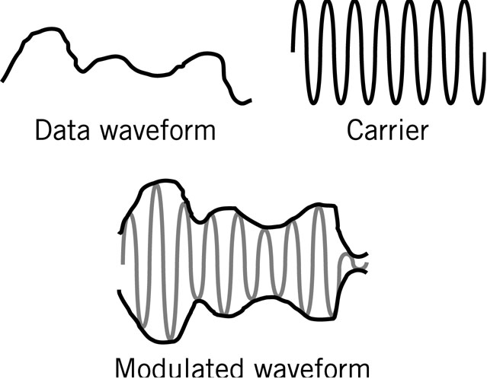
Amplitude Modulations
Copyright 2013 John Wiley & Sons, Inc.
14-<number>

Slide 20
Modulating Digital Signals
Two possible values: 0 and 1
3 techniques
  ASK: amplitude shift keying
    Represents data by holding the frequency constant while varying the amplitude
  FSK: frequency shift keying
    Represents data by holding the amplitude constant while varying the frequency
  PSK: phase shift keying
    Represents data by an instantaneous shift in the phase or a switching between two signals of different phases
Copyright 2013 John Wiley & Sons, Inc.
14-<number>

Slide 21
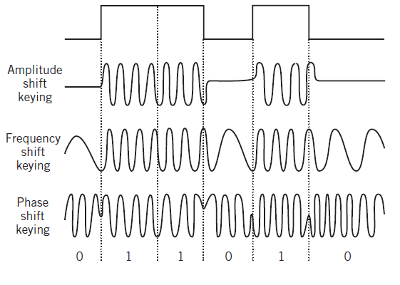
Modulating Digital Signals
Copyright 2013 John Wiley & Sons, Inc.
14-<number>

Slide 22
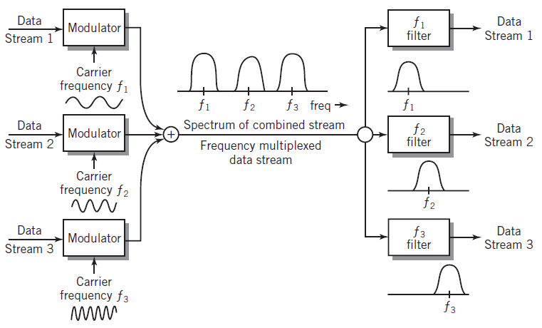
Frequency Division Multiplexing
Optical form of frequency division multiplexing (FDM) is known as wavelength division multiplexing (WDM)
Copyright 2013 John Wiley & Sons, Inc.
14-<number>

Slide 23
Attenuation
Function of the nature of the transmission medium and the physical length of the channel
More difficult to separate the signal from noise at higher transmission speeds
  Signal-to-noise ratio:
    Strength of the signal in relation to power of the noise
    Measure at the receiving end
Amplifiers: restore original strength of the signal (but also amplifies noise)
Copyright 2013 John Wiley & Sons, Inc.
14-<number>

Slide 24
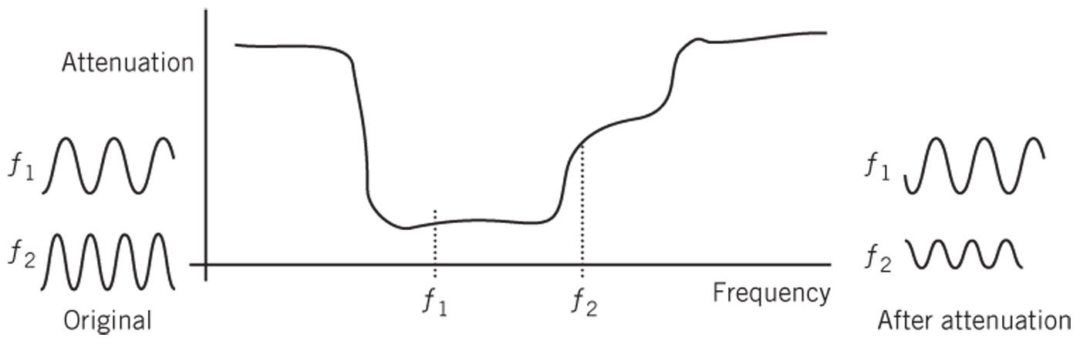
Effects of Attenuation
Channel fading and phase shifts vary with the frequency of the signal
  Example: If the signal consists of sine waves of frequencies f₁ and f₂ from different parts of the spectrum, the output of the channel will be distorted
Copyright 2013 John Wiley & Sons, Inc.
14-<number>

Slide 25
Synchronizing Digital Signals
Synchronizing digital signals difficult
Asynchronous transmission
  Clear start and stop signals
  Small number of bits, usually one byte
  Use: low-speed modems, Ethernet frames
Synchronous transmission
  Continuous digital signal
  Use: high-speed modems and point-to-point methods
Copyright 2013 John Wiley & Sons, Inc.
14-<number>

Slide 26
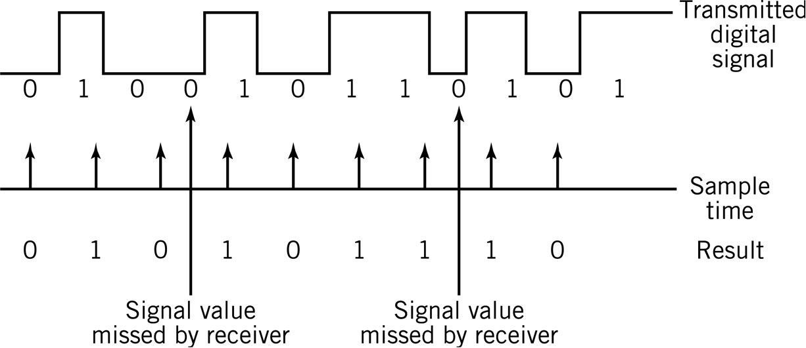
Reception Errors
Timing mismatch between sending and receiving computers
Inability to distinguish groups of 1’s or 0’s
Copyright 2013 John Wiley & Sons, Inc.
14-<number>

Slide 27
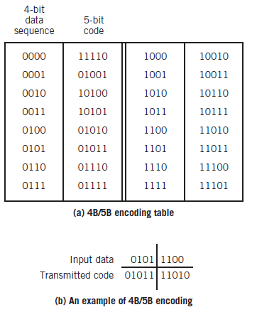
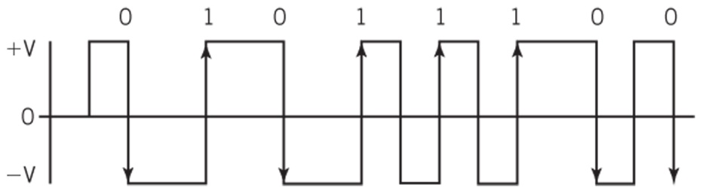
Block and Manchester Encoding
Block Encoding
Manchester Encoding
Copyright 2013 John Wiley & Sons, Inc.
14-<number>

Slide 28
A-to-D Conversion
Digital signals used to represent analog waveforms
Examples:
  CDs, DVDs
  Direct satellite TV
  VOIP
  Telephone voice mail
  Streaming video
A-to-D Pulse Code Modulation
Copyright 2013 John Wiley & Sons, Inc.
14-<number>

Slide 29
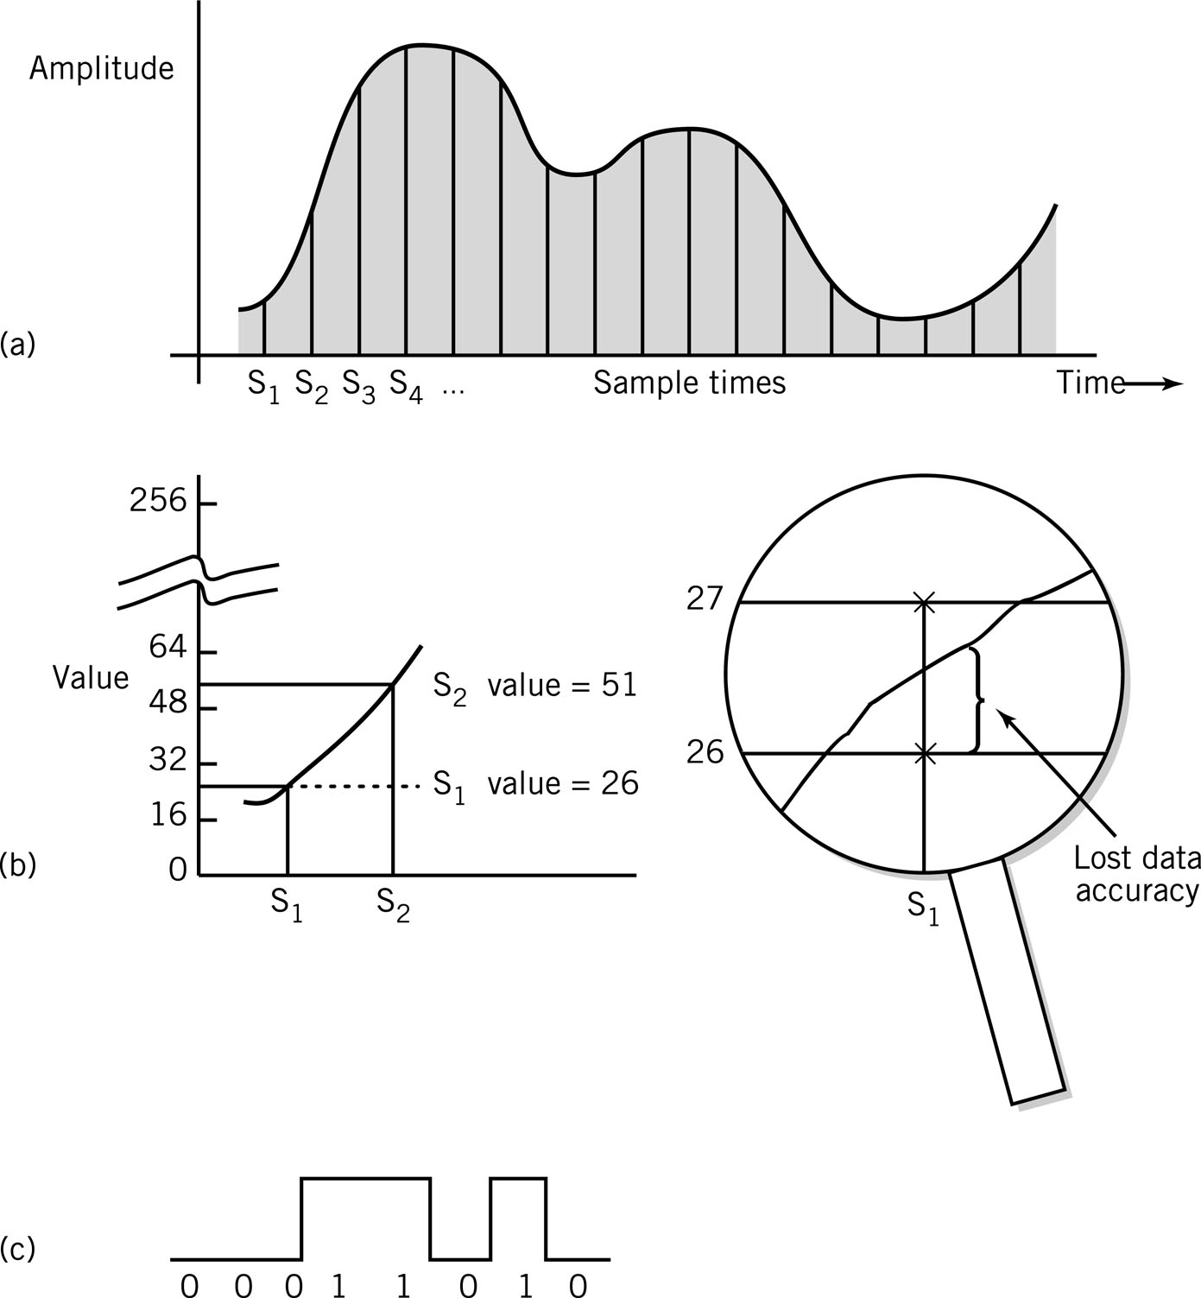
A-to-D: Pulse Code Modulation
Analog waveform sampled at regular time intervals
  Maximum amplitude divided into intervals
    Example: 256 levels requires 8 bits/sample
Copyright 2013 John Wiley & Sons, Inc.
14-<number>

Slide 30
A-to-D: Pulse Code Modulation
Sample values converted into corresponding number value
  Information lost in conversion
Copyright 2013 John Wiley & Sons, Inc.
14-<number>

Slide 31
A-to-D: Pulse Code Modulation
Number reduced to binary equivalent
Copyright 2013 John Wiley & Sons, Inc.
14-<number>

Slide 32
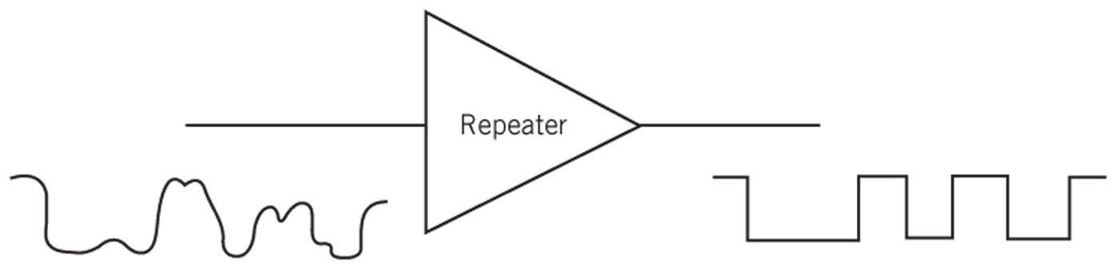
Digital Signal Quality
Subject to noise, attenuation, distortion like analog
Signal quality less affected because only necessary to distinguish two levels
Repeaters
  Recreate signals at intervals
  Use: transmit signals over long distances
Error correction techniques available
Copyright 2013 John Wiley & Sons, Inc.
14-<number>

Slide 33
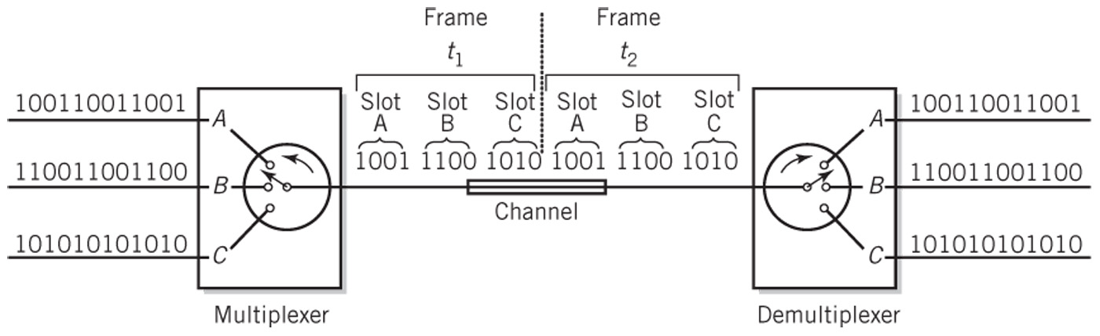
Time Division Multiplexing
TDM - multiple signals share channel
Copyright 2013 John Wiley & Sons, Inc.
14-<number>

Slide 34
Bandwidth
Digital signals: sum of sine waves of different frequencies
Higher frequencies: higher data rates
Channel with wider bandwidth has higher data rates
Data rates usually measured in bits per second
Copyright 2013 John Wiley & Sons, Inc.
14-<number>

Slide 35
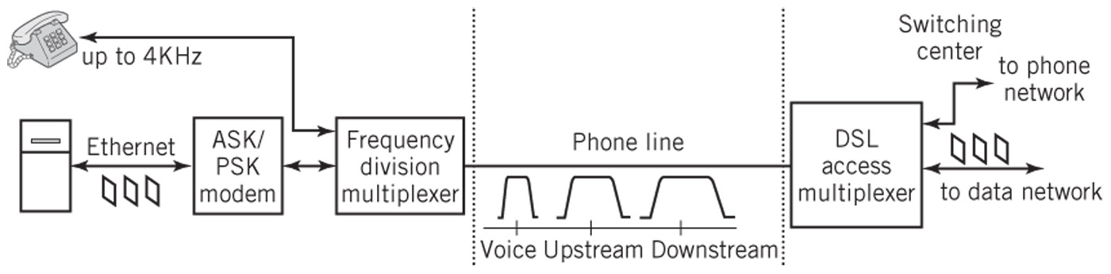
Modems
Modem (modulator/demodulator)
  Convert digital signals to analog and back
  Use: home to service provider via phone line or cable
  Speed: baud rate or bits per second (bps)
DSL
Copyright 2013 John Wiley & Sons, Inc.
14-<number>

Slide 36
Transmission Media
Means used to carry signal
Characterized by
  Physical properties Bandwidth
  Signaling method(s) Sensitivity to noise
Guided media: confine signal physically to some kind of cable
Unguided media: broadcast openly
Signal-to-noise ratio
  Higher ratio for given bandwidth increases data capacity of the channel
Copyright 2013 John Wiley & Sons, Inc.
14-<number>

Slide 37
Electrical Media
Require complete circuit
  Two wires: one to carry the signal, second as a return to complete the circuit
Wired media or just wire
  Inexpensive and easy to use
Signals carried as changing electrical voltage or current
Copyright 2013 John Wiley & Sons, Inc.
14-<number>

Slide 38
Types of Cable: Copper
Twisted pair
  Most local area networks; phone lines in buildings
  More susceptible to noise than coaxial cable
  Used for shorter distances and slower signals
Coaxial cable
  Wire surrounded by insulation
  Copper shield around insulation
    Acts as signal return
    Shields from external noise
  High bandwidth: 100 Mbps
    Example: analog cable TV with FDM for dozens of channels at 6 MHz bandwidth per channel
Copyright 2013 John Wiley & Sons, Inc.
14-<number>

Slide 39
Types of Cable: Fiber Optic
Fiber optic cable
  Consists of glass fiber thinner than human hair
  Uses light to carry signals
  Laser or light-emitting diode produces signal
  Cladding: plastic sheath to protect fibers
Advantages
  Light waves: high frequency means high bandwidth
  Less susceptible to interference and tampering
  Lighter than copper cable
Disadvantages
  Difficult to use, especially for multipoint connections
Copyright 2013 John Wiley & Sons, Inc.
14-<number>

Slide 40
Electromagnetic Waves
Microwaves
  Frequencies below light but above 1 GHz
Unguided medium
  Tightly focused for point-to-point use
  Highly susceptible to interference
Applications
  Large-scale Internet backbone channels
  Direct satellite-to-home TV
  IEEE 802.11 Wi-Fi
Copyright 2013 John Wiley & Sons, Inc.
14-<number>

Slide 41
Wireless Networking
Wi-Fi (wireless Ethernet)
  Short-range, local area networking
WiMAX, cellular telephone technology
  Competing versions of longer range wireless networking
Bluetooth
  Personal level networking
Copyright 2013 John Wiley & Sons, Inc.
14-<number>

Slide 42
Copyright 2013 John Wiley & Sons
All rights reserved. Reproduction or translation of this work beyond that permitted in section 117 of the 1976 United States Copyright Act without express permission of the copyright owner is unlawful. Request for further information should be addressed to the Permissions Department, John Wiley & Sons, Inc. The purchaser may make back-up copies for his/her own use only and not for distribution or resale. The Publisher assumes no responsibility for errors, omissions, or damages caused by the use of these programs or from the use of the information contained herein.
Copyright 2013 John Wiley & Sons, Inc.
14-<number>

