Slide 1
CHAPTER 9: Input / Output
The Architecture of Computer Hardware, Systems Software & Networking:
An Information Technology Approach
5th Edition, Irv Englander
John Wiley and Sons ©2013
PowerPoint slides authored by Angela Clark, University of South Alabama
PowerPoint slides for the 4th edition were authored by Wilson Wong, Bentley University

Slide 2
Basic Model
Processing speed or program execution
  Determined primarily by ability of I/O operations to stay ahead of processor
Input
Process
Output
Copyright 2013 John Wiley & Sons, Inc.
9-<number>

Slide 3
I/O Requirements
Means for addressing different peripheral devices
A way for peripheral devices to initiate communication with the CPU
An efficient means of transferring data directly between I/O and memory for large data transfers since programmed I/O is suitable only for slow devices and individual word transfers
Buses that interconnect high-speed I/O devices with the computer must support high data transfer rates
Capability of handling devices operating at varying speeds with varying delays
Means for handling devices with extremely different control requirements
Copyright 2013 John Wiley & Sons, Inc.
9-<number>

Slide 4
I/O Interfaces
Are necessary because of
  Different formats required by the devices
  Incompatibilities in speed between the devices and the CPU that make synchronization difficult
  Bursts of data vs. streaming data
  Device control requirements that would tie up too much CPU time
Copyright 2013 John Wiley & Sons, Inc.
9-<number>

Slide 5
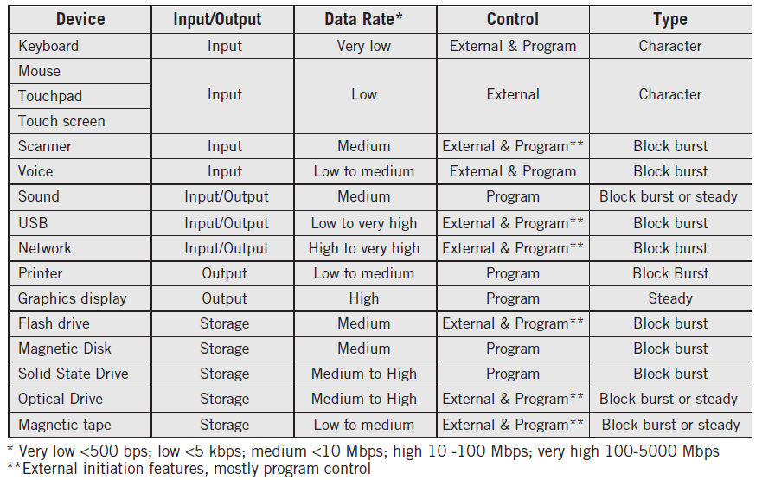
Examples of I/O Devices
Copyright 2013 John Wiley & Sons, Inc.
9-<number>

Slide 6
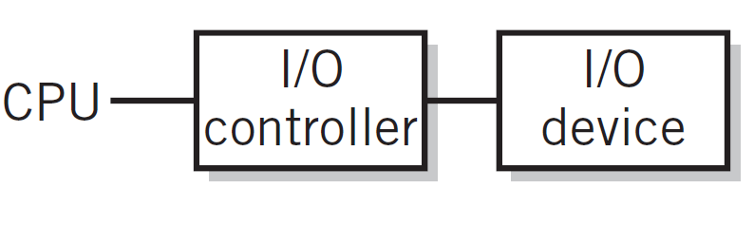
Simple I/O Configuration
Copyright 2013 John Wiley & Sons, Inc.
9-<number>

Slide 7
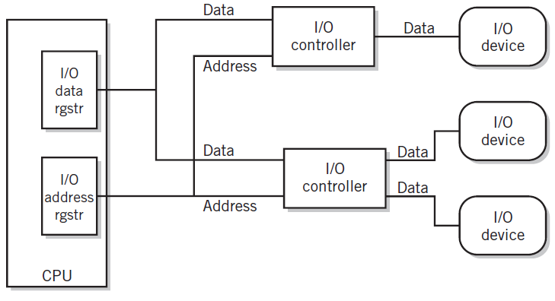
More Complex I/O Module
Copyright 2013 John Wiley & Sons, Inc.
9-<number>

Slide 8
Advanced I/O Techniques
Programmed I/O
  CPU controlled I/O
Interrupt Driven I/O
  External input controls
Direct Memory Access Controllers
  Method for transferring data between main memory and a device that bypasses the CPU
Copyright 2013 John Wiley & Sons, Inc.
9-<number>
Notes:
I/O Modules - responsible for the control of one or more external devices and for the exchange of data between those devices and MM or CPU registers; the I/O module must have an interface internal to the computer and external to the computer;
Programmed I/O - data are exchanged between the CPU and the I/O module, CPU has direct control of the I/O operation, when the CPU issues a command to the I/O module it must wait until the I/O operation is complete;
Interrupt driven I/O - the CPU issues a command and then continues to execute other instructions and the I/Omodule issues an interrupt when it completes its task - Intel 8255A Programmable Peripheral Interface(single chip, gp I/O module designed for use with the Intel 8086
Direct Memory Access - the I/O module and main memory exchange data directly without CPU involvement; common on Network Boards, CD ROMs, sound boards, floppy drives, whenever large amounts of data are read/written
DMA channels only on ISA bus (not PCI bus)

Slide 9
Programmed I/O
I/O data and address registers in CPU
One word transfer per I/O instruction
Address information for each I/O device
  LMC I/O capability for 100 devices
Full instruction fetch/execute cycle
Primary use:
  Keyboards
  Communication with I/O controllers (see DMA)
Copyright 2013 John Wiley & Sons, Inc.
9-<number>

Slide 10
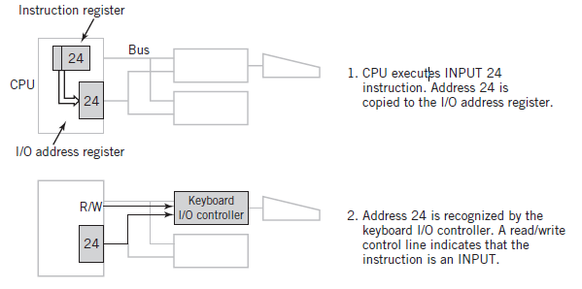
Programmed I/O Example
Copyright 2013 John Wiley & Sons, Inc.
9-<number>

Slide 11
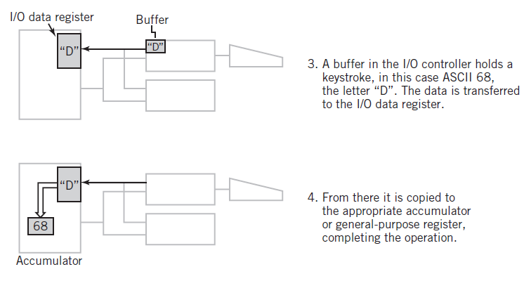
Programmed I/O Example
Copyright 2013 John Wiley & Sons, Inc.
9-<number>

Slide 12
Interrupts
Signal that causes the CPU to alter its normal flow of instruction execution
  Frees CPU from waiting for events
  Provides control for external I/O initiation
Examples
  unexpected input
  abnormal situation
  illegal instructions
  multitasking, multiprocessing
Copyright 2013 John Wiley & Sons, Inc.
9-<number>

Slide 13
Interrupt Terminology
Interrupt lines (hardware)
  One or more special control lines to the CPU
Interrupt request
Interrupt handlers
  Program that services the interrupt
  Also known as an interrupt routine or device driver
Context
  Saved registers of a program before control is transferred to the interrupt handler
  Allows program to resume exactly where it left off when control returns to interrupted program
Copyright 2013 John Wiley & Sons, Inc.
9-<number>
Notes:
Pcs generally have 8 or 15 interrupt lines (IRQ1 …. IRQx)
In the interrupt cycle the CPU checks to see if any interrupts have occurred, indicated by the presence of an interrupt signal
If an interrupt has occurred the CPU 1) saves the context of the current program being executed. 2) sets the PC to the starting address of an interrupt handler program,
The CPU then proceeds to the fetch portion of the instruction cycle and fetches the first instruction in the interrupt handler
Disabled interrupts - the CPU will ignore interrupt signals ex. when currently executing one interrupt it will ignore any others,

Slide 14
Use of Interrupts
Notify that an external event has occurred
  Real-time or time-sensitive
Signal completion
  Printer ready or buffer full
Allocate CPU time
  Time sharing
Indicate abnormal event (CPU originates for notification and recovery)
  Illegal operation, hardware error
Software interrupts
Copyright 2013 John Wiley & Sons, Inc.
9-<number>
Notes:
External event notifier - frees CPU from polling,
a means for the user to control the computer from an input device,
Completion signal - means of controlling the flow of data to an external device, I.E. device will let the CPU know it is ready for (more) data,
Allocation of CPU time - to different programs (multi-tasking), an internal clock times the execution of programs and sends an interrupt to the CPU,
Abnormal event indicator - power failure, illegal instructions (/ by 0), non-existent OPCODE, Byte error,
Internal Interrupts - traps or exceptions
Software interrupts - SW simulation of interrupts, address space indicates which interrupt is called (INT),
Keyboards use Programmed I/O and Interrupts

Slide 15
The CPU – The Interrupt Cycle
Fetch / Execute cycle
Interrupt cycle
START
Fetch Next
Instruction
Execute
Instruction
HALT
Interrupts Disabled
Process
Interrupt
Check for
Interrupt
Copyright 2013 John Wiley & Sons, Inc.
9-<number>

Slide 16
Servicing the Interrupt
Lower priority interrupts are held until higher priority interrupts are complete
Suspend program in progress
Save context, including last instruction executed and data values in registers, in the PCB or the stack area in memory
Branch to interrupt handler program
Copyright 2013 John Wiley & Sons, Inc.
9-<number>

Slide 17
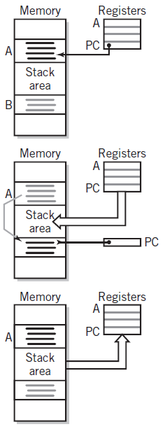

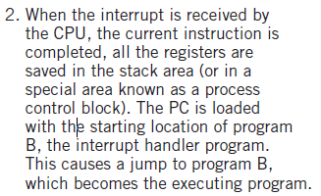

Servicing an Interrupt
Copyright 2013 John Wiley & Sons, Inc.
9-<number>

Slide 18
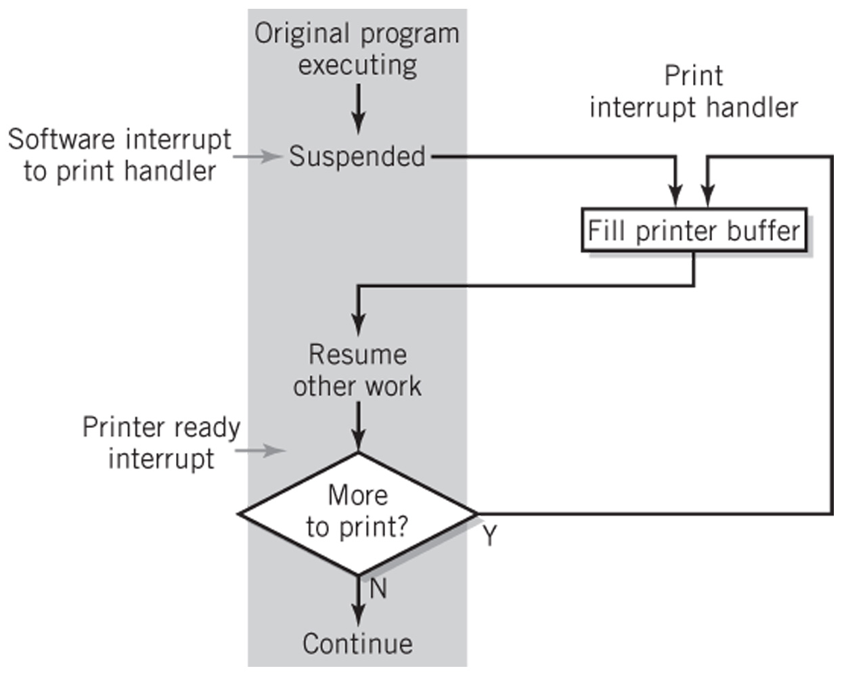
Print Handler Interrupt
Copyright 2013 John Wiley & Sons, Inc.
9-<number>

Slide 19
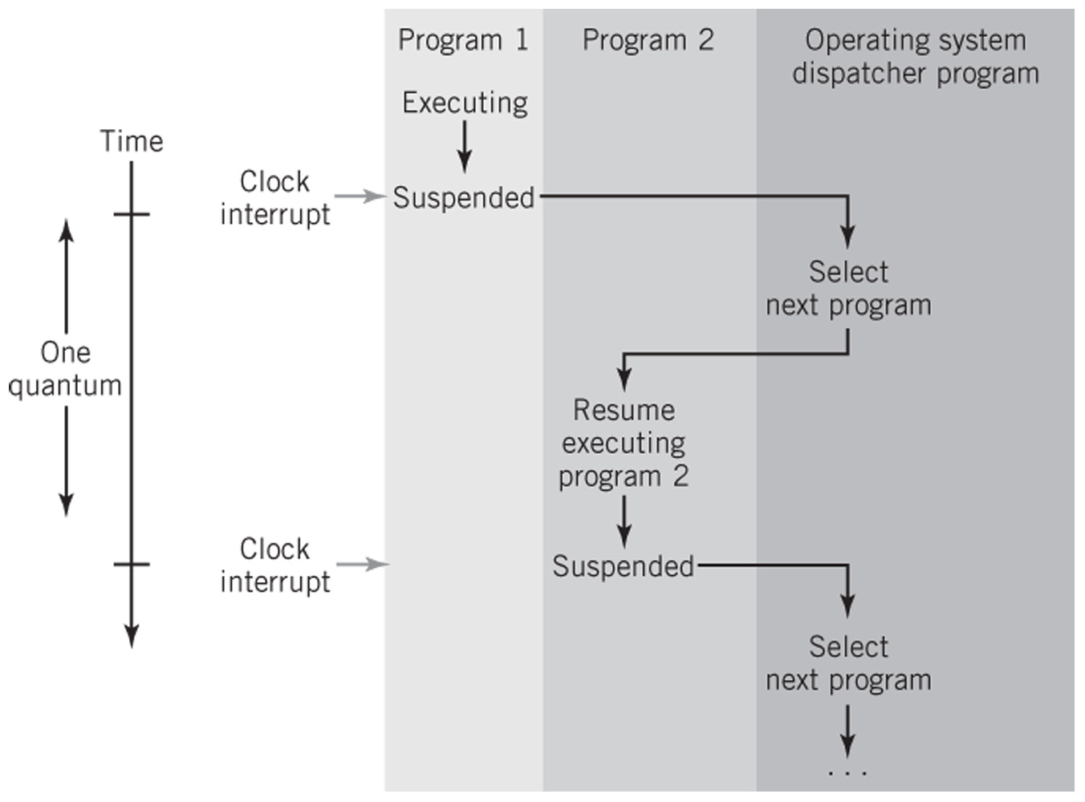
Using an Interrupt for Time Sharing
Copyright 2013 John Wiley & Sons, Inc.
9-<number>

Slide 20
Interrupt Processing Methods
Vectored interrupt
  Address of interrupting device is included in the interrupt
  Requires additional hardware to implement
Polling
  Identifies interrupting device by polling each device
  General interrupt is shared by all devices
Copyright 2013 John Wiley & Sons, Inc.
9-<number>

Slide 21
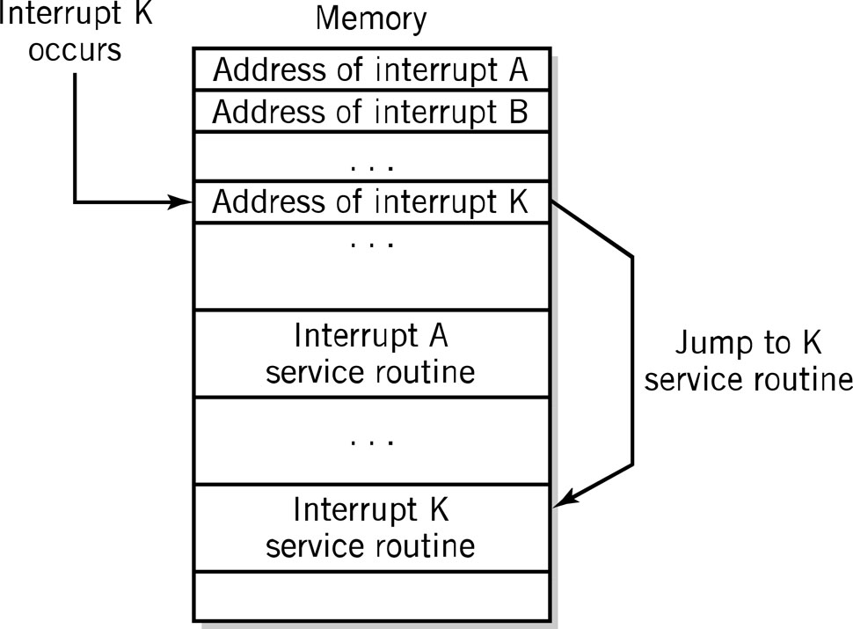
Vectored Interrupts
Copyright 2013 John Wiley & Sons, Inc.
9-<number>

Slide 22
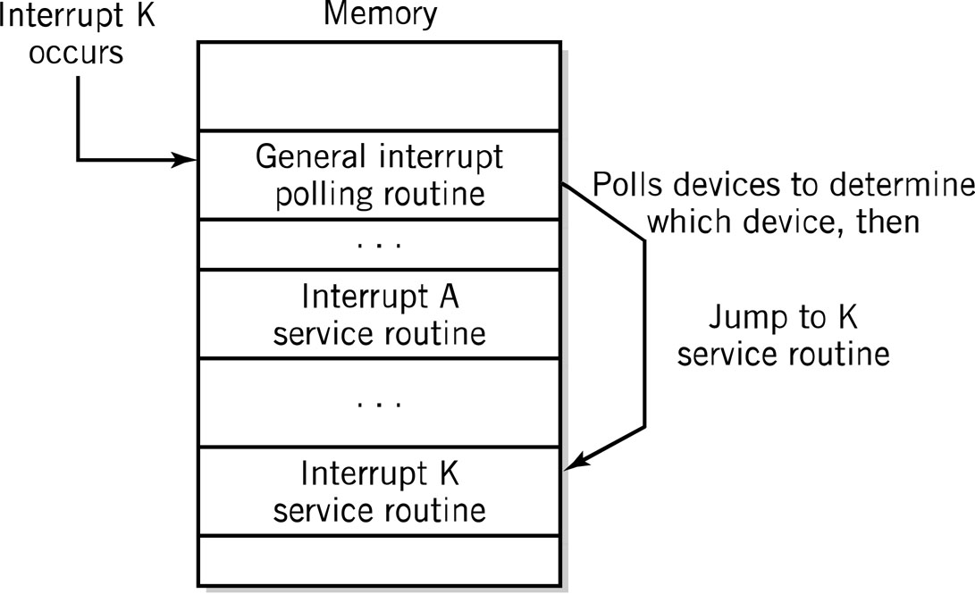
Polled Interrupts
Copyright 2013 John Wiley & Sons, Inc.
9-<number>

Slide 23
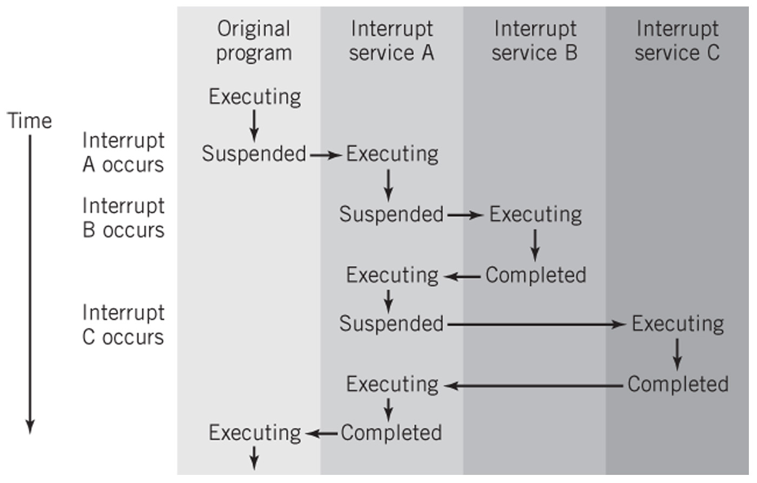
Multiple Interrupts Example
Copyright 2013 John Wiley & Sons, Inc.
9-<number>

Slide 24
Direct Memory Access
Transferring large blocks of data
Direct transfer to and from memory
CPU not actively involved in transfer itself
Required conditions for DMA
  The I/O interface and memory must be connected
  The I/O controller must be capable of reading and writing to memory
  Conflicts between the CPU and the I/O controller must be avoided
  Interrupt required for completion
Copyright 2013 John Wiley & Sons, Inc.
9-<number>

Slide 25
DMA Instructions
Application program requests I/O service from operating system
  Privileged programmed I/O instructions
To initiate DMA, programmed I/O is used to send the following information:
  Location of data on I/O device
  Starting location in memory
  Size of the block
  Direction of transfer: read or write
Interrupt to CPU upon completion of DMA
Copyright 2013 John Wiley & Sons, Inc.
9-<number>

Slide 26
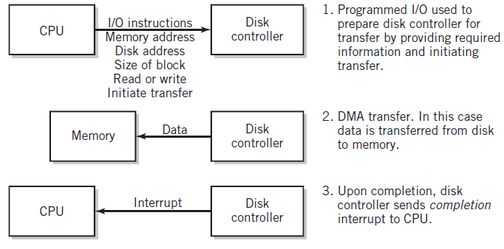
DMA Initiation and Control
Copyright 2013 John Wiley & Sons, Inc.
9-<number>

Slide 27
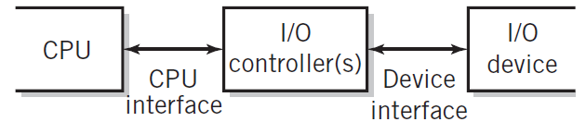
I/O Controller Interfaces
Copyright 2013 John Wiley & Sons, Inc.
9-<number>

Slide 28
I/O Controller Functions
Recognizes messages from device(s) addressed to it and accepts commands from the CPU
Provides a buffer where the data from memory can be held until it can be transferred to the device
Provides the necessary registers and controls to perform a direct memory transfer
Physically controls the device
Copies data from its buffer to the device/from the CPU to its buffer
Communicates with CPU
Copyright 2013 John Wiley & Sons, Inc.
9-<number>

Slide 29
Copyright 2013 John Wiley & Sons
All rights reserved. Reproduction or translation of this work beyond that permitted in section 117 of the 1976 United States Copyright Act without express permission of the copyright owner is unlawful. Request for further information should be addressed to the Permissions Department, John Wiley & Sons, Inc. The purchaser may make back-up copies for his/her own use only and not for distribution or resale. The Publisher assumes no responsibility for errors, omissions, or damages caused by the use of these programs or from the use of the information contained herein.
Copyright 2013 John Wiley & Sons, Inc.
9-<number>

