Slide 1
Exploration of COVID-19 Data
Daniel Kadyrov
CS559 – Machine Learning
Spring 2020
Project

Slide 2
Agenda
Introduction
Data
Exploration of Data
Predicting COVID19 Spread
Predicting the End of COVID19
Types of Mitigation and Growth Rate
Effects of Weather Conditions
New York City Case Study
Conclusion

Slide 3
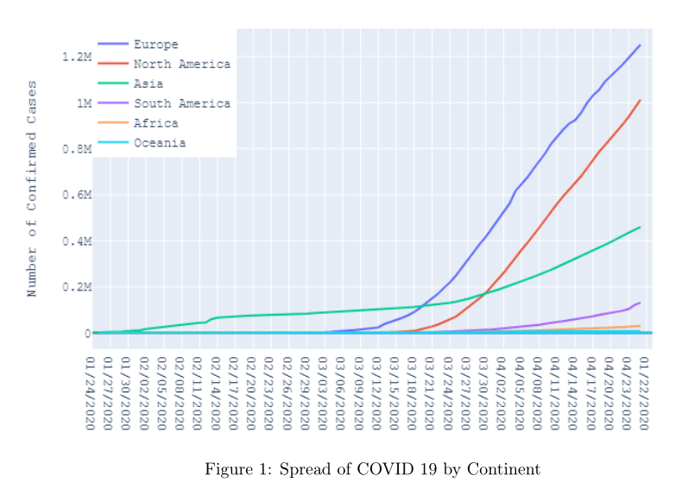
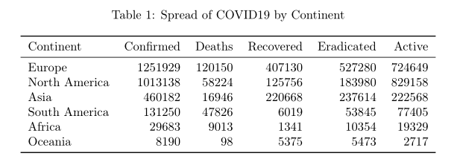
Data
Kaggle
New York City Coronavirus
New York City Open Data

Slide 4
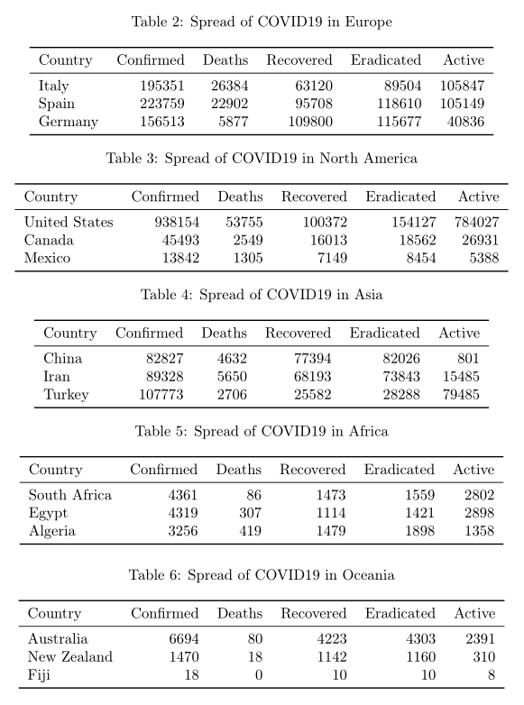



Slide 5


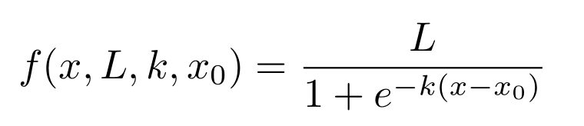
Predicting Spread

Slide 6
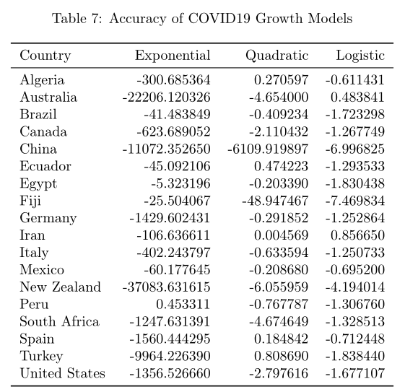

Slide 7
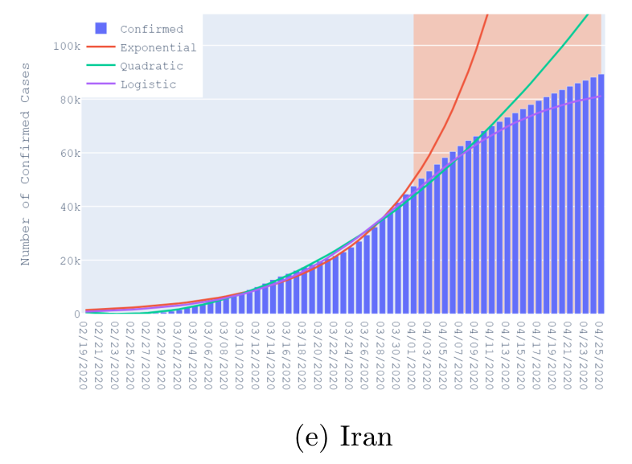
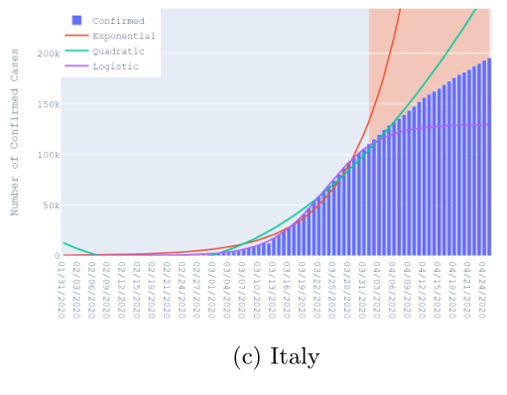
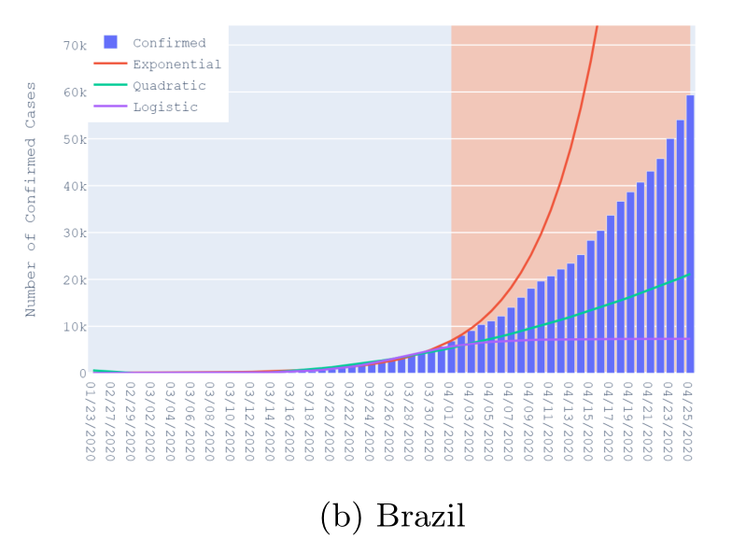
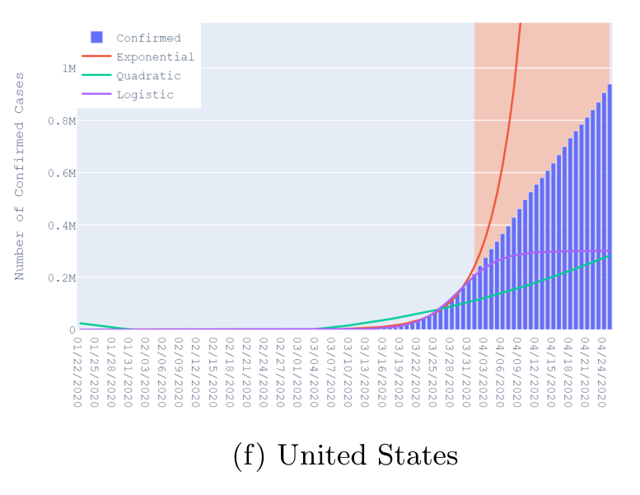

Slide 8
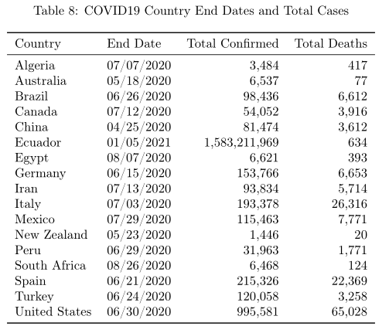
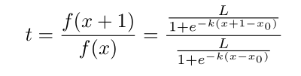

Predicting the End

Slide 9
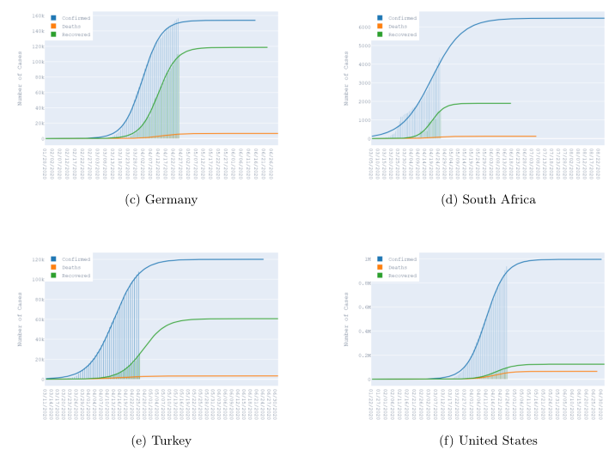

Slide 10
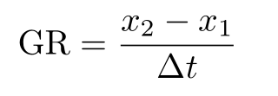
Mitigation

