Slide 1
Linear Discriminant Analysis
Classification of blue pen ink using infrared spectroscopy and linear discriminant analysis
Daniel Kadyrov
CS559 – Machine Learning
Spring 2020
Presentation

Slide 2
Linear Discriminate Analysis
Contents
Article: Silva, C. S., Borba, F. D. S. L., Pimentel, M. F., Pontes, M. J. C., Honorato, R. S., & Pasquini, C. (2013). Classification of blue pen ink using infrared spectroscopy and linear discriminant analysis. Microchemical Journal, 109, 122–127. doi: 10.1016/j.microc.2012.03.025
https://www.sciencedirect.com/science/article/pii/S0026265X12000719
Introduction
Materials and Methods
Results and Discussion
Conclusion

Slide 3
Introduction
Ink analysis is important in forensic document examination to identify manipulated or falsified documents (checks, passports, working papers, etc.)
Ink characteristics include color, dye, lubricants, resins, pigments, solvents, emulsifiers, and pH control.
In destructive ink analysis methods, ink is removed from documents using solvents which is undesirable for forensic cases.
Non-destructive methods use luminescence and reflective infrared spectroscopies to extract chemical components of the ink.
Usually the analytical methods involve visual inspection
This paper investigates using chemometric multivariate analysis to characterize pen ink

Slide 4
Introduction
Ballpoints use viscous, oil based inks. Made by dissolving dyes in mixtures of alcohols and fatty acids. Little to no bleed through but require more pressure to write.
Gel use pigments suspended in water based gel. Smooth ink flow requires less pressure and allows for smaller pen tips. Higher dry times and tend to skip.
Rollerball uses liquid ink of dyes dissolved in water (fountain pen). Bleeds through lower quality paper.
The Difference Between Ballpoint, Gel, and Rollerball Pens. (n.d.). Retrieved from https://www.jetpens.com/blog/the-difference-between-ballpoint-gel-rollerball-pens/pt/167

Slide 5
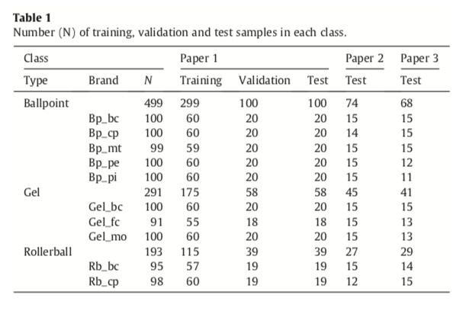
Materials and Methods
Samples
3 Different types of blue ink pens:
Ballpoint (5 Brands), Rollerball (2 brands), and gel (3 brands)
3 Different types of papers:
2 brands of A4 print paper and 1 brand of recycled A4 paper.
Spectra acquisition was facilitated using Perkin Elmer Spectrum400 ($25k)
Average of 16 scans
Spectra of paper was taken and subtracted from pen spectrum.
Sample is completely preserved during acquisition

Slide 6
Materials and Methods
Classification Models - LDA
Linear Discriminate Analysis (LDA) was used for classification because its ability to reduce dimensional characteristics of the data into a well-defined separation of classes.
Criterion is based on the maximization of the ratio between class variability and within-class variability in the training set.
Number of training vectors must be larger than the number of feature vectors.
Appropriate variable selection procedures (SPA, SW, and GA) is required for the high dimensional infrared spectral data that was used.

Slide 7
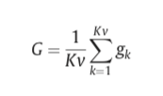
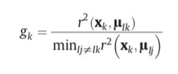
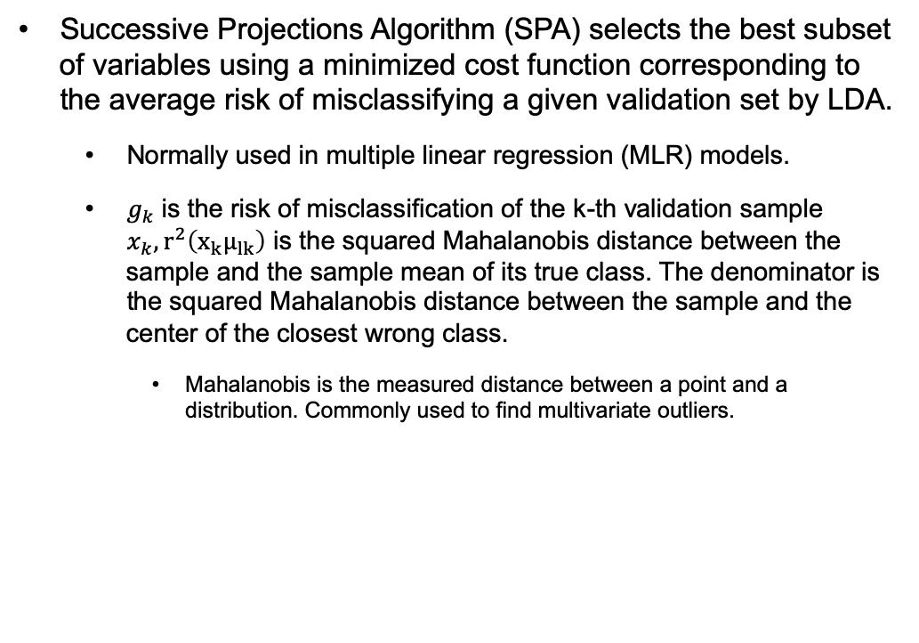
Materials and Methods
Classification Models - SPA
Successive Projections Algorithm (SPA) selects the best subset of variables using a minimized cost function corresponding to the average risk of misclassifying a given validation set by LDA.
Normally used in multiple linear regression (MLR) models.
$g_{k}$ is the risk of misclassification of the k-th validation sample $x_{k}, r^{2}\left(x_{k}μ_{lk}\right)$ is the squared Mahalanobis distance between the sample and the sample mean of its true class. The denominator is the squared Mahalanobis distance between the sample and the center of the closest wrong class.
Mahalanobis is the measured distance between a point and a distribution. Commonly used to find multivariate outliers.

Slide 8
Materials and Methods
Classification Models – SW and GA
Smith-Waterman (SW) algorithm evaluates each spectral variable according to its discriminability with respect to the classes under discrimination.
A spectrum variable is selected with the largest discriminability and leave-one-out cross validation is performed. The variables that are highly correlated are discarded.
Genetic Algorithm (GA) generates solutions to optimization and search problems.
Algorithm encodes variables in the form of binary strings (0s and 1s) termed chromosomes.
Each gene of the chromosome is related to one of the variables. When the gene is 1, the corresponding variables are included in the classification model.
The algorithm starts with a random generated population and through evaluation individuals are stochastically selected and modified to form a new population.
The routine was carried out over 100 generations with 200 chromosomes until the best solution resulted from 3 realizations.

Slide 9
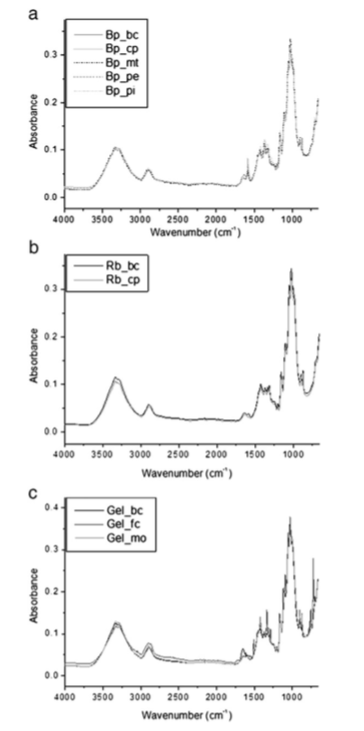
Results and Discussion
Wavenumber: the number of waves per unit distance between probes.
Typical absorption bands are found between 1800 and 650 cm-1
Peaks are at 1430, 875, and 712 cm-1
Spectra for papers 1 and 2 are similar but the recycled paper is different especially between 1500 cm-1 and 1300 cm-1.
This is associated with the cellulose bands of the paper.

Slide 10
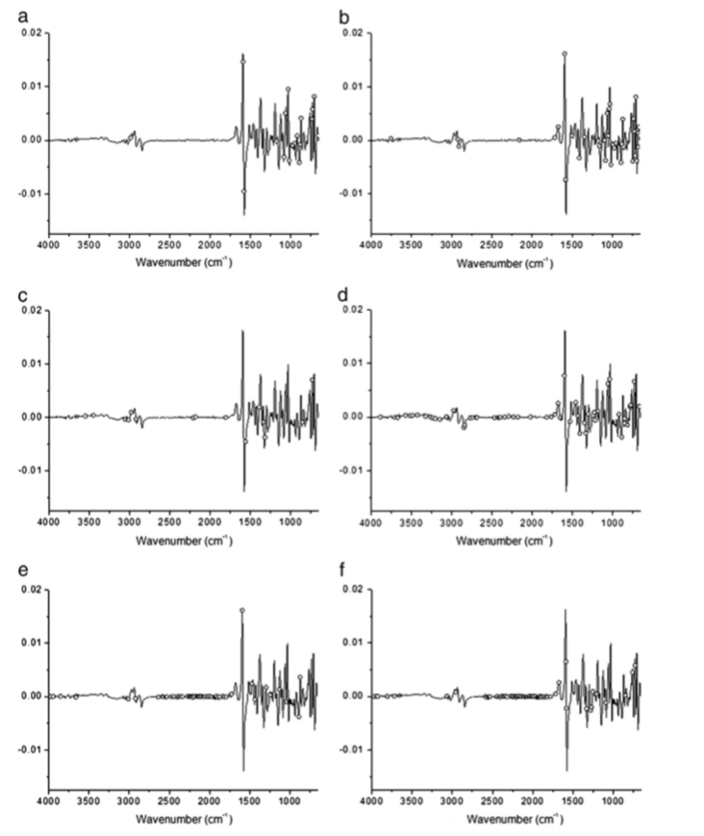
Results and Discussion
Type
Brand
SPA procedure selected 17 type and 39 brand variable combinations to incorporate in the model.
GA selected 15 types and 59 brand variable combinations.
SWA selected 62 types and 67 brand classifications.

Slide 11
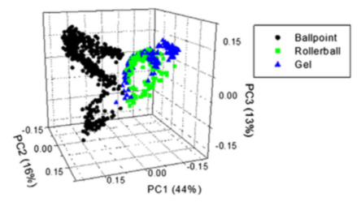
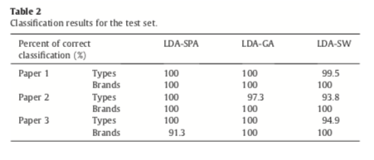
Results and Discussion
Score plot (PC1xPC2xPC3) for all blue ink pens on paper 1 after preprocessing and paper subtraction.
Overlap in spectra between rollerball and gel.
Classification rate of 100% was obtained by brand, independent of variable selection algorithm.
LDA-SPA and LDA-GA showed a better performance than LDA-SW models.

Slide 12
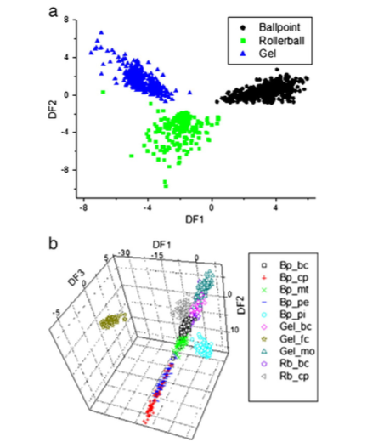
Conclusion
Examination of a method to identify ink without destruction of evidence.
Successfully built a model to classify different types of blue ink on various papers.
Studied different variable selective methods concluding that LDA-SWA is the most effective.

Slide 13
Comments about Paper
English grammar results in unclear conclusions:
“For SPA selection procedure, 17 and 39 variables were incorporated in the model…”
Minimal description of spectra technique i.e. wavenumber
No explanation on different pen types

Slide 14
Thank you

