Slide 1
Clustering Russian cities to determines food tastes in different regions
Alexander V. Ivanov
11.08.2020

Slide 2
Introduction
Background
Russia or the Russian Federation is one of the largest country in the world area. Its territory extends from Baltic Sea in the west to the Pacific Ocean in the east. Russia is the most populous nation in Europe. It is a multi-national state with over 185 ethnical groups, the population of those groups very enormously, from millions (Russian and Tatars) to under 10.000(Samis and Eskimos)
Problem
Because Russia’s multi-national and wide-spread territory Russian’s people tastes can vary from one region to another. So if your company is big and you what to expand your restaurant busines you need to know what kind of food/kitchen people prefer in desirable region.

Slide 3
Data sources
For Cities:
http://en.wikipedia.org/wiki/List_of_cities_and_towns_in_Russia_by_population
For cities coordinates:
Nominatim API
For venues:
FourSquare API

Slide 4
Methodology
Four step methodology:
1.Determine cities and locations by parsing Wikipedia and using Nominatim API
2.Create city – venues DataFrame usin FourSquare API
3.Prepare DataFrame for clustering
4. Use Kmeans model from sklearn library to define Clusters

Slide 5
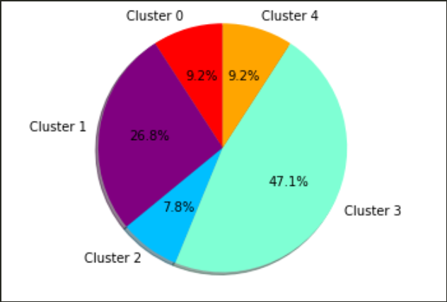
Results
Cluster 0: In this cluster people prefers Pizzas and sushi.
Cluster 1: People most time visit small cafes and eat national cousins.
Cluster 2: People eats variety of foods from European to Asian.
Cluster 3: In this cluster people prefers European foods and love to visit cafes.
Cluster 4: Peoples prefers cafes and Asian kitchen.

Slide 6
Conclusion
The purpose of this project was to identify what kind of food prefer Russian people in different cities or regions. To achieve our goal we used data from Wikipedia and FourSquare API and clustering Kmean model. We created 5 clusters with similar food preferences.
The recommendation is to use our cluster model to decide what kind of restaurant to open in chosen city or region.

