Slide 1
Prioritising SNPs for genomic prediction using plant DNA foundation models
Thomas Crow
Claire Huang
Dr David Kainer

Slide 2
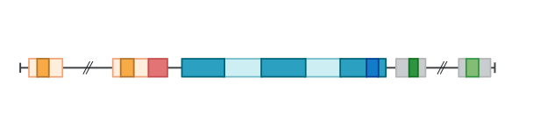
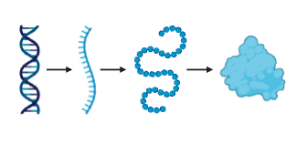
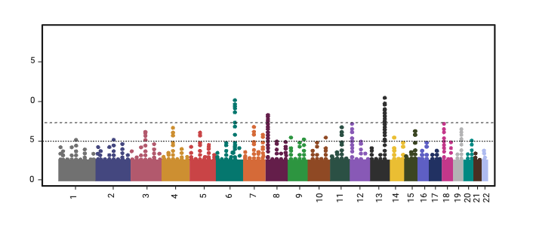
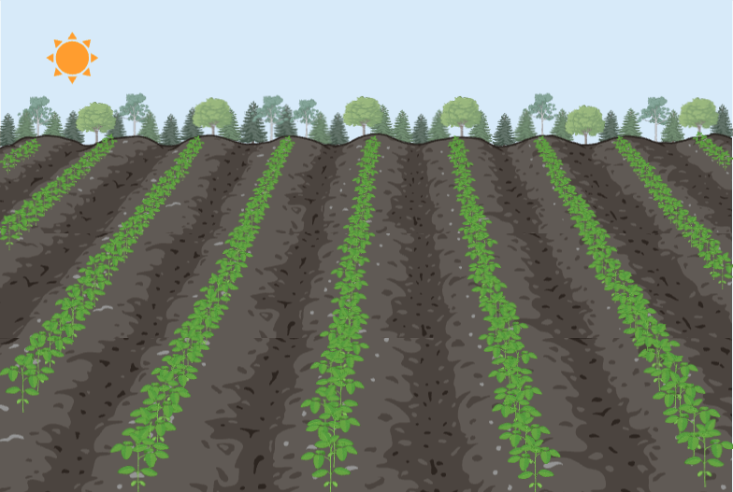
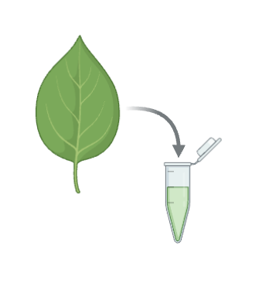
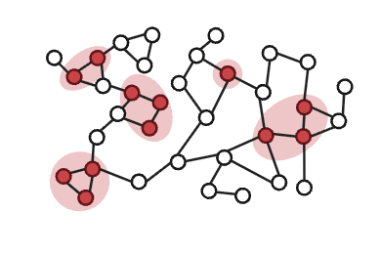
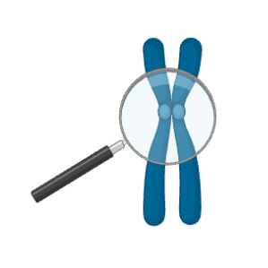



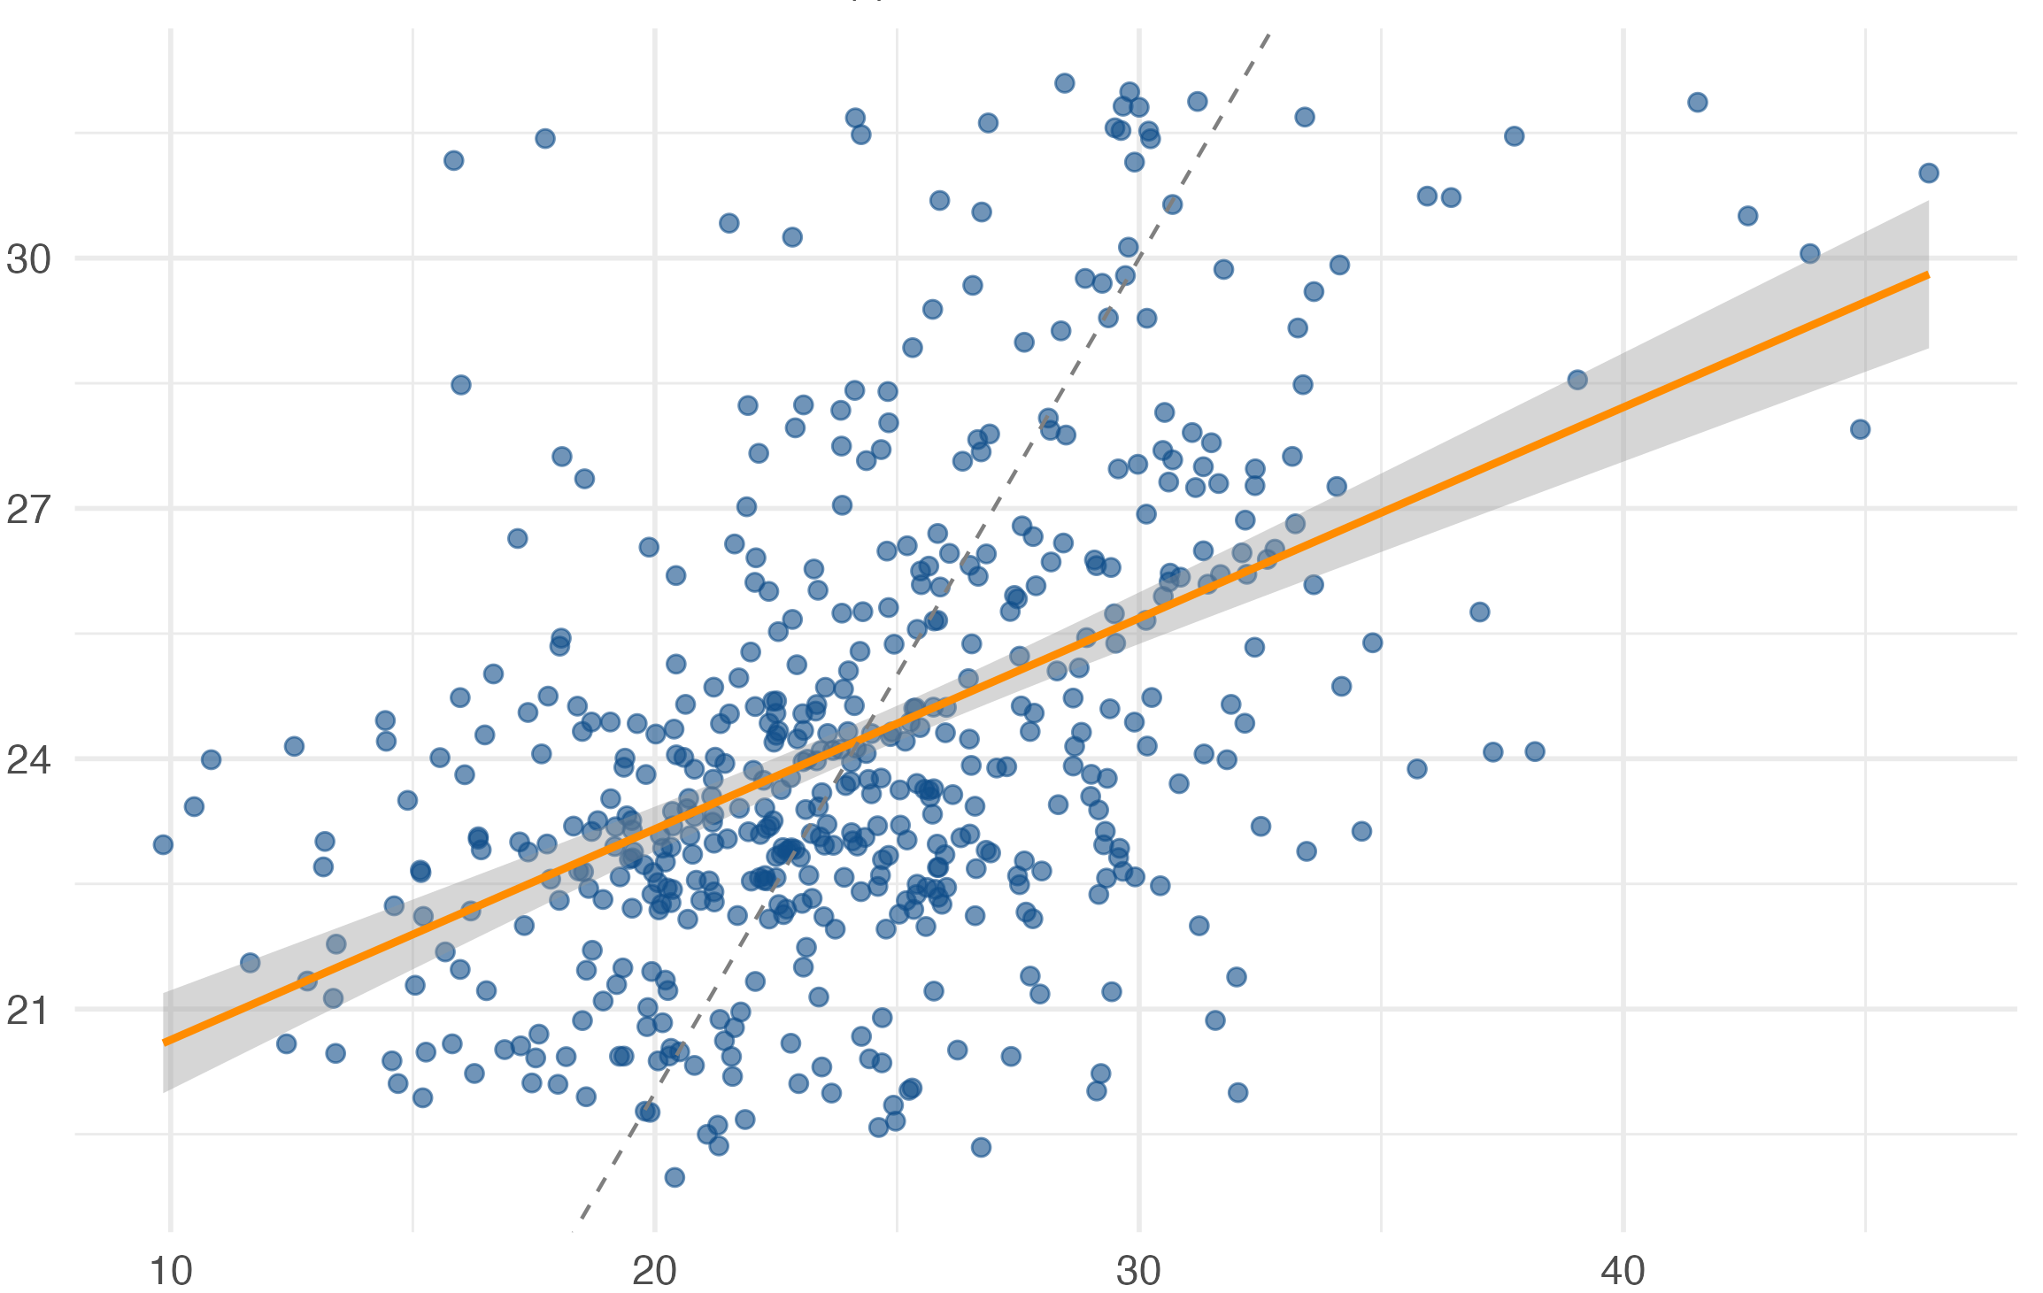
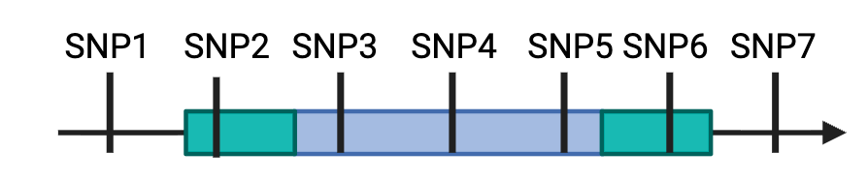

Why genomic prediction?
Genes
Successful breeding comes from measurable improvement.
Expression
GWAS
$∆G=ir_{a}σ_{a}$
How to get there: breeder’s equation
The breeder’s equation defines the components of measurable improvement.
Biological
Networks
Goal: better crops
through breeding
Biological
Knowledge
Additive
genetic variance
r_{a} is accuracy of prediction. We can either improve the models or what goes into them.
Improved
selection
Genomic prediction
models
SNP Selection
DNA Foundation
Models
2

Slide 3
Can we improve genomic prediction (GP)?
Genes
Expression
GWAS
$∆G=ir_{a}σ_{a}$
How to get there: breeder’s equation
Biological
Networks
Goal: better crops
through breeding
Biological
knowledge
Additive
genetic variance
Improved
selection
Genomic prediction
models
SNP selection
DNA Foundation
Models
3

Slide 4

Can we use AI for variant effect prediction?
The Problem:
Existing variant effect prediction is based on human heuristics
(e.g. STOP codon)
Complex sequence interactions are hard for humans to identify and interpret
Our solution:
AI models can learn complex, hidden interactions directly from DNA.
Does AI improve on traditional variant effect prediction?
Testable by comparing SNP scores and genomic prediction accuracy
4

Slide 5
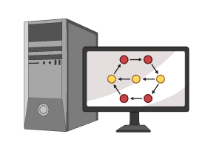




How large language models work
Input
Input Embeddings
Large language model
Prediction
trained to learn and understand the structure of language
The
h₁ h₂ h₃ h₄ h_{n}
The
d₁ d₂ d₃ d₄ d_{n}
quick
quick
d₁ d₂ d₃ d₄ d_{n}
jumps = 0.80
brown
brown
d₁ d₂ d₃ d₄ d_{n}
says = 0.72
fox
fox
d₁ d₂ d₃ d₄ d_{n}
runs = 0.36
trained on millions of texts to learn language
?
(meaning and context)
eats = 0.36
jumps
Day 1:
Transformers with Yoni Nazarathy
5

Slide 6
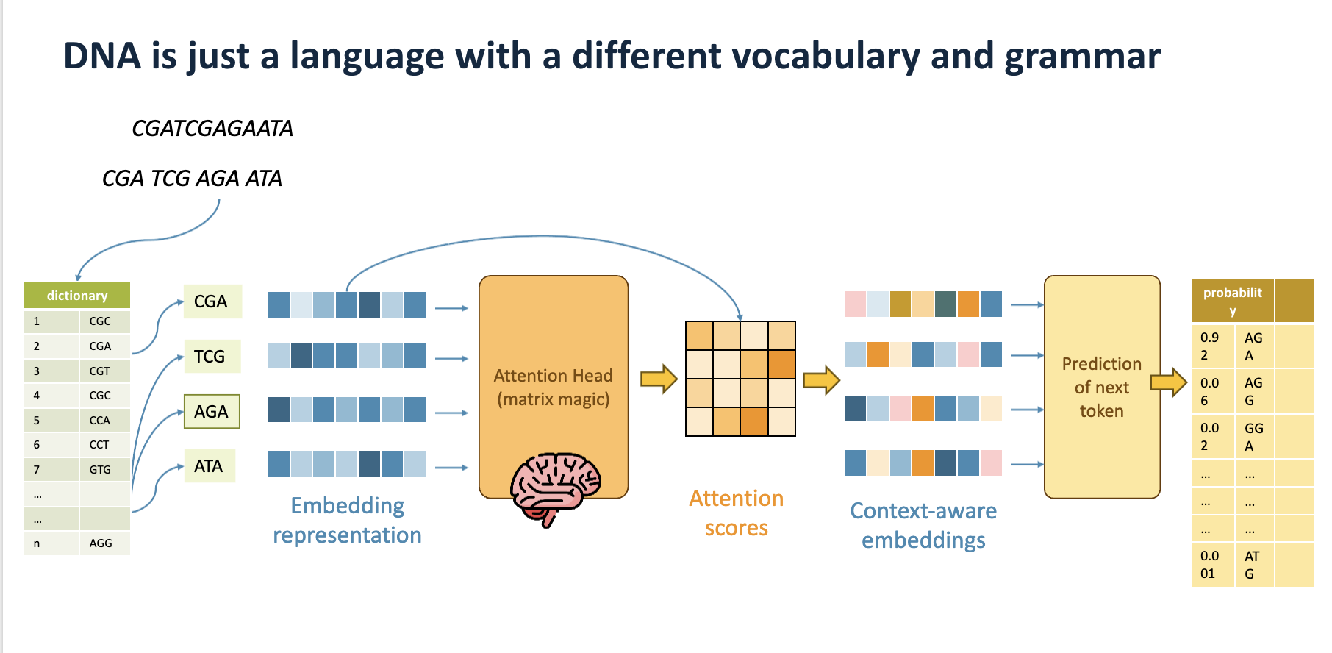


Day 1: David Kainer
Mehrnush Forutan
Trained on many sequences and genomes across species
6

Slide 7
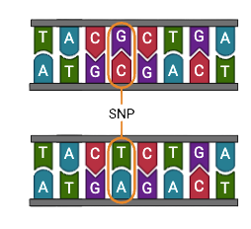
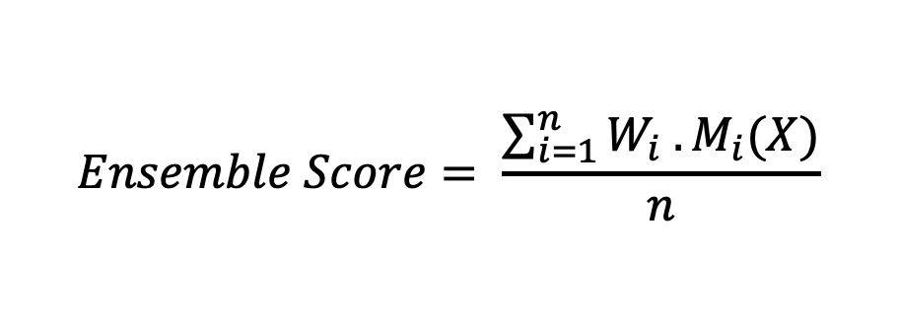
DNA foundation model SNP selection methods
evolutionary/purifying selection
expression prediction
likelihood of a sequence or SNP
or other features not easily observable humans
Sequence
score
ref
Reference
Variant effect score
Δ = ref – alt
Ensemble methods let us benefit from a diversity of predictions
Alternate (SNP)
Sequence
score
alt
$$Ensemble Score= \frac{\sum_{i=1}^{n}{W_{i} . M_{i}(X)}}{n}$$
7

Slide 8
DNA foundation model SNP selection methods
evolutionary/purifying selection
expression prediction
likelihood of a sequence or SNP
or other features not easily observable humans (embeddings)
Sequence
score
ref
Reference
Variant effect score
Δ = ref – alt
Ensemble methods let us benefit from a diversity of predictions
Alternate (SNP)
Sequence
score
alt
$$Ensemble Score= \frac{\sum_{i=1}^{n}{W_{i} . M_{i}(X)}}{n}$$
8

Slide 9


Method 1
Method 2
Embedding similarity
Log likelihood
Input
Prediction
ref
ALT
A
ref
A
A
G
A = 0.80
ref
ALT
G = 0.72
G
G
?
h₁
h₂ h₃
h₄
h_{n}
h₁
h₂ h₃
h₄
h_{n}
ref
A
C
$$θ$$
C = 0.36
ALT
T
ALT
T = 0.36
T
T
C
C
C
$$∆logP= \log{P\left(ALT\right)}−logP(ref)$$
Embeddings = AI learnt meaning
The impact of a SNP (ALT)
Shows impact on the whole nucleotide sequence
9

Slide 10
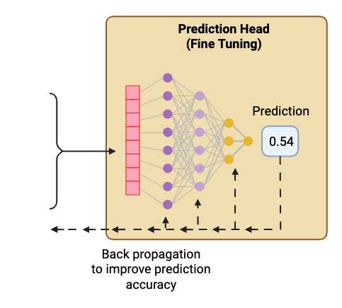
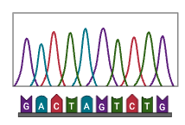
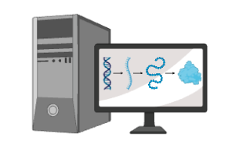
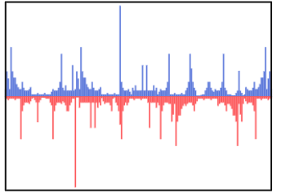
Can we predict actual effects? (Method 3)
Input
Fine-tuned
DNA foundation model
DNA sequence
Labelled expression data
(e.g. RNA-seq)
10

Slide 11
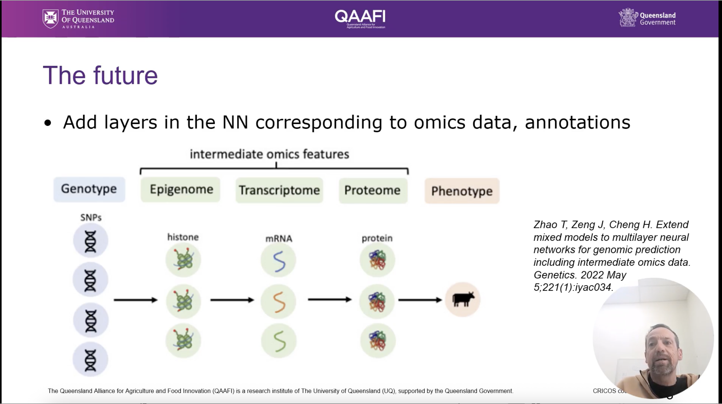
Ben Hayes
11

Slide 12
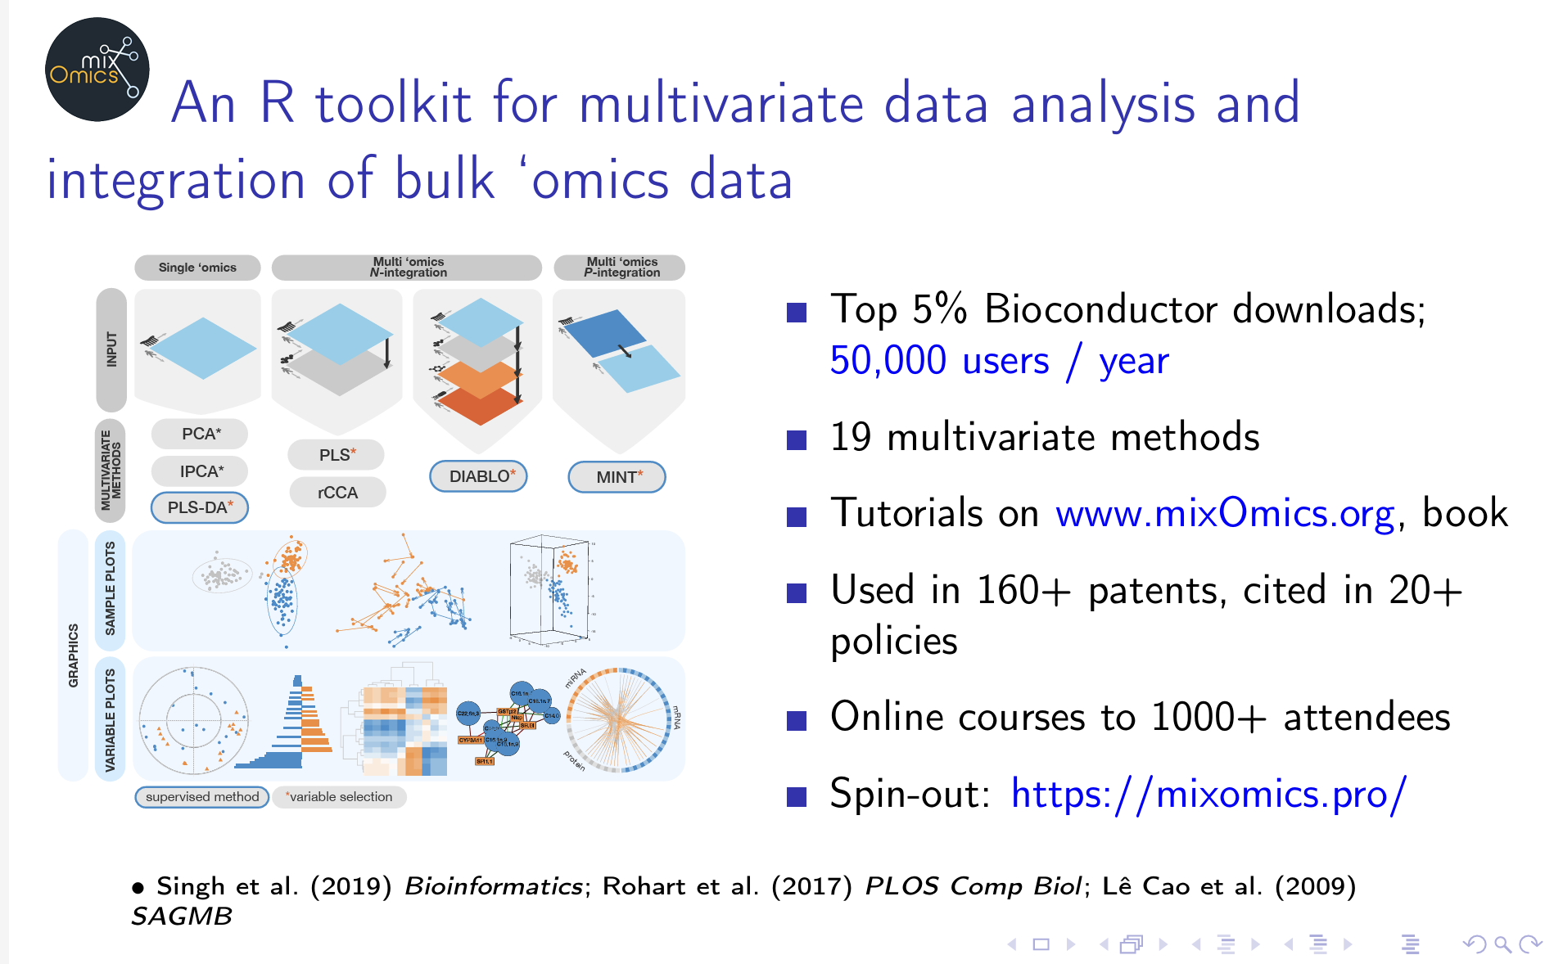
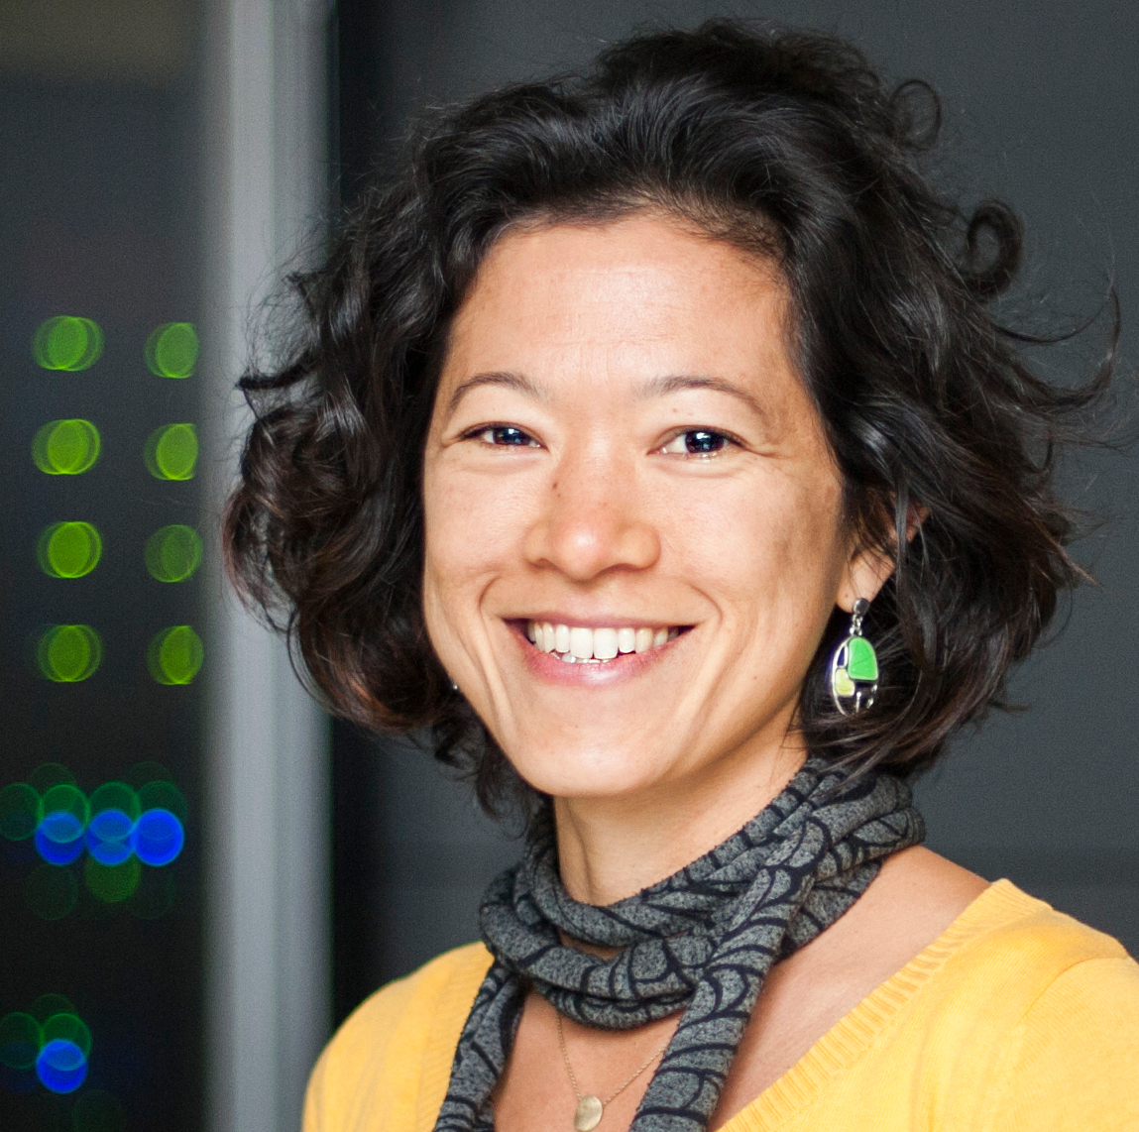
Kim-Anh Le Cao
12

Slide 13
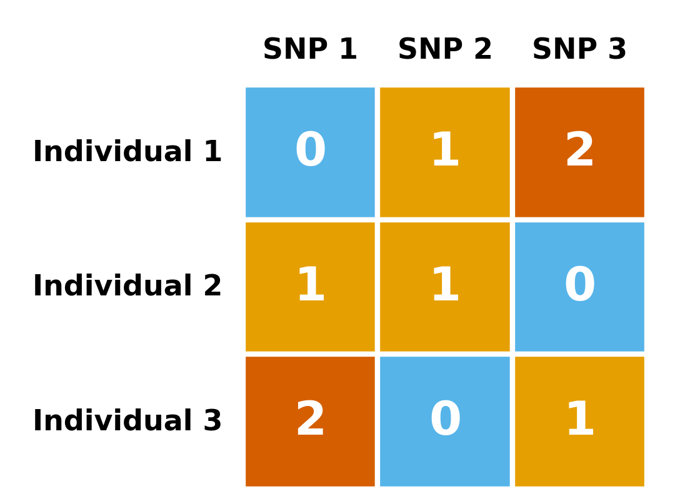
Applying DNA foundation models to SNP selection
Use these prebuilt models to predict variant effect scores
Build a pipeline to use the top-ranked SNPs in genomic prediction
SNP₁
SNP₂ SNP₃
SNP₄
SNP_{n}
SNPs with sequence
PlantCad2 scoring
Top SNPs
Filtered genotype matrix
Genomic prediction
13

