Slide 1
Introduction to Applying Large Language Models to Spatial Data
Devika Jain
Centre for Geographic Analysis, Harvard University

Slide 2
Overview
Title: Introduction to applying Large Language Models (LLMs) on Spatial Data
Duration: 2 Hours
Format: Interactive, hands-on workshop
Tools: Python, Jupyter Notebook, LM Studio / Gemini, GeoPandas

Slide 3
Learning Objectives
By the end of this workshop, you will be able to:
Understand how LLMs can classify and analyze geotagged text data.
Prepare and clean spatial text datasets.
Design and test effective prompts for classification.
Interact with LLMs via Python and APIs.
Visualize classified tweets to reveal insights.

Slide 4
Workshop Requirement
Basic Python knowledge (data frames, loops, APIs)
Laptop with:
Python 3.9+ and Jupyter Notebook,
LM Studio or OpenAI API key
Installed libraries: pandas, geopandas, matplotlib, requests, openai
Dataset: tweets_sample.csv

Slide 5
Workshop Requirement
Basic Python knowledge (data frames, loops, APIs)
Laptop with:
Python 3.9+ and Jupyter Notebook,
LM Studio or OpenAI API key
Installed libraries: pandas, geopandas, matplotlib, requests, openai
Dataset: tweets_sample.csv

Slide 6
Agenda Overview
0:00 – 0:10 Intro & Overview – Motivation and objectives
0:10 – 0:25 Data Exploration – Load, clean, and explore tweets
0:25 – 0:45 Model Integration – Connect to LLM APIs
0:45 – 1:10 Prompt Design – Draft classification prompts
1:10 – 1:30 Implementation – Run classifications
1:30 – 1:50 Results – Analyse the classified tweets
1:50 – 2:00 Conclusions – Discussion and next steps

Slide 7
Introduction to LLMs for Spatial
What are Large Language Models?
How can they process and classify text?
Why spatial context matters: linking location with meaning.
Example use cases: public sentiment, event detection, policy mapping.

Slide 8
Exploring the dataset
Geotagged tweets: latitude, longitude, and text.
Cleaning text: remove URLs, emojis, and stopwords.
Hands-on: Explore dataset using pandas.

Slide 9
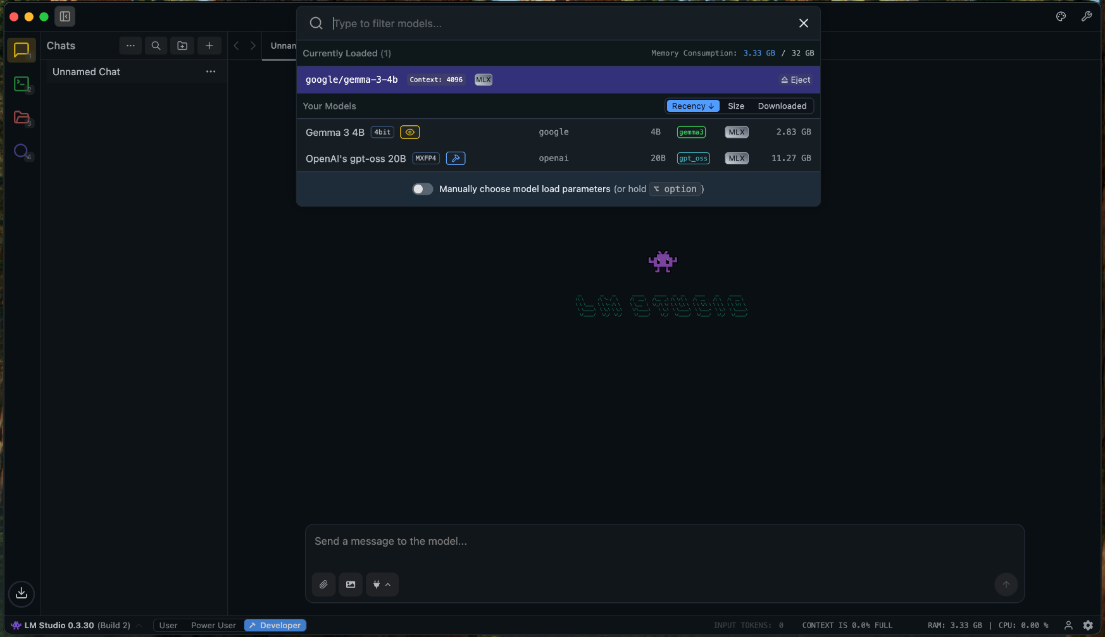
Connect to Large Language Model
LM Studio setup and Model loading

Slide 10
Prompt Engineering
Prompts as instructions for LLMs.
Types: classification, summarization, reasoning.
Example: “Classify this tweet is about Public Health, Environment, or Transport.”
Tips: be specific, structured, and consistent.

Slide 11
Visualizing Results
Use Pandas + matplotlib + folium for mapping.
Color-code tweets by category or sentiment.
Identify spatial patterns and regional themes.
Example visualization output.

Slide 12
Wrap-up and Key Takeaways
LLMs can enhance spatial data analysis through classification and interpretation.
Prompt design is critical for accuracy.
APIs enable scalable AI integration.
Visualizations reveal geospatial insights.

Slide 13
Next step and Resources
Try embeddings for clustering or RAG workflows.
Extend analysis with dashboards.
Resources:
  OpenAI API Docs
  GeoPandas
  LM Studio

Slide 14

Exercise
Find the exercise document in the GitHub repo

Slide 15
Questions/ Comments?
Devika Jain
kakkar@fas.harvard.edu

