Slide 1
Getting Started with AI for Spatial Data
Devika Jain
Centre for Geographic Analysis, Harvard University

Slide 2
Overview
Title: Applying LLMs to spatial data with NYC 311 service requests
Duration: about 90 minutes, interactive and hands-on
Tools: Google Colab (free T4 GPU), Gemma 4 via Hugging Face, NYC Open Data, folium
Nothing to install: everything runs in your web browser
Materials: Google Drive folder GenAI_Spatial_Workshop

Slide 3
Learning Objectives
By the end of this workshop, you will be able to:
Classify real geotagged text with an open LLM (Gemma 4) on GPU
Improve prompts with constrained decoding, retrieval and ensembles
Evaluate LLM labels with accuracy, Cohen’s kappa and calibration
Map LLM labels and compare them with official categories

Slide 4
Workshop Requirements
Basic Python knowledge (data frames, running notebook cells)
Laptop with an up-to-date web browser and internet; nothing to install
A Google account (for Google Colab and Google Drive)
A Hugging Face account and a Read access token (recommended)
Workshop folder on Google Drive: GenAI_Spatial_Workshop with Spatial_AI_Workshop_Script.ipynb

Slide 5
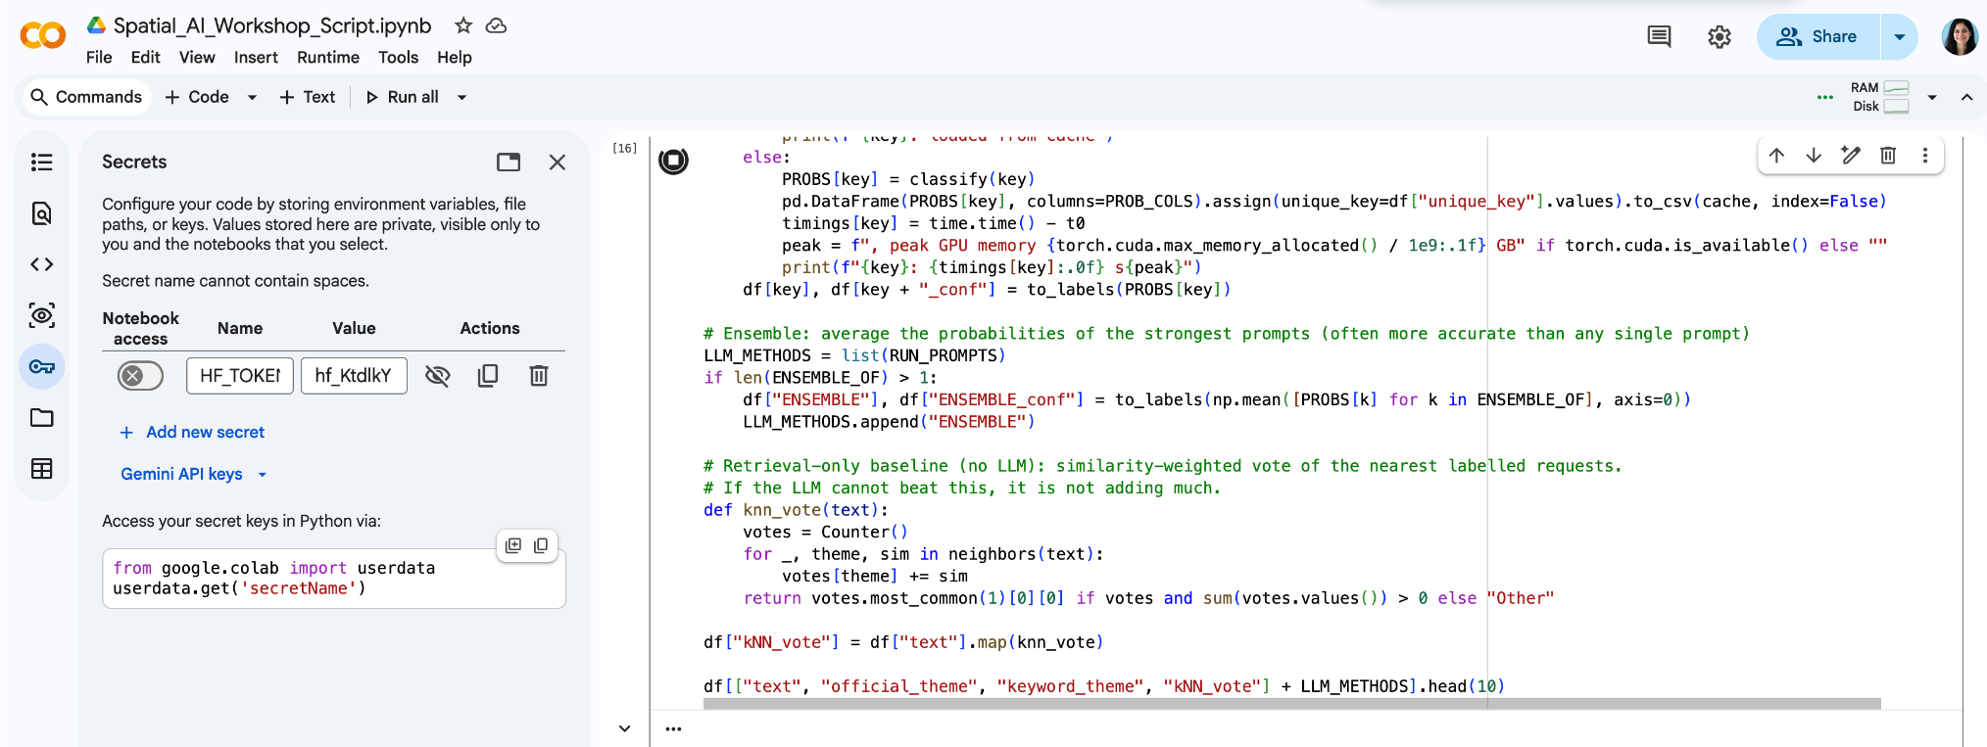
Setup Before the Workshop
1. Create a Google account
2. Create a Hugging Face account and verify your email
3. Create a Read token: Settings → Access Tokens
4. Open NYC311_Spatial_AI_Workshop.ipynb from Drive in Colab; File → Save a copy in Drive
5. Runtime → Change runtime type → T4 GPU
6. Add the token as Colab secret HF_TOKEN (key icon, notebook access on)
Colab Secrets panel: name HF_TOKEN, notebook access on. Full steps with screenshots are in the workshop instructions.

Slide 6
Agenda Overview
0:00 – 0:10 Intro & Overview – Motivation and objectives
0:10 – 0:20 Setup check – Colab copy, T4 GPU, HF_TOKEN secret, Drive
0:20 – 0:35 Data – NYC 311 requests and a keyword baseline (Parts 1–2)
0:35 – 0:45 Model – Load Gemma 4, sanity check, constrained decoding (Part 3)
0:45 – 1:25 Prompt design, evaluation and mapping (Parts 4–5)
1:25 – 1:30 Next steps (Part 6)

Slide 7
Introduction to LLMs for Spatial
What are Large Language Models?
How can they process and classify text?
Why spatial context matters: linking location with meaning.
Example use cases: 311 triage, public sentiment, event detection, policy mapping.

Slide 8
The Data: NYC 311 Service Requests
NYC’s non-emergency line: each request has a location, an official complaint type, a descriptor and a location type
One week from NYC Open Data; random sample of 1,000
The model reads only the descriptor and location type
Answer key: official complaint types grouped into 7 themes
No street addresses are downloaded
Text the model reads | Official theme
Banging/Pounding; location: Residential Building/House | Noise
PESTS; location: RESIDENTIAL BUILDING | Housing & Buildings
Blocked Hydrant; location: Street/Sidewalk | Streets, Traffic & Parking
Removal Request; location: Sidewalk | Sanitation & Cleanliness
Branch Cracked and Will Fall; location: Street | Trees, Parks & Environment
Non-Chronic; location: Subway | Homelessness & Public Safety
Food Vendor; location: Street | Business & Consumer

Slide 9
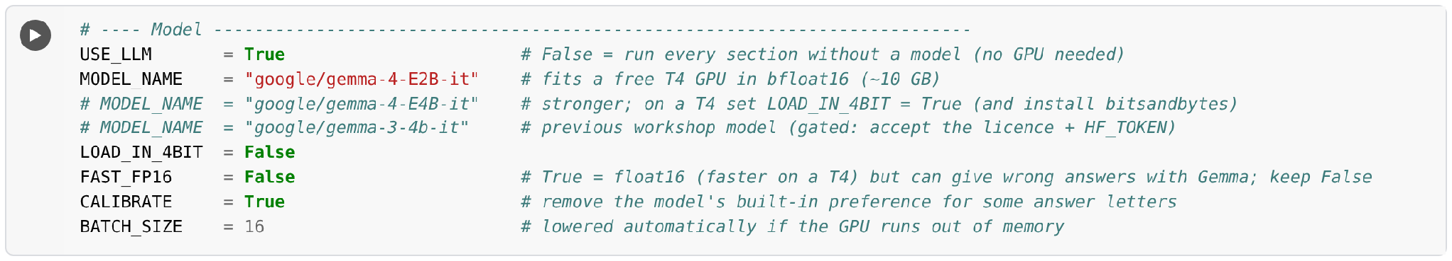
Load Gemma 4 from Hugging Face
Gemma 4 E2B (google/gemma-4-E2B-it): open, Apache 2.0, runs on a free Colab T4
Runs in bfloat16 (reliable); keep FAST_FP16 = False
Sanity check: 7 obvious requests must score at least 6/7 before Part 4
Token stored as the Colab secret HF_TOKEN; USE_LLM = False runs everything offline

Slide 10
Constrained Decoding
Themes are listed as letters A–G; the reply starts with “Answer:” and we read each letter’s probability
Always a valid label, with a confidence; one forward pass per prompt: fast
Calibration: score an empty “N/A” request to remove the model’s preference for some letters
Each unique prompt is scored once and results are cached
Invalid scores are re-tried, never silently labelled
Illustrative: P(answer) for “PESTS; location: RESIDENTIAL BUILDING”
A Noise
3%
B Housing & Buildings
81%
C Streets, Traffic & Parking
4%
D Sanitation & Cleanliness
7%
E Trees, Parks & Environment
2%
F Homelessness & Public Safety
1%
G Business & Consumer
2%
Probabilities are illustrative, not model output.

Slide 11
Prompt Engineering
Precise theme definitions that match the answer key
Real examples of easily confused cases
Retrieval: the 8 most similar past requests (never from the test sample)
Ensemble: average the probabilities of the best prompts
kNN_vote: does the LLM add value over simple lookup?
Method | Strategy
P1_zero_shot | Plain instruction
P2_definitions | + theme definitions
P3_few_shot | + 14 real examples
P4_geo_context | + borough, time of day
P5_retrieval | + 8 similar past requests
ENSEMBLE | Average of P2, P3, P5
kNN_vote | Neighbours vote, no LLM

Slide 12
Evaluating the Labels
Answer key: official complaint types grouped into 7 themes
Compare keyword search, kNN, P1–P5 and the ensemble
Abstain when confidence is low: coverage vs accuracy
Read the disagreements: the model is not always the one that is wrong
Map the LLM labels and compare them with the official themes by borough
Accuracy & macro F1
Share correct, and the average over themes so small themes count
Cohen’s kappa
Agreement corrected for chance: 0 = chance, 1 = perfect
Calibration
Is the model right as often as it is confident?
Confusion matrix
Which themes get mixed up, and why

Slide 13
Wrap-up and Key Takeaways
LLMs can classify messy geotagged text at scale, even on a free GPU.
Constrained decoding, retrieval and ensembles make prompts more accurate.
Always validate against a reference and read the disagreements.
Maps of the labels show where different problems are reported.

Slide 14
Next step and Resources
Try a larger Gemma 4 model or fine-tune on labelled 311 data.
Add spatial statistics (H3 hexagons, hot spots) and Census data to study reporting bias.
Resources:
  Gemma 4 model card
  NYC 311 Service Requests (NYC Open Data)
  folium (interactive maps)

Slide 15

Exercise
Notebook, slides and instructions are in the Google Drive folder GenAI_Spatial_Workshop:https://drive.google.com/drive/folders/1VYULWe1fjw92qhobaEvD2ekPursl2mse?usp=sharing

Slide 16
Questions/ Comments?
Devika Jain
kakkar@fas.harvard.edu

