Slide 1


Geospatial data management with PostGIS
Harvard Data Fest
January 17th, 2018
Devika Kakkar
Notes:
Mention somewhere funded by Sloan and BARI. Work integrates with Harvard Dataverse.

Slide 2
Introduction
PostgreSQL is a powerful, object-relational database management system (ORDBMS)
PostGIS adds support for geographic objects to the PostgreSQL object-relational database
PostGIS is a spatial database: Spatial databases store and manipulate spatial objects like any other object in the database
Oracle Spatial and SQL Server (2008 and later) are also spatial databases

Slide 3
PostGIS Overview/History
June 2001 –Version 0.1
Spatial types tied to GiST
July 2001 – Version 0.5
Tie-in to UMN MapServer
Wider ability to visualize data
May 2007 – Version 1.2
Full support for OpenGIS SF-SQL
Performance increases
Analysis and transformation functions

Slide 4
Why PostGIS ?
Support multiple users editing and accessing the same data at the same time
Support large data volumes better than files
Provide a unified means of accessing and analysing data
Provide a unified means of access control for data. Fine grained
Provide an integration point for spatial data and enterprise data
Supports complex ad hoc queries
Performance on large data sets

Slide 5
Who uses PostGIS ?
North Dakota State Water Commission in Bismark uses PostGIS as the cost-effective foundation for managing the use of state-wide water resources
Institut Geographique National, France is the national mapping agency of France, and uses PostGIS to store the high resolution topographic map of the country, “BDUni”

Slide 6
Workshop Summary
The widely used geospatial relational database PostGIS, will be introduced
Installation and configuration of PostGIS on an Amazon instance will be covered followed by spatial data loading, the use of Spatial SQL for spatial analysis, and export of results
The use of QGIS as a PostGIS query and visualization client will also be covered

Slide 7
About the data
The data for this workshop is four shapefiles for New York City:
nyc_census_blocks: A census block is the smallest geography for which census data is reported
nyc_neighborhoods: New York has a rich history of neighborhood names and extent. Neighborhoods are social constructs that do not follow lines laid down by the government
nyc_streets: The street centerlines form the transportation network of the city
nyc_subway_stations: The subway stations link the upper world where people live to the invisible network of subways beneath

Slide 8
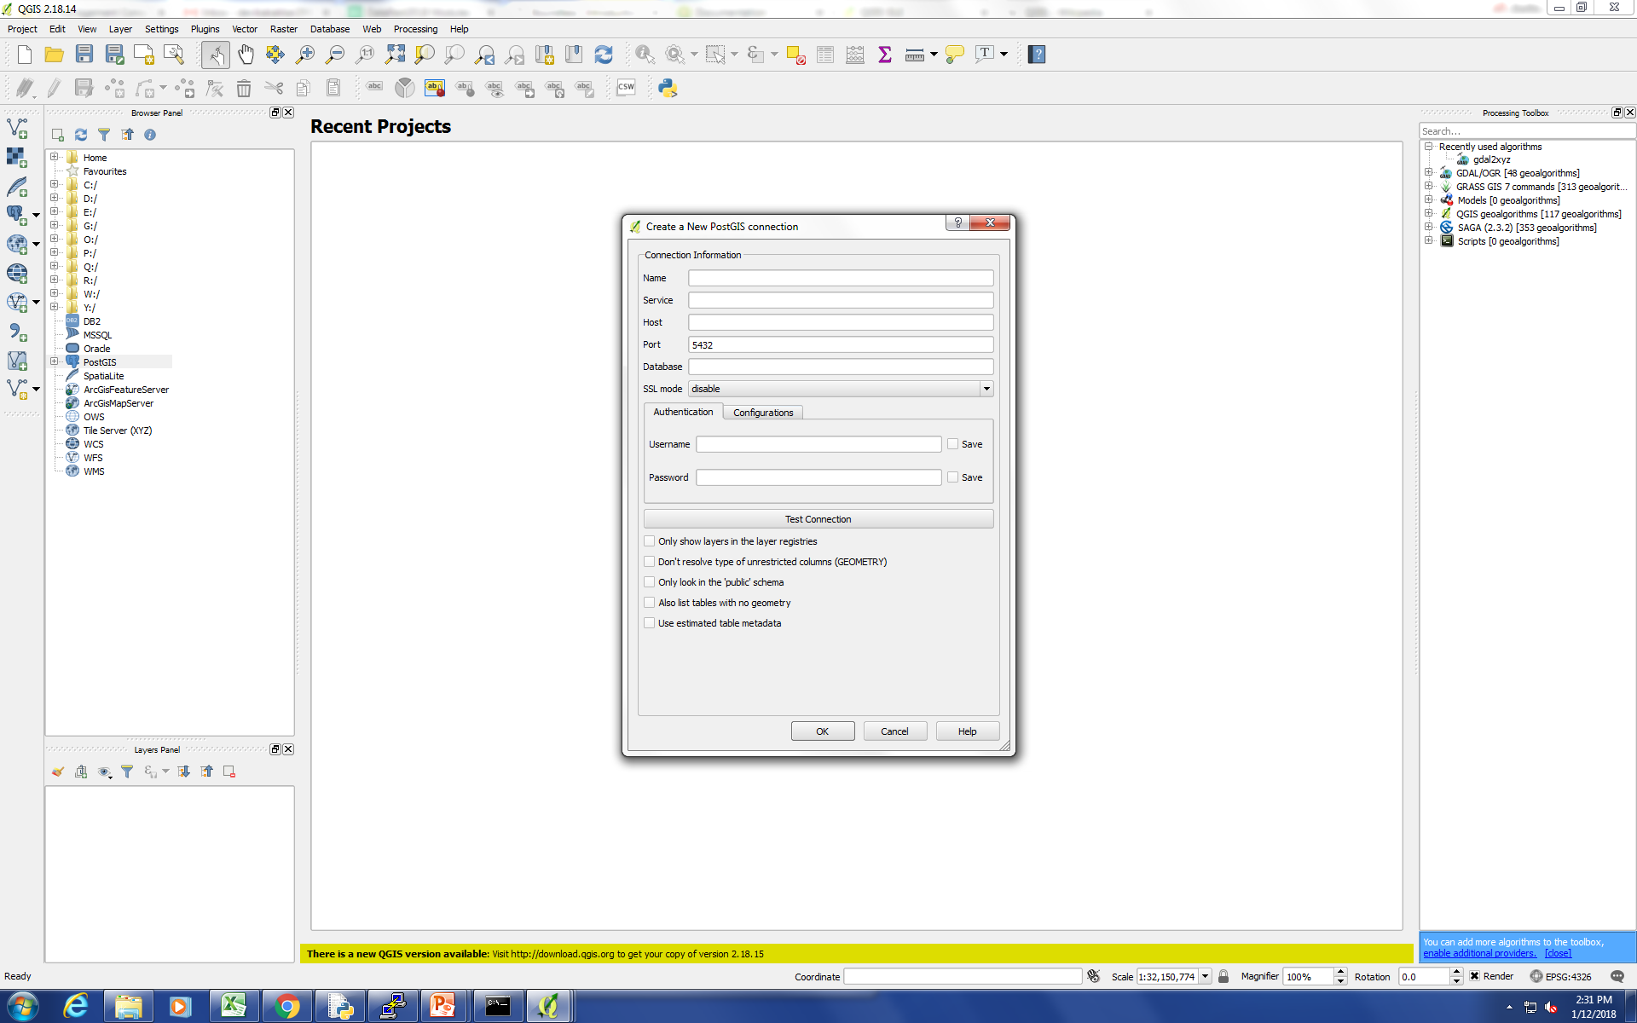
About QGIS
QGIS is a free and open-source cross-platform desktop geographic information system (GIS) application that supports viewing, editing, and analysis of geospatial data. It can be used to visualize and analyze data residing in PostGIS

Slide 9
References
Boundless: Introduction to PostGIS http://workshops.boundlessgeo.com/postgis-intro/creating_db.html
Introduction to PostGIS Workshop - FOSS4G 2007, Paul Ramsay
http://2007.foss4g.org/workshops/W- 04/PostGIS%20Workshop.ppt

Slide 10
Thank you
Devika Kakkar
kakkar@fas.harvard.edu

