Slide 1
Basic Shell in C
Daniel Kalley

Slide 2
Requirements & Testing Procedures
Requirement | Test | Expected Output
Design | ./myshell | [User]@[Computer Name]:[CWD]
Build-in Commands | ls cd [dir] jobs history help | List of current directory’s contents Change to specified directory List current running jobs List history of commands used Display
Handle Multiple Commands | ./long & ./long & | [1] process id [2] process id [1] Exit Code ./long [2] Exit Code ./long
Command History | Use arrow keys to navigate command list | Up arrow displays older commands Down arrow displays newer commands

Slide 3
Requirements & Testing Procedures
Requirement | Test | Expected Output
Tab Autofill | Type ‘cd she’ and hit tab | The shell directory will be displayed
Ctrl-c | Run ./long press ctrl-c to kill the process Press ctrl-c idle in the command | The long program will be exited ‘^C’ will be displayed
Exit | Type any of the exit commands exit, close, or quit | Shell exits successfully

Slide 4
Technical Details
Modularized Components
Main control loop
Gnu Readline and History libraries
Enabled efficient input gathering with the ability to use arrow keys
Enabled efficient memory of commands
Input processing
Built-in commands
Command Execution
mmap and munmap
Used to map and unmap shared memory across different processes

Slide 5
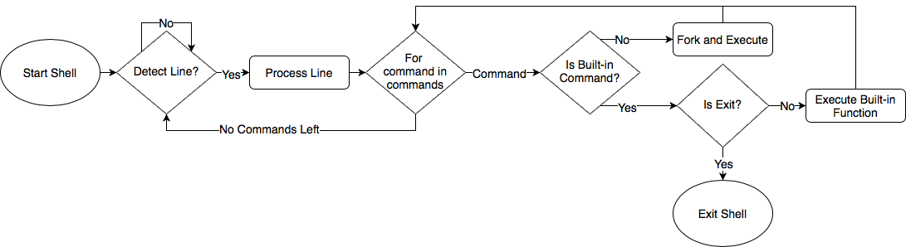
Main Control Flow

Slide 6
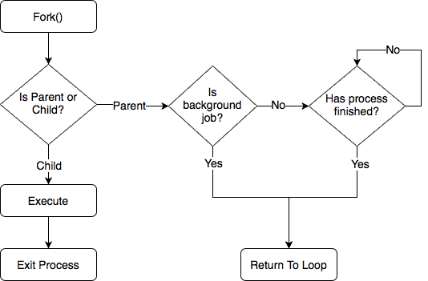
Command Execution Control Flow

Slide 7
Demo

